Slide 1

Moodzr

Slide 2
Vision
Every day we go through so many people. Every person represents an opportunity.
Our inhibitions prevent us to reach out to one another.
We want to create new opportunities and choices for

Slide 3
Introduction
The human being is guided by its inhibitions.
He turned himself to the virtual meeting, but we can’t let our destiny into the hands of algorithms.
The dating website/app are disgusting, not effective, immoral and shameful.

Slide 4
Why ?
It’s time to revolutionize the way to meet people, it’s time to disrupt the « dating » market, people deserves a new way of doing things, truer and human.
The permanent geolocation, the exploitation of personal data, the multitude of fake accounts are potential dangers and pose minimal ethical concerns
Without counting those who do not want to be found on a dating app.
The reluctance of people to those problems is real and should be heard.
So us let offer a solution
In Moodzr, we want to connect people in the real life

Slide 5
How ?
2.0 Acquaintance cards
Cards with a catch phrase which sent us to the profile of the transmitter when we get it behind the smartphone (NFC technology), on Moodzr app.
The card allows us to enter into conversation and/or allow to the person to find us on the app.
A funny, real, simple and new way to adress a person.
We also help womens to be active while remaining elegant.
We put human at the center of our solution

Slide 6
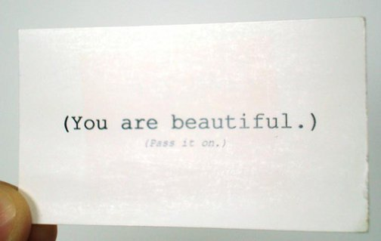
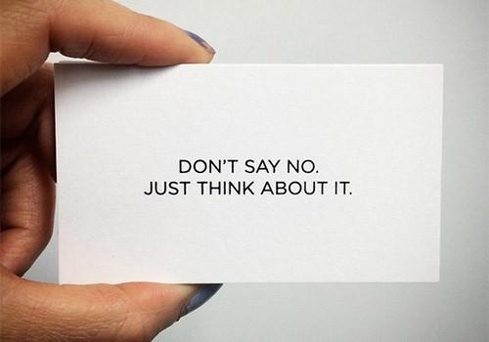

Slide 7
No phone number
No personal data
No geolocation
No fake account
…and especially no regrets
Just the real life

Slide 8
« An acquaintance that begins with a compliment is sure to develop into a real friendship »
Oscar Wilde

Slide 9
Moodzr wants to disrupt the meeting market, not the online dating market
The meeting can be lovely, friendly and professional, the most important is to keep in touch

Slide 10
Segmentation
Basic edition
- Luxury edition
Artist edition
Limited edition
Girl edition
- …

Slide 12
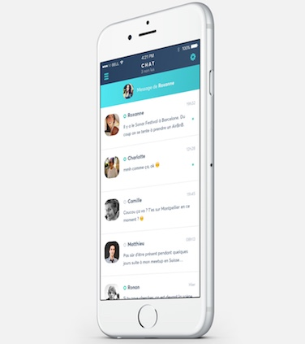

Slide 13
Marketing strategy
Celebrity marketing : Need to be massive, include celebrities in the capital of
Moodzr. Why ? Because the celebrity will use his entire network, because
it’s in his best interest to develop the company.
Collaboration with artist for limited edition cards

Slide 14
Moodzr for business

Slide 15
In the long term we want that the client will be able to ask
whatever he wants in 2 seconds and without effort.
Imagine a client who can communicate with the enterprise
just sliding the smartphone beside the bread bag.
Delivery, information, request…
The Moodzr NFC tags will be everywhere
That’s our vision

Slide 16
Business cards (and more) for enterprises: Business cards, with the
same concept, the client will be guided to the profile of the enterprise.
Just imagine how fast the client will communicate with the professional.
Instant messaging platform: The client can discuss with the enterprise
Service and develop customer’s loyalty: Great experience, ultimate
Communication tool

Slide 17
Brands
Small businesses
Freelancers, Independant workers

Slide 18
Nearly 1 million independant workers in France
40 millions freelancers in USA, 60 millions by 2020

Slide 19
Instant messaging is the ultimate communication tool, the new way, the future

Slide 20
Our process is easy
Establishment
Development
Innovation
First clients
Feedback
Internationalize
«Moodzr for business » development
Expand our offerings
Innovate user experience
Artist collaboration
New cards design
New NFC support for pro

Slide 21
Office

Slide 22
Thank you

