Slide 1
QP CODES LLC
PITch deck 2017 | new jersey, usa.

Slide 2
WHY US?
Because we are a recent birth company and we have innovative ideas and great goals.
Our goal is to give a FAST, CHEAP and EASY solution to the problems the costumer have in day to day through technology.
Our strategy is to offer and sell our products and services to the banking system to make our business grow very fast.

Slide 3
PROBLEMS
CHECKS
COST & TIME
FRAUD
C. CARDS
COST
FRAUD
PAYMENTS
NFC PAYMENTS
BILL PAYMENTS

Slide 4
PAYMENTS
NFC PAYMENTS
BILL PAYMENTS

Slide 5
NFC PAYMENTS
NOT EVERYONE WHO USES SMARTPHONE TRUST 100% NFC WALLETS (APPLE PAY, SAMSUNG PAY, ANDROID PAY ...)
THE REASONS ARE:
SECURITY IN WALLET APPS.
FUTURE OR HIDDEN FEES.
CREDIT CARD CLONATION.

Slide 6
BILL PAYMENTS
The bill or monthly service payments are with excessive commissions and slow payment system.
[4 - 6 USD]

Slide 7
BILL PAYMENTS
At the moment there are apps and websites who offer bill payment service.
They are external to the banks and the clients don’t trust completely in them so they prefer to continue making the payments through the banks.

Slide 8
BILL PAYMENTS
Also when you get an home invoice through letter or phone payment request you don’t get a fast payment method.
You have to access to their website or pay by phone call at the bank or the company that offers the service.

Slide 9
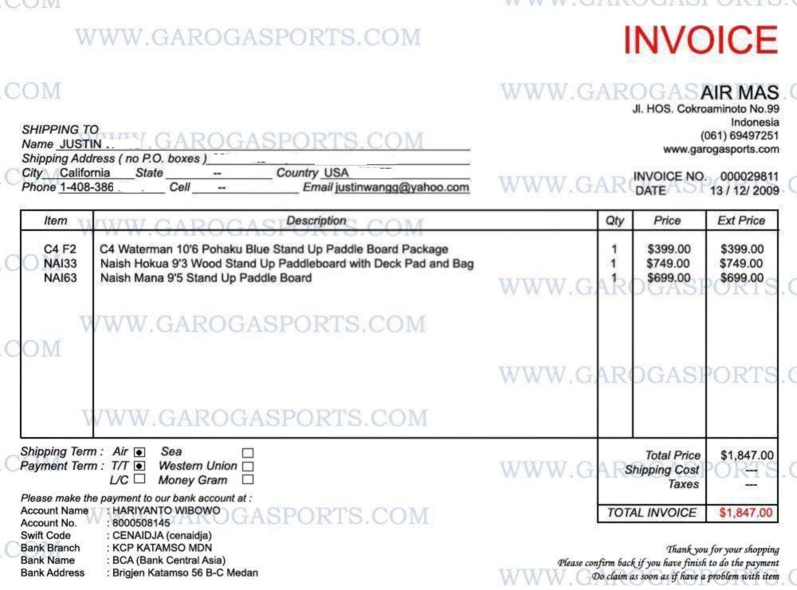
BILL PAYMENTS
EXAMPLE

Slide 10
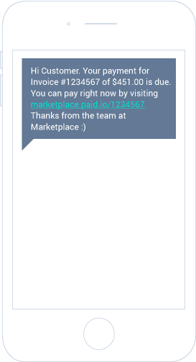
BILL PAYMENTS
EXAMPLE

Slide 11
PROBLEMS
CHECKS
COST & TIME
FRAUD
C. CARDS
COST
FRAUD
PAYMENTS
NFC PAYMENTS
BILL PAYMENTS

Slide 12
CREDIT CARDS
COST
FRAUD

Slide 13
COST
Yearly only in the US 1.5 billion credit cards are made.
The cost of them cards are from
1 TO 4 $ WITH CHIP AND NFC

Slide 14
COST
The Banks also need to buy card readers for ATMs, NFC Receivers and more items to use the credit cards.
This can increase spending and lower the annual profits.

Slide 15
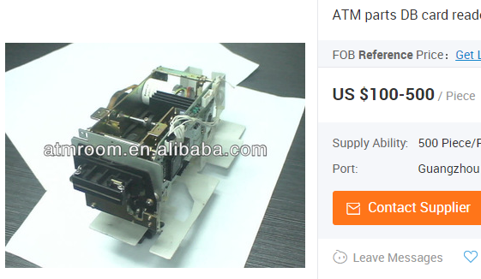
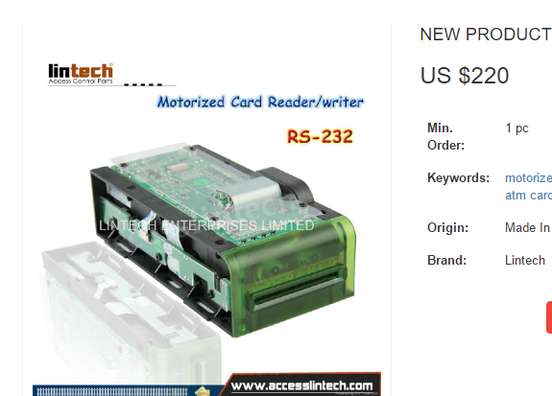
COST
ATM CARD READERS

Slide 16
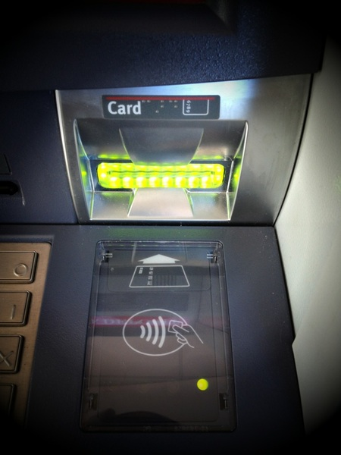
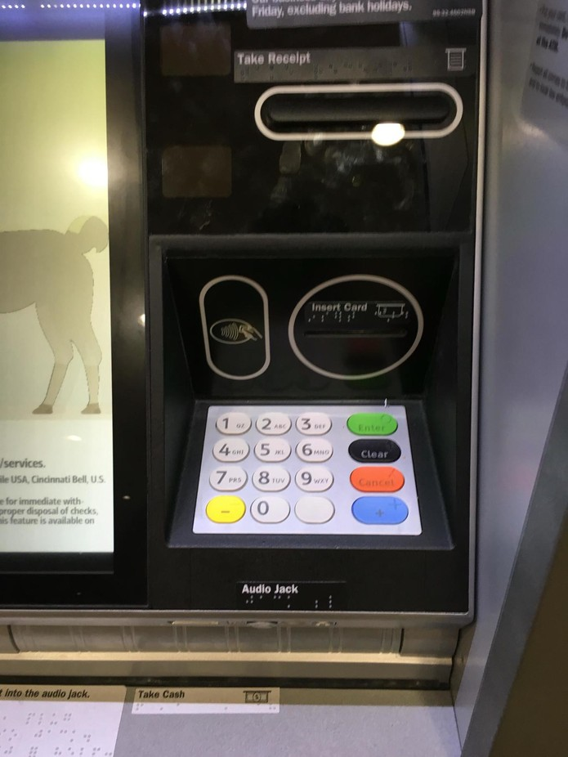
COST
NFC
CARD
READERS
100 – 400 USD

Slide 17
FRAUD
One of the most common frauds in banking is the cloning cards, security pin picking and the new method is clone NFC cards.
There are many products that can made this kind of fraud.

Slide 18
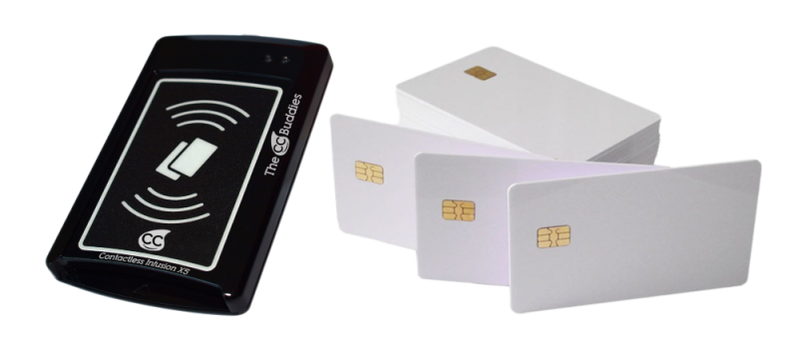
FRAUD
Can clone 15 NFC cards by seconds
From 8 cm
of distance.
CONTACTLESS INFUSION X5

Slide 19
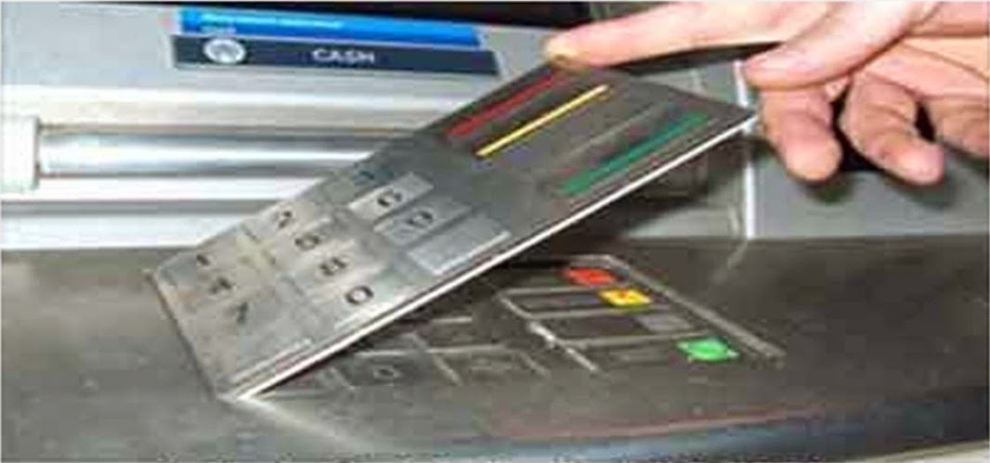
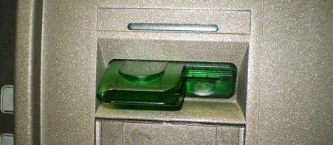
FRAUD
These products sold in the Deep Web are made in china. With them they clone the cards and copy the security pin for steal money in others ATMs.

Slide 20
PROBLEMS
CHECKS
COST & TIME
FRAUD
C. CARDS
COST
FRAUD
PAYMENTS
NFC PAYMENTS
BILL PAYMENTS

Slide 21
CHECKS
COST & TIME
FRAUD

Slide 22
COST
Currently paper checks have a very high cost for consumers. [1-3 USD BLANK CHECK]
The banks charge for activation and maintenance of checking accounts plus a commission for sending and deposit every check.
Also the check deposit are made after 24h-72h depending if it’s a national or international transaction, because the bank through its intermediaries verifies the authenticity of the check.

Slide 23
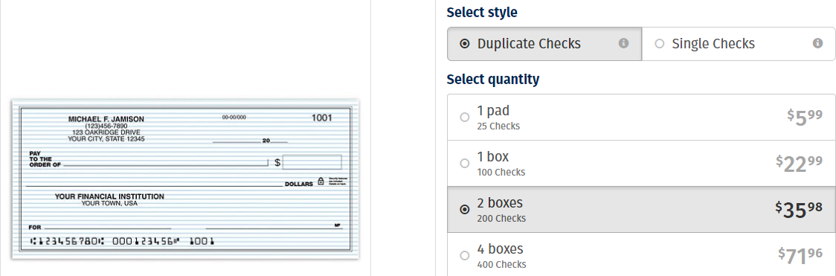
COST

Slide 24
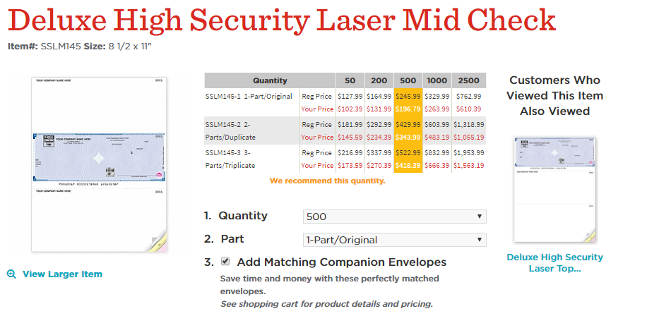
COST

Slide 25
CONTACT US
YOU WANT TO LEARN MORE ABOUT OUR SOLUTIONS?
EMAIL TO US AT CODESQP@GMAIL.COM
OR ANSWER THAT EMAIL
THANKS FOR YOUR TIME
- ALVARO G.

