Slide 1
SAVERIGHTS Pitch Deck Digital Insurance

Slide 2
SAVERIGHTS Insurance ®
“My Life, My Content, My Digital Rights“
Solutions
Metadata Analysis:
Indexation solution
Track uses of your images
No right-click
Content Protected & Watermarked
Insertion of a unique Alphanumeric Key or bar code
Results
Legal Registration:
Protected Version
Collect metadata
Data Safe Storage (based locally)
Assistance with personal lawyers
Promote, Buy, or Sell Licensing coverage according to local lawyers:

Slide 3
Legal Authentication
Digital Life Insurance
Digital Insurance - Register your native content
Your image, images of your children or relatives is yours. Follow your content in the global sphere, Keep control.
SaveRights is made by you for you.
Subscribers manage as they want their digital life. They are responsible, they know that behind an image there is a life who has to be respected.

Slide 4
My Image, My Rights
You authenticate - We protect content owners, by licensing subscribers giving them a unique digital insurance
Preserve images technically and legally
Preserve publications of children's
Preserve digital legacy
Prevent image theft or sharing without approvals
Earn better commissions with sharing platforms

Slide 5
Through a Legal Agreement We assist social media users on their image rights
Content indexation & syndication
Digital protection
Subscribers Licensing
Content Trading Platform (Buy, sell digital rights via sharing platforms)
Live Video Reporter database

Slide 6
1.
SaveRights Answers
SAVERIGHTS Licensing Content Owners

Slide 7
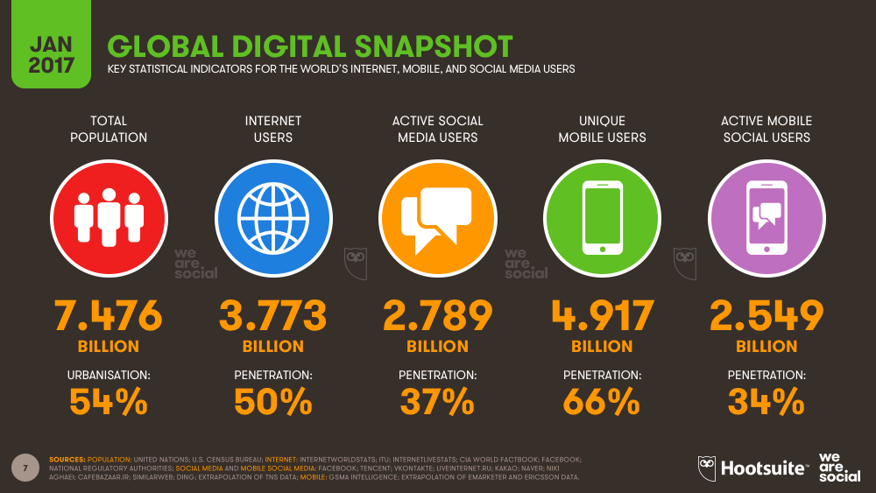

Slide 8
Big Idea
SAVERIGHTS adds a legal fingerprint to your social media activity
Lock your digital content by sharing only a protected version

Slide 9
How protect his native CONTENT on Social Media
Technically
Metadata are best proof of ownership mostly when they are supervised with dedicated lawyers.
Prevent : Right click or Printscreen
By adding a watermarking bar code or individual fingerprints key.
Indexation of protected version by subscribers
Legally
Your content is registered legally through lawyers and following World Intellectual Property Organization where we are registered.
Native format has to be stored locally on a safe storage for legal accordance, having less waste energy and answering to individual responsibilities.
Protected version are used on private cloud or social media networks.

Slide 10
Advantages
Financially (Our subscribers are better remunerated)
Retro commission
Possibility to sell or buy licensed materials through a “Content Trading Platform”
Subscribers can also make remunerated video report
Legally (Key Answer)
Through individual aggreement our subscribers are registered and protected (different layer of subcription: Basic who is free, Premium 9€, VIP 99€)
Distinction between native format and protected version
Technically (Responsibalize subscribers)
Subscribers manage themself their content
Collect of metadata are best proof of ownership
Fingerprints insertion or Facial Recognition are technically registered

Slide 11
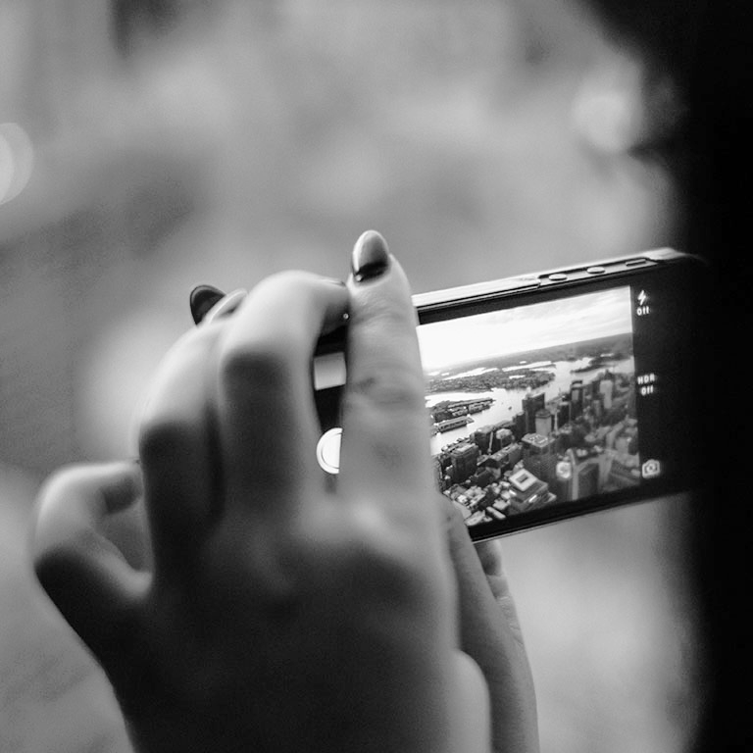
Democratization of Copyrights
We make selfies, videos but
How justify that this content is mine and not yours?
How keep my digital rights?
How make profit with my content?

Slide 12

Consequences
Protected Version = Share Responsibly

Slide 13
Let’s review SAVERIGHTS concepts
Legal Registration
Subscribers are registered. Their native content including their image is under legal protection.
Indexation
Subscribers follow their pictures or video on the WebSphere. Through this technology they supervise exchanges of their protected content.
Native Content
Subscriber share as usual their content but only a protected and registered version. Native format is saved locally.
Syndication
Subscriber are supported concerning retro commission and interactions done. Knowing that any content has a value !
Cloud
Different possibilities are proposed. Subscribers can of course use cloud storage for protected version.
Content Trading Platform
Subscriber sell or buy pictures/video as professional video editor. They can also propose additional services remunerated like Video Reporter, Blogger, depending of interests.

Slide 14
Process Overview
Today Native Format is most of the time
registered via Personal & Mobile Hard Disk
Native Format
+
Metadata
Collect
Access Restricted
+
Fingerprints Recognition
Local Safe Storage
Registered
&
Legalized
Licensing
+
Indexation
+
Syndication
+
Watermarking
Protected
Version
Better Retro Commission
SAVERIGHTS
Legal Layer
Digital Assistance

Slide 15
SAVERIGHTS PRICE LISTS
 | Basic | Premium | VIP
Legal Registration Monthly Fees | Free | 9.90$ | 99$
Data Safe Capacity Storage | 100Mb* | 1*Giga | Unlimited*
Access Content Trading Platform | No | Yes | Yes Events Promotions

Slide 16
10,000,000$
100,000 users
100%
Of revenue that’s will be a good start
Realistic Target
Total success!

Slide 17
Projection - Sales Business Model
Basic Coverage Free
Premium Assistance 9$ monthly
VIP reputation 99$ monthly
=
Legal
Registration
+
Local Storage
+
Promotions & Events
First Year
Target 100K users
(0.001% Facebook Users in Europe)
Responsibalize Subscribers
+
Monetization of Social Content
Content Trading Platform
Revenue Repartition
50% Subscribers
30% Platform Operations and Maintenance
20% Lawyers

Slide 18
Thanks!
Any questions?
You can reach me:
abdel.gaddari@saverights.com
abdel.gaddari@colt.net
+41 78 600 14 66

