Slide 1

Schateen

Slide 2
Schateen's mission is to provide a product that resolves issues for people creating relationships
Schateen

Slide 3
Problems worth solving
Many fake accounts
Many abandoned accounts
Without automate classifications by age
It is hard to strike up a conversation
Many annoying ads
Schateen

Slide 4
Our solutions
Profile video to avoid fake accounts
Remove abandoned accounts yearly
Automated people's classification by age
Annual membership to avoid ads
Schateen

Slide 5
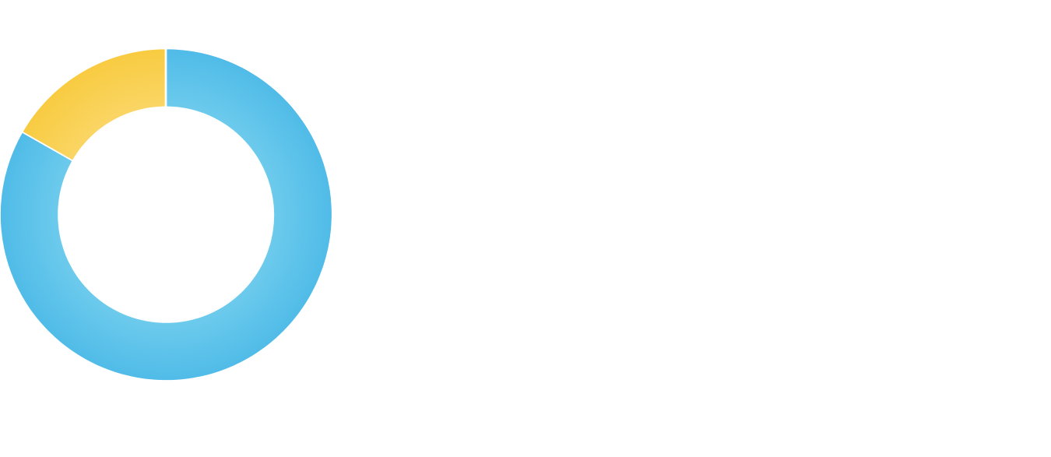
Target market
600M
Young people
prospects
Mature adults
Market size:
$600M
Schateen

Slide 6
Competitive landscape
Competitors | How our solution is better
Skout | It is faster to strike up a conversation
Skout | Ads-free environment
Skout | Lower price
Connected2 | Profile video to avoid fake accounts
Connected2 | We remove abandoned accounts yearly
Schateen

Slide 7
Funding needed
$250K
Funds raised will be used for improving the existing beta app, servers maintenance, cloud services like Heroku and AWS and marketing
Schateen

Slide 8
Sales channels
Annual membership payments
Schateen

Slide 9
Marketing activities
Word of mouth marketing to get users
With social influencers
With AdWords
Schateen

Slide 10
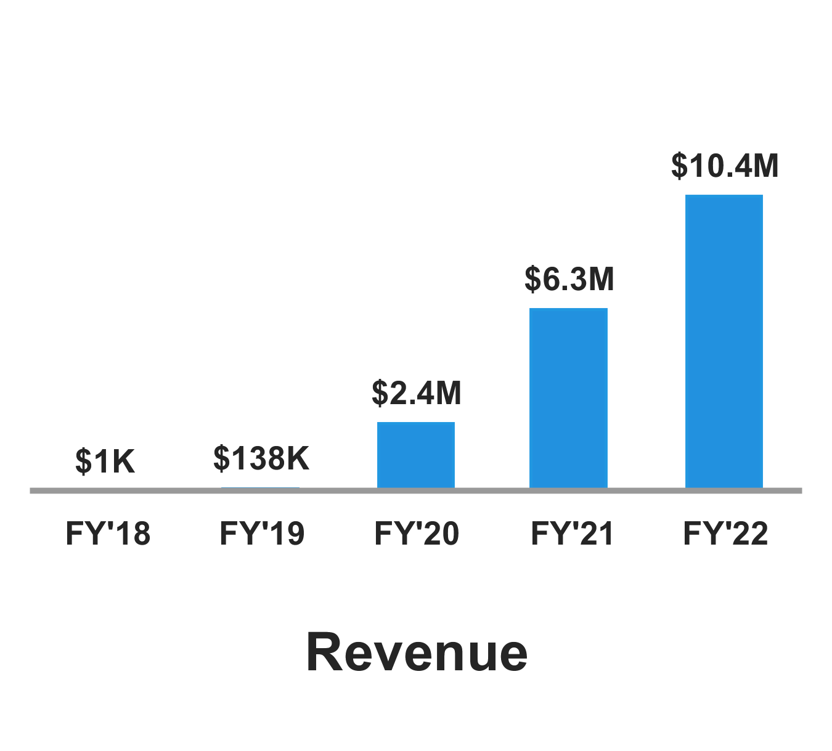
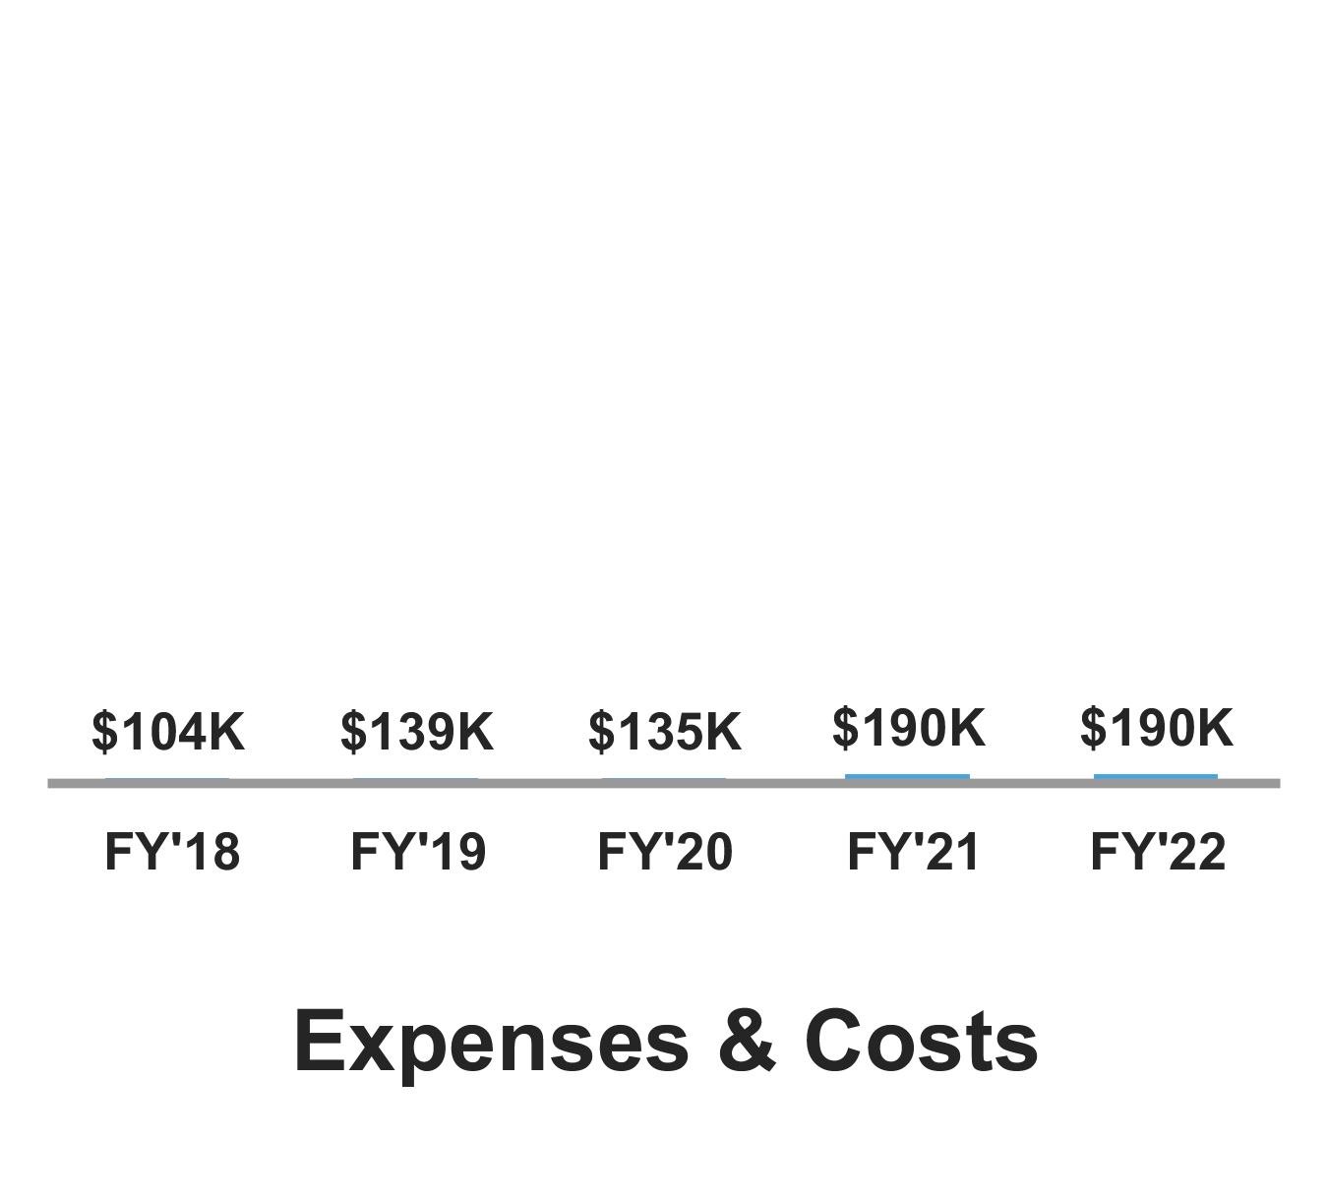
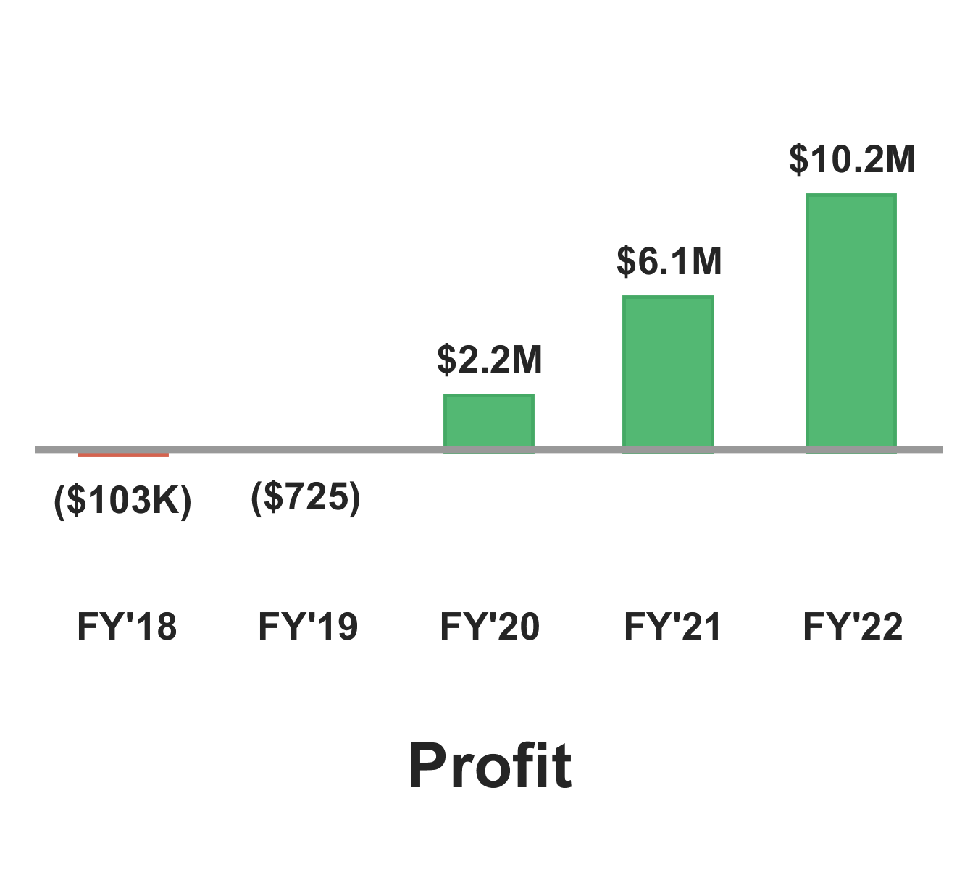
Financial projections
Schateen

Slide 11

Milestones
Date | Milestone
November 15, 2017 | Scale architecture for the app
May 16, 2018 | Launch app V2 with annual membership payments
August 16, 2018 | Reach 500k of users
February 1, 2020 | 1M in revenue/year
June 1, 2020 | Profitability
Schateen

Slide 12

Team and key roles
Heberth Vargas
CEO and engineer
He is a software engineer & entrepreneur with years of experience with startups, he thinks that the world can be changed by one idea
linkedin
Schateen

Slide 13

Partners and resources
Socialtom ventures
they serve as our business advisers their support team of experts provides real work and assistance, not just opinions and connections
Schateen

