Slide 1
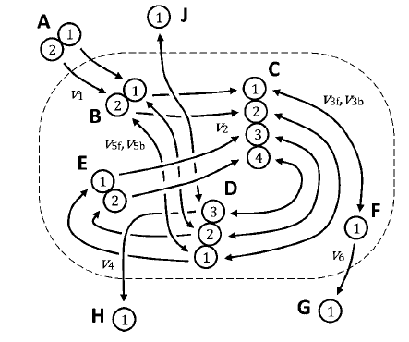
model.mappings_carbon{2}.graph_r.mets =
[2 5]
model.mappings_carbon{2}.graph_r.node_info =
[1 1 2 2]
model.mappings_carbon{2}.graph_p.mets =
[3]
model.mappings_carbon{2}.graph_p.node_info =
[1 1 1 1]
model.mappings_carbon{2}.mapping_p =
[ 1 2 3 4]
model.mappings_carbon{2}.mapping_r =
[ 1 2 3 4]
model.mappings_carbon{2}.mapping_mat_p.double.met =
[2 5]
model.mappings_carbon{2}.mapping_mat_p.double.mat{1}+0 =
[1 0
0 1
0 0
0 0]
[0 0
0 0
1 0
0 1]
model.mappings_carbon{2}.mapping_mat_p.double.mat{2}+0

Slide 2
EMU_list =
3 1
2 1
5 1
4 1
6 1
1 1
4 2
3 2
9 1
3 3
3 4
2 2
2 3
5 2
1 2
4 3
1 3
4 4
3 5
3 6
EMU_met{3}
ans =
1 0 1 0 0 0
1 1 0 1 1 0
1 1 0 1 0 1
1 1 0 0 0 0

