Slide 1
Nicotine Metabolism Genes in the Oral Microbiomes of Nicotine Users and Non-Users
John Sterrett - IQ Biology Rotation 2
Advisor: Noah Fierer, EBIO

Slide 2
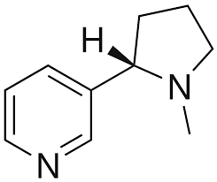
Nicotine Use
> 45 million Americans smoke cigarettes or use e-cigarettes (vaping)
Frequent ingestion of nicotine
Smoking increases risk of lung disease, cardiovascular disease, and cancer
Long term impacts of vaping unclear
$225 billion spent by U.S. to treat diseases from nicotine use

Slide 3
Personalized Medicine
Market for personalized medicine is growing
Genetically determined rate of nicotine metabolism affects likelihood of cessation
Could we use genomic data to better help patients stop smoking or vaping?
Microbiome-targeted medicine is a rising field within personalized medicine
Drug metabolism by the microbiota affects treatment outcomes
How might nicotine metabolism by the microbiota affect treatment outcomes?

Slide 4
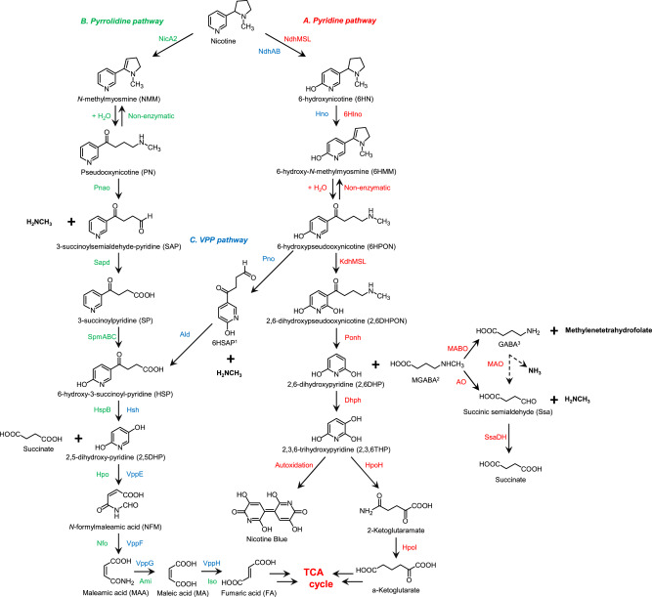
Nicotine metabolism
Occurs in bacteria through 3 pathways
Pyridine
Pyrrolidine
VPP (not main focus)
Enzymes and their gene sequences are known
Observed in other environments
e.g. Tobacco leaves
Not studied in the microbiota

Slide 5
Microbiome of Nicotine Users
Multiple differences in taxonomy and functional gene categories in microbiomes of smokers/vapers versus controls
Primarily studied using 16S metabarcoding (taxonomy only)
Few studies use shotgun metagenomics (taxonomy and genes)
None specifically investigate genes for nicotine degradation
Do genes for nicotine degradation exist in the oral or lung microbiota?
Does the consistent exposure of the microbiota to nicotine select for bacteria capable of nicotine degradation?
If not, where do the microbiome differences come from?

Slide 6
Research aims
Create a custom database of bacterial nicotine degradation genes and a pipeline for finding and quantifying these genes in metagenomic datasets.
See if nicotine degradation genes are present in oral metagenomes.
Test differences in nicotine degradation genes between smokers/vapers and control participants.

Slide 7
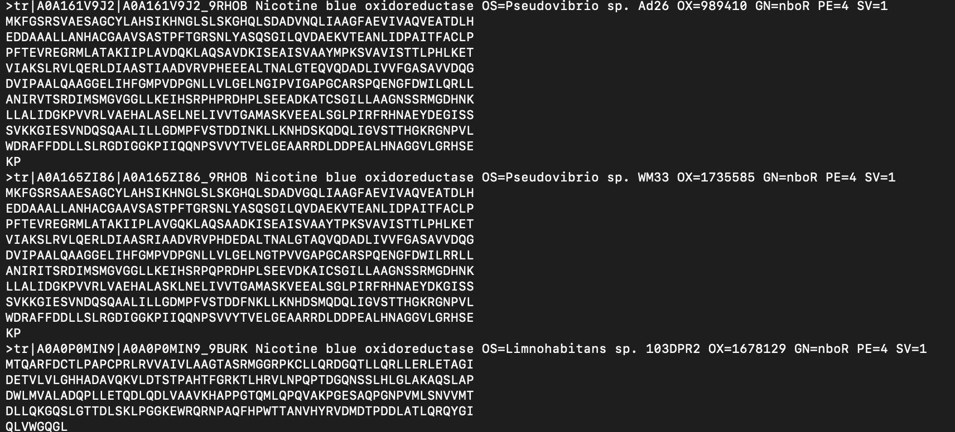
Methods
Compile custom database of bacterial nicotine catabolism genes
Pull pathways from MetaCyc
Use E.C. numbers to pull amino acid sequences from UniProt
Compile into a DIAMOND compatible database
Pull raw data from the sequence read archive (SRA)

Slide 8
Methods
Compile custom database of bacterial nicotine catabolism genes
Pull pathways from MetaCyc
Use E.C. numbers to pull amino acid sequences from UniProt
Compile into a DIAMOND compatible database
Pull raw data from the sequence read archive (SRA)
Merge reads (PEAR) and filter reads < 75 base pairs (Cutadapt)
BLAST each read against the database (DIAMOND)
Pick top BLAST hit per read, map name to UniProt database

Slide 9
Methods
Compile custom database of bacterial nicotine catabolism genes
Pull pathways from MetaCyc
Use E.C. numbers to pull amino acid sequences from UniProt
Compile into a DIAMOND compatible database
Pull raw data from the sequence read archive (SRA)
Merge reads (PEAR) and filter reads < 75 base pairs (Cutadapt)
BLAST each read against the database (DIAMOND)
Pick top BLAST hit per read, map name to UniProt database
BLAST each read against database of bacterial single-copy marker genes
Normalize nicotine catabolism genes by the number of bacterial single-copy marker genes for each sample
Analyze differences between gene counts in smokers/vapers versus controls

Slide 10
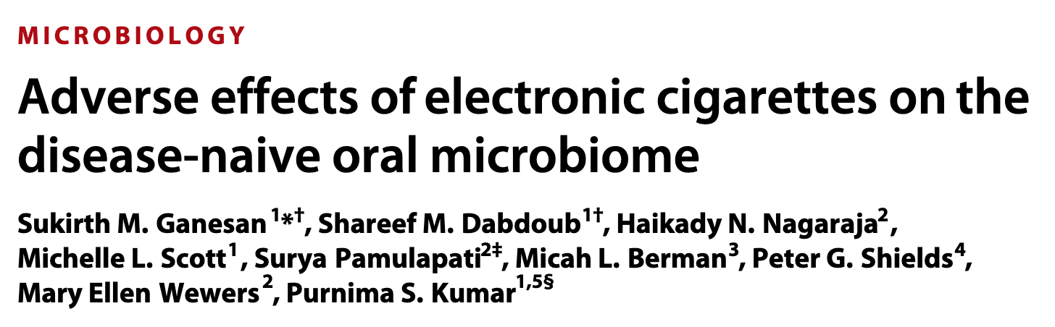
Data Source
Study of:
25 non-smokers
25 smoker
20 e-cigarette (electronic nicotine delivery system, ENDS) users
25 former smokers using ENDS
28 current smokers also using ENDS

Slide 11
Genes Found
ndhA/B/C
kdhA/B/C
pao
nicX
nicD
sad
nboR
nicF
maiA
mao
nctB
hspB

Slide 12
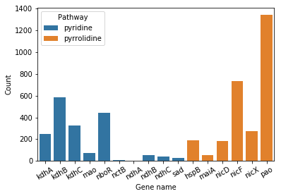
Genes Found

Slide 13
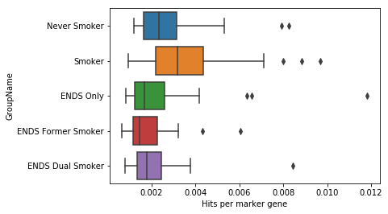
Genes per Group
Significant difference in nicotine degrading genes per group
Kruskal Wallis (H = 18.4), p = 0.001
Dunn post-hoc: never smoker to ENDS former smoker p = 0.007
But, the differences weren’t in the direction we hypothesized

Slide 14
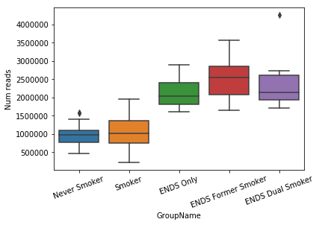
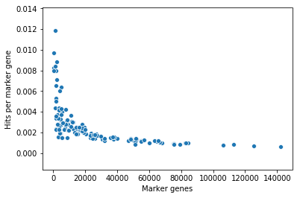
Limitations: Sequencing Depth and Normalization
Smokers and controls had far fewer reads and bacterial single-copy marker genes than ENDS users
Weird relationship between marker genes and the number of normalized nicotine catabolism genes

Slide 15
Future directions
Apply pipeline to other metagenomic datasets
2 other oral metagenome studies
1 lung metagenome study
Apply pipeline to mine bacterial genomes to identify potential nicotine degrading bacteria
Develop qPCR assay to quantify absolute abundances of these genes

Slide 16
Conclusions
Created database of bacterial genes for nicotine degradation
Created a Snakemake pipeline that can easily be applied to other datasets
Found 16 of the 27 genes in this dataset
Number of reads for smokers/vapers vs non-smokers was not what we expected, but that could be related to limitations of the normalization process

Slide 17


Acknowledgements
Noah Fierer and Michael Hoffert
BioFrontiers Institute & IQ Biology
National Science Foundation

