Slide 1
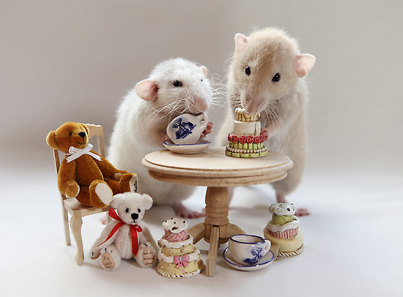
Modulation of green tea absorption and neurotransmitter concentrations by the gut microbiome
John Sterrett, Kevin Quinn, Katrina Doenges,
Nichole Nusbacher, Cassandra Levens, Mike Armstrong, Kristine Kuhn, Cathy Lozupone, Nichole Reisdorph
Ellen van Deelen

Slide 2
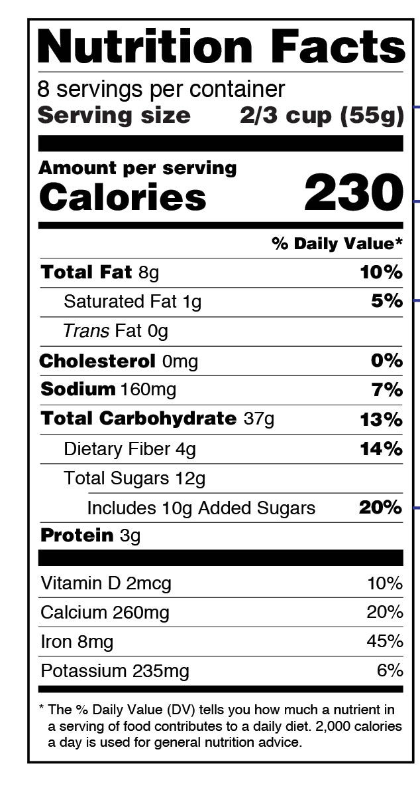
Background
Foods don’t just contain a few nutrients!

Slide 3
Background
x 1,000
Foods don’t just contain a few nutrients!
Thousands of compounds are in all foods.

Slide 4
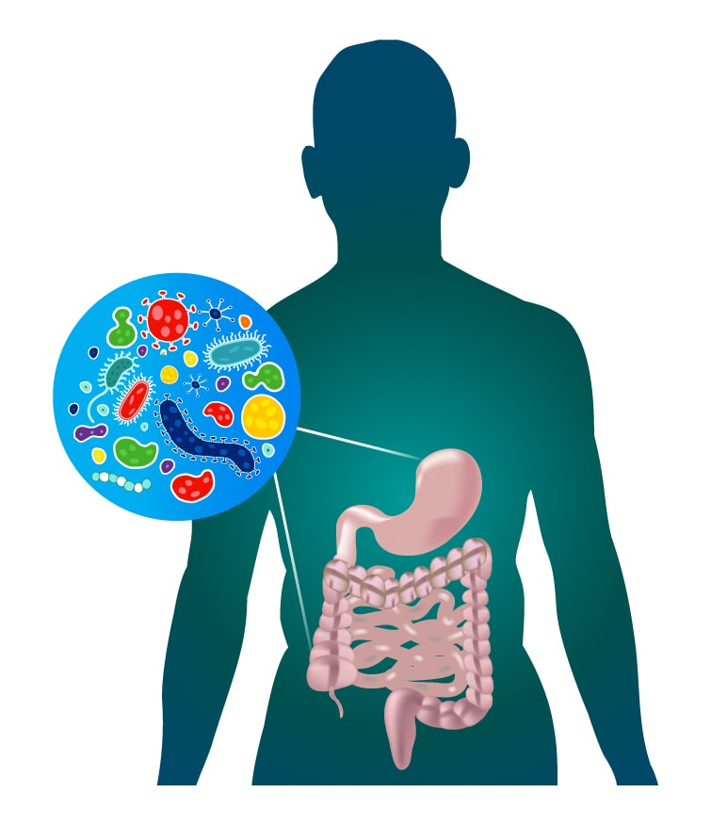
Background
x 1,000
Foods don’t just contain a few nutrients!
Thousands of compounds are in all foods.
What do our gut bacteria do with all these compounds?
Do the bacteria impact what we get from foods?
Norman Biotek

Slide 5
Aims
Quantify number of green tea compounds detectable in plasma after consumption
Identify green tea compounds in plasma that are associated with microbiome composition
Identify neurotransmitters that are associated with microbiome composition

Slide 6

Study design
Michael R. Miller
29 mice
20 mice humanized with 10 microbiomes (in pairs)
9 “germ free”
Gavaged with green tea
2 hrs later:
Cheeks bled (plasma)
Sacrificed, brain and fecal samples collected
Gut microbiome
20 humanized
Plasma lipidome
Green tea gavage
Plasma metabolome
29 mice
Plasma neurotransmitters
9 germ free
Brain neurotransmitters

Slide 7
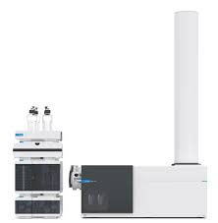
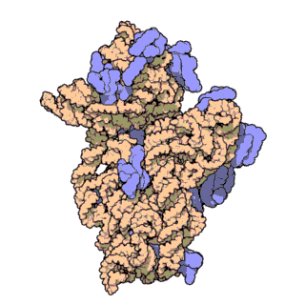
Methods
Liquid chromatography - mass spec (LC-MS)
Untargeted metabolomics and lipidomics
Green tea
Plasma
Targeted neurotransmitter assay
Plasma
Brain
Following data processing, compounds found in both green tea and plasma were used in subsequent analyses
Microbiome sequenced
Illumina short read sequencing of 16S rRNA v4 region

Slide 8
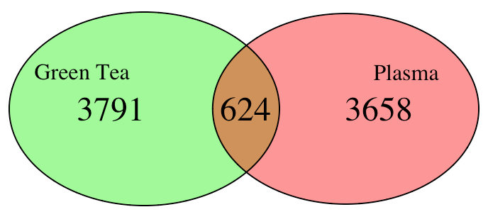
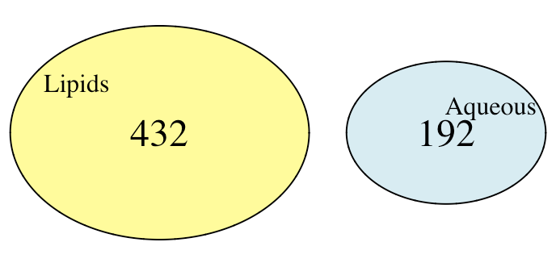
Compounds detected
Plasma - ~4,200
Green tea - ~4,415
Detected green tea compounds in plasma
624 total
432 lipids
192 aqueous

Slide 9
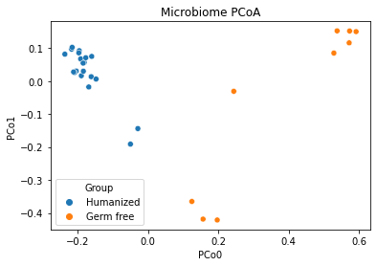
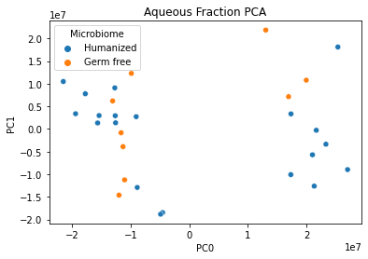
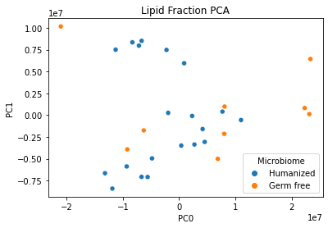
Ordination
Clear separation in microbiome
No clear separation in metabolome (germ free vs humanized)
Not based on experiment/batch
Only green tea compounds found in plasma
Why?

Slide 10
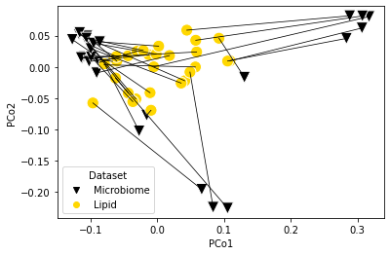
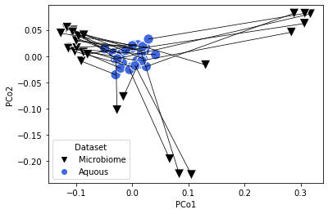
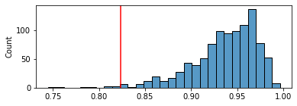
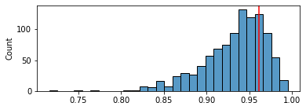
Procrustes Randomization Test
p = 0.011
p = 0.756

Slide 11
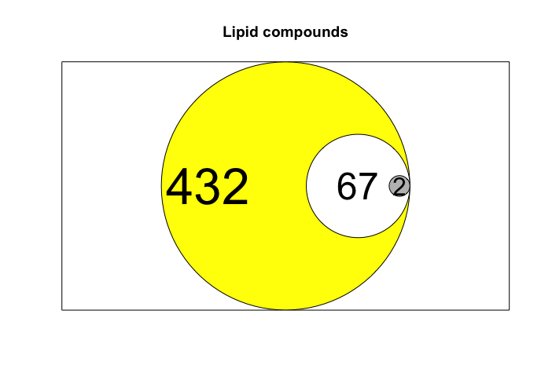
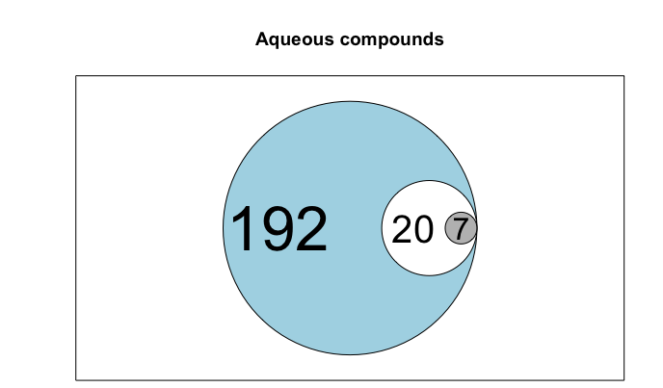
Compounds associated with microbiome composition
1.Total 2. Significant 3.FDR corrected

Slide 12
Compounds associated with microbiome composition
Lipid (named, top 5 p < 0.05)
Cerevisterol
Fungal compound inhibits DNA polymerase alpha and NF-kappa B (source)
Anticancer effects in vitro
Ixabepilone
Used as a chemotherapy drug
Microtubule stabilizing agent (source)
Cholesteryl beta-D-glucoside
Upregulates reactive oxygen species production in vitro (source)
Montecristin
3-Teracrylmelazolide
Aqueous (named, FDR p <0.05)
Shikonofuran
Inhibits NF-kappa B and MAPK (source)
Clitidine
Fungal toxin that shifts tryptophan metabolism toward niacin (source)
Dopamine
Reward neurotransmitter
Also endogenous
Acetylagmatine
Lactiflorin
Notes:
No direction to correlation

Slide 13
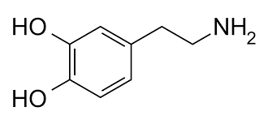
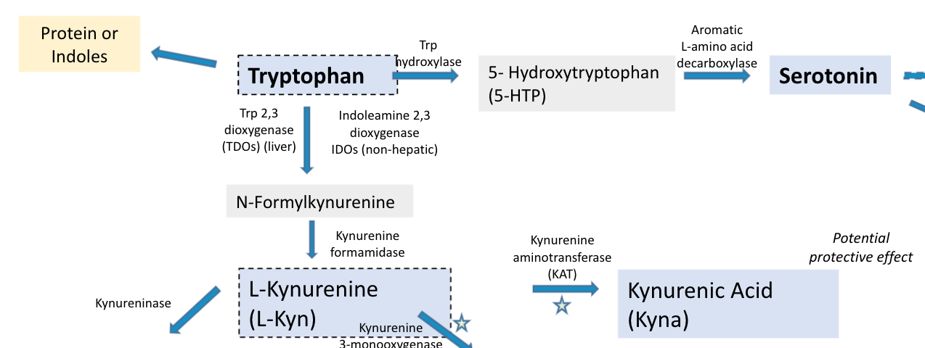
Neurotransmitters associated with microbiome composition
(Targeted LC-MS)
Brain:
Dopamine
Plasma:
Glycyl-phenylalanine
Kynurenic acid
Tryptophan
Notes:
No direction to correlation

Slide 14
Limitation s
No samples before green tea gavage
Which compounds already exist in plasma? (Background subtraction?)
Green tea might be the largest source of variation of these compounds
Neurotransmitter variation could be due to microbiome in general, not the microbiome’s metabolism of green tea
Compare samples before and 2 hours after green tea
Correlation with microbiome beta diversity doesn’t inform about which taxa
How to control for power/false discovery rate when looking at all taxa that correlate with green tea compounds?
Correlation network ~1.7 million comparisons…

Slide 15
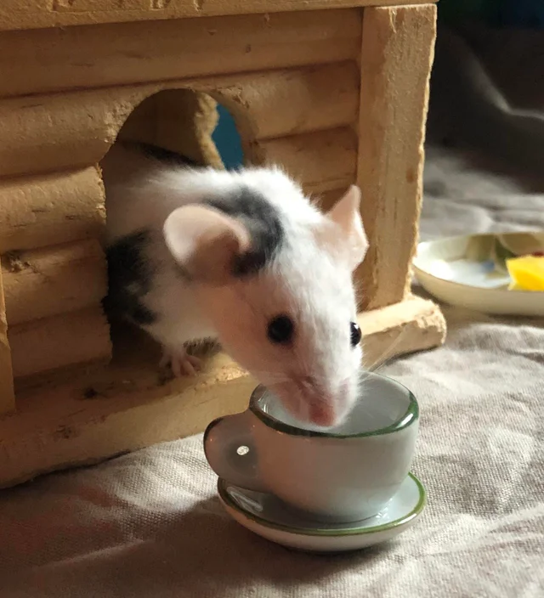
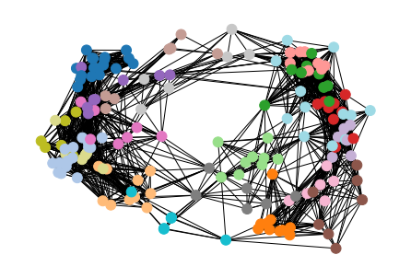
Conclusions and next steps
u/HarrietJoYo
Microbiome impacts plasma lipids more strongly than plasma aqueous green tea compounds
Dopamine, tryptophan/kynurenic acid concentrations were associated with the microbiome
Next steps
Co-occurrence network
Specific taxa associated with certain green tea compounds
Background subtraction of green tea compounds also in plasma

Slide 16


Acknowledgements
Nichole Reisdorph
Kevin Quinn
Kat Doenges
Cathy Lozupone
Gnotobiotic Animal Core
IQ Biology
National Science Foundation
ALSAM Foundation

Slide 17
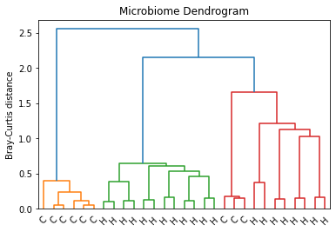
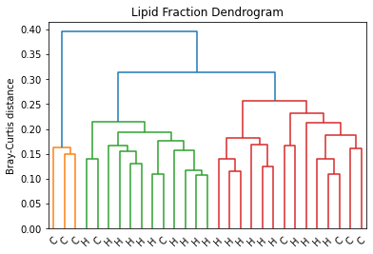
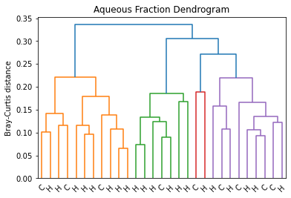
Extra figures:
Clustering

Slide 18
Protein or
Indoles
Aromatic L-amino acid decarboxylase
Trp hydroxylase
Tryptophan
5- Hydroxytryptophan
(5-HTP)
Serotonin
Melatonin
Trp 2,3 dioxygenase (TDOs) (liver)
Indoleamine 2,3 dioxygenase
IDOs (non-hepatic)
Other metabolites
N-Formylkynurenine
Kynurenine formamidase
Kynurenine aminotransferase (KAT)
Potential protective effect
Pyridoxal
L-Kynurenine (L-Kyn)
Kynurenic Acid (Kyna)
Isopyridoxal
Kynureninase
Vitamin B6 cofactors
Kynurenine 3-monooxygenase
Anthranilic Acid (AA)
Kynurenine aminotransferase (KAT)
3-Hydroxy-Kynurenine (3-HK)
Xanthurenic Acid (XA)
Kynureninase
3-Hydroxy-Anthranilic Acid (3-HAA)
3-hydroxyanthranilate 3,4 dioxygenase
2-amino-3-carboxymuconate semialdehyde
Picolinic Acid (PA)
Spontaneous cyclisation
Potential toxic effect
Nicotinamide
Quinolinic Acid (Quin)
Nicotinate ribonucleotide
NAD+
N-Methylnicotinamide

Slide 19
Arginyl-phenylalanine
Phenylalanine
Glycyl-phenylalanine
Phenylalanine hydroxylase
Tyrosine
Tyrosine hydroxylase
L-DOPA =
L-3,4-dihydroxyphenylalanine
Vanilpyruvic Acid
L-DOPA
Aromatic L-amino acid decarboxylase*
*Also converts 5HTP to Serotonin
Dopamine
Dopamine-glucuronide
Dopamine-4-sulfate
3,4-Dihydroxyphenyl-acetic acid

Slide 20
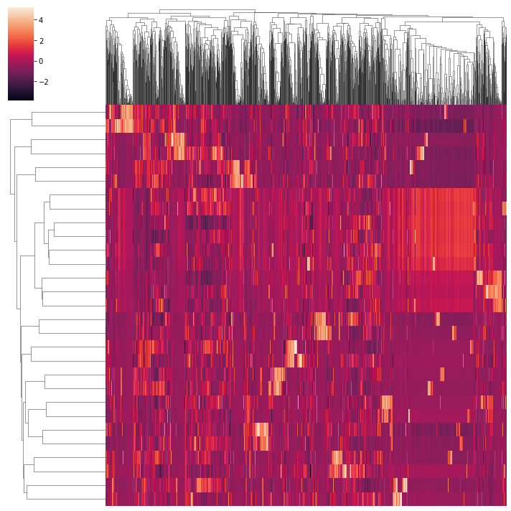
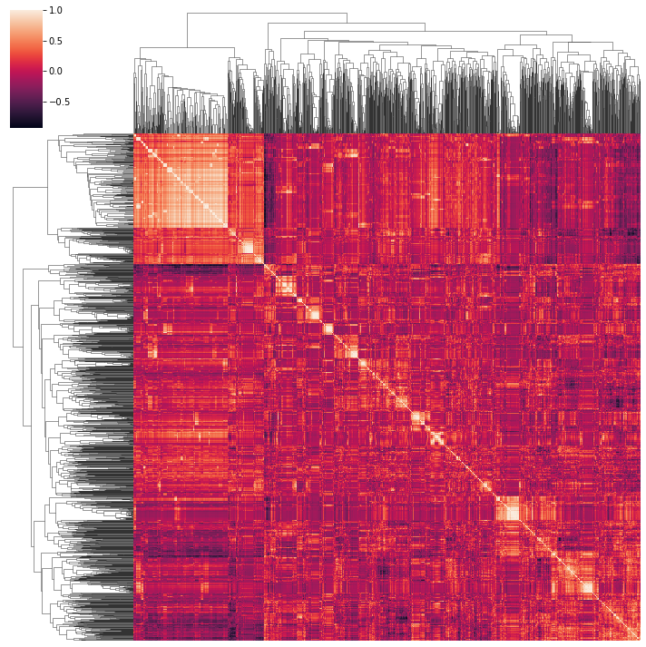
Extra figures: clustermap

