Slide 1
QuickQuotesusa.com
By Cameron Evon

Slide 2
QuickQuotesusa.com mission
Eliminate calling around, trying to find local companies, and whether they are reputable and reliable or not. QuickQuotesUSA Mission is to quickly and effectively help homeowners, commercial Managers, etc… find reputable companies in their area that are suited to their wants and needs.
QuickQuotesUSA will offer their services via a social media style app.

Slide 3
Client page (home-owners/commercial managers page)
The home-owner/ will have a social media type profile, like Instagram. The app will use location services to make sure you are only set in touch with local contractors.
Can quickly make posts to the app with multiple pictures and a description, the app will also offer the Iphone measuring tool to quickly measure work areas
Like the contractor page the client page will also be rated by previous contractors.
Clients will have a page where they can organize their bids and quickly choose the best Company for their needs, this includes filters by Price, ratings, A-Z , etc.
Once the client has chosen a contractor, the contractor will receive a message via the app and the client and contractor can set a start date and begin the project

Slide 4
Clients Page

Slide 5
Client tools

Slide 6
Company page (contractors, handyman, business page)
Contractors page will be set up as a profile page as well, but can only make post of previous work completed.
Contractors will be able to surf through clients post (like an Instagram style system) and quickly make bids that’ll be sent to the client instantly.
The contractors page will have a rating system as well.

Slide 7
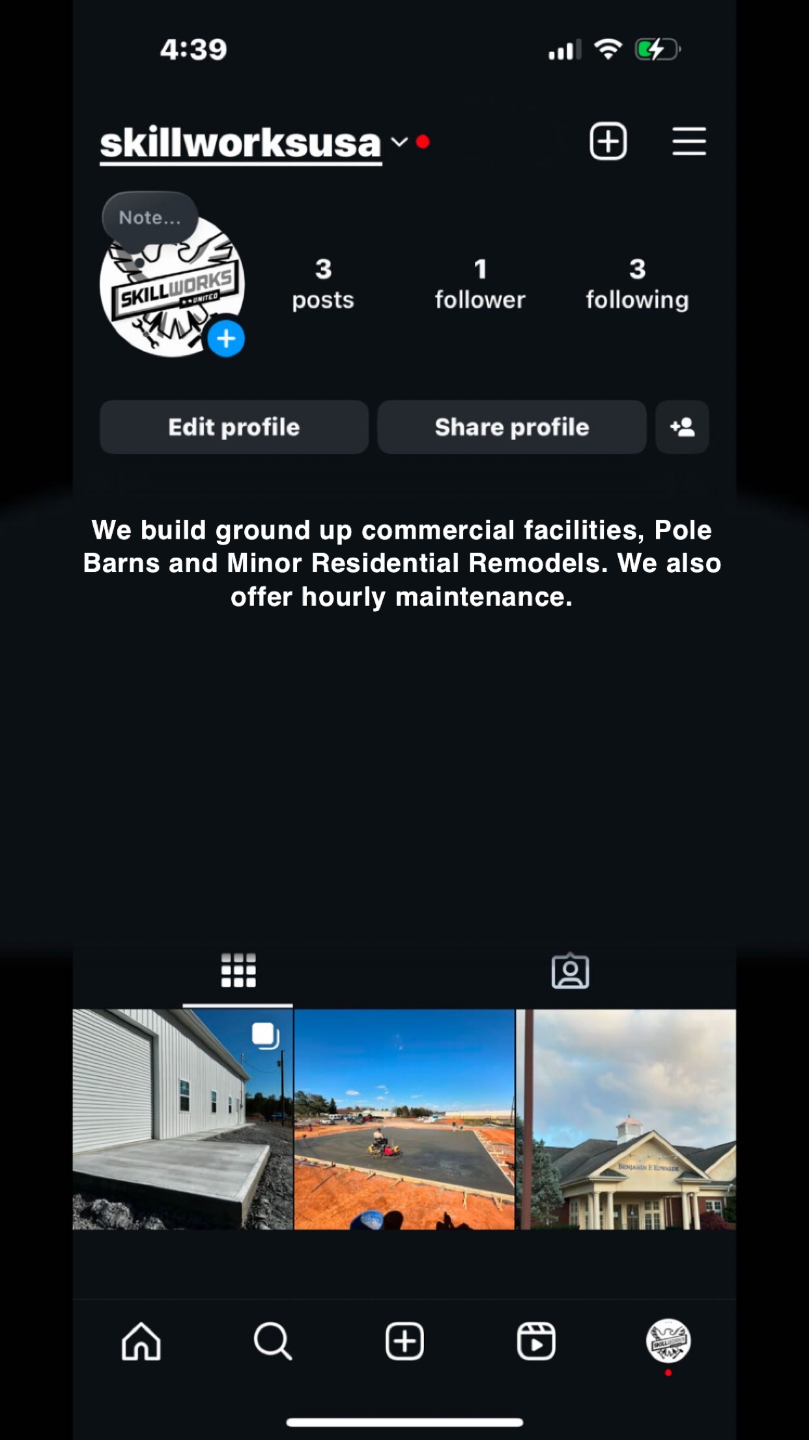
Company Page
NOTE: Possible Rating by stars shown under description

Slide 8
Main Feed (companies view)

Slide 9
Income ideas for quickquotesusa.com
1.99 to Submit 10 Estimats a month
5.99 to submit 50 Estimates a month
9.99 to submit unlimited Estimates a month
Idea 1: QuickQuotesUSA will generate revenue via a small 5% commission off of each project price. For instants - $5,000 flooring job will be required to send a fee of $250 to QuickQuotes.
Idea 2: QuickQuotesUSA will generate revenue via bid limits from contractors. Contractor will be required to buy bids. For instants – buy 10 bids for $1.99 a month, 50 Bids for $5.99 a month, or unlimited bids for $9.99 a month.
Idea 3: QuickQuotesUSA will generate revenue via ads on the webpage and in the app. Cannot place a number due to many variables with ads and website/app activity.

Slide 10
Long term goals for Quickquotesusa
In house financing for jobs, clients will be able to use company like affirm, to finance their projects.
Quickquotesusa to be a 3rd party money team that can assist in the money transactions from client to company to help prevent no shows, bad work, incomplete work, etc…

