Slide 1
Model Analysis Summary
Insights and Visualizations by Nneoma Nnorom

Slide 2
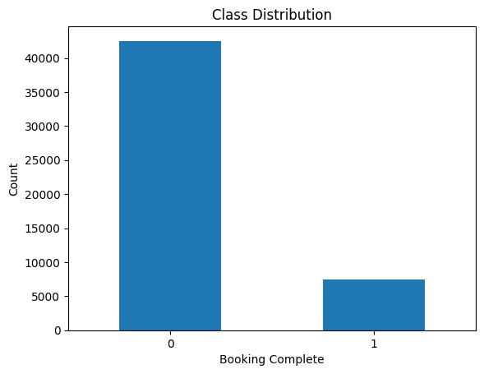
Findings
After choosing some features and merging others, the final features were:
num_passengers, sales_channel, trip_type, length_of_stay, flight_hour, flight_day, route, booking_origin, booking_complete, route_category, flight_time_slot, lead_time_category, booking_lead_time, avg_flight_duration_per_passenger, late_booking, wants_any_extra_services.
Data Preprocessing ended in Finding the Model.
The best model was RandomForestClassifier with the F1 score of I chose the F1 score as evaluation metric because the data was unbalanced as you can see on the right side.

