Slide 1
Steven Testa MCTS, CDIA+, ECMp
Applications Developer, Hyland Software
Owner/Developer, Testa Software
Email: steve@testasoftware.com Twitter: @steven_testa Website: http://testasoftware.com
Speaker Rate: http://speakerrate.com/steven-testa

Slide 2
Inversion of Control
An introduction to IoC

Slide 3
Summary
Overview
Terminology
Dependency Injection
IoC Containers
Building a Container
Mature Projects

Slide 4
Terminology
Dependencies
“Something” that a class or higher level object needs in order to do its job
Explicit versus Implicit
Examples
Framework
Third Party Libraries
Database
File System
Email
Web Services
System Resources (Clock)

Slide 5
Terminology
Dependency Inversion Principle
High level modules should not depend on low-level modules. Both should depend on abstractions
Abstractions should not depend on details. Details should depend on abstractions.

Slide 6
Copy Program
Read Keyboard
Write Printer
Write File
Write Stream

Slide 7
Copy Program
Config
reader
writer
Read Keyboard
Read File
Write Printer
Write File
Write Stream

Slide 8
Terminology
Inversion of Control
The “what”
A set of pattern-ish concepts: interface inversion, flow inversion, creation inversion.
IoC can be achieved in several ways
Factory Pattern
Service Locator
Dependency Injection

Slide 9
Terminology
Dependency Injection
One of the how(s)
A form of Inversion of Control implemented by giving an object its dependencies
The Hollywood Principle

Slide 10
Terminology
IoC Container
A framework for doing dependency injection.
Popular containers include: Structure Map, Ninject, Castle.Windsor, Unity

Slide 11
Dependency Injection
The how to IoC’s what.

Slide 12


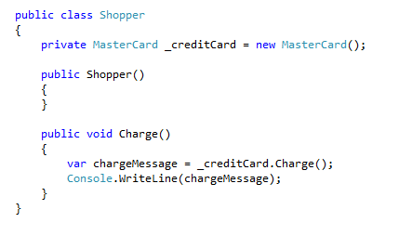
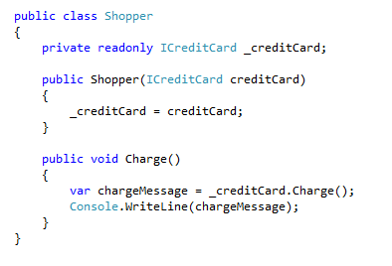

Slide 13


Slide 14
Why do I care?
Same reasons for using a factory pattern.
Single Responsibility Principle
Loose Coupling
Modularity and Code Reuse
Maintainability
Testability

Slide 15
Danger, Will Robinson!
Leaks the internal implementation details of the class
Prevents deferred creation
Shelters pain points

Slide 16
Injection Types
Constructor Injection
Pros
Classes self-document
Works well with or without a container
Classes are always in a valid state after construction
Cons
Constructors can accrue too many parameters/dependencies
Some features may require a default constructor
Not all methods in the class may require the same dependencies

Slide 17
Injection Types

Slide 18
Injection Types
Property Injection / Setter Injection
Pros
Dependencies can be changed at any time
Very flexible
Cons
Objects may be in an invalid state after construction and before setter injection
Not self-documenting and less intuitive

Slide 19

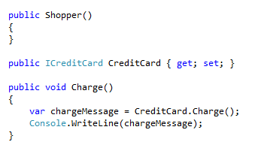
Injection Types

Slide 20
Injection Types
Parameter Injection
Pros
Most granular
Very flexible
Requires no changes to the rest of the class
Cons
Breaks method signature
Can result in many parameters

Slide 21

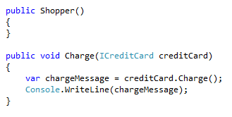
Injection Types

Slide 22
IoC Containers

Slide 23
Benefits
Manage entire dependency graphs
Fluent and file based configurations
Automatic registration
Concrete types
Convention
Dependency lifecycle and scope management

