Slide 1
Revision 2016 Seminar
News from an Alien and Twisted Musical Desert
Kylearan / Cluster

Slide 2
Agenda
Atari VCS 2600 audio capabilities
Music routines
  Public and proprietary
Trackers
  Semi-public and vaporware
VCS music culture
TIATracker

Slide 3
Atari VCS 2600 Audio

Slide 4

VCS Audio Capabilities
2 channels
3 parameters per channel:
  Distortion (waveform):
  10 different
  Volume: 16 values
  Frequency: 32 values
...no filters, in-built ADSR envelopes, ...

Slide 5

32 Frequencies?
Wait, only 32 frequency values?
One octave: 12 notes → Only ~3 octaves?
...it’s worse:
Frequencies don’t match with traditional notes
Many notes are missing completely
Most are (way) off-tune
It all differs between waveforms!

Slide 6
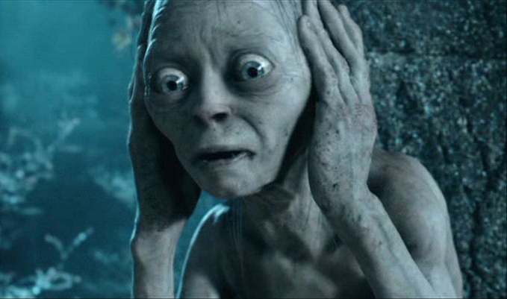
All notes the VCS can produce
You may want to cover your ears now

Slide 7
Survey:
Player Routines and Trackers

Slide 8
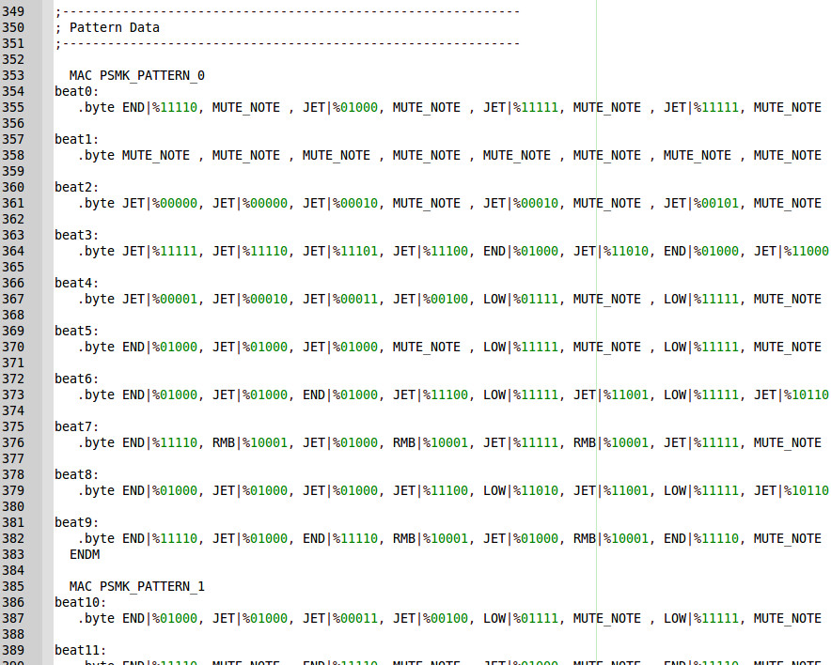
Paul Slocum’s Sequencer Kit

Slide 9
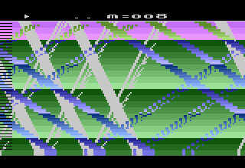
Paul Slocum’s Sequencer Kit
Mature, well-optimized routine
4 Sub-patterns of eight 32nd notes form a measure
  Note: 1 out of 8 waveforms plus frequency
  Plus accentuation
Each channel has a sequence of measures
Looping auto Hi-hat measure
Configurable via compiler switches
Composing happens in source code
No envelopes!

Slide 10
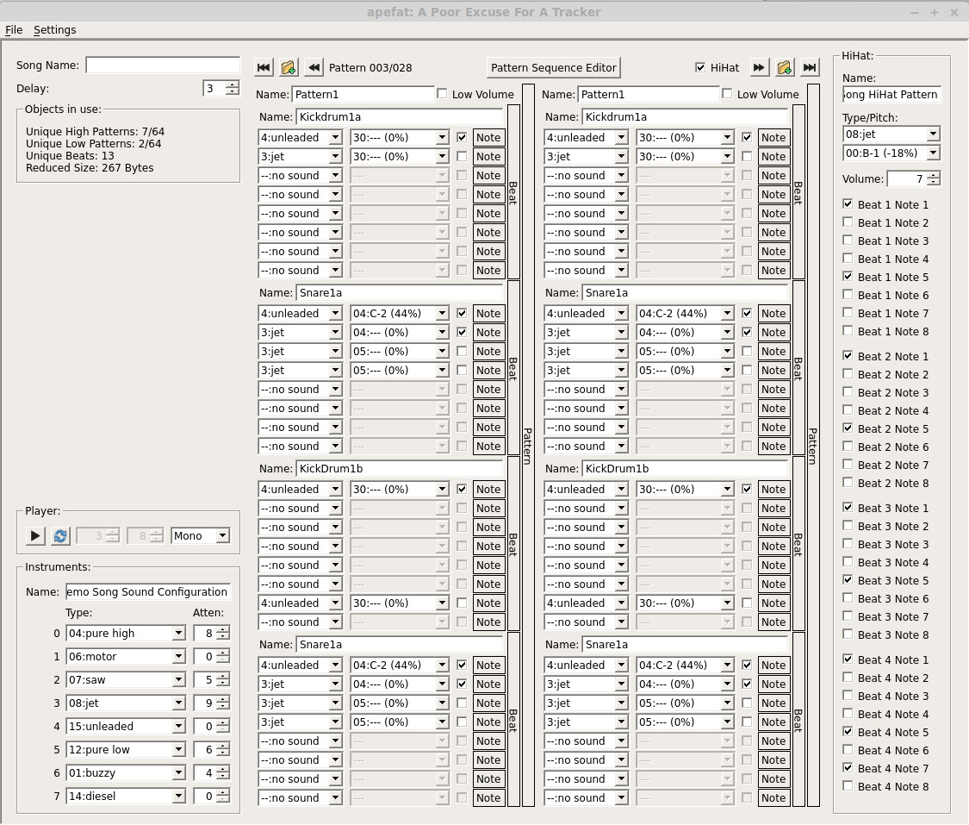
Apefat

Slide 11
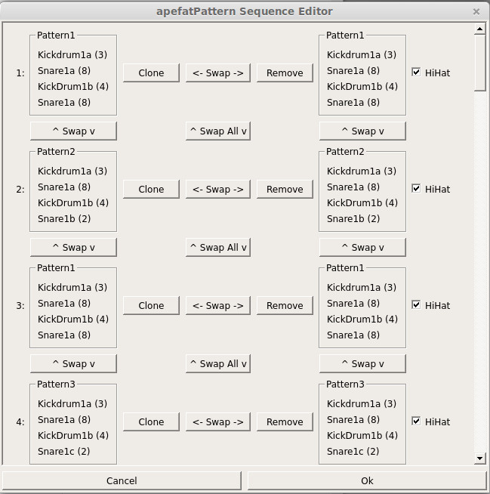
Apefat
Semi-public open source
A bit clumsy to use
  Drop-down menus for notes and waveforms
  Cluttered GUI
Good: Uses 6507 and TIA emulation for playback
Big improvement over composing in source

Slide 12
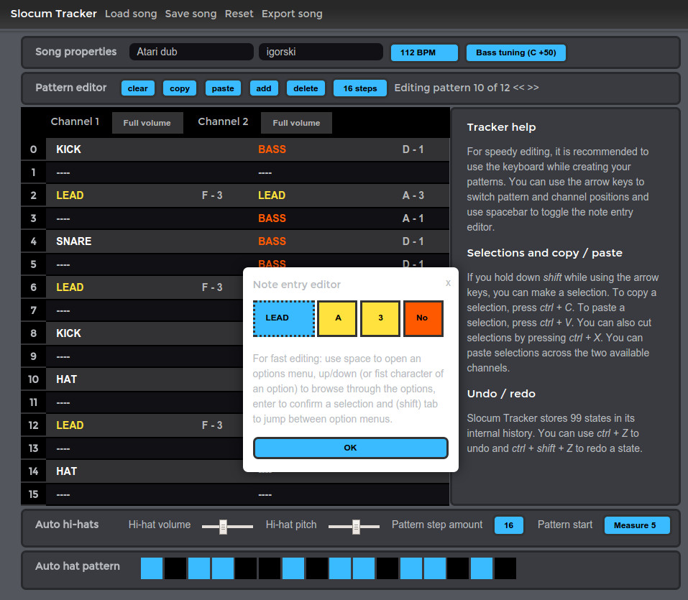
Slocum Tracker

Slide 13
Slocum Tracker
Web-based tracker:
http://www.igorski.nl/experiment/slocum-tracker
Clean design with helpful hints
A bit clumsy to use
  Each note opens a pop-up
  export→compile→listen
Only has 5 preset waveforms

Slide 14
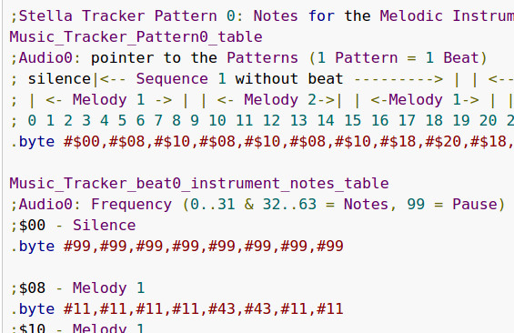
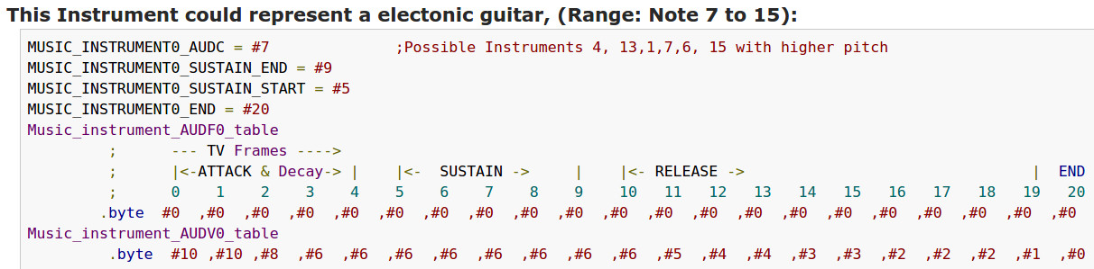
Richi_S’ In-Game Sound Engine

Slide 15
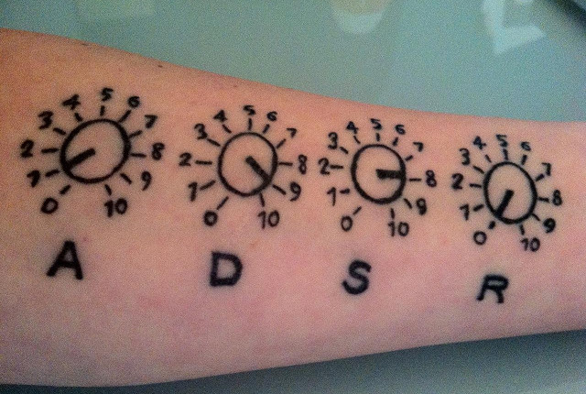
Richi_S’ In-Game Sound Engine
Sequence of patterns of 8 notes each
Features melodic and percussion instruments
  ADSR envelopes for melodic instruments!
  “Play-once” envelopes for percussion
One dedicated channel for melody and
one for percussion
  Cannot mix melody and percussion
  in same channel
Composing happens in source code
Buggy and unoptimized code

Slide 16
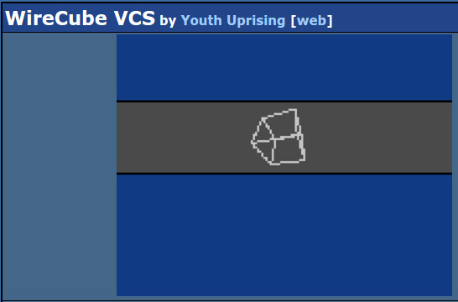
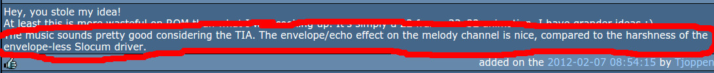
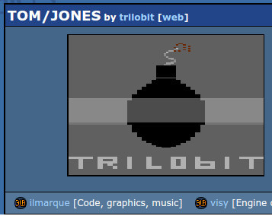
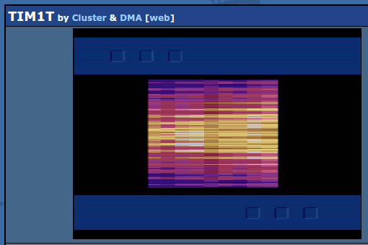
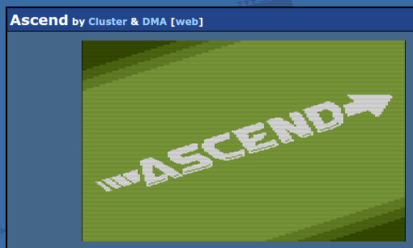
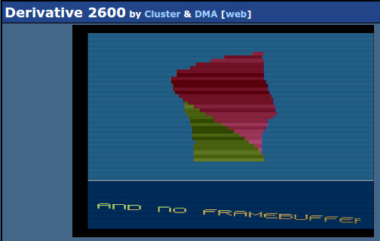
Proprietary Music Routines

Slide 17
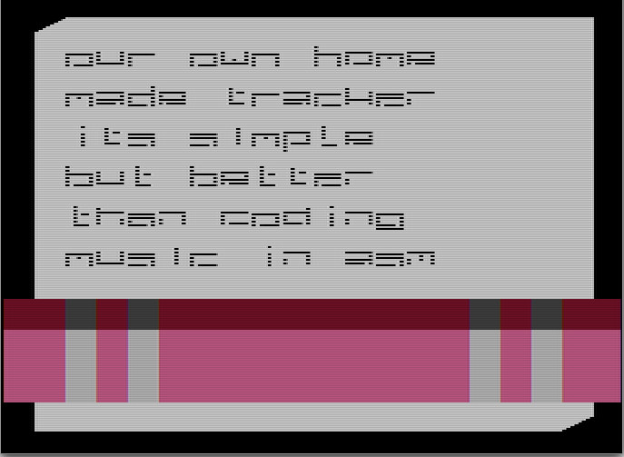
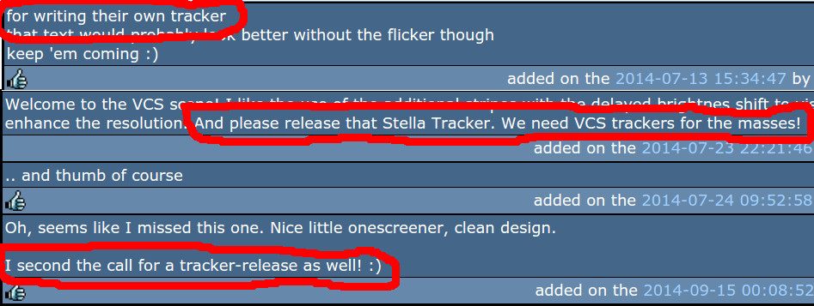
Proprietary / non-public Trackers
“Lowres” by Contraz
Wise words:
“tracker […] better than coding music in asm”

Slide 18
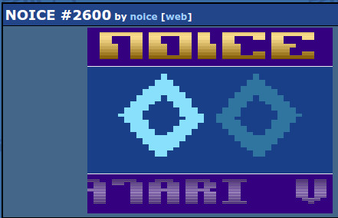
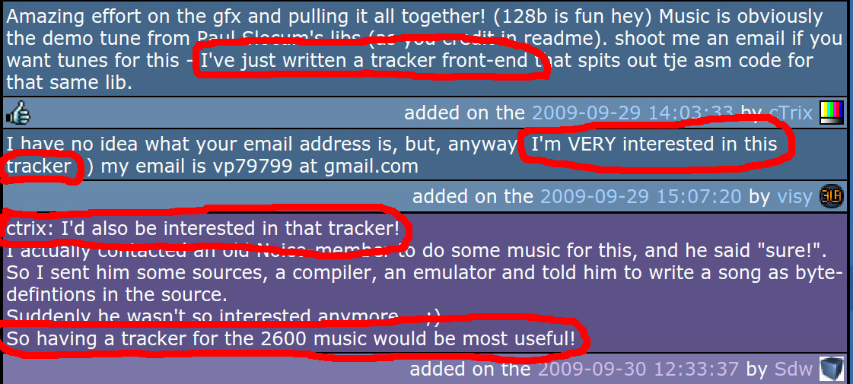
Proprietary / non-public Trackers

Slide 19
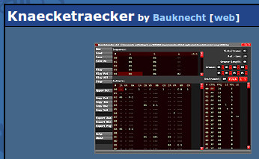
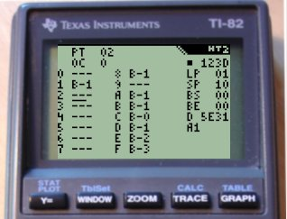
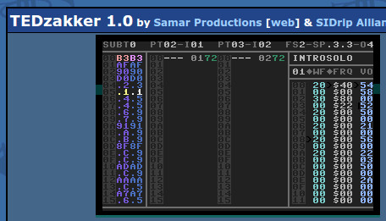
Trackers for Limited Platforms...

Slide 20
VCS Music Culture

Slide 21
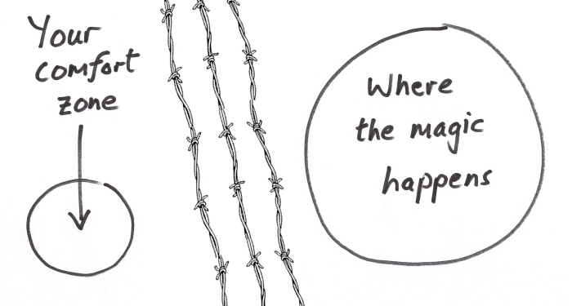
Tools Influence Form
Slocum’s player strongly favors 4/4 time
  Partly true for many trackers, but here even more so
Lack of ADSR envelopes favors short notes
Long feedback cycles
  Discourages experiments
  Promotes tried and proven styles
Composing is more coding than creating art
  And done more often by coders than on other platforms
  Coder music!

Slide 22
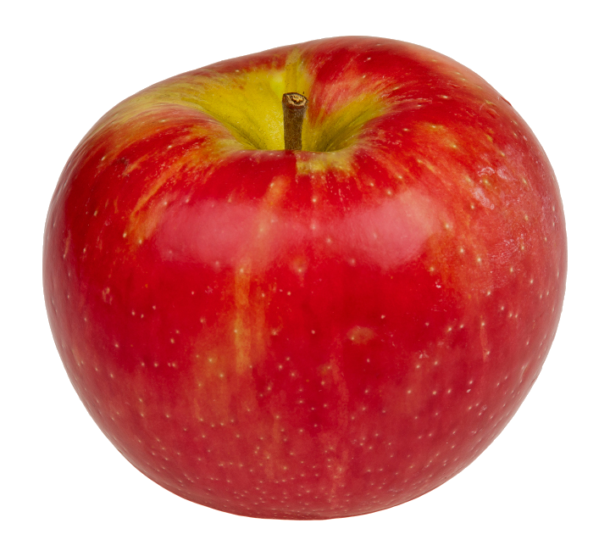
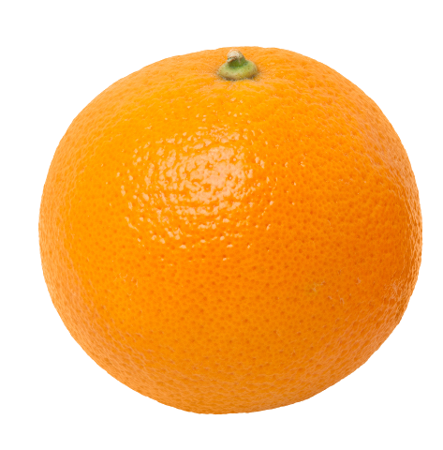
Coders Favor Code
Demo creation is dominated by coders
  Music often only a second thought
Demo | Audio
Hydrokinetics | 35,8%
Wishful Seedling | 40,3%
Traskogen | 25,6%
Back in the Saddle | 19,0%
Demo | Audio
Tom/Jones | 13,7%
Saigon | 14,8%
Sicktro | 13,5%
Dead Tunnel Needed | 14,6%
Coke Zero | 11,8%
vs.
Musicians seem to get less space on VCS to make music

Slide 23

Scientific Experiment
So why is the average music quality on VCS not very high?
Technical limitations too severe?
Platform too old, too unpopular?
…?
...or…
Lack of tools?
  Deters musicians
  Frustrates coders and lessens their focus on music

Slide 24
TIATracker

Slide 25
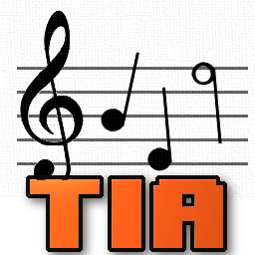
Features
Player routine for the VCS
  Instruments with ADSR envelopes
  Variable pattern lengths
  Configurable, size-optimized code and data structures
Tracker application for the PC
  Full sound emulation
  “Pitch guides” to help with lack of notes
  Instrument editor with “virtual” instruments
  Detailed statistics about sizes

Slide 26
Melodic Instruments
Base waveform
Volume ADSR envelope (absolute)
Volume: 0 - 15
AD
R
Time (frames)
S
Frequency ADSR envelope (relative to the note played)
Frequency: -7 - +7
AD
Time (frames)
S
R

Slide 27
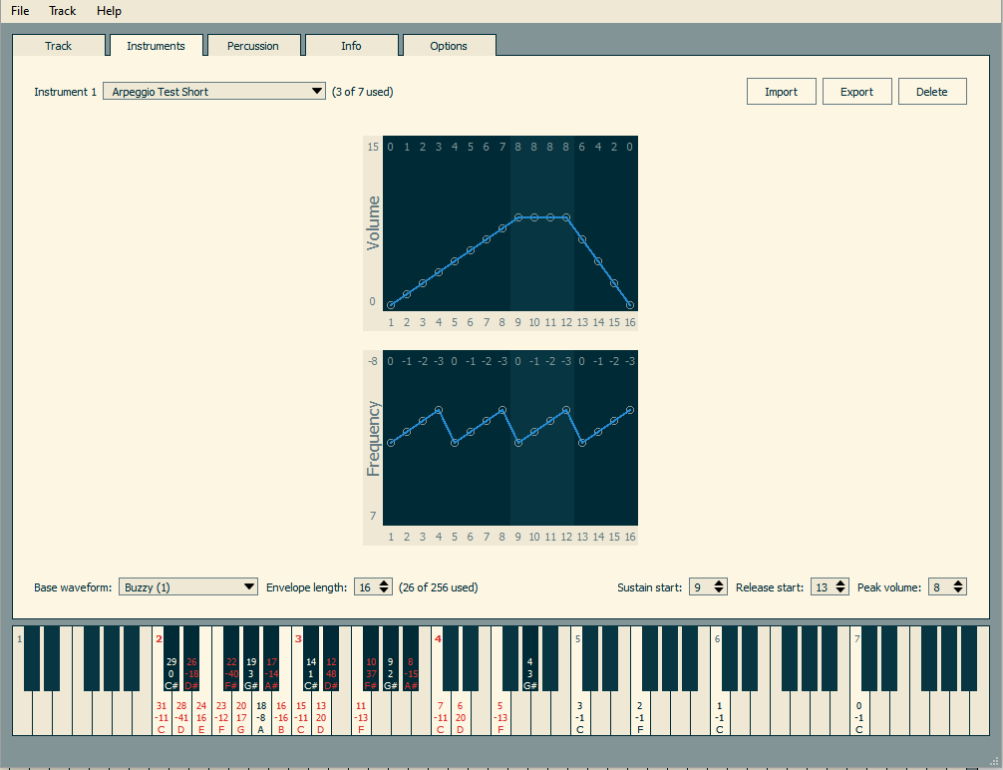
Instrument editor

Slide 28
Percussion Instruments
Set waveform, frequency, volume each frame
Cannot be played at different pitch
  Remember: Waveforms offer different frequencies
Played only once
Can be marked as “overlay”
  Similar, but more flexible than Slocum’s auto hi-hat
  Mitigation for low number of channels

Slide 29
Overlay Percussion
Instrument in extra channel
Percussion
Instrument played after percussion
Percussion
Instrument
Overlay percussion

Slide 30
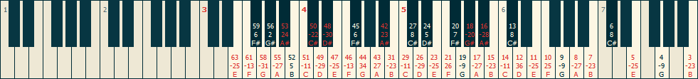
Pitch Guides
Which notes are available, and how off-tune are they?
Orientation for the musician
  Visual display on piano keyboard
  Enter/display note names instead of frequency values
Presets
  Pitch-perfect PAL/NTSC (a4 = 440Hz)
  Non-pitch perfect, optimized for specific waveforms

Slide 31
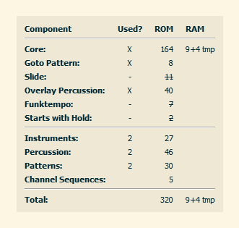
Info and Statistics

Slide 32
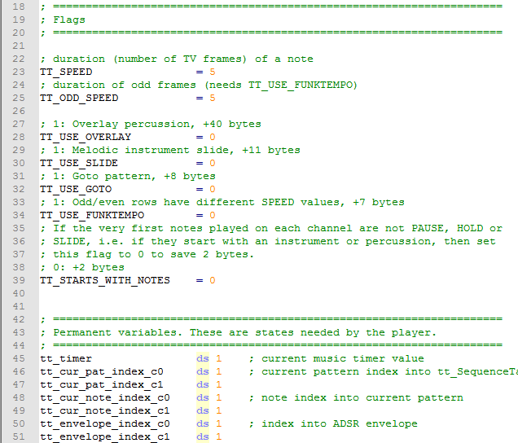
Export to .asm
Export track-specific data only
  <title>_variables.asm
  <title>_init.asm
  <title>_trackdata.asm
Export complete player
  <title>_player.asm
  <title>_framework.asm
Heavily commented

Slide 33
Outlook
Grab it at https://bitbucket.org/kylearan/tiatracker
  Full version will arrive at Pouet next week
Pitch guide creator based on desired notes
Alternate waveforms with same frequencies
More precise timers
Configurations for RAM optimization
Export to k65
Usability

Slide 34

Go and Make Music!
Accept the challenge and push the boundaries!
Show that the VCS can do better!
Maybe with more and better music, we get more VCS demos too…
And I need example songs and instruments. :)

