Slide 1
Student Reviews Frontend Design ideas
01/15/19

Slide 2

General Thoughts
I think we should plan on being able to integrate whatever we design with the Provost’s website, shown below.
If we can maybe copy their style and color scheme, I think that would be a very good idea.

Slide 3
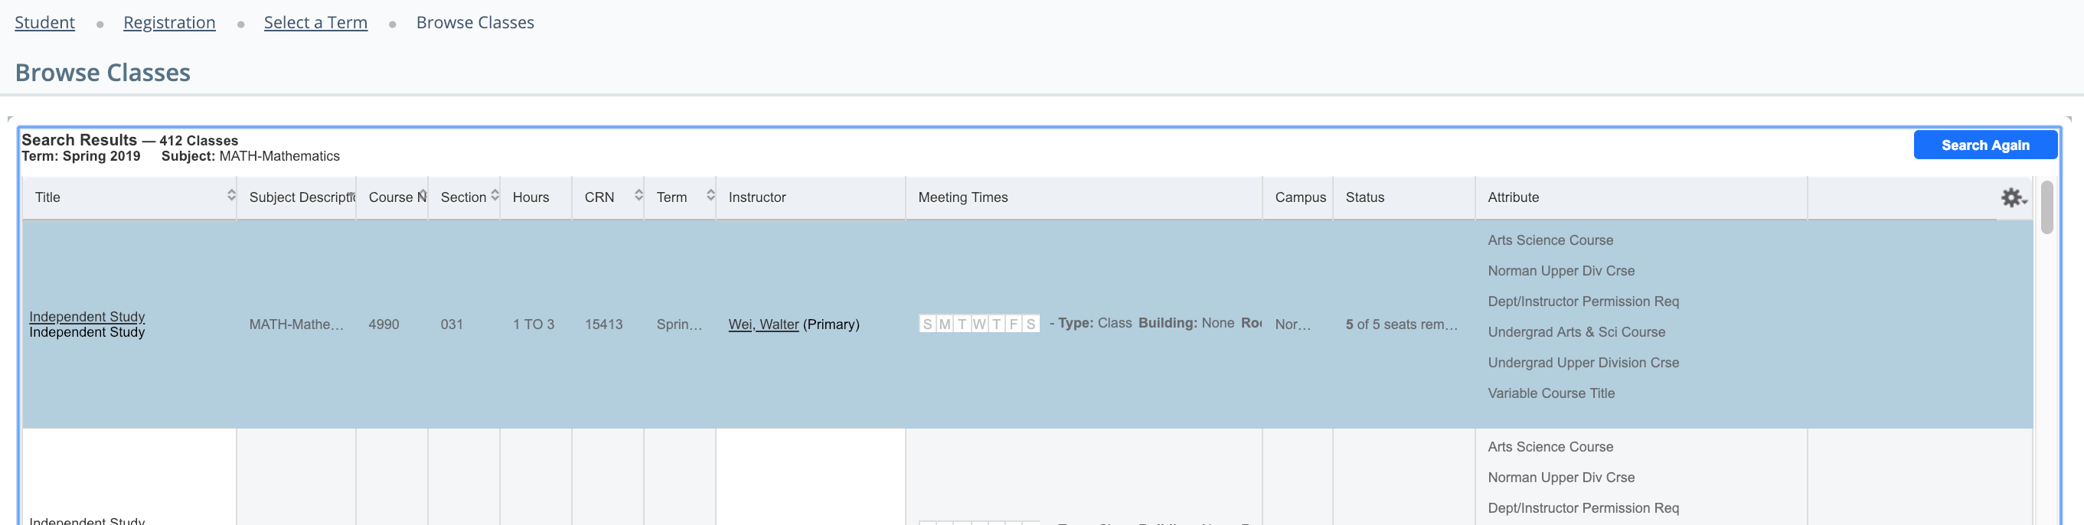
General Thoughts
The current website is vertically-focused, with new content building down from the bottom of the page.
Whatever, we do, lets make it better than the current course enrollment website/interface.

Slide 4
Initial Screen
A
OU Student Reviews Visualization
* Upon clicking a button, the button slides over and reveals a text box, or splits in half or something like that. Better than a text box and a click three buttons.
Start with a short blurb about OU student Reviews, covering:
- Where the reviews come from
The extent of the data (timeframe, colleges, etc.)
Any helpful hints for navigating the website
Search By:
* The courses should be searchable by both the Dept and course number, i.e AME 4553, or the course name, i.e. Thermodynamics
Course
A
Course
Enter query here
Instructor
B
Department
C
For more information about how the reviews are defined/aggregated, click here

Slide 5
Search By Course, Multiple Results
-A
Main Menu > Search by Course “Query”
We found multiple results for that search. Which one are you interested in?
* The courses should be searchable by both the Dept and course number, i.e AME 4553, or the course name, i.e. Thermodynamics. But I think only one input box is the way to go. Are there some smart query options we can look into?
Result 1: i.e. AME 4553: Thermodynamics

Slide 6
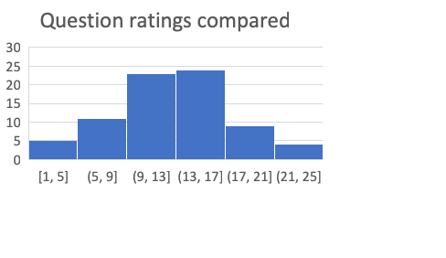
Search By Course
A
Main Menu > Search by Course “Query”
Course Name
{n} teachers have taught this course in the past 2 years (4 sems):
Name
Rating in this course
Average Rating
* The courses should be searchable by both the Dept and course number, i.e AME 4553, or the course name, i.e. Thermodynamics
* There should be some way to navigate from here to instructor and department ratings for this department. Hyperlinks, but not too easy access, just because we don’t want people to accidentally click something and navigate away from their content
Yingtao Liu
Chung-Hao Lee
David Baldwin
5
4.2
3.4
5
4.2
3.4
Here’s how your course compares to the rest of the courses in the { insert dept} department over the previous year (Previous 3 data points?)
Hows the course changing over time? (dept. rating, course rating, num enrolled)
I1
Rating
Course ranked {23}^{rd} out of {170} in dept
See the below questions and average responses that contributed to this rating
Question
Average Question Rating
Q1: How and when and why?
1.5
...
2.6
Overall:

Slide 7
Search By Instructor, Multiple Results
-A
Main Menu > Search by Instructor “Query”
We found multiple results for that search. Which one are you interested in?
Result 1: i.e. Yo Lee
Me Lee
Yiu Lee

Slide 8

Search By Instructor
A
Main Menu > Search by Instructor “Query”
* We kind of need to pick a time domain that we call “recent”. I think that things like the bar chart should only display “recent” data, maybe data from the last 2 years? I think the line graph can show all data points.
Instructor Name
This instructor has taught {n} courses in the {m} years since they’ve been at OU
Name
* There should be some way to navigate from here to instructor and department ratings for this department. Hyperlinks, but not too easy access, just because we don’t want people to accidentally click something and navigate away from their content
AME 4553: Dez Caught it
ECE 4553: pee wee dee
Pee pee pew
This instructor rates here within the department
Hows the course changing over time? (Instructor rating in each course that he/she has taught along with overall rating)
* I wanted to put lots of information in, but this might be info overload. Maybe we put most of these charts into dropdown menus or something like that?
* Might be nice to mix up the layouts/plot types if possible between search by instructor and search by course. Don’t want to look lazy or bore viewer?
Rating
Instructor ranked {23}^{rd} out of {170} in AME, and {45}th out of {198} in ECE
See the below questions and responses that contributed to the instructors ratings, averaged across courses
Question
Average Question Rating
Q1: How and when and why?
1.5
...
2.6
Overall:

Slide 9
Search By Department
A
Start with a short blurb about OU student Reviews, covering:
- Where the reviews come from
The extent of the data (timeframe, colleges, etc.)
Any helpful hints for navigating the website
Search By:
Course
A
Instructor
B
Department
C

