Slide 1
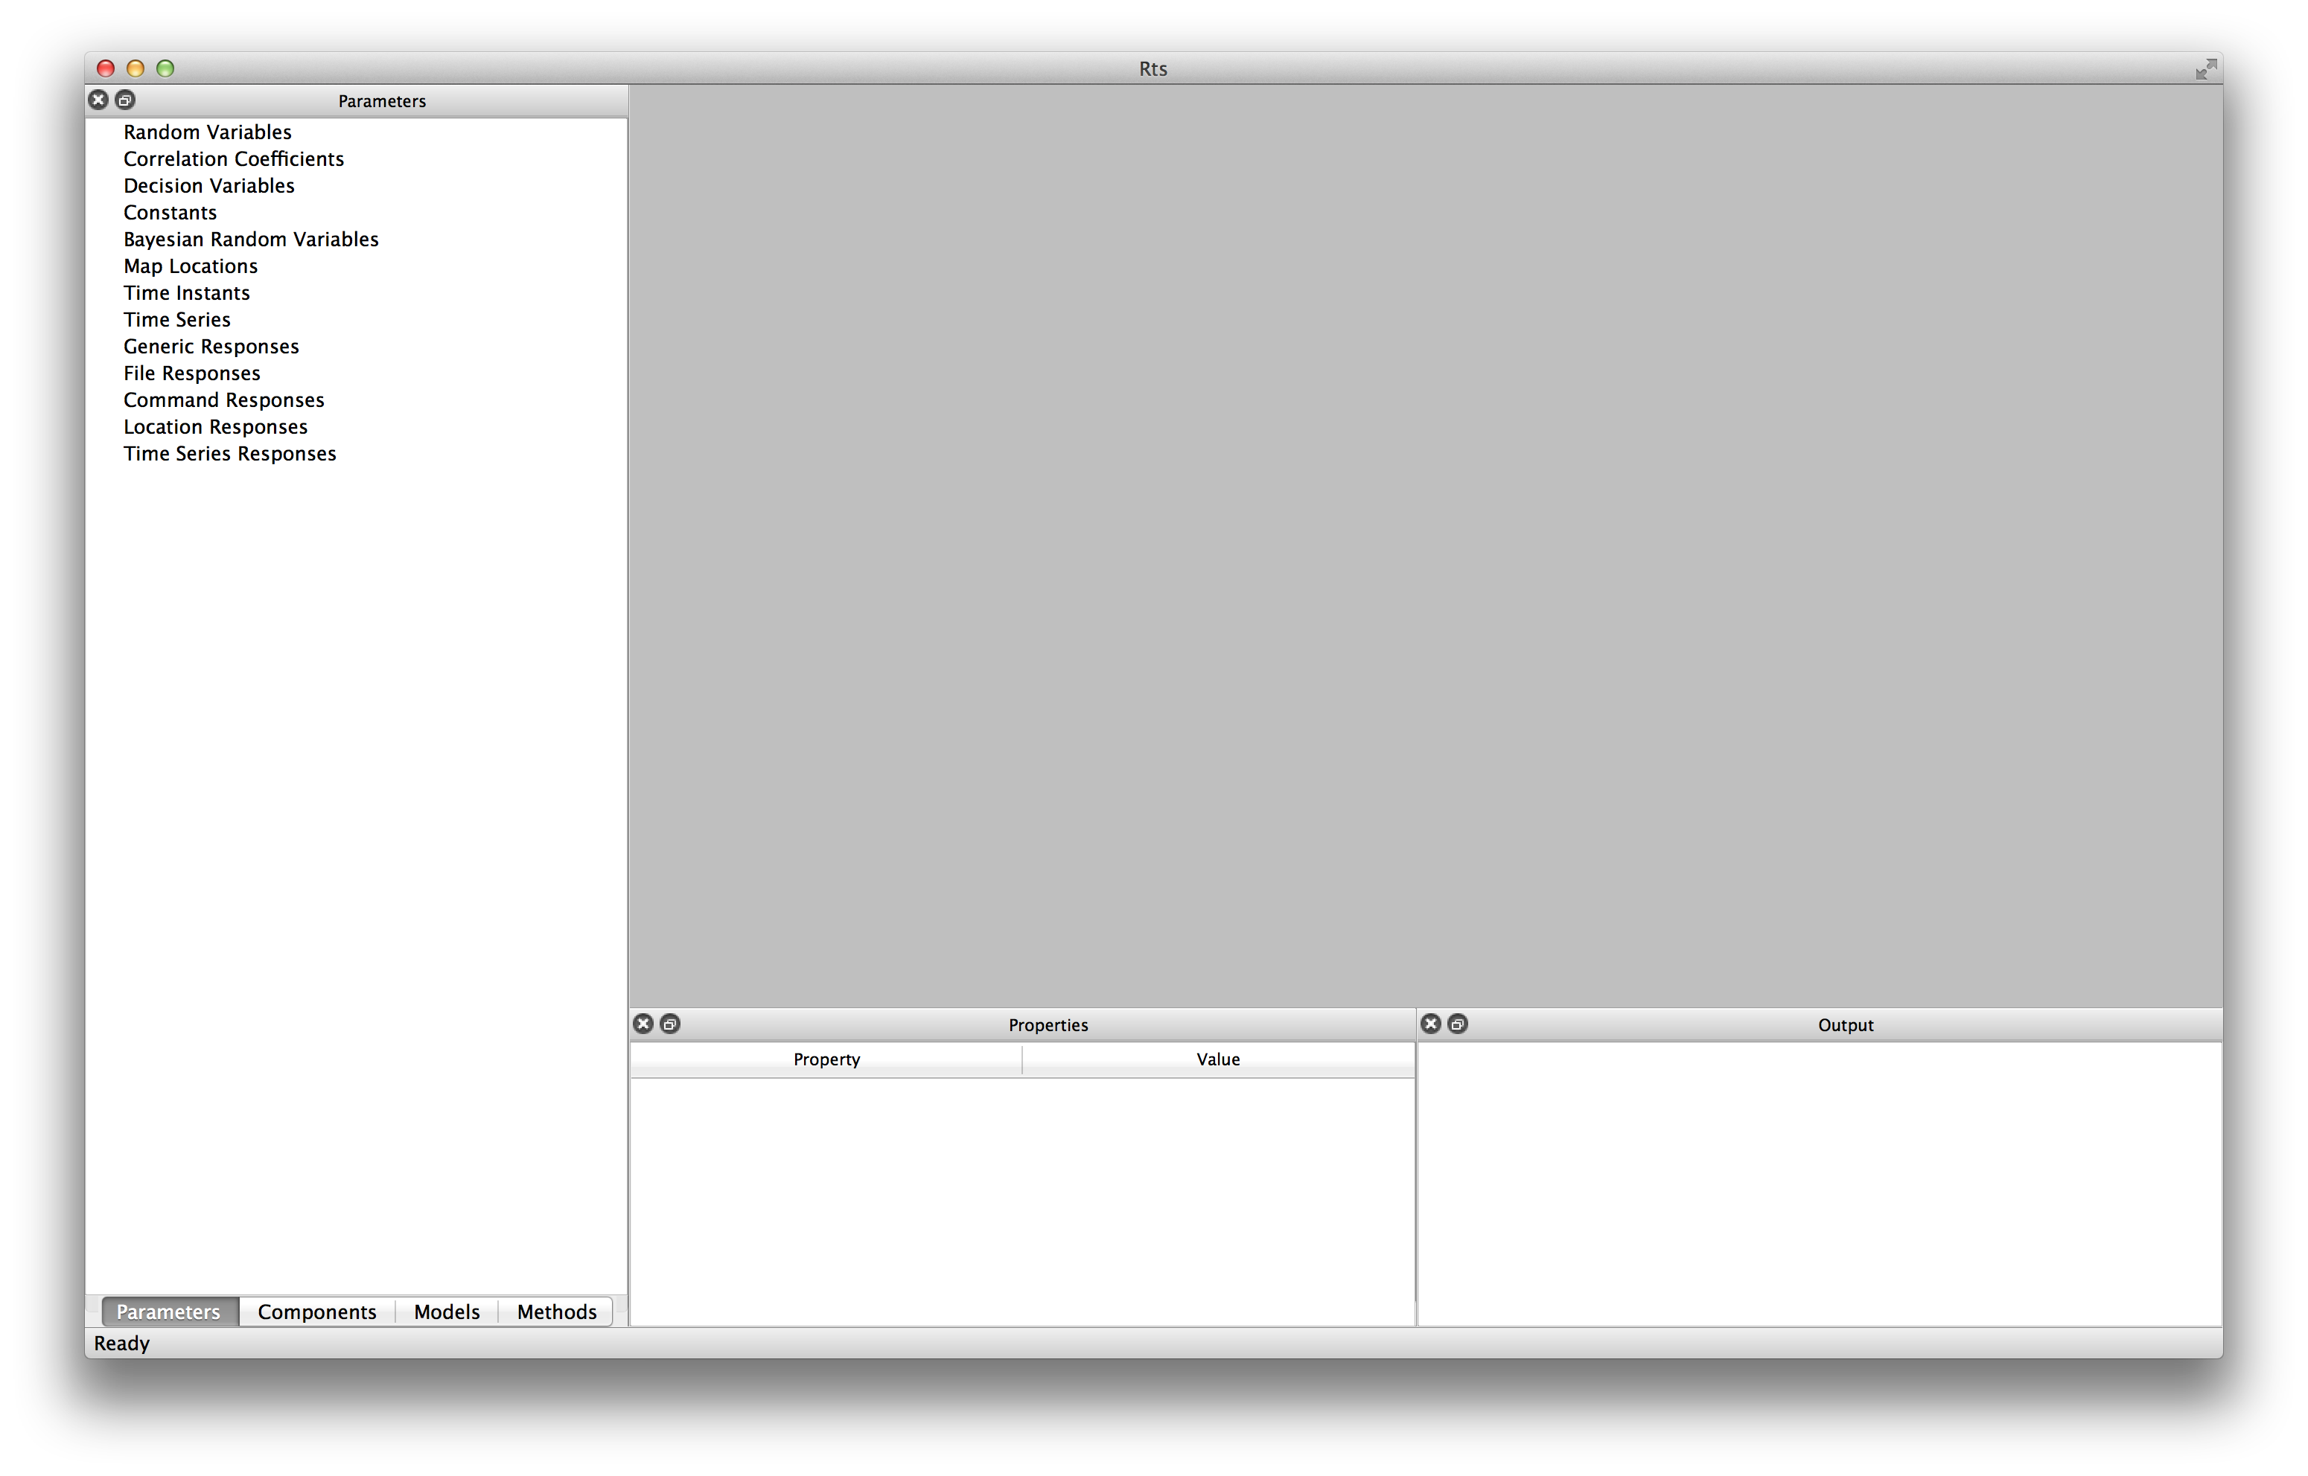
Welcome to Rts in Engineering!
This is the opening screen for the computer program Rts
In the “Objects Pane” you view and create objects
In the “Main Pane” you see visualization plots and help pages
Drag and drop files here to load input files
The “Output Pane” displays text output while the analysis is running
In the “Properties Pane” you view and change properties of the selected object

