Slide 1

Parallel Lossless Data Compression based on the Burrows-Wheeler Transform
Advanced Algorithms and Parallel Programming AY 2017/2018
prof. Ferrandi Fabrizio
ing. Lattuada Marco
Stefano Valladares stefano.valladares@mail.polimi.it

Slide 2
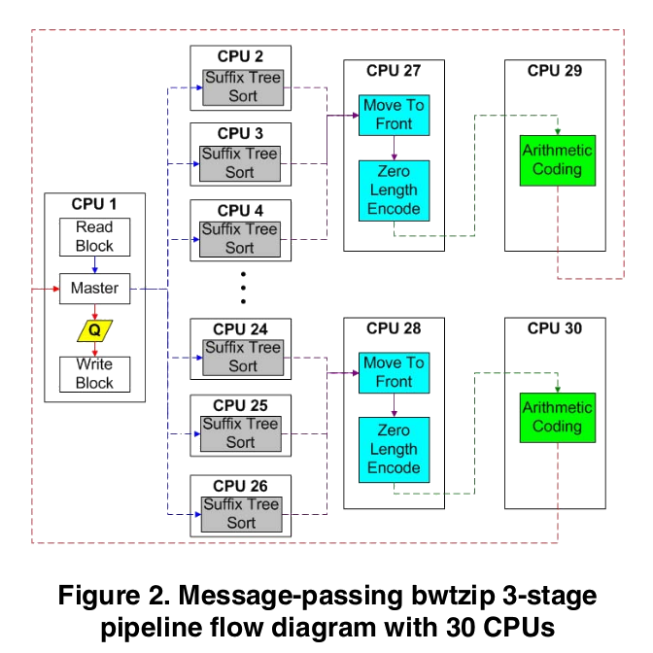
Object of the presentation
The work has been carried out from the analysis of the algorithm described in the section 2.3.2 of the paper:
“Parallel Lossless Data Compression Based on the Burrows-Wheeler Transform”, written by Jeff Gilchrist and Aysegul Cuhadar.
Notes:
2018/12/18

Slide 3
The algorithm
The algorithm uses a block-sorting technique for compression. The file is initially split into blocks and then each block is processed through 4 stages.
Burrows-Wheeler Transform
Move to front Transform
Zero-length encoding
Arithmetic encoding
SUFFIX TREE SORT
MOVE TO FRONT
ZERO-LENGTH ENCODING
ARITHMETIC ENCODING

Slide 4
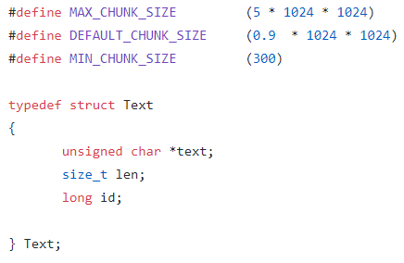
INPUT
The input file is divided into blocks.
Each block is saved as an array of unsigned char before entering the pipeline.
The id is used to keep track of the order of blocks for unsynchronized execution.

Slide 5
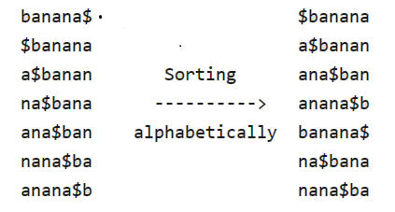
1) Burrows-Wheeler Transform
The BWT is a lexicographical reversible permutation of the input string so that similar characters are grouped together.
The transform is done by sorting all the circular shifts of the text.
Often the output of the BWT is easier to compress.

Slide 6
1) Burrows-Wheeler Transform(cont.)
IMPLEMENTATION:
It can be shown that:
sort_circular_shifts(input) == sort_suffixes(input+SENTINEL)
Where SENTINEL is a special character, that must differ from all the others. In the implementation is the number 256.
Sorting suffixes is done by going through the following steps :
Construct the suffix tree of the input - (Ukkonen’s algorithm)
Construct the suffix array – (lexicographic DFS traversal of the suffix tree)
Write the output from the suffix array encoding also the index of the first byte of the input and the one of the sentinel.

Slide 7
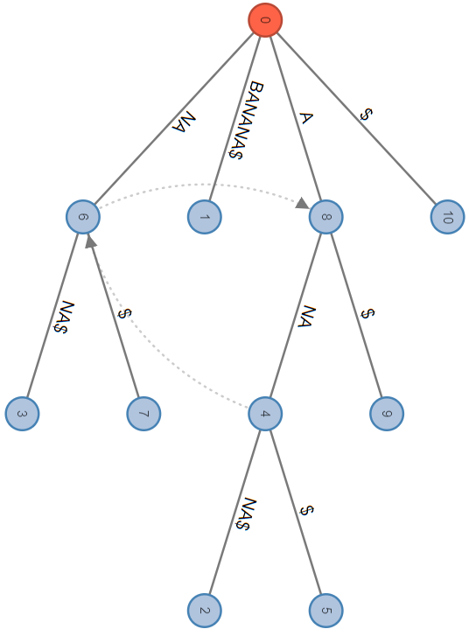
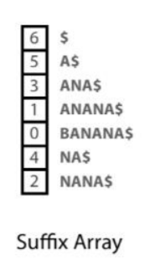
1) Burrows-Wheeler Transform(cont.)
Example: BANANA$ ($ is the sentinel index)
BWT = T[SA[i] – 1] for each i
i 0 1 2 3 4 5 6
T[i] B A N A N A $
SA[i] 6 5 3 1 0 4 2
SA[i]-1 5 4 2 0 6 3 1
BWT A N N B $ A A
0
6
index: 3 6
2
4
5
1
3
Visualization of Ukkonen’s algorithm

Slide 8
1) Burrows-Wheeler Transform(cont.)
COMPLEXITY
Construct suffix tree ---> O(n)
Construct suffix array ---> O(n)
Output BWT ---> O(1)
OUTPUT
PRIMARY_INDEX + SENTINEL_INDEX + BWT(input + ‘$’)
  The indexes are encoded as a sequence of 4 bytes each that represents the number big-endian.
  The output is 9 bytes longer.

Slide 9
2) Move to front transform
The MTF is a reversal transform of a sequence of input characters to an array of output numbers.
The output data has more local correlations and therefore is easier to compress.
IMPLEMENTATION
For each byte in input, replace it with its index in the list of bytes and then move the value of the current index to the front of the list.
The use of a linked list makes the cost of performing the move to front operation constant.
COMPLEXITY: O(n)

Slide 10
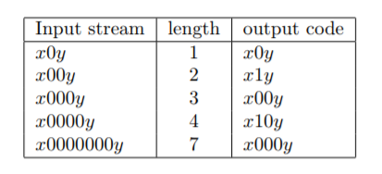
3) Zero-length Encoding
The ZLE is a specific run-length encoding, used by Wheeler, in which sequences of zeros are encoded in a number that holds the length of the zero-run.
After the first two stages long sequences of zeros are frequent.
The length of a sequence is encoded in a binary number.
COMPLEXITY: O(n)
IMPLEMENTATION
Given a sequence of zeros of length n:
Convert (n+1) to binary.
Write the binary number in the output, starting from the LSB, leaving out the MSB.
Examples of Wheeler’s run-length coding

Slide 11
4) Arithmetic encoding
In this stage an adaptive arithmetic encoder implements a lossless compression.
It is a form of entropy encoder in which the entire input is encoded in an interval of real number between 0 and 1.
It separates the model for representing data from the encoding of information with respect to that model.
IMPLEMENTATION
Start with an interval [0,1] and a model for the probability of occurrence of each possible byte in input, then for each byte:
Divide the current interval into subintervals with respect to the probability model.
Select the interval of the current byte as the new interval.
Update the probability model.
COMPLEXITY: O(n)

Slide 12
OUTPUT
At the end of the pipeline the output of the arithmetic encoder is concatenated with its length, and the result is written into the output file.
OVERALL COMPLEXITY: O(n)

Slide 13
Parallel implementation
The pThread API, defined by the standard POSIX.1c thread extension, has been used to parallelize the algorithm.
The idea is to parallelize the pipeline process so as to assign different stages of the pipeline to different threads.
CPU 0
CPU 1
Suffix Tree sort
Read block
CPU 2
CPU 6
Suffix Tree sort
Move to Front
+
Zero length encoding
CPU 7
Master
CPU 3
Arithmetic encoding
Suffix Tree sort
ARRAY
CPU 4
Suffix Tree sort
Write block
CPU 5
Suffix Tree sort

Slide 14
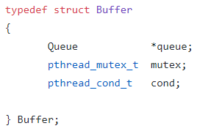
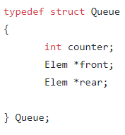
Parallel implementation(cont.)
SYNCHRONIZATION:
Threads run asynchronously.
Queues between stages to exchange values.
Exclusive access to queues is guaranteed by mutexes, one associated with each queue.
Signal mechanism to wait when the queue is empty.
The output is saved into an array before it is written into the output file.

Slide 15
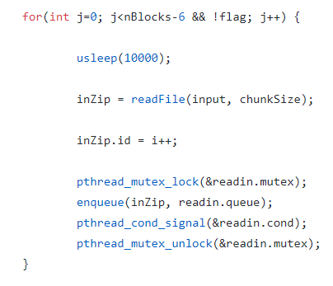
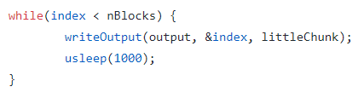
Threads: Main
It has to deal with two tasks:
Read the input file block by block and add it to the read queue.
Write the compressed blocks stored in the output array into the output file.
Write loop.
Read loop.

Slide 16
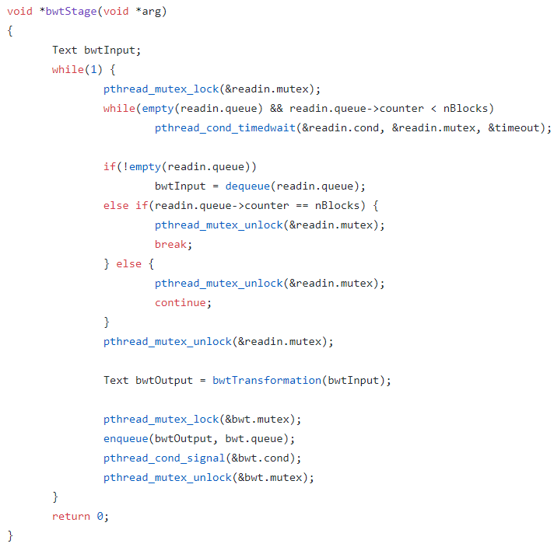
Threads: BWT
READ THE INPUT
STAGE TRANSFORMATION
WRITE THE OUTPUT

Slide 17
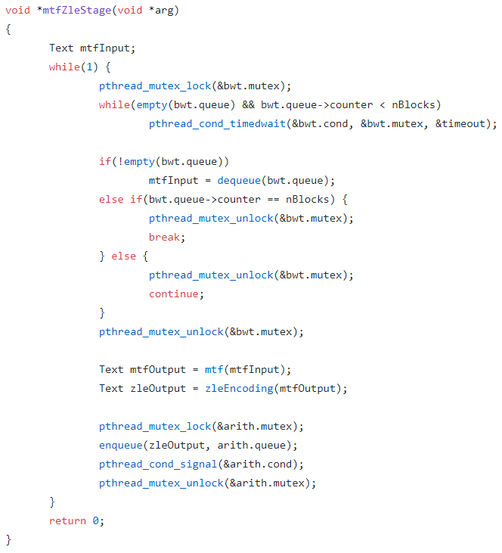
Threads: MTF and ZLE
READ THE INPUT
STAGE TRANSFORMATION
WRITE THE OUTPUT

Slide 18
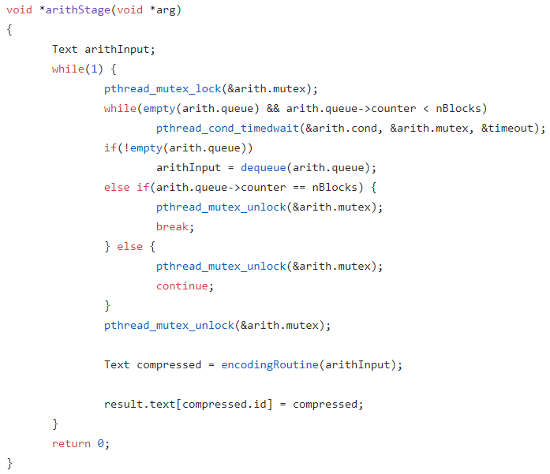
Threads: ARITH
READ THE INPUT
STAGE TRANSFORMATION
WRITE THE OUTPUT

Slide 19
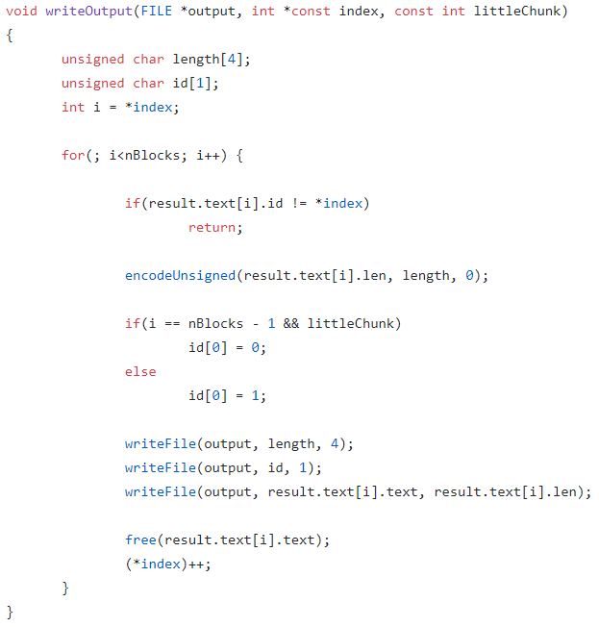
Out of order execution and in order completion
The main thread continuously calls this function to check if the next block to be output is available.
The index keeps trace of the id of the next block to output.
The id of the result are initialized to -1 so the main thread knows when a compressed block has been stored into the array.

Slide 20
Results
TESTED FILES:
World192.txt - the CIA world fact book (2.5 MB)
Bible.txt - the King James version of the bible (4 MB)
E.coli - complete genome of E.coli bacterium (4.6 MB)
Dickens - collected works of Charles Dickens (10.2 MB)
Samba - tarred source code of Samba 2-2.3
Mozilla - tarred executable of Mozilla 1.0 (51.2 MB)
The first three files come from "The large corpus", the others come from the "Silesia corpus".
TEST MACHINE
CPU Intel® Core™ i7-6700HQ, Quad-core, 8 Threads, 2.60GHz

Slide 21
Compression performance
Bigger blocks lead to better compression, but at the cost of running the algorithm slower.
File | Size (MB) | Compressed (%)
 |  | 0,1 MB | 0,9 MB | 1,8 MB | 3,6 MB | 5 MB
World192.txt | 2,5 MB | 72,77 | 79,94 | 81,19 | 82,26 | 82,26
Bible.txt | 4 MB | 74,46 | 78,52 | 79,16 | 19,64 | 79,88
E.coli | 4,6 MB | 74,33 | 74,60 | 74,63 | 74,68 | 74,71
Dickens | 10,2 MB | 66,58 | 71,78 | 72,73 | 73,64 | 74,02
Samba | 20,1 MB | 75,79 | 78,13 | 78,26 | - | -
Mozilla | 51,2 MB | 62,37 | 63,73 | 64,13 | 64,56 | 64,66

Slide 22
Sequential vs Parallel
The sequential algorithm is a little faster then the parallel implementation only for small files (less then 5 MB) with a few blocks (1 or 2).
All the experiments measure the wall clock time. Each experiment has been carried out 10 times and the average of the times of each run has been taken.
The results on the next table show that the bigger the file, the better the parallel algorithm perform with respect to the sequential.

Slide 23
File | Size (MB) | Time (sec)
 |  | 0,1 MB |  | 0,9 MB |  | 1,8 MB |  | 3,6 MB |  | 5 MB
 |  | S | P | S | P | S | P | S | P | S | P
World192,txt | 2,5 MB | 8,695 | 5,741 | 8,411 | 7,217 | 8,552 | 8,170 | 8,623 | 9,160 | 8,623 | 9,160
Bible.txt | 4 MB | 14,616 | 9,436 | 14,970 | 11,314 | 15,378 | 13,770 | 16,014 | 17,687 | 16,204 | 16,383
E.coli | 4,6 MB | 21,010 | 14,375 | 22,798 | 17,343 | 23,615 | 19,751 | 24,530 | 22,750 | 25,117 | 26,087
Dickens | 10,2 MB | 39,931 | 26,562 | 41,747 | 28,609 | 43,621 | 29,970 | 45,169 | 34,817 | 45,550 | 42,049
Samba | 20,1 MB | 66,21 | 42,46 | 69,97 | 43,58 | 71,31 | 46,50 | - | - | - | -
Mozilla | 51,2 MB | 169,646 | 108,847 | 180,590 | 110,947 | 183,865 | 115,355 | 187,500 | 118,820 | 189,850 | 126,593
In this case the parallel implementations used to compare with the sequential version uses 9 threads: the main thread in core 0, cores from 0 to 5 for BWT threads, core 6 for MTF and ZLE thread and core 7 for Arithmetic encoding thread.

Slide 25
CPUs Scalability
File: Samba, 21,6 MB.

Slide 26
Conclusions

Slide 27
References
Parallel Lossless Data Compression Based on the Burrows-Wheeler Transform, Jeff Gilchrist and Aysegul Cuhadar, Carleton University.
Silesia corpus, http://sun.aei.polsl.pl/~sdeor/index.php?page=silesia.
Large corpus, http://corpus.canterbury.ac.nz/descriptions/.
Visualization suffix tree, http://brenden.github.io/ukkonen-animation/.
Construction of the suffix tree (Ukkonen’s algorithm), https://www.geeksforgeeks.org/ukkonens-suffix-tree-construction-part-1/.
Arithmetic encoding, https://github.com/wonder-mice/arcd.
POSIX Thread documentation, https://pubs.opengroup.org/onlinepubs/7908799/xsh/pthread.h.html.
BWT compression, Burrows Wheeler Compression: Principles and Reflections, Peter Fenwick, The University of Auckland.
Bwt zip, https://nuwen.net/bwtzip.html.

