Slide 1
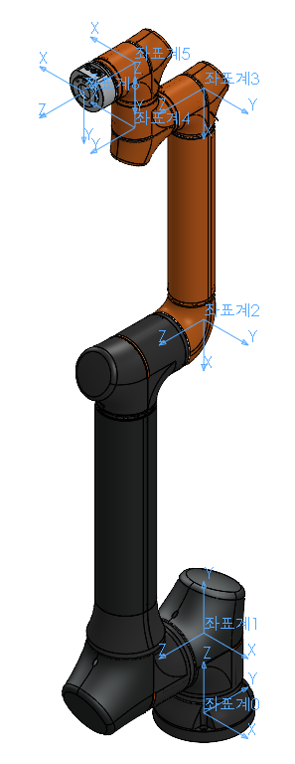
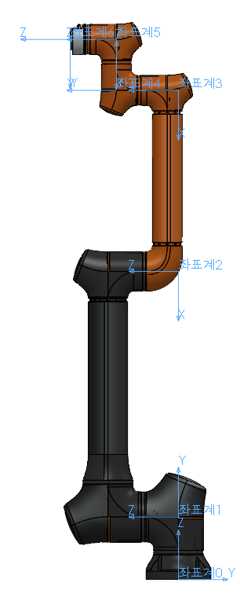
12 3세대
DH parameters of HCR12B (1420mm version)
Joint | Θ(°) | offset(°) | d[mm] | a[mm] | α(°)
1 | q1 | 0 | 186 | 0 | 90
2 | q2 | -90 | 0 | -730 | 0
3 | q3 | 0 | 0 | -538.5 | 0
4 | q4 | -90 | 185 | 0 | 90
5 | q5 | 0 | 151.5 | 0 | -90
6 | q6 | 0 | 137.5 | 0 | 0

Slide 2
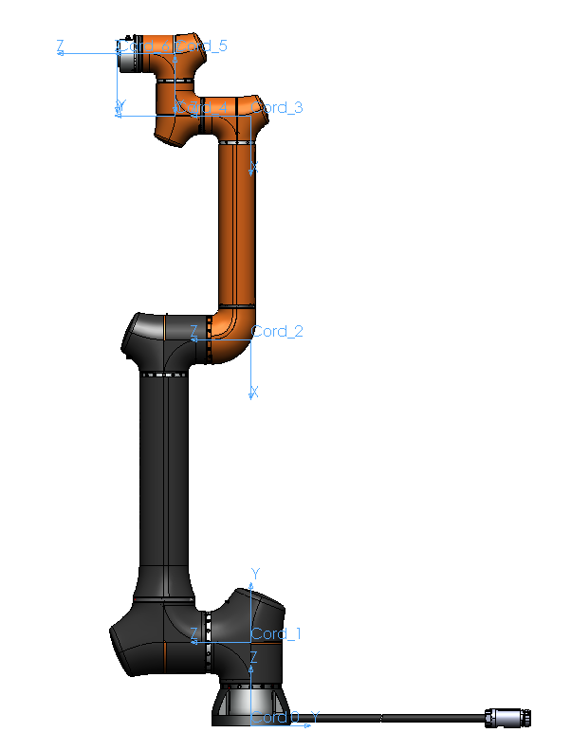
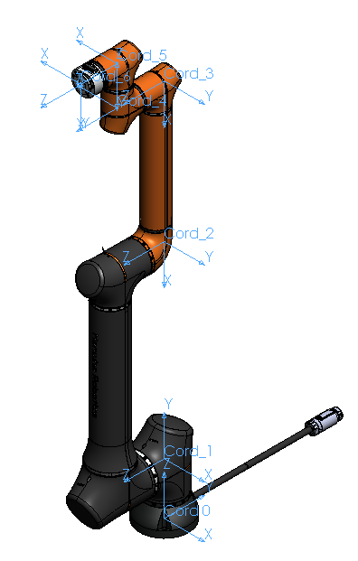
DV 단계
DH parameters of HCR14 (1420mm version)
Joint | Θ(°) | offset(°) | d[mm] | a[mm] | α(°)
1 | q1 | 0 | 201 | 0 | 90
2 | q2 | -90 | 0 | -730 | 0
3 | q3 | 0 | 0 | -540.5 | 0
4 | q4 | -90 | 183 | 0 | 90
5 | q5 | 0 | 149.5 | 0 | -90
6 | q6 | 0 | 139.5 | 0 | 0

Slide 3
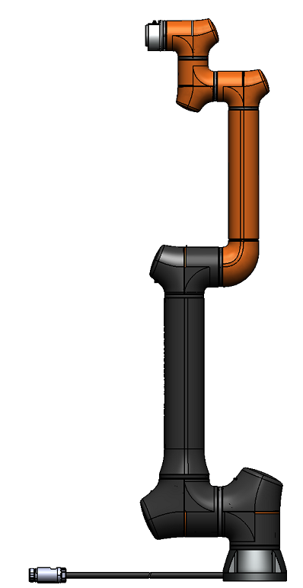





















PV 단계
d6=141.2
d4=184.7
$$x_{6}$$
$$x_{5}$$
$$z_{6}$$
$$z_{5}$$
$$y_{5}$$
d5=151.2
$$y_{6}$$
$$z_{4}$$
$$x_{4}$$
$$y_{4}$$
$$z_{3}$$
$$y_{3}$$
$$x_{3}$$
DH parameters of HCR14 (1420mm version)
Joint | Θ(°) | offset(°) | d[mm] | a[mm] | α(°)
1 | q1 | 0 | 207 | 0 | 90
2 | q2 | -90 | 0 | -730 | 0
3 | q3 | 0 | 0 | -538.8 | 0
4 | q4 | -90 | 184.7 | 0 | 90
5 | q5 | 0 | 151.2 | 0 | -90
6 | q6 | 0 | 141.2 | 0 | 0
a3=538.8
$$z_{2}$$
1420
$$y_{2}$$
$$x_{2}$$
a2=730
$$y_{1}$$
$$z_{1}$$
d1=207
$$x_{1}$$
$$z_{0}$$
$$y_{0}$$
$$x_{0}$$

