Slide 1
Robot Forward/Inverse Kinematics
Notes:
Hello Thank you for inviting me first.
I hope Hanwha and Schaeffler can help each other.
I will briefly introduce myself.
I am Bae Gang-tae, research engineer at Hanwha Precision Machinery Robot Division.
As you have seen at the last meeting in korea,
this is the leader engineer Mr lee in the algorithm part
Today we will go over what we need to worry about

Slide 2
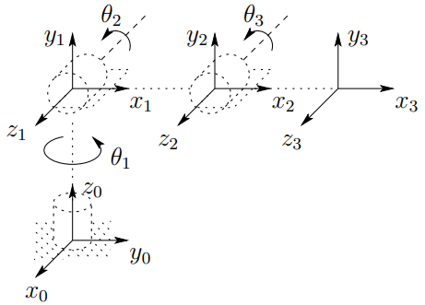

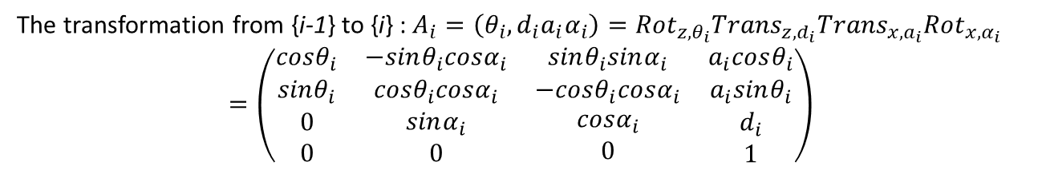




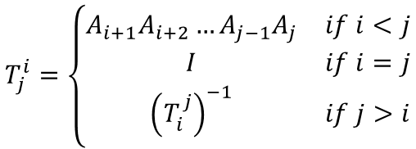
Kinematic Chain
$∎$ Transformation matrix
$$T_{j}^{i}=\left\{\begin{matrix}A_{i+1}A_{i+2}…A_{j−1}A_{j} & if i<j \\ I & if i=j \\ {\left(T_{i}^{j}\right)}^{−1} & if j>i\end{matrix}\right.$$
$$T_{n}^{0}=A_{1}\left(q_{1}\right)⋯A_{n}\left(q_{n}\right)$$
$$\left(\begin{matrix}R_{n}^{0} & o_{n}^{0} \\ 0 & 1\end{matrix}\right)=H$$
$∎$ DH(Denavit-Hartenberg) parameters
$θ_{i}$
$$d_{i}$$
$$a_{i}$$
$$α_{i}$$
: joint angle – the angle between the $x_{i−1}$ axes about the $z_{i−1}$ axis
: link offset – the distance from the origin of frame {i-1} to $x_{i}$ axes along the $z_{i−1}$ axis
: link length – the distance between the $z_{i−1}$ and $z_{i}$ axes along the $x_{i}$ axis
: link twist – the angle from the $z_{i−1}$ to $z_{i}$ axis about $x_{i}$ axis
The transformation from {i-1} to {i} : $A_{i}=\left(θ_{i},d_{i}a_{i}α_{i}\right)={Rot}_{z,θ_{i}}{Trans}_{z,d_{i}}{Trans}_{x,a_{i}}{Rot}_{x,α_{i}}$
$$=\left(\begin{matrix}\begin{matrix}cosθ_{i} \\ sinθ_{i}\end{matrix} & \begin{matrix}−sinθ_{i}cosα_{i} \\ cosθ_{i}cosα_{i}\end{matrix} & \begin{matrix}sinθ_{i}sinα_{i} \\ −cosθ_{i}cosα_{i}\end{matrix} & \begin{matrix}a_{i}cosθ_{i} \\ a_{i}sinθ_{i}\end{matrix} \\ \begin{matrix}0 \\ 0\end{matrix} & \begin{matrix}sinα_{i} \\ 0\end{matrix} & \begin{matrix}cosα_{i} \\ 0\end{matrix} & \begin{matrix}d_{i} \\ 1\end{matrix}\end{matrix}\right)$$

Slide 3
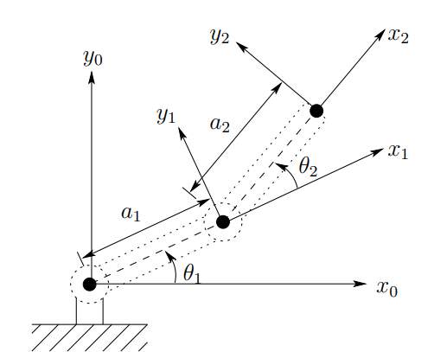
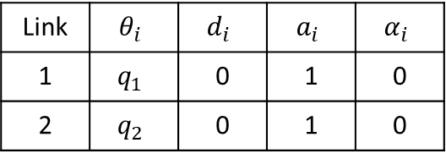





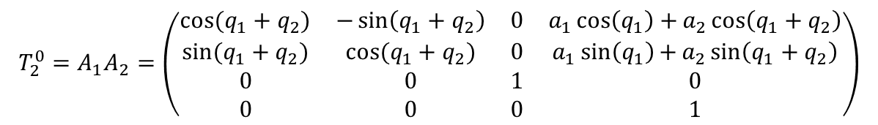
A-2-Link Robot(SE(2))
$∎$ DH parameters
Link | $$θ_{i}$$ | $$d_{i}$$ | $$a_{i}$$ | $$α_{i}$$
1 | $$q_{1}$$ | 0 | 1 | 0
2 | $$q_{2}$$ | 0 | 1 | 0
$∎$ Forward kinematics
Analyzing a 2-joint planar robot arm | Robot Academy
$$T_{2}^{0}=A_{1}A_{2}=\left(\begin{matrix}cos⁡(q_{1}+q_{2}) & −\sin\left(q_{1}+q_{2}\right) & 0 & a_{1}\cos\left(q_{1}\right)+a_{2}\cos\left(q_{1}+q_{2}\right) \\ sin⁡(q_{1}+q_{2}) & cos⁡(q_{1}+q_{2}) & 0 & a_{1}\sin\left(q_{1}\right){+}a_{2}\sin\left(q_{1}+q_{2}\right) \\ 0 & 0 & 1 & 0 \\ 0 & 0 & 0 & 1\end{matrix}\right)$$
$∎$ Inverse kinematics
Inverse Kinematics for a 2-Joint Robot Arm Using Geometry | Robot Academy
Solve “two” nonlinear equations in “two” unknowns.
$$q_{2}=\cos^{−1}\left(\frac{x_{2}^{2}+y_{2}^{2}−a_{1}^{2}−a_{2}^{2}}{2a_{1}a_{2}}\right)$$
$$q_{1}=\tan^{−1}\left(\frac{y_{2}}{x_{2}}\right)−\tan^{−1}\left(\frac{a_{2}\sin\left(q_{2}\right)}{a_{1}+a_{2}\cos\left(q_{2}\right)}\right)$$

Slide 4
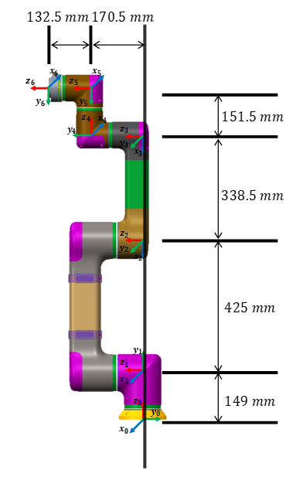
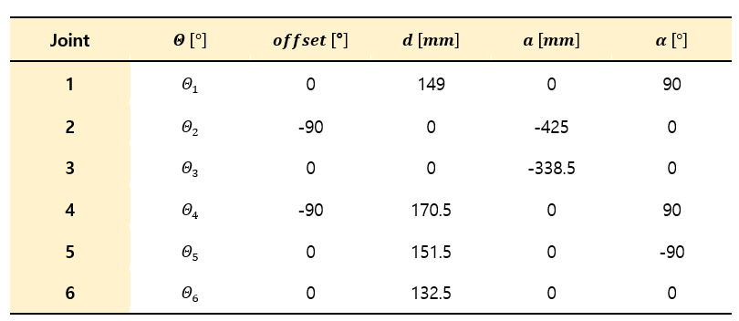
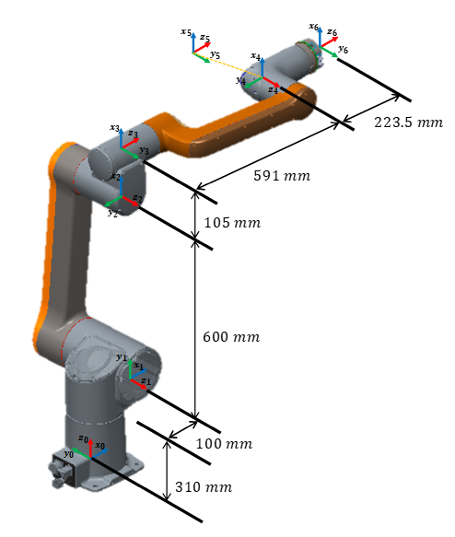
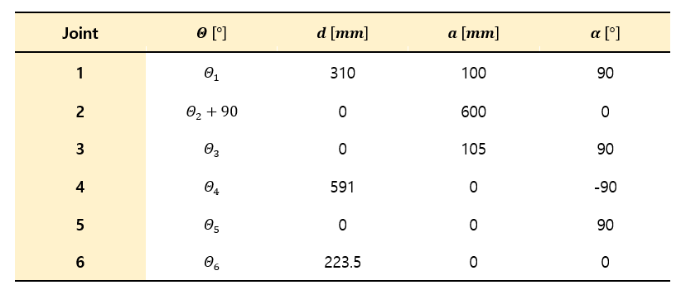


Hanwha Collaborative Robot
$∎$ HCR5
$∎$ HCR12

Slide 5



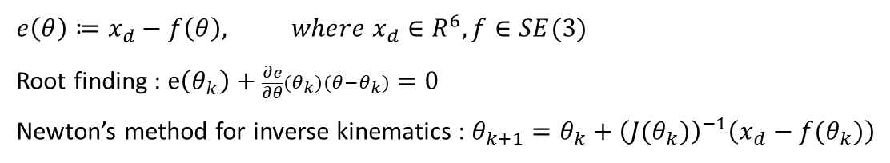
Inverse kinematics – Numerical Solution
$∎$ Newton’s method
$$e\left(θ\right)≔x_{d}−f\left(θ\right), where x_{d}∈R^{6}, f∈SE(3)$$
Root finding : $e\left(θ_{k}\right)+\frac{∂e}{∂θ}(θ_{k})(θ−θ_{k})=0$
Newton’s method for inverse kinematics : $θ_{k+1}=θ_{k}+{\left(J(θ_{k})\right)}^{−1}\left(x_{d}−f(θ_{k})\right)$
(geometric) Jacobian
$∎$ Line search method
$$θ_{k+1}=θ_{k}+α_{k}{\left(J(θ_{k})\right)}^{−1}\left(x_{d}−f(θ_{k})\right)$$
Step size selection : Armijo’s backtracking line search method
AME 50551 – Introduction To Robotics – Patrick M. Wensing (nd.edu)

Slide 6
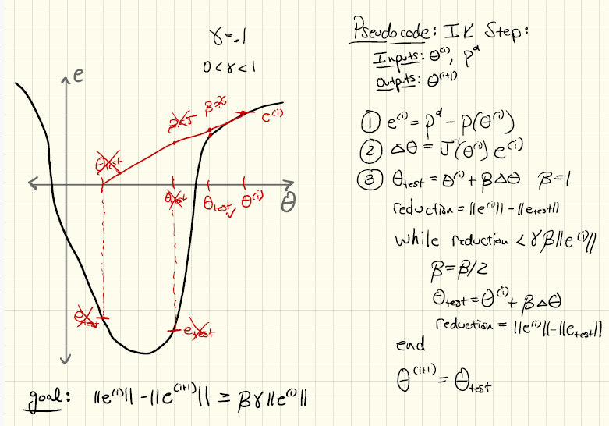
Project 1
AME 50551 – Introduction To Robotics – Patrick M. Wensing (nd.edu)

Slide 7
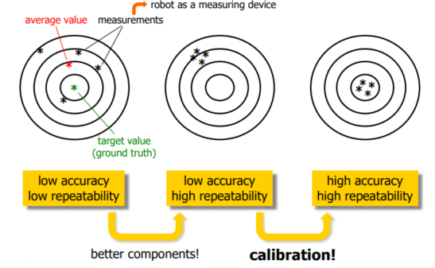
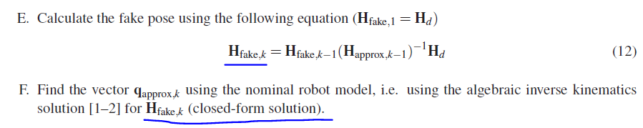
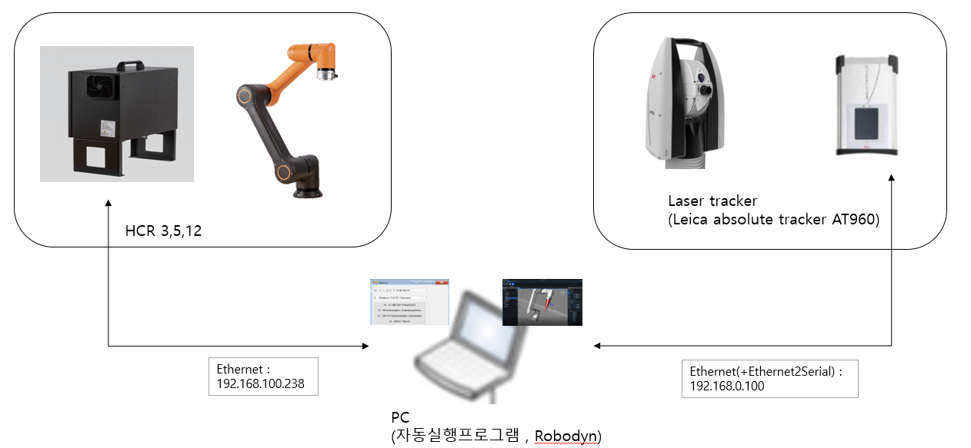



별첨. Kinematic Calibration
$∎$ Accuracy and repeatability
Course material Robotics 2 (uniroma1.it)
$∎$ Numerical inverse kinematic solution [6]
$∎$ HCR’s Improvement by kinematic calibration
Before calibration
After calibration
1.3~2.2 mm
≤ 0.4 mm

Slide 8
References
Spong, M. W., Hutchinson, S., & Vidyasagar, M. (2020). Robot modeling and control. John Wiley & Sons.
Corke, P. I., Jachimczyk, W., & Pillat, R. (2011). Robotics, vision and control: fundamental algorithms in MATLAB (Vol. 73, p. 2). Berlin: Springer.
Srinivasan, M. (2015). Mechanics and Control of Robots
Wensing, P. M. (2017). Introduction to Robotics-Lecture 20: Numerical Inverse Kinematics
De Luca, A. (2023). Robotics2Introduction to Robotics-Lecture 01: Calibration
Nubiola, A., & Bonev, I. A. (2014). Geometric approach to solving the inverse displacement problem of calibrated decoupled 6R serial robots. Transactions of the Canadian Society for Mechanical Engineering, 38(1), 31-44.

Slide 9
Thank you
Notes:
appreciate for listening
Anything else question?

