Slide 1
Robot Dynamics
Notes:
Hello Thank you for inviting me first.
I hope Hanwha and Schaeffler can help each other.
I will briefly introduce myself.
I am Bae Gang-tae, research engineer at Hanwha Precision Machinery Robot Division.
As you have seen at the last meeting in korea,
this is the leader engineer Mr lee in the algorithm part
Today we will go over what we need to worry about

Slide 2
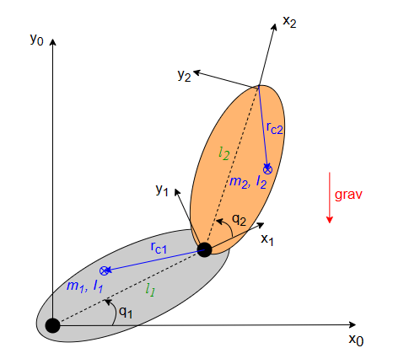


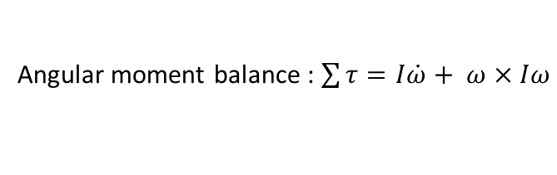
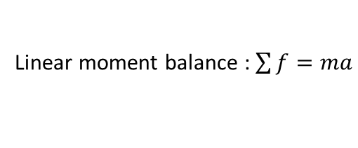
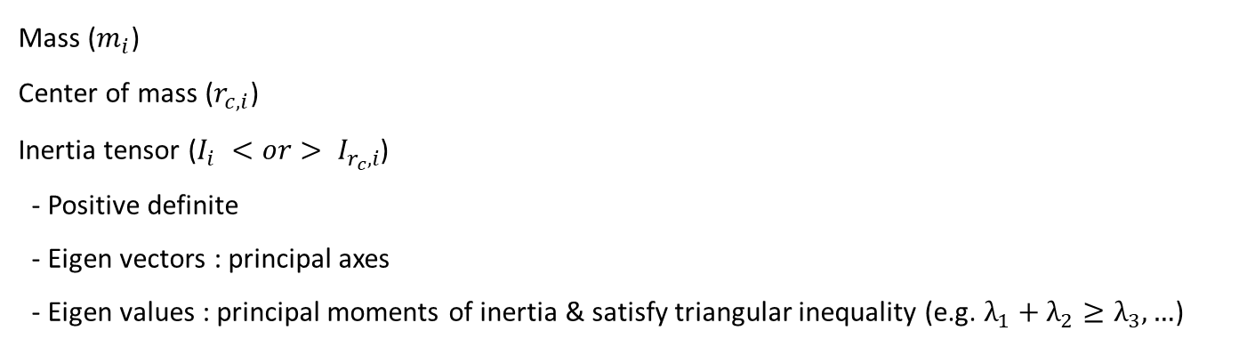


Newton Euler Method vs Lagrange Method
$∎$ Dynamic parameters of robot links for n Dofs
Mass ($m_{i}$)
Center of mass ($r_{c, i}$)
Inertia tensor ($I_{i} <or> I_{r_{c},i}$)
- Positive definite
- Eigen vectors : principal axes
- Eigen values : principal moments of inertia & satisfy triangular inequality (e.g. $λ_{1}+λ_{2}≥λ_{3}, …$)
$$i=1,⋯n$$
$∎$ Dynamic torques
Moment based method
Energy based method
Linear moment balance : $\sum{f}=ma$
Lagrangian : $L(q,\dot{q})=K(q,\dot{q})−U(q)$
kinetic energy
potential energy
Angular moment balance : $\sum{τ}=I\dot{ω}+ ω×Iω$
Euler-Lagrange equation : $τ=\frac{d}{dt}\frac{∂L}{∂\dot{q}}−\frac{∂L}{∂q}$

Slide 3




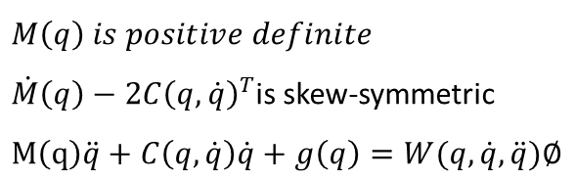

Dynamics of a Rigid Body
$∎$ Equation of motion
, where $M\left(q\right),C\left(q,\dot{q}\right)∈R^{n×n}, g∈R^{n}$
$$M\left(q\right)\ddot{q}+C\left(q,\dot{q}\right)\dot{q}+g\left(q\right)= τ$$
Inertial
terms
Coriolis
and Centrifugal terms
Gravity
terms
$∎$ Properties
$$M\left(q\right) is positive definite$$
$\dot{M}\left(q\right)−{2C\left(q,\dot{q}\right)}^{T}$is skew-symmetric
$$M\left(q\right)\ddot{q}+C\left(q,\dot{q}\right)\dot{q}+g\left(q\right)=W(q,\dot{q},\ddot{q})∅$$
, where $W\left(q,\dot{q},\ddot{q}\right)∈R^{N×p}, ∅∈R^{p}$

Slide 4
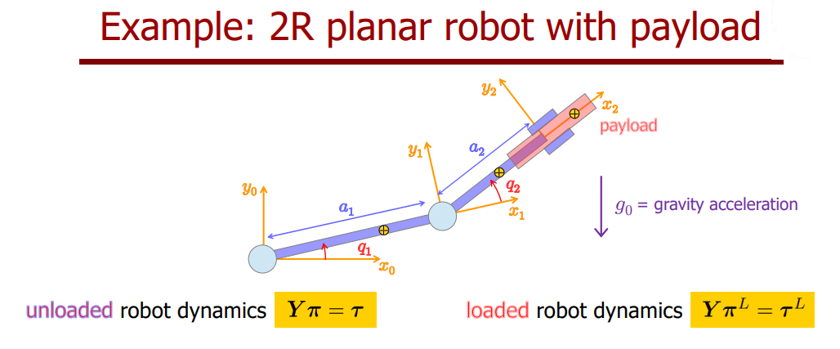
Project 2
Procedure
  Exiting trajectory for identification (position, velocity, acceleration)
  Compute the inverse dynamic torques
  Obtaining estimates of dynamic coefficients

Slide 5


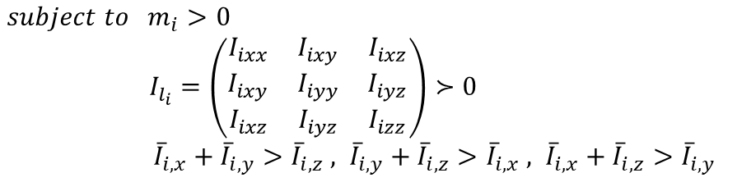


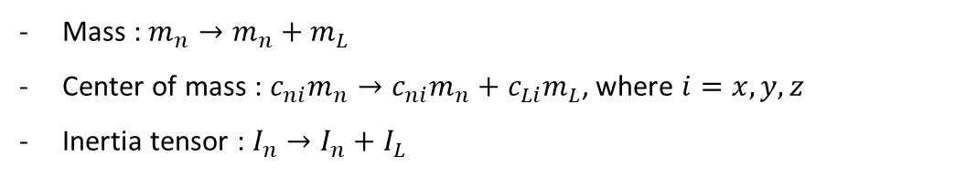
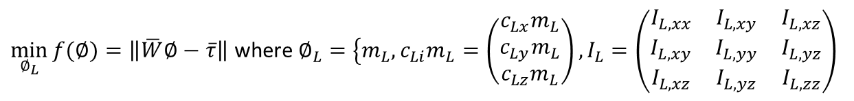
별첨. Dynamic Parameters Identification
$∎$ Linear parametrization of dynamic model ([6])
$$M\left(q\right)\ddot{q}+C\left(q,\dot{q}\right)\dot{q}+g\left(q\right)=W(q,\dot{q},\ddot{q})∅$$
$∎$ Identification of dynamic coefficients ([4])
$$\min_{∅}{f(∅)}=\left\|\overline{W}∅−\overline{τ}\right\|$$
$$subject to m_{i}>0$$
    $I_{l_{i}}=\left(\begin{matrix}I_{ixx} & I_{ixy} & I_{ixz} \\ I_{ixy} & I_{iyy} & I_{iyz} \\ I_{ixz} & I_{iyz} & I_{izz}\end{matrix}\right)≻0$
${\overline{I}}_{i,x}+{\overline{I}}_{i,y}>{\overline{I}}_{i,z} , {\overline{I}}_{i,y}+{\overline{I}}_{i,z}>{\overline{I}}_{i,x} , {\overline{I}}_{i,x}+{\overline{I}}_{i,z}>{\overline{I}}_{i,y}$
$∎$ Including an additional payload ([5])
Mass : $m_{n}→m_{n}+m_{L}$
Center of mass :$c_{ni}m_{n}→{c_{ni}m}_{n}+{c_{Li}m}_{L}$, where $i=x, y, z$
Inertia tensor : $I_{n}→I_{n}+I_{L}$
$\min_{∅_{L}}{f(∅)}=\left\|\overline{W}∅−\overline{τ}\right\|$ where $∅_{L}=\left\{m_{L}\right.,{c_{Li}m}_{L}=\left(\begin{matrix}{c_{Lx}m}_{L} \\ {c_{Ly}m}_{L} \\ {c_{Lz}m}_{L}\end{matrix}\right),I_{L}=\left(\begin{matrix}I_{L,xx} & I_{L,xy} & I_{L,xz} \\ I_{L,xy} & I_{L,yy} & I_{L,yz} \\ I_{L,xz} & I_{L,yz} & I_{L,zz}\end{matrix}\right)$

Slide 6
References
De Luca, A. (2023). Robotics2 Introduction to Robotics-Lecture 03-05: Dynamic model of robots : Lagrangian approach
De Luca, A. (2023). Robotics2 Introduction to Robotics-Lecture 05b: Linear parametrization and identification of robot dynamics
De Luca, A. (2023). Robotics2 Introduction to Robotics-Lecture 06: Dynamic model of robots : Newton-Euler approach
Gaz, C., Cognetti, M., Oliva, A., Giordano, P. R., & De Luca, A. (2019). Dynamic identification of the franka emika panda robot with retrieval of feasible parameters using penalty-based optimization. IEEE Robotics and Automation Letters, 4(4), 4147-4154.
Gaz, C., & De Luca, A. (2017, September). Payload estimation based on identified coefficients of robot dynamics—With an application to collision detection. In 2017 IEEE/RSJ International Conference on Intelligent Robots and Systems (IROS) (pp. 3033-3040). IEEE.
Gabiccini, M., Bracci, A., De Carli, D., Fredianelli, M., & Bicchi, A. (2009, September). Explicit Lagrangian formulation of the dynamic regressors for serial manipulators. In Proceedings of the XIX Aimeta Congress, Ancona, Italy (pp. 14-17).

Slide 7
Thank you
Notes:
appreciate for listening
Anything else question?

