Slide 1
Robot Force Control
Direct Control Method / Indirect Control Method
Notes:
Hello Thank you for inviting me first.
I hope Hanwha and Schaeffler can help each other.
I will briefly introduce myself.
I am Bae Gang-tae, research engineer at Hanwha Precision Machinery Robot Division.
As you have seen at the last meeting in korea,
this is the leader engineer Mr lee in the algorithm part
Today we will go over what we need to worry about

Slide 2








Robot Dynamics
$∎$ Dynamic equation
  $$M\left(q\right)\ddot{q}+C\left(q,\dot{q}\right)\dot{q}+g\left(q\right)=u− J^{T}\left(q\right)f_{c} , where q,\dot{q},\ddot{q} ∈R^{n}$$
Input torque
Contact force
$∎$ Torque-controlled robot
Motor drive
Torque controller
$$u$$
Robot
$$\int{\ddot{q}}dt$$
$$\int{\dot{q}}dt$$
$$q$$
Forward kinematics
$$p$$
$$f, τ$$
Sensor

Slide 3





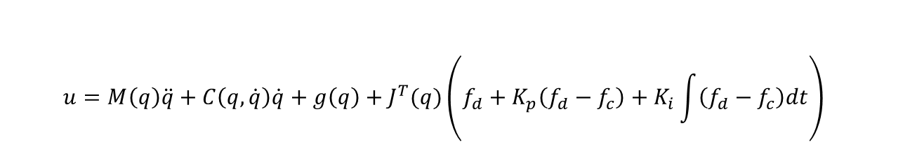
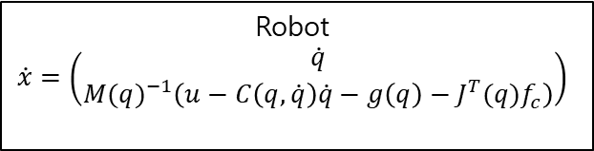


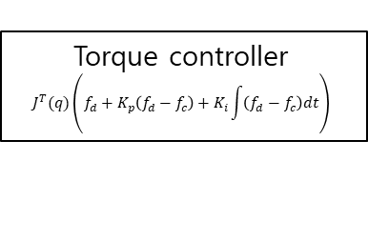


Direct Force Control
$∎$ Dynamic equation
  $$M\left(q\right)\ddot{q}+C\left(q,\dot{q}\right)\dot{q}+g\left(q\right)=u−J^{T}\left(q\right)f_{c} , where q,\dot{q},\ddot{q} ∈R^{n}$$
$∎$ Feedback linearization in the Joint space
$$u=M\left(q\right)a+C\left(q,\dot{q}\right)\dot{q}+g\left(q\right)+J^{T}\left(q\right)f_{c}→\ddot{q}=a$$
  $$u=M\left(q\right)\ddot{q}+C\left(q,\dot{q}\right)\dot{q}+g\left(q\right)+J^{T}(q)\left(f_{d}+K_{p}\left(f_{d}−f_{c}\right)+K_{i}\int{\left(f_{d}−f_{c}\right)dt}\right)$$
$∎$ Control law
  $$→ K_{p}\dot{f_{e}}+K_{i}f_{e}=0 (if K_{p}≻0 andK_{i}≻0)$$
$∎$ Block diagram
Torque controller
$$J^{T}(q)\left(f_{d}+K_{p}\left(f_{d}−f_{c}\right)+K_{i}\int{\left(f_{d}−f_{c}\right)dt}\right)$$
Robot
$$\dot{x}=\left(\begin{matrix}\dot{q} \\ {M(q)}^{−1}\left(u−C\left(q,\dot{q}\right)\dot{q}−g\left(q\right)−J^{T}(q)f_{c}\right)\end{matrix}\right)$$
$$f_{d}$$
$$u$$
$$\int{\dot{x}}dt$$
$$x$$
$$f_{c}$$
Sensor

Slide 4
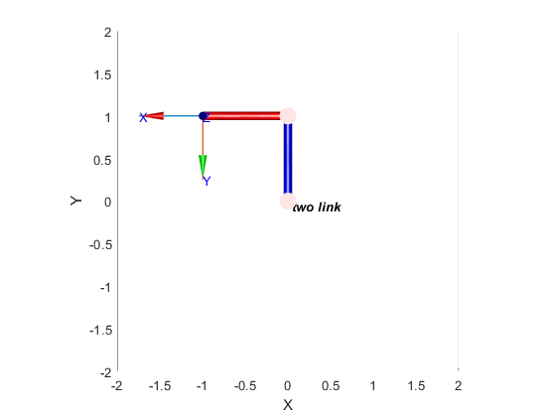
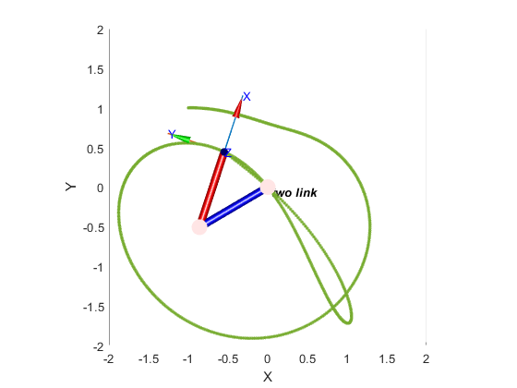
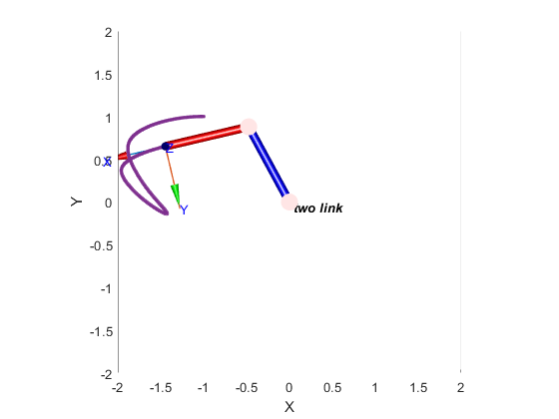

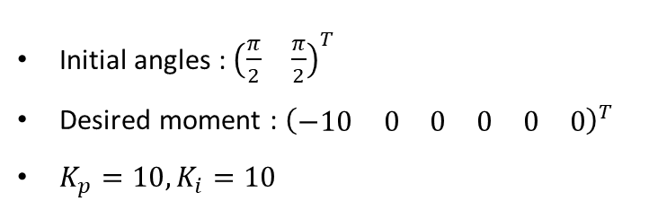
Direct Force Control
$∎$ Simulation result
Initial angles : ${\left(\begin{matrix}\frac{π}{2} & \frac{π}{2}\end{matrix}\right)}^{T}$
Desired moment : ${\left(\begin{matrix}\begin{matrix}−10 & 0 & 0\end{matrix} & \begin{matrix}0 & 0 & 0\end{matrix}\end{matrix}\right)}^{T}$
$K_{p}=10,K_{i}=10$
Jacobian in {E.E} coordinate
Jacobian in {base} coordinate

Slide 5



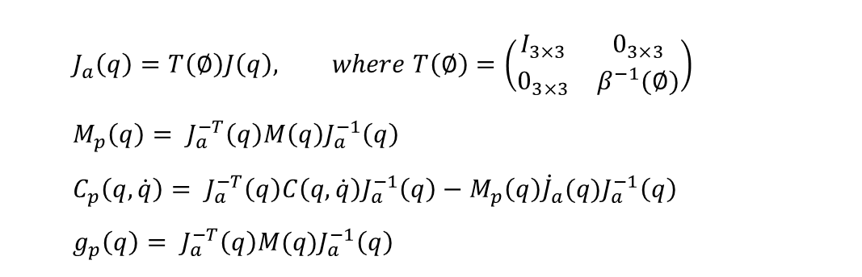
Indirect Force Control
$∎$ Cartesian space dynamic equation
  $$M_{p}\left(q\right)\ddot{p}+C_{p}\left(q,\dot{q}\right)\dot{p}+g_{p}\left(q\right)=J_{a}^{T}\left(q\right)u+f_{c} , where q,\dot{q},\ddot{q} ∈R^{n}$$
$$with$$
  $$J_{a}\left(q\right)=T\left(∅\right)J\left(q\right), where T\left(∅\right)=\left(\begin{matrix}I_{3×3} & 0_{3×3} \\ 0_{3×3} & β^{−1}(∅)\end{matrix}\right)$$
  $$M_{p}\left(q\right)= J_{a}^{−T}\left(q\right)M\left(q\right)J_{a}^{−1}\left(q\right)$$
  $$C_{p}\left(q,\dot{q}\right)= J_{a}^{−T}\left(q\right)C\left(q,\dot{q}\right)J_{a}^{−1}\left(q\right)−M_{p}\left(q\right){\dot{J}}_{a}(q)J_{a}^{−1}\left(q\right)$$
  $$g_{p}\left(q\right)= J_{a}^{−T}\left(q\right)M(q)J_{a}^{−1}\left(q\right)$$
$∎$ Feedback linearization in the Cartesian space
  $$u= J_{a}^{T}\left(q\right)\left(M_{p}\left(q\right)a+C_{p}\left(q,\dot{q}\right)\dot{p}+g_{p}\left(q\right)−f_{c}\right)→ \ddot{p}=a$$

Slide 6


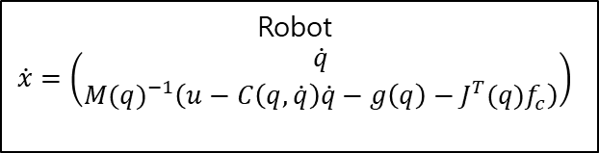

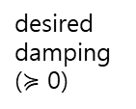







Indirect Force Control
$∎$ Control law
  $$u= J_{a}^{T}\left(q\right)\left(M_{p}\left(q\right)a+C\left(q,\dot{q}\right)\dot{p}+g_{x}\left(q\right)−f_{c}\right)$$
    $f_{c}=M_{m}\left(\ddot{p}−{\ddot{p}}_{d}\right)+D_{m}\left(\dot{p}−{\dot{p}}_{d}\right)+K_{m}(p−p_{d})$ : impedance control
desired inertia ($≻$ 0)
desired damping ($≽$ 0)
desired stiffness ($≻$ 0)
    $f_{c}=D_{m}\left(\dot{p}\right)+K_{m}\left(p−p_{d}\right)$ : compliance control (impedance control with $M_{m}=M_{p}\left(q\right),{\ddot{p}}_{d}=0,{\dot{p}}_{d}=0$)
$∎$ Block diagram
$$p_{d}$$
$${\dot{p}}_{d}$$
$${\ddot{p}}_{d}$$
Robot
$$\dot{x}=\left(\begin{matrix}\dot{q} \\ {M(q)}^{−1}\left(u−C\left(q,\dot{q}\right)\dot{q}−g\left(q\right)−J^{T}(q)f_{c}\right)\end{matrix}\right)$$
Torque controller
$$a={\ddot{p}}_{d}+M_{m}^{−1}\left(D_{m}\left(\dot{p}−{\dot{p}}_{d}\right)+K_{m}\left(p−p_{d}\right)+f_{c}\right)$$
$$J_{a}^{T}\left(q\right)\left(M_{p}\left(q\right)a+C\left(q,\dot{q}\right)\dot{p}+g_{x}\left(q\right)−f_{c}\right)$$
$$u=\ddot{p}$$
$$\int{\dot{x}}dt$$
$$x$$
$f_{c}$ <or> no contact force feedback
Sensor

Slide 7
Thank you
Notes:
appreciate for listening
Anything else question?

