Slide 1
Robot Collision Detection
Generalized-momentum-based external torque observer
Notes:
Hello Thank you for inviting me first.
I hope Hanwha and Schaeffler can help each other.
I will briefly introduce myself.
I am Bae Gang-tae, research engineer at Hanwha Precision Machinery Robot Division.
As you have seen at the last meeting in korea,
this is the leader engineer Mr lee in the algorithm part
Today we will go over what we need to worry about

Slide 2






Robot Dynamics
$∎$ Dynamic equation
  $$M\ddot{q}+C\dot{q}+g=τ+ J^{T}f_{c} , where q,\dot{q},\ddot{q} ∈R^{n}$$
External torque($τ_{c}$)
Actual torque : motor torque($τ_{m}$) – friction torque ($τ_{f}$)
$∎$ Generalized momentum
  $$p= M\dot{q}$$
$∎$ Filtered version of external torque observer
  $${\hat{τ}}_{c}=\frac{λ}{s+λ}τ_{c}$$
First order continuous time filter , where s : Laplace variable, λ : cutoff frequency
[De Luca et al., 2006, IROS]

Slide 3




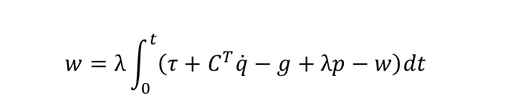



External Torque Observer in Continuous Time
  $$p= M\dot{q}$$
  $$\dot{p}= \dot{M}\dot{q}+M\ddot{q}$$
  $$M\ddot{q}=τ_{c}−C\dot{q}−g+τ$$
  $\dot{M}=C^{T}+C$ : skew symmetric
  $$\dot{p}=C^{T}\dot{q}+C\dot{q}+τ_{c}+τ−C\dot{q}−g$$
  $$τ_{c}= \dot{p}−τ−C^{T}\dot{q}+g$$
  $$τ_{c}=\frac{s+λ}{λ}{\hat{τ}}_{c}$$
  $$∴{\hat{τ}}_{c}=λp\left(t\right)−λ\int_{0}^{t}{\left(τ+C^{T}\dot{q}−g+{\hat{τ}}_{c} \right)dt}$$
  Let $w=λp−{\hat{τ}}_{c}$
  $$w=λ\int_{0}^{t}{\left(τ+C^{T}\dot{q}−g+λp−w\right)dt}$$
$$w=\frac{λ}{s+λ}\left(λp+τ+C^{T}\dot{q}−g\right)$$
  $$∴{\hat{τ}}_{c}=λp\left(t\right)−\frac{λ}{s+λ}\left(λp+τ+C^{T}\dot{q}−g\right)$$
[Bledt et al., 2018, ICRA]

Slide 4


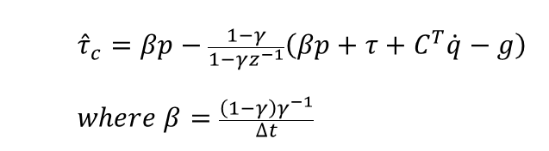




External Torque Observer in Discrete Time
  $$τ_{c}=M\ddot{q}+C\dot{q}+g−τ$$
Continuous time external torque observer : First order low pass filter
  $${\hat{τ}}_{c}=\frac{λ}{s+λ}τ_{c}$$
Apply discrete time filter
  $$\frac{1−γ}{1−γz^{−1}}$$
  $${\hat{τ}}_{c}=λp\left(t\right)−\frac{λ}{s+λ}\left(λp+τ+C^{T}\dot{q}−g\right)$$
Convert filter to discrete time
(S domain to Z domain)
  $$γ=e^{−λ∆t}$$
  $${\hat{τ}}_{c}=λp−\frac{1−γ}{1−γz^{−1}}\left(λp+τ+C^{T}\dot{q}−g\right)$$
  $${\hat{τ}}_{c}=βp−\frac{1−γ}{1−γz^{−1}}\left(βp+τ+C^{T}\dot{q}−g\right)$$
  $$where β=\frac{\left(1−γ\right)γ^{−1}}{∆t}$$
[Bledt et al., 2018, ICRA]

Slide 5
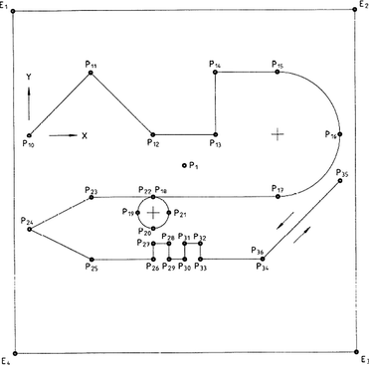
Experimental Result
$∎$ HCR5 ISO test with maximum velocity 100, maximum acceleration 2500 :

Slide 6
Experimental Result
$∎$ HCR5 ISO test with maximum velocity 1000, maximum acceleration 2500 :

Slide 7


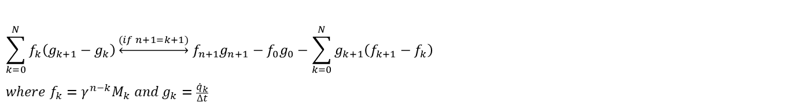


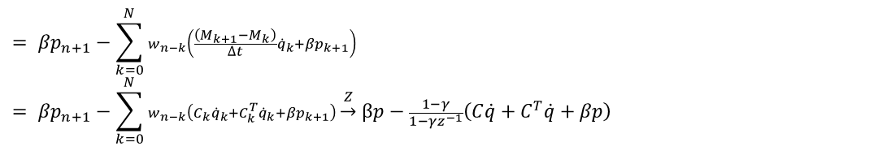
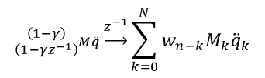
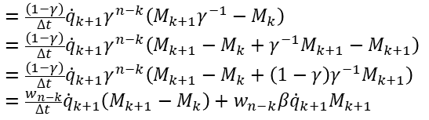


별첨
  Derive $β=\frac{\left(1−γ\right)γ^{−1}}{∆t}$
$$\sum_{k=0}^{N}{f_{k}\left(g_{k+1}−g_{k}\right)}\underset{↔}{(if n+1=k+1)} f_{n+1}g_{n+1}−f_{0}g_{0}−\sum_{k=0}^{N}{g_{k+1}\left(f_{k+1}−f_{k}\right)}$$
$$where f_{k}=γ^{n−k}M_{k} and g_{k}=\frac{{\dot{q}}_{k}}{∆t}$$
$$Let w_{k}={\left(1−γ\right)γ}^{k}$$
$$\frac{\left(1−γ\right)}{\left(1−γz^{−1}\right)}M\ddot{q}\underset{→}{z^{−1}}\sum_{k=0}^{N}{w_{n−k}M_{k}{\ddot{q}}_{k}}$$
$$\sum_{k=0}^{N}{\left(1−γ\right)r^{n−k}M_{k}\frac{{\dot{q}}_{k+1}−{\dot{q}}_{k}}{∆t}}= \frac{\left(1−γ\right)γ^{−1}}{∆t}M_{n+1}{\dot{q}}_{n+1}−\frac{\left(1−γ\right)γ^{n}}{∆t}M_{0}{\dot{q}}_{0}−\sum_{k=0}^{N}{\frac{\left(1−γ\right)}{∆t}{\dot{q}}_{k+1}\left(γ^{n−k−1}M_{k+1}−γ^{n−k}M_{k}\right)}$$
$$≜β$$
$$=p$$
$=0(if {\dot{q}}_{0}=0)$
$$=\frac{\left(1−γ\right)}{∆t}{\dot{q}}_{k+1}γ^{n−k}\left(M_{k+1}γ^{−1}−M_{k}\right)$$
$$=\frac{\left(1−γ\right)}{∆t}{\dot{q}}_{k+1}γ^{n−k}\left(M_{k+1}−M_{k}+γ^{−1}M_{k+1}−M_{k+1}\right)$$
$$=\frac{\left(1−γ\right)}{∆t}{\dot{q}}_{k+1}γ^{n−k}\left(M_{k+1}−M_{k}+{\left(1−γ\right)γ}^{−1}M_{k+1}\right)$$
$$=\frac{w_{n−k}}{∆t}{\dot{q}}_{k+1}\left(M_{k+1}−M_{k}\right)+w_{n−k}β{\dot{q}}_{k+1}M_{k+1}$$
$$= βp_{n+1}−\sum_{k=0}^{N}{w_{n−k}\left(\frac{\left(M_{k+1}−M_{k}\right)}{∆t}{\dot{q}}_{k}+βp_{k+1}\right)}$$
$$= βp_{n+1}−\sum_{k=0}^{N}{w_{n−k}\left(C_{k}{\dot{q}}_{k}+C_{k}^{T}{\dot{q}}_{k}+βp_{k+1}\right)}\underset{→}{ Z } βp−\frac{1−γ}{1−γz^{−1}}\left(C\dot{q}+C^{T}\dot{q}+βp\right)$$
$$∴{\hat{τ}}_{c}=\frac{\left(1−γ\right)}{\left(1−γz^{−1}\right)}τ_{c }=\frac{\left(1−γ\right)}{\left(1−γz^{−1}\right)}\left(M\ddot{q}+C\dot{q}+g−τ\right)=βp−\frac{1−γ}{1−γz^{−1}}\left(C\dot{q}+C^{T}\dot{q}+βp\right)+\frac{1−γ}{1−γz^{−1}}\left(C\dot{q}+g−τ\right)$$
$$=βp−\frac{1−γ}{1−γz^{−1}}\left(βp+τ+C^{T}\dot{q}−g\right)$$

Slide 8
References
De Luca, A. Albu-Schaffer, S. Haddadin and G. Hirzinger, "Collision Detection and Safe Reaction with the DLR-III Lightweight Manipulator Arm," 2006 IEEE/RSJ International Conference on Intelligent Robots and Systems, Beijing, China, 2006, pp. 1623-1630, doi: 10.1109/IROS.2006.282053.
G. Bledt, P. M. Wensing, S. Ingersoll and S. Kim, "Contact Model Fusion for Event-Based Locomotion in Unstructured Terrains," 2018 IEEE International Conference on Robotics and Automation (ICRA), Brisbane, QLD, Australia, 2018, pp. 4399-4406, doi: 10.1109/ICRA.2018.8460904.

Slide 9
Thank you
Notes:
appreciate for listening
Anything else question?

