Slide 1
An introduction to Event Sourcing
Steve Hocking

Slide 2
Don’t take notes!
http://bit.ly/2SIk3CF

Slide 3
What are events?
Micro level events:
The mouse was moved
A key was pressed
The screen was touched
Macro level events:
An order was placed
A user modified something
A new blog post was posted
In Event Driven Architectures and Event Sourcing we are interested in the macro level events

Slide 4
What is Event Sourcing?
Used in Event Driven Architectures
Requires persistence of all events to durable storage
The event store is the Single Source of Truth for the system

Slide 5
Temporal Queries
An example: Look for all the events in Twitter where somebody mentions Starbucks, coffee and happy within five minutes of each other.

Slide 6
Demo!

Slide 7
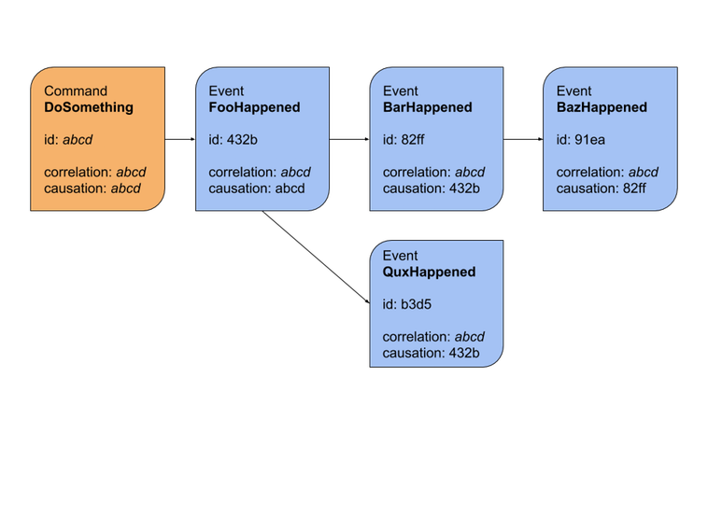
Debugging – So many Id’s
https://blog.arkency.com/correlation-id-and-causation-id-in-evented-systems/

Slide 8
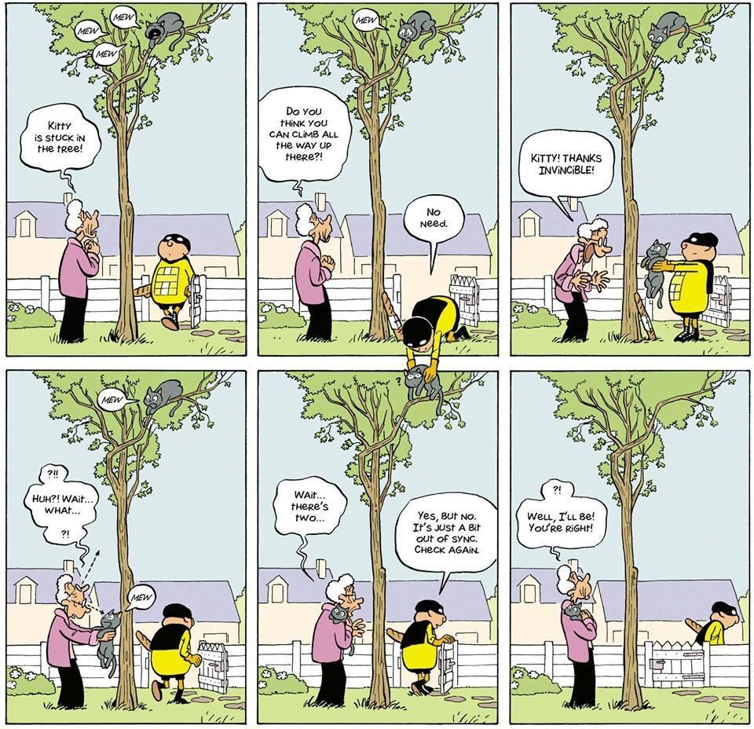
Eventual Consistency
https://twitter.com/mykola/status/1101337299525267457
https://twitter.com/skaalf/status/1101385421769060353

Slide 9
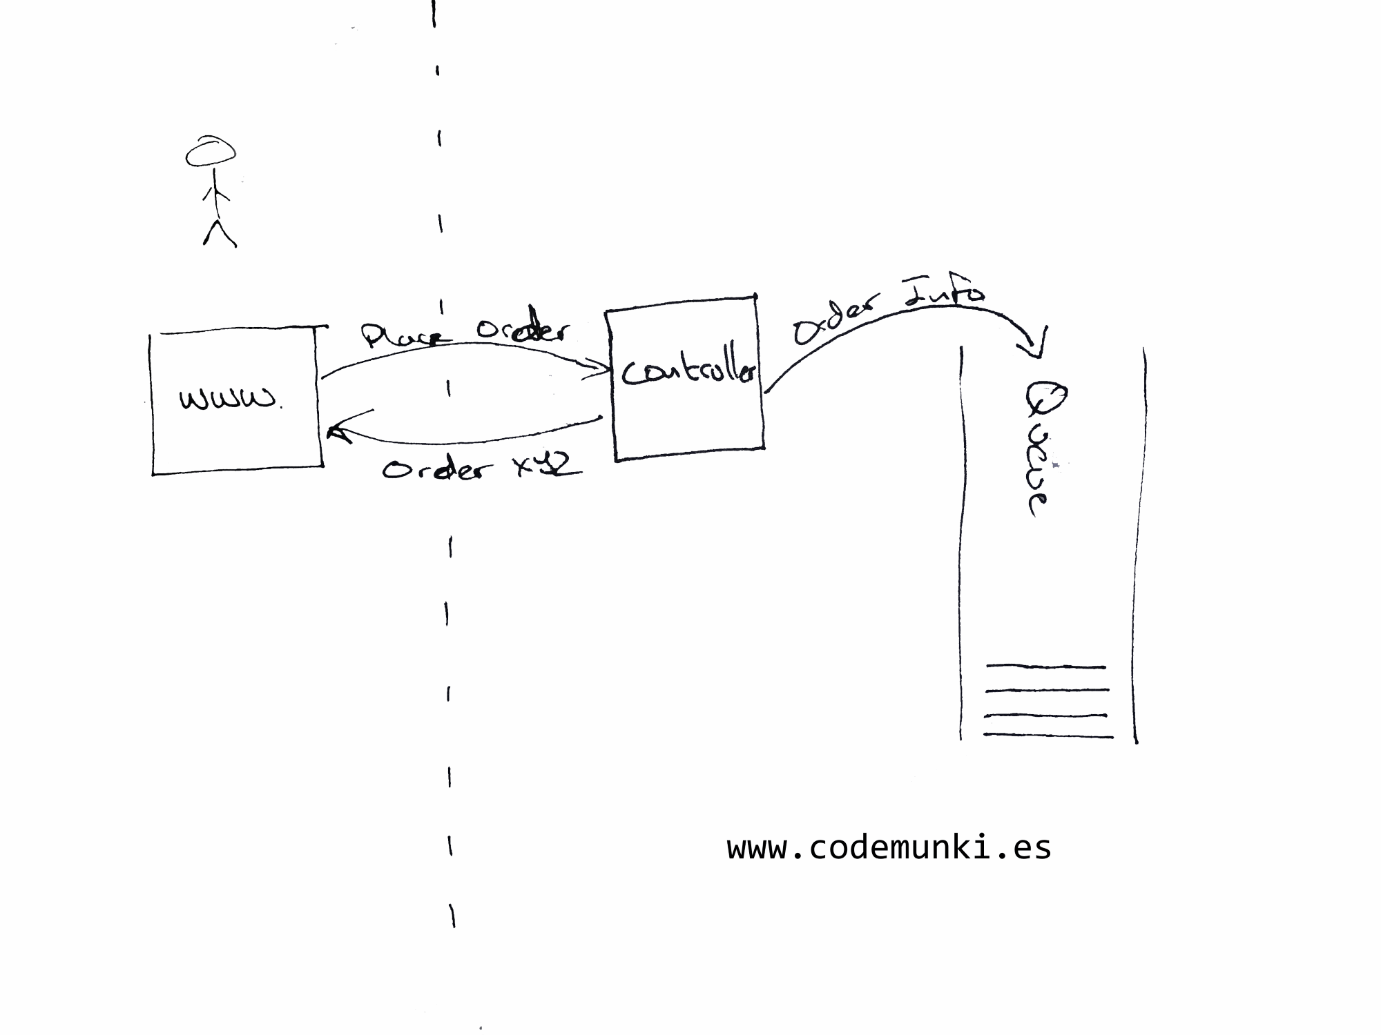
Eventual Consistency

Slide 10
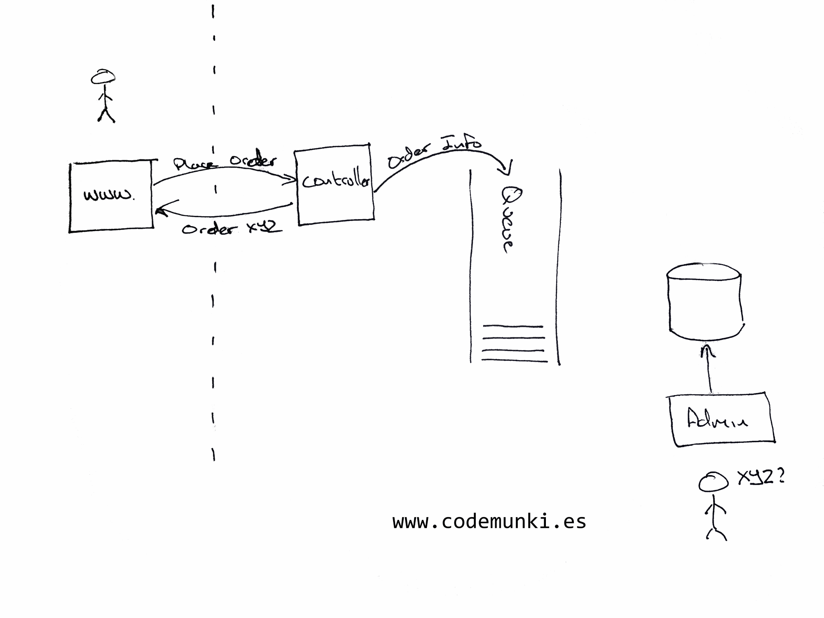
Eventual Consistency

Slide 11
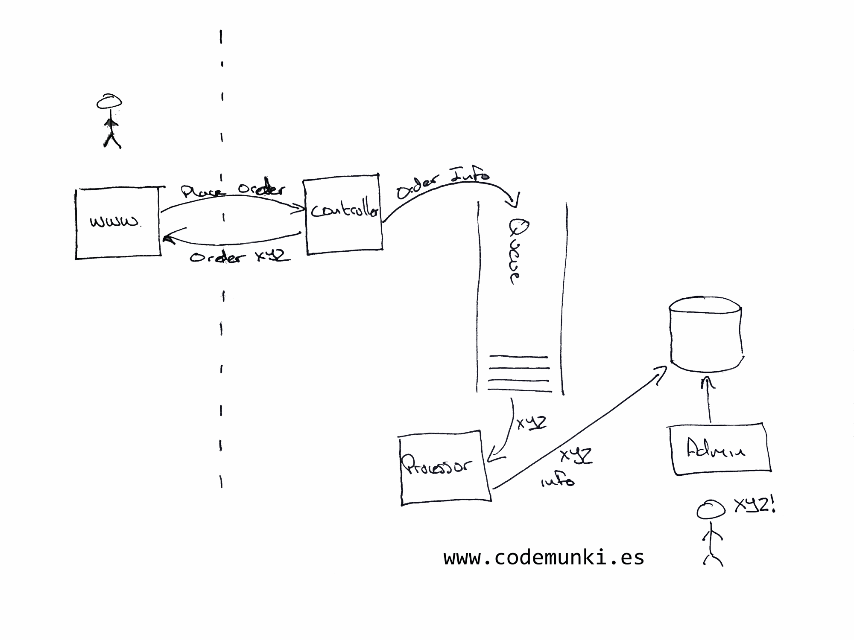
Eventual Consistency

Slide 12
A couple of things to consider
Debugging
Why did this happen?
What caused this?
Eventual consistency
What is it?

