Slide 1
An introduction to Event Sourcing
Steve Hocking

Slide 2
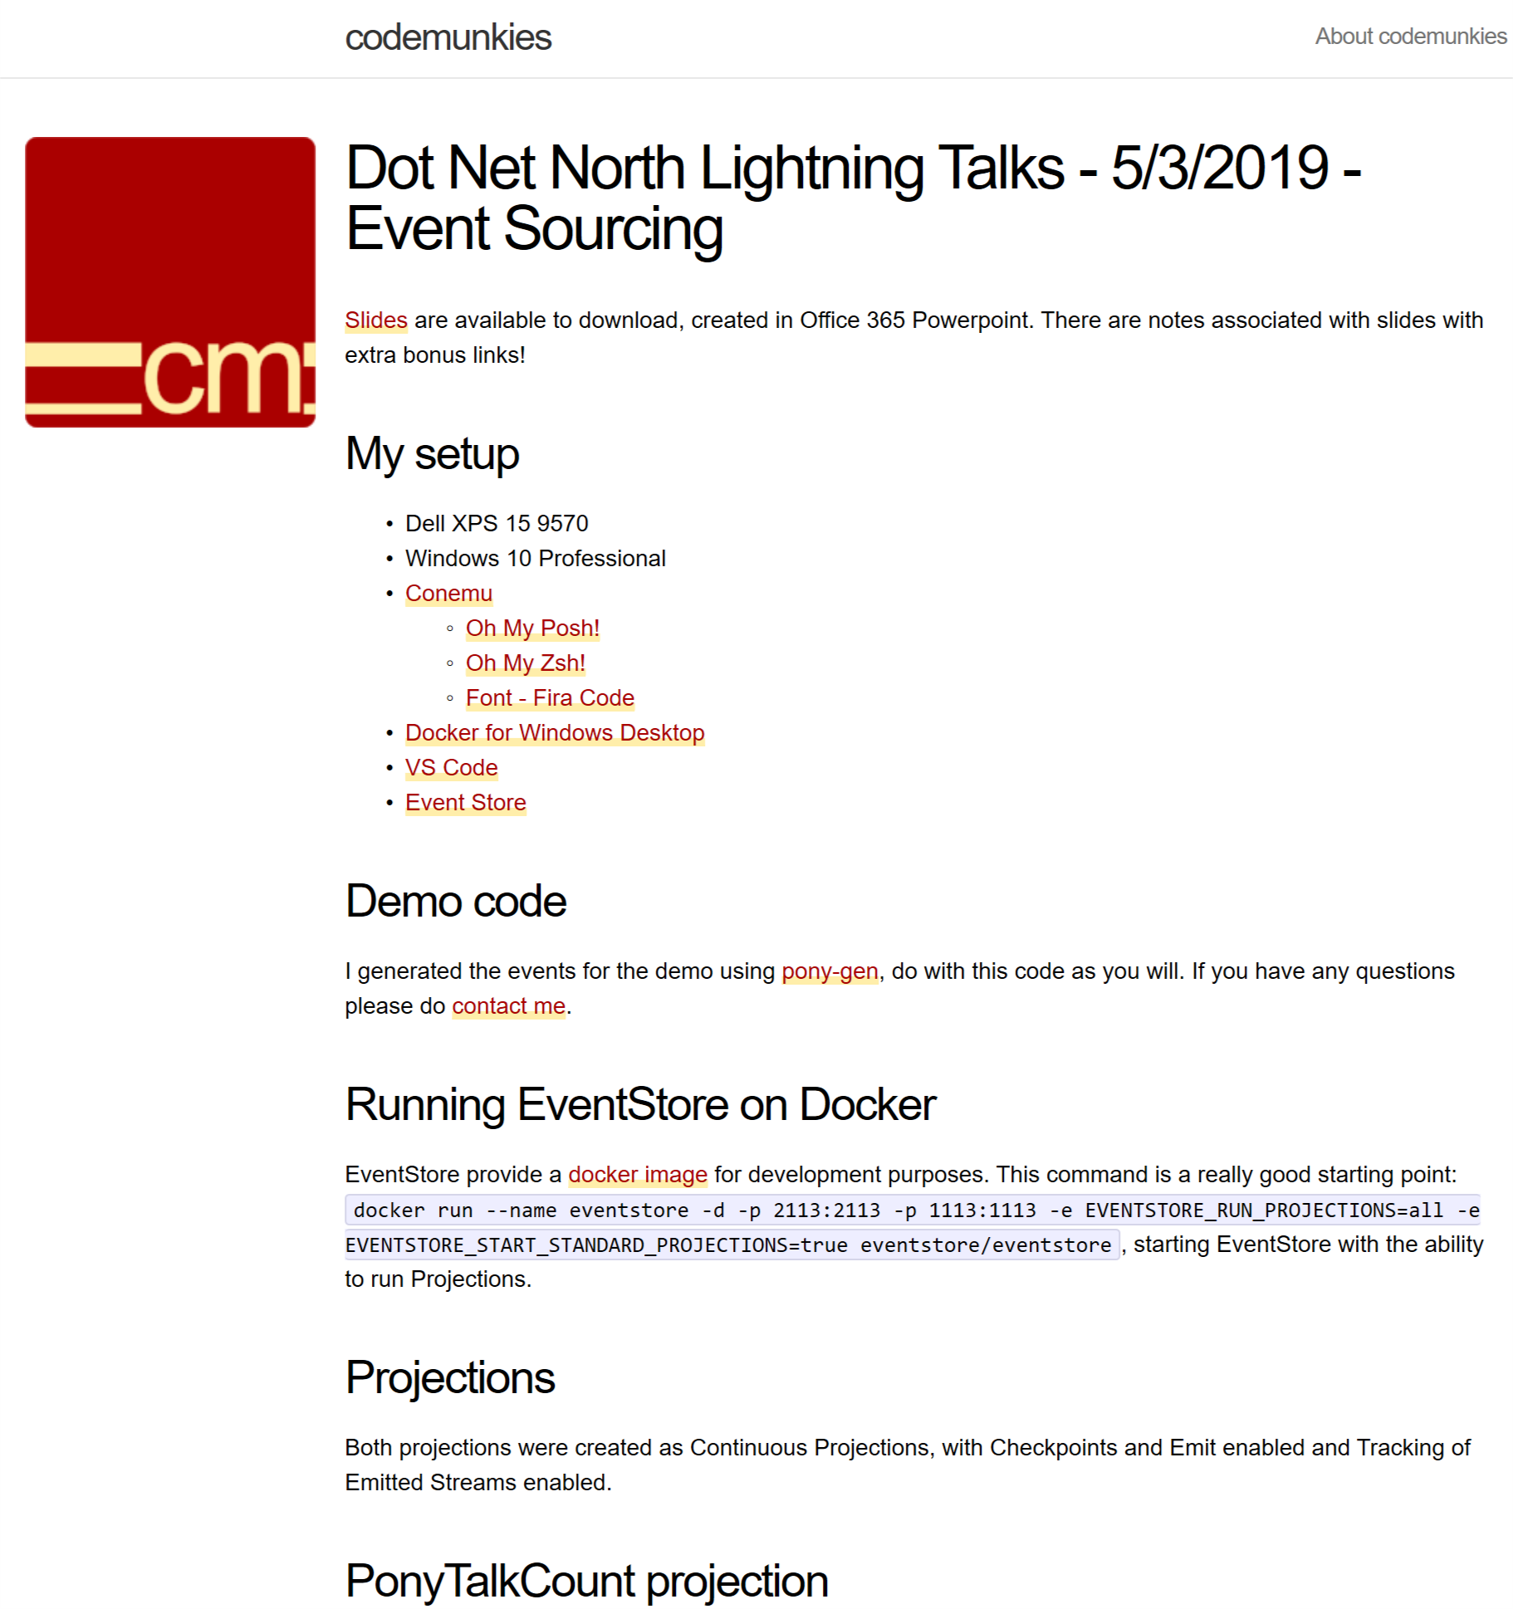
Don’t take notes!
http://bit.ly/dnn-sh-es

Slide 3
What are events?
Micro level events:
The mouse was moved
A key was pressed
The screen was touched
Macro level events:
An order was placed
A user modified something
A new blog post was posted
In Event Driven Architectures and Event Sourcing we are interested in the macro level events

Slide 4
What is Event Sourcing?
Used in Event Driven Architectures
Requires persistence of all events to durable storage
The event store is the Single Source of Truth for the system
Notes:
Durable storage could be:
Disk
A document database
An RDBMS
Anything that allows you to retrieve the data and metadata of the event to replay the message into your system
Being the Single Source of Truth for a system means that any other data stores that are used by the system should be reconstructable from the events in the system. E.g. a searchable database of customers can be constructed from a stream of account manipulation events.

Slide 5
Temporal Queries
An example: Look for all the events in Twitter where somebody mentions Starbucks, coffee and happy within five minutes of each other.
Notes:
Temporal queries should be answerable however the event sourcing is done, Event Store is particularly adept.

Slide 6
Demo!

Slide 7
The immutability of events
Events are immutable
You will probably need an Anti-Corruption Layer (ACL)
https://docs.microsoft.com/en-us/azure/architecture/patterns/anti-corruption-layer
Notes:
Because events are immutable this means that if there is a problem or an error then a correcting event is raised. It should not be possible to modify an event once it has be raised.
This also means that your system needs to be able to deal with malformed events gracefully, the Azure docs (linked) have a really good description.

Slide 8
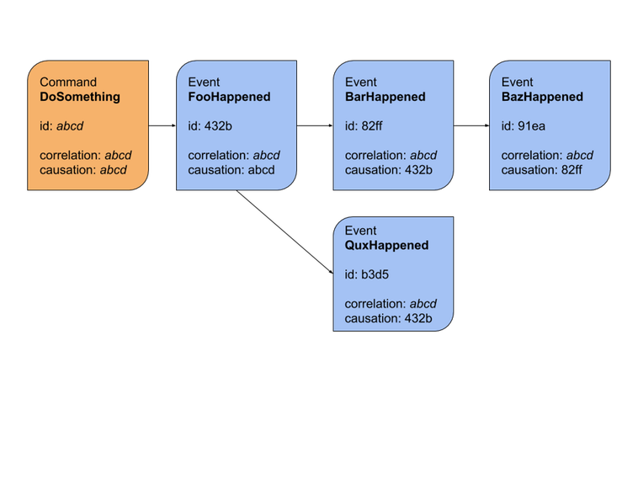
Debugging – So many Id’s
https://blog.arkency.com/correlation-id-and-causation-id-in-evented-systems/
Notes:
Correlation: The set of events that were raised
Causation: What caused a specific event to be raised
Consider using the Empty Guid where the cause is unknown.
Consider using a special list of well known Guids for user actions that trigger events.

Slide 9
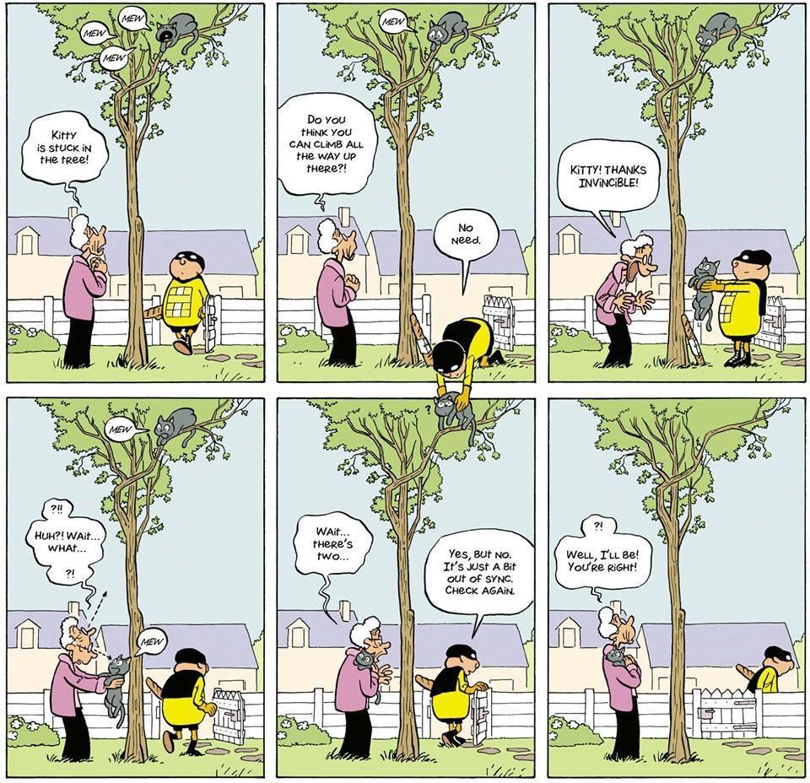
Eventual Consistency
Notes:
Comic sourced from:
https://twitter.com/mykola/status/1101337299525267457
https://twitter.com/skaalf/status/1101385421769060353

Slide 10
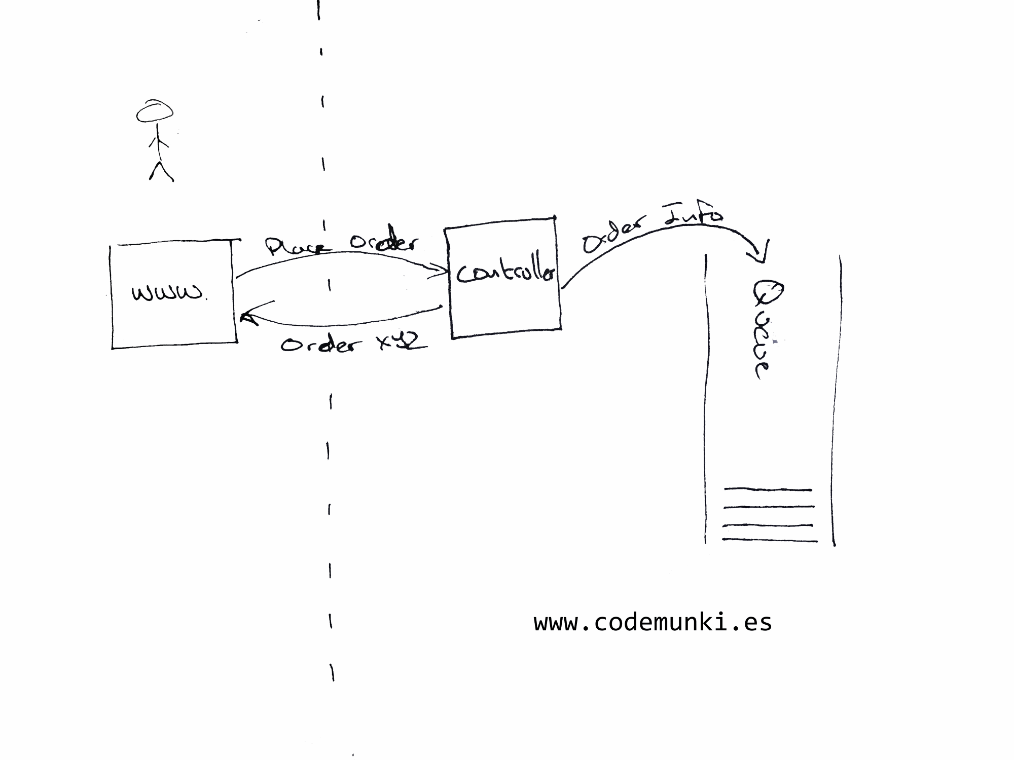
Eventual Consistency
Notes:
The order Id needs to be human readable, and shouldn’t necessarily be used as the id for any event, consider using a Ticket Server: http://code.flickr.net/2010/02/08/ticket-servers-distributed-unique-primary-keys-on-the-cheap/

Slide 11
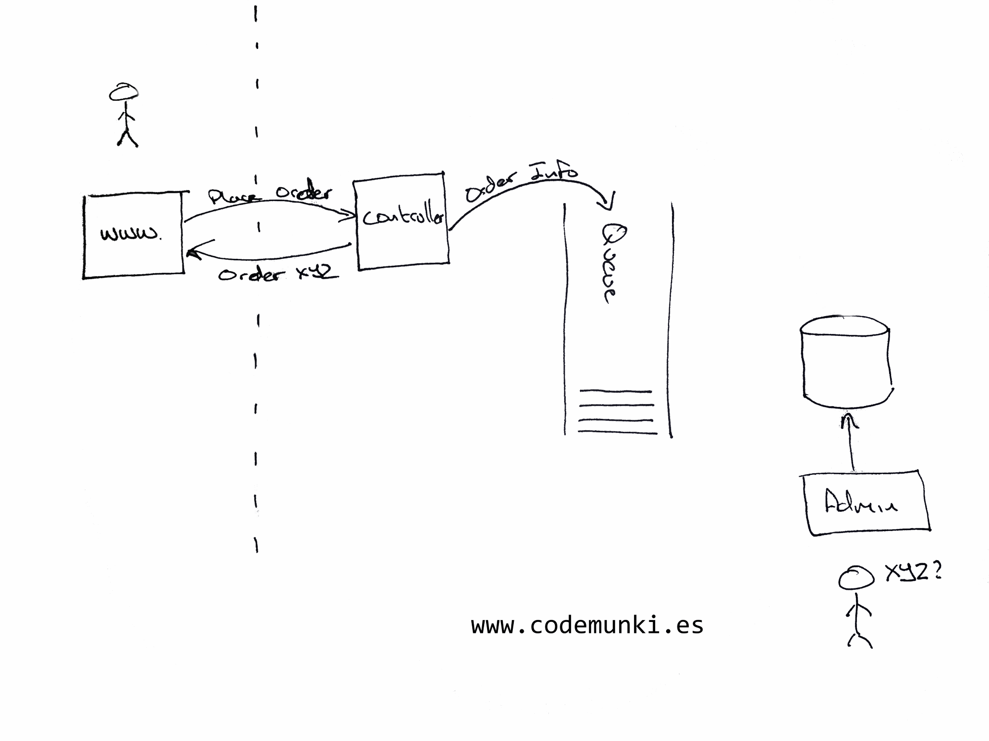
Eventual Consistency

Slide 12
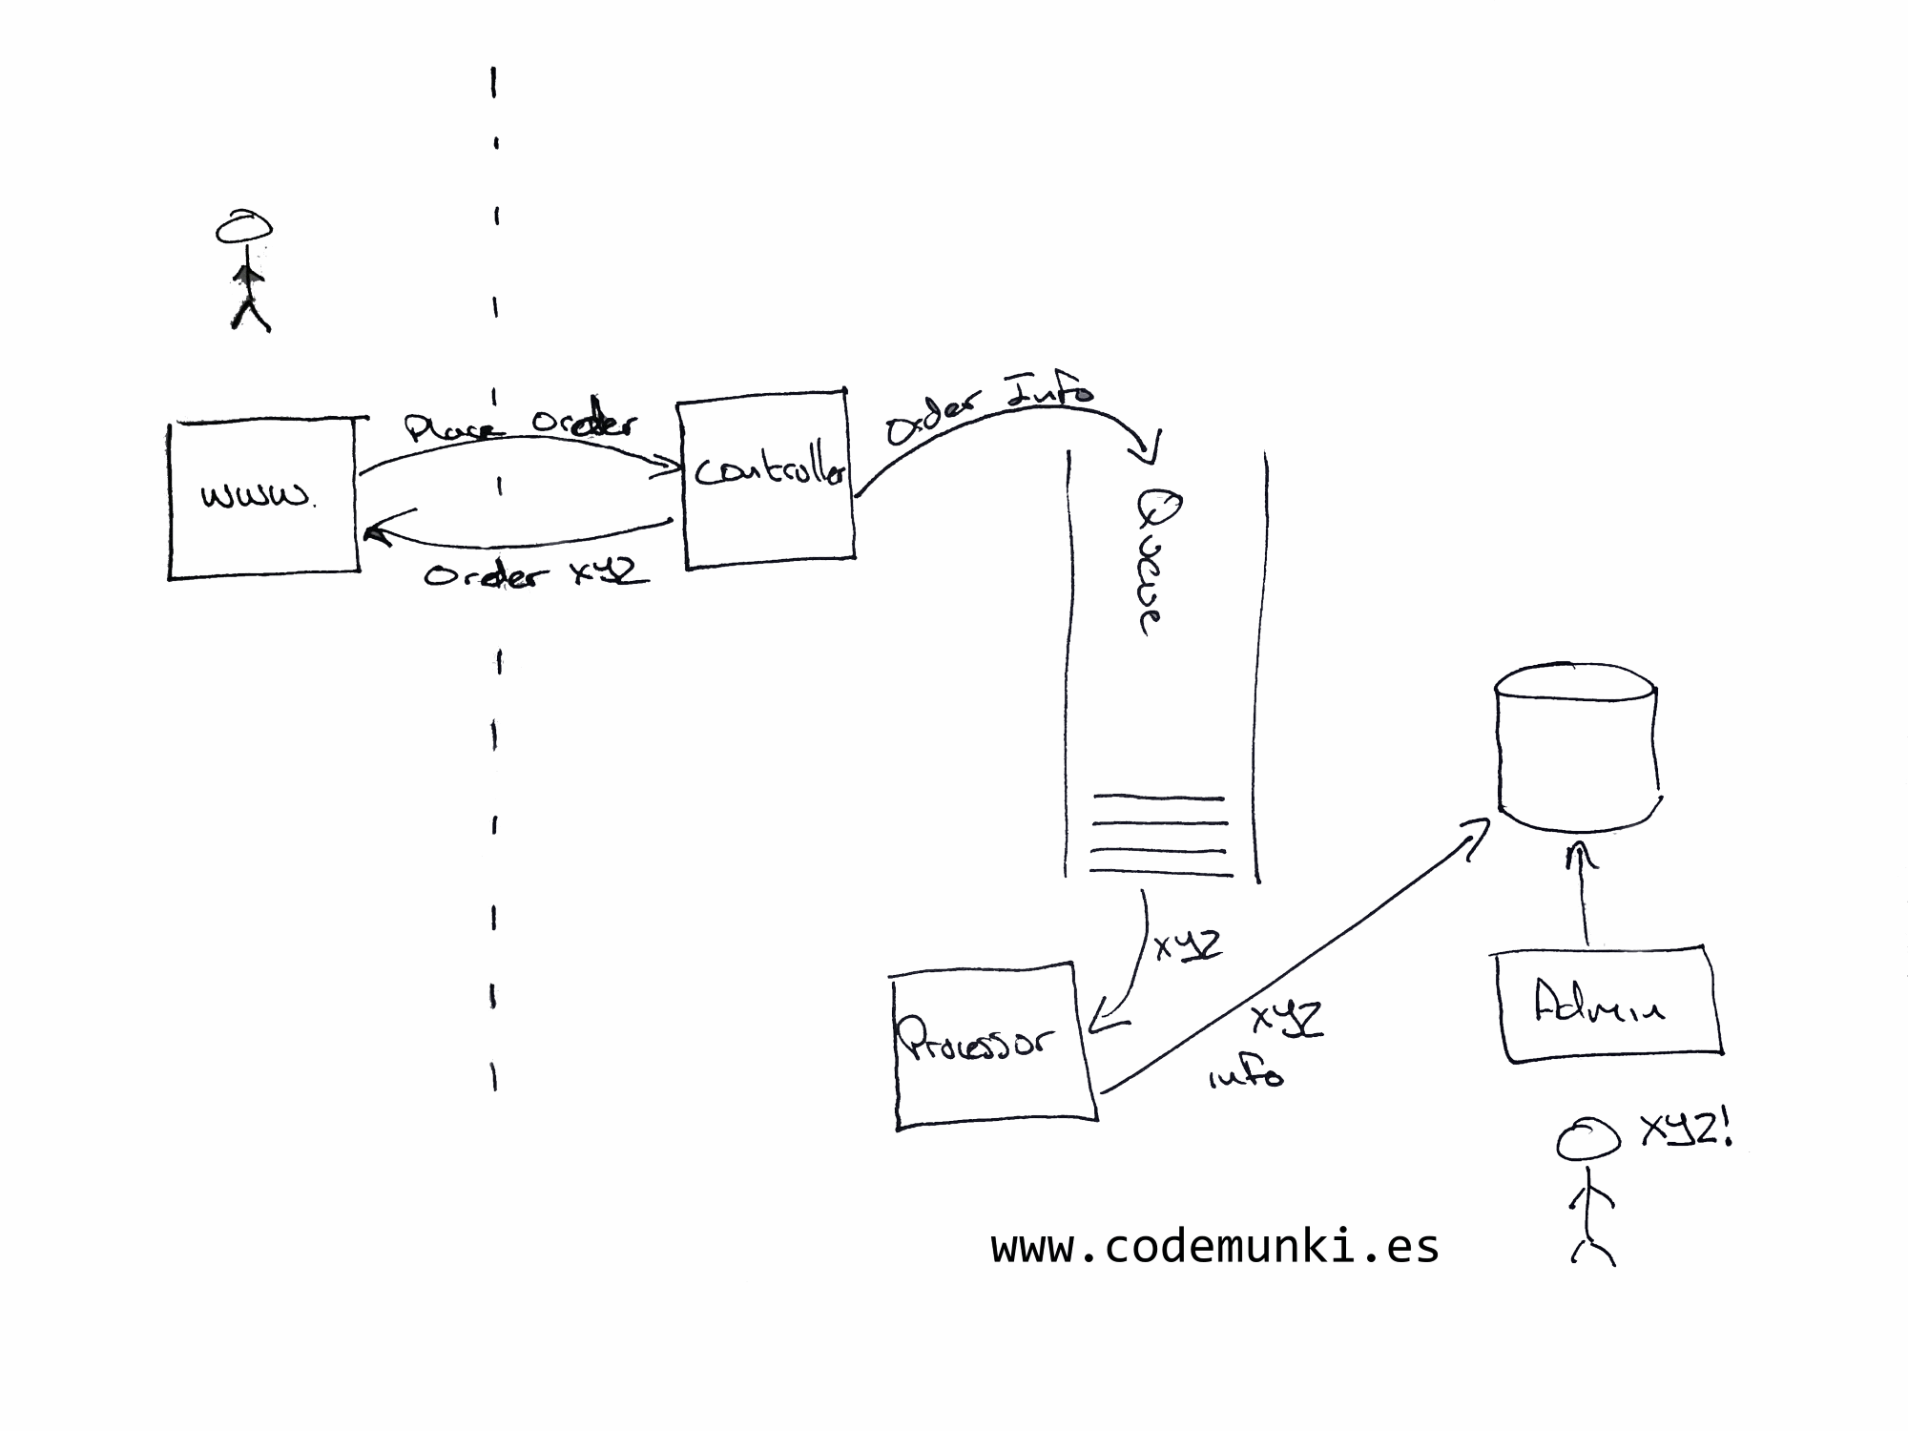
Eventual Consistency

Slide 13
So many things not talked about
Domain Driven Design
CQRS
Aggregates
Should you be looking to event source everything
(Spoiler! Maybe not…)

