Slide 1
Instructor Training Met Office
November 24-25 2016
Steve Crouch, Greg Wilson
s.crouch@software.ac.uk, gvwilson@software-carpentry.org

Slide 2
Background
Software & Data Carpentry
Volunteer researchers, educators, and more
Develop lessons, teach 2-day workshops
Basic computing and data skills for researchers
Emphasising best practice
What will we do here?
Skills for teaching, emphasise best practice
Show evidence and overall SWC/DC philosophy
Applicable across all lessons

Slide 3
What happens afterwards?
We won’t cover workshop content in detail
You get to do this after this course!
Instructor Training ‘checkout procedure’
For a SWC/DC lesson: submit a change request to fix issue or suggest improvement, provide feedback on issue or pull request
Participate in hour-long group discussion of lesson
Demonstrate live coding in group session

Slide 4
Basic Format
Etherpad for questions!
http://bit.ly/ITMet2016
Add your name in top right input box
Add your name, email, GitHub, Twitter in list
Ask questions in ‘Chat’ on the right
For each lesson
Some theory of learning, or tool for teaching
Hands-on exercises and discussion
Sticky notes!
If you would prefer not to be photographed, please let us know!

Slide 5
Agenda
09:00 Welcome
09:10 Introduction
09:40 Novices and Formative Assessment
10:40 Morning coffee
10:55 Teaching as a Performance Art
11:55 Morning Wrap-up
12:10 Lunch
13:10 Expertise and Memory (Greg)
14:25 Afternoon coffee
14:40 Performance Revised
15:25 Cognitive Load (Greg)
16:05 Afternoon Wrap-up
16:20 Finish
09:00 Live Coding
10:15 Morning coffee
10:30 The Carpentries
11:30 Carpentry Teaching Practices
12:00 Morning Wrap-up
12:15 Lunch
13:15 Motivation and Demotivation
14:00 Lessons and Objectives (Greg)
15:00 Afternoon coffee
15:15 Afternoon Wrap-up
16:00 Finish
NB: subject to change!
Notes:
Novices and FA: nature of the novice and how to assess if learning is taking place
Teaching as a PA: how teachers improve, recording yourselves and getting feedback
Expertise and memory: how learning takes place, how to develop concept maps for things you want to teach
Performance Revised: another go at recording yourselves, using a concept map
Cognitive Load: how people learn, remember and apply information, limits
Live coding: core practice of SWC/DC – how to do it, then do it yourselves!
Carpentries/Carpenty TPs: operational practices of a workshop, approach benefits, prep
Motivation and Demotivation: what affects learners and instructors during teaching?
Lessons and Objectives: how to think about and structure lessons

Slide 6
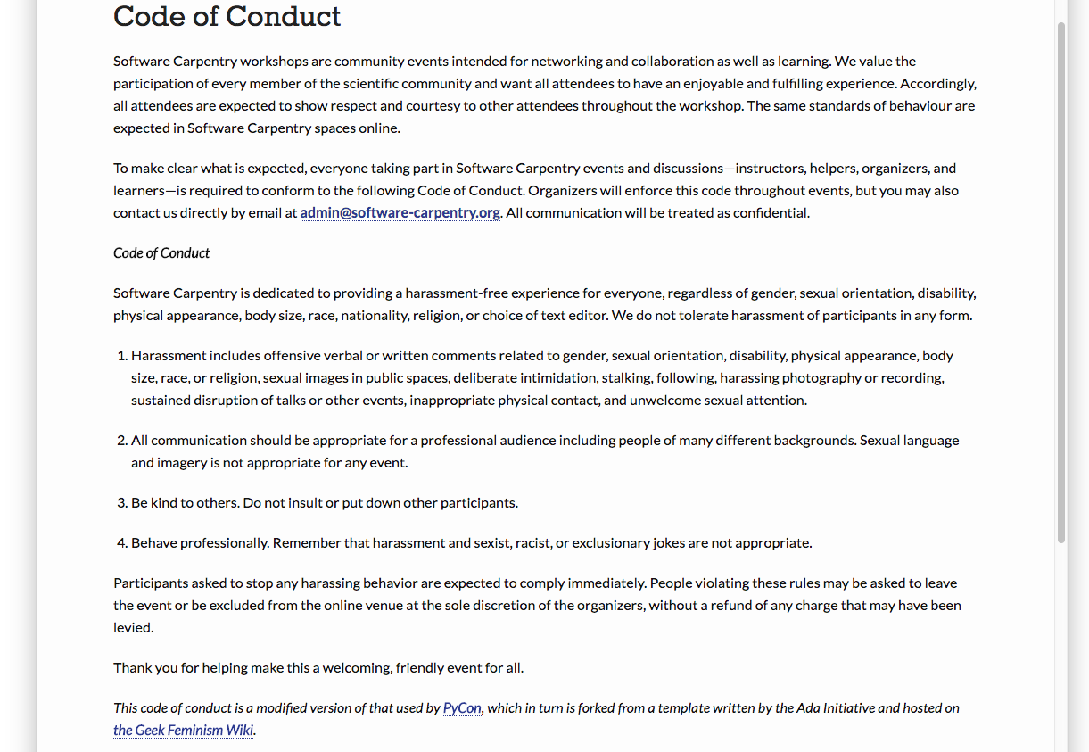
Code of Conduct
http://software-carpentry.org/conduct/
Notes:
Don’t harass people
Communicate appropriately
Be polite
Be a professional

Slide 7
So what’s behind it all?
Notes:
Some important terms that underpin this training material.
Essentially, a kind of ethos for how we approach developing and delivering training

Slide 8
Educational Psychology
The study of how people learn
Two perspectives:
Situated learning – where learning and application occur in the same social context
Essentially, our learners
From a novice to contributing community member
Legitimate peripheral practice
Cognitivism – neuropsychology
The low-level mechanics
WHY we teach
HOW we teach
Notes:
Situated learning:
- Learners explore data and programming on their own
- Bring them into a community of others doing the same (by attending a workshop)
- Show them best practice and ideas within that community of practice
- Can then become members of that community

Slide 9
Instructional Design
But, we need to apply educational psychology
Conceptually, EP is too large!
Need to try out methods in actual classes
Assess those methods
Apply through Instructional Design
Educational Psychology is the science
Instructional Design is the engineering

Slide 10
Pedagogical Content Knowledge
Can only teach what we know…
The ‘what’ – the things we teach
e.g. function parameters
e.g. what examples to use when teaching how parameters are passed to a function
Understanding of psychology of learning
Notes:
Can divide what teachers know into…
Training course focuses on PCK.
We’ll see PCK in action tomorrow when looking at workshop operations

Slide 11
Books
How learning Works: 7 Research-Based Principles for Smart Teaching
Ambrose, Bridges, DiPietro, Lovett, Norman
Building a Better Teacher: How Teaching Works (And how to teach it to everyone)
Elizabeth Green

