Slide 1
Carpentry Teaching Practices
Notes:
Teaching is a performance art, no different than drama, music, athletics.
As in those fields, we have a collection of small tips and tricks.
These are common to both Software and Data Carpentry.

Slide 2
Challenges
Diversity of backgrounds and skills
Regardless of content or pace, perhaps…
20% of room lost
20% of room bored
… if you manage that, you’re doing well!
Split class by skill level?
Dunning-Kruger effect
Instead ask specific questions in pre-assessment
Notes:
Dunning-Kruger: the less people know about a subject, the less accurate their estimate of their knowledge is.
Pre-assessment: goes some way, but
- Haven’t done laborious work of validating questions
- Haven’t followed-up questionnaires’ categorisation matches learner’s in-class proficiency

Slide 3
Things we Can Do!
Communicate skill level clearly before workshop
Provide multiple exercises for advanced learners
Ask advanced learners to help people next to them
Get non-teaching instructor and helpers to monitor for problems, intervene early
No class can ever meet everyone’s individual needs!
Notes:
Ask advanced learners: they often enjoy this anyway, get to show off what they know!
Instructor slows down to help two struggling learners – 38 not well served.
Instructor discusses advanced topic to two bored learners – 38 won’t understand it and will feel left out.

Slide 4
Other Practices
Sticky notes on laptop lid
Green: ok, finished exercise, Red: I have a problem!
Discreet, can keep working, instructor can quickly check state of class
Minute cards, use sticky notes
Green: one positive, Red: one negative, a question
One up, one down
At end of each day
Go round class, ask for alternate positive/negative points without repeating
Minute cards anonymous, one-up-one-down is not
Each has strengths & weaknesses
Notes:
These are genuinely very useful!!!

Slide 5
Other Practices
Learners use their own machines
Learners like machine to be set up for real work
VMs don’t really work
Collaborative note-taking
Use of Etherpad, good for sharing code and data
Bit of a winner with learners!
More advanced learners can answer questions
Scanning Etherpad good way to discover issues

Slide 6
Other Practices
Pair programming
Good practice in real life too!
For assistance, clarifying misconceptions
Strongly prefer flat vs. theatre-style seating
Peak rule
People judge experience on most intense point, and at end
So finish on a high note!
Instructor notes
Many lesson materials have them

Slide 7
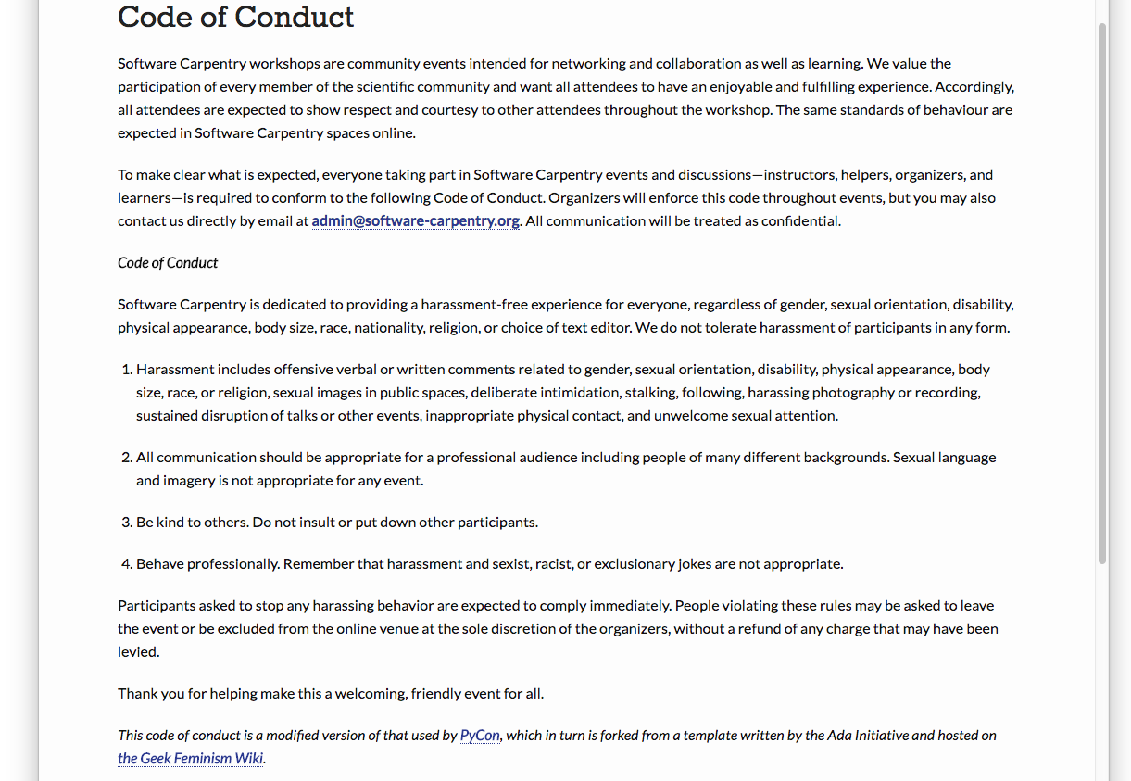
Code of Conduct
http://software-carpentry.org/conduct/
Notes:
Don’t harass people
Communicate appropriately
Be polite
Be a professional

Slide 8
Code of Conduct
Our workshops are welcoming, safe spaces
Reminding attendees…
Host must remind during registration
Instructors must remind at start of workshop
Makes expectations and consequences clear
Violations are very rare, but have happened
Instructor has right to sanction disruptive students

Slide 9
If a Violation Happens…
Depends on severity and whether it was intentional
Can warn them, ask them to apologise, and/or expel
Can also walk out if participants or hosts not supporting your attempts to enforce the Code of Conduct
In either case, contact appropriate Carpentry admin as soon as possible

