Slide 1
Programming for Manufacturing and In-Field Updates
June 11, 2013

Slide 2
Overview
Summary of methods for programming during manufacture and in-field updates
Advantages and disadvantages for each method
Lab: programming using SD card

Slide 3
Programming Methods
SD card
Ethernet
New Product Introduction (NPI)
Notes:
JTAG???

Slide 4
Programming for Manufacturing: SD Card
Advantages
  Easy to use
  Fast
  Ideal for in-field updates
Disadvantages
  Requires SD card slot on DM3730/AM3703 system
Recommended method by Logic PD

Slide 5
Programming for Manufacturing: Ethernet
Advantage
  Easy to use
  Fast
  Possibility for in-field updates
Disadvantage
  Requires Ethernet on the DM3730/AM3703 system
  Requires host PC for TFTP transfers
Contact Logic PD support for more information

Slide 6
Programming for Manufacturing: NPI
Advantage
  DM3730/AM3703 SOM comes pre-programmed, no additional work needed
Disadvantage
  Non-standard part number
  Software development must be completed prior to ordering the DM3730/AM3703 SOM
  Requires minimum order and possible NRE charge
  Requires either SD Card or Ethernet for in-field updates
Contact Logic PD sales for more information

Slide 7
Example: SD Card Programming
Objective: Create a formatted SD card that will automate the programming process
  Identify required files for SD card programming
  Understand procedure for flashing components into NAND
  Program system to boot from NAND

Slide 8
SD Card Programming: Identify Required Files
boot.scr: Compiled boot.script using the mkimage tool
boot.script: Script used during the update
MLO: Binary image of X-Loader
rootfs.yaffs: YAFFS-based root filesystem
u-boot.bin: Binary image of U-Boot to be booted from SD card
u-boot.bin.ift: Binary image of U-Boot to be booted from NAND
uImage: Binary image of Linux kernel

Slide 9
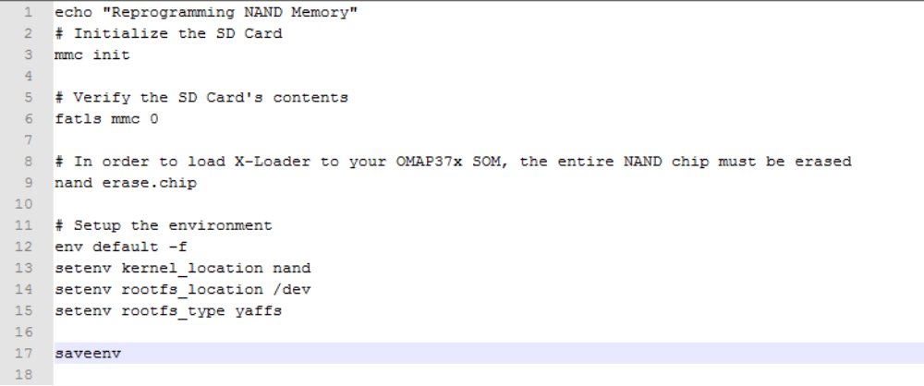
SD Card Programming: Understand boot.script
Initialize MMC interface and erase NAND
Default environment sets up most variables we need
Modify specific variables to boot from NAND
  kernel_location, rootfs_location, rootfs_type

Slide 10
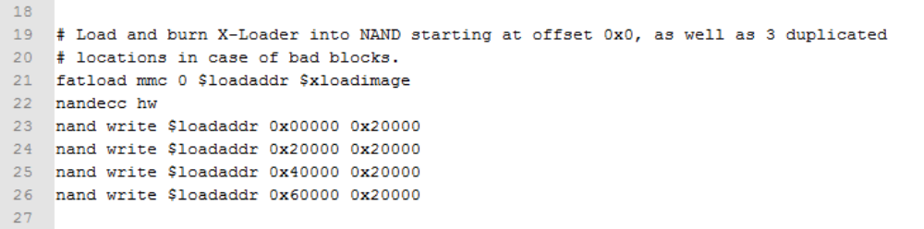
SD Card Programming: Understand boot.script
Load X-Loader image from SD card
X-Loader requires 1-bit ECC scheme used by GPMC ECC engine (nandecc hw)
Write X-Loader into first four blocks of NAND
  This accounts for the possibility of bad blocks

Slide 11
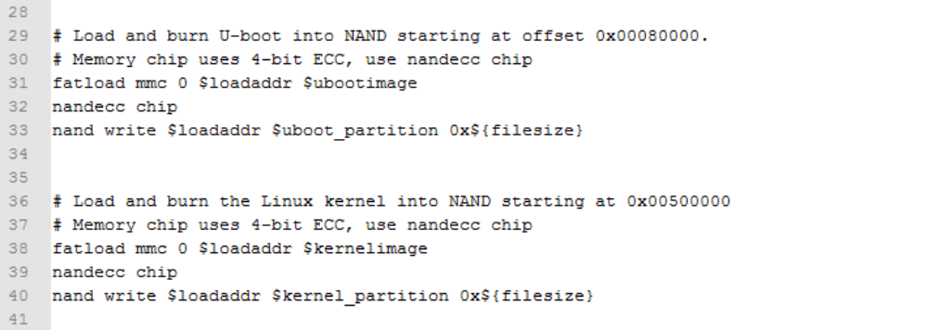
SD Card Programming: Understand boot.script
Load U-Boot/kernel image from SD card into RAM
Write U-Boot/kernel image into respective partitions

Slide 12
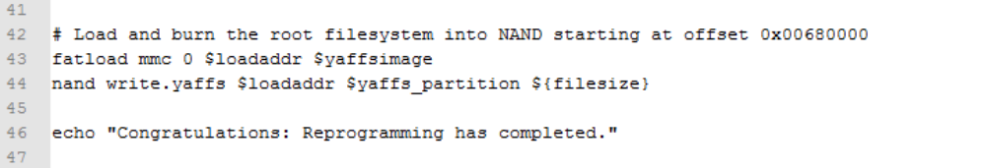
SD Card Programming: Understand boot.script
Load rootfs.yaffs image from SD card
YAFFS requires a specific write command: nand write.yaffs

Slide 13
SD Card Programming: Create boot.scr
Copy boot.script into the U-Boot directory in the Linux VM
If it is not already installed, install uboot-mkimage package
Create the boot.scr image using the mkimage tool
logic@logic-virtual: ~$ sudo apt-get install uboot-mkimage
logic@logic-virtual: ~$ mkimage -A arm -O linux -a 0 -e 0 -T script -C none -n “SD Card Programming” -d boot.script boot.scr

Slide 14
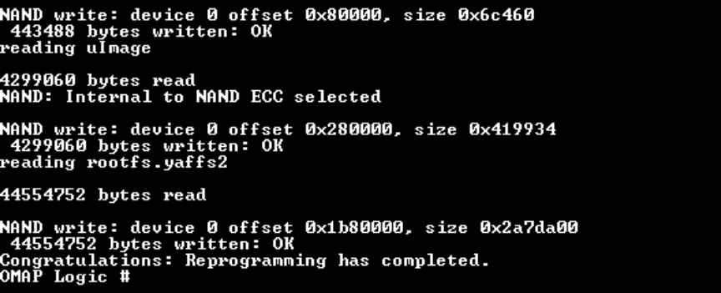
SD Card Programming: Program NAND Flash
Format an SD card using the mkLogicFATcard.sh script in Linux or the HP USB Disk Storage Format Tool[1] in Windows
Copy MLO file first
Copy the rest of the required files
Insert the SD card and boot the system
  [1] http://support.logicpd.com/DesktopModules/Bring2mind/DMX/Download.aspx?portalid=0&EntryId=2760

Slide 15
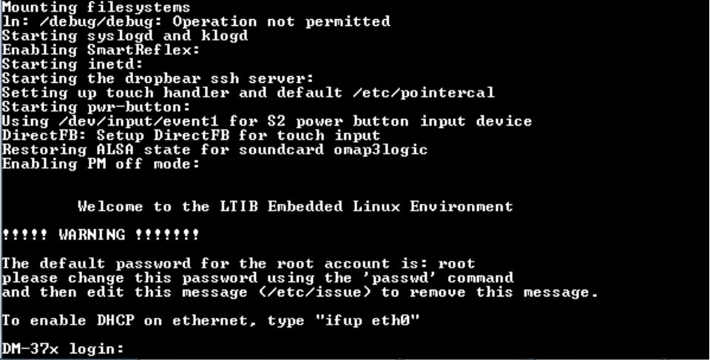
SD Card Programming: Program NAND Flash
Once programming is complete, remove the SD card and power cycle the board
The board will boot from NAND into the Linux command prompt

