Slide 1
LTIB (Linux Target Image Builder)
June 11, 2013

Slide 2
Overview
How LTIB determines what is built
How to build with LTIB
LTIB target and package configuration
Kernel configuration

Slide 3
LTIB Overview
Two config files
  One for the LTIB build environment; one for the kernel
Default configuration vs. config
  Default configuration file will be used if no .config file is present

Slide 4
LTIB Configuration File
The default configuration file for LTIB is named “defconfig”
  ./config/platform/omap_logic/defconfig
Initial build copies contents of “defconfig” into “.config”
Subsequent builds will make use of “.config”
  ./config/platform/omap_logic/.config
Any changes made in the LTIB configuration menu will be reflected in the .config file

Slide 5
Kernel Configuration File
The default configuration file for the kernel is named “omap3logic_defconfig”
  ./rpm/BUILD/linux-3.0/arch/arm/configs/omap3logic_defconfig
Initial build copies contents of “omap3logic_defconfig” into “.config”
Subsequent builds will make use of “.config”
  ./rpm/BUILD/linux-3.0/.config
The previous config is saved in
  ./rpm/BUILD/linux-3.0/.config.old
Any changes made in the kernel configuration menu will be reflected in the .config file

Slide 6
Build LTIB
For the initial build, use the command below:
  This will tell the build environment to copy the default configuration into the .config file
For subsequent builds, use the command below:
$ ./ltib -b --preconfig config/platform/omap_logic/defconfig
$ ./ltib

Slide 7
Modify LTIB Configuration
Modify the LTIB configuration by entering the configuration menu:
Commands to navigate the menu:
  Arrows: Navigate menu options
  Y: Select menu option
  N: Deselect menu option
  Enter: Select sub-menu
$ ./ltib -c

Slide 8
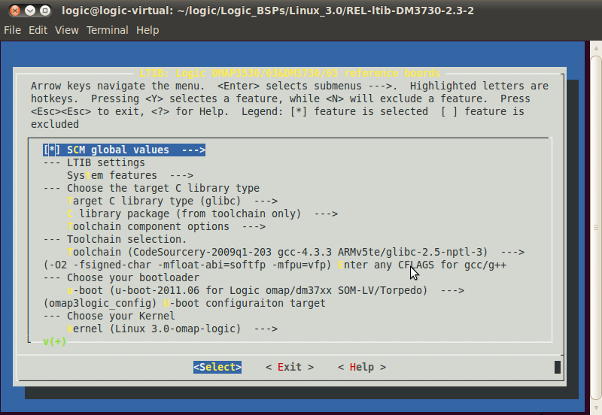
LTIB Configuration Menu

Slide 9
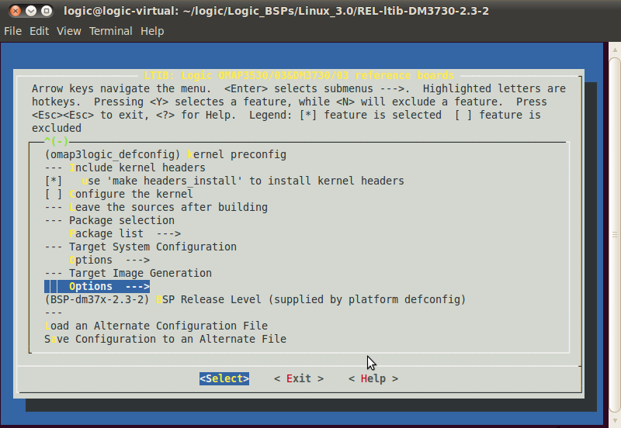
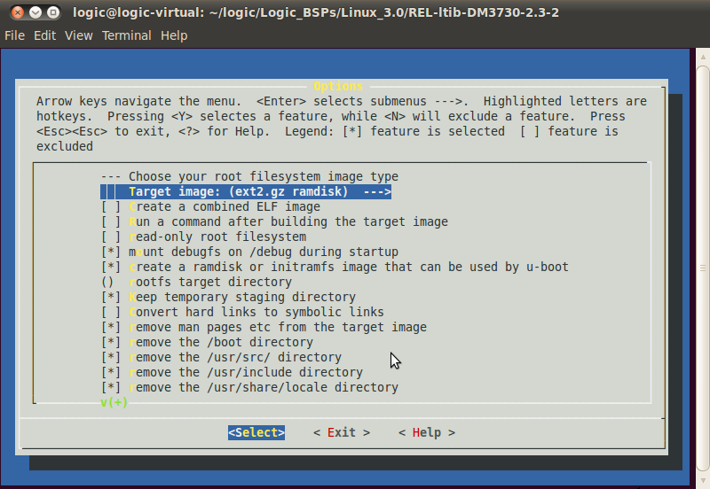
Example: Target Image Generation
Enter the configuration menu using the command below:
Under the Target Image Generation heading, select Options > Target Image (ext2.gz).
$ ./ltib -c

Slide 10
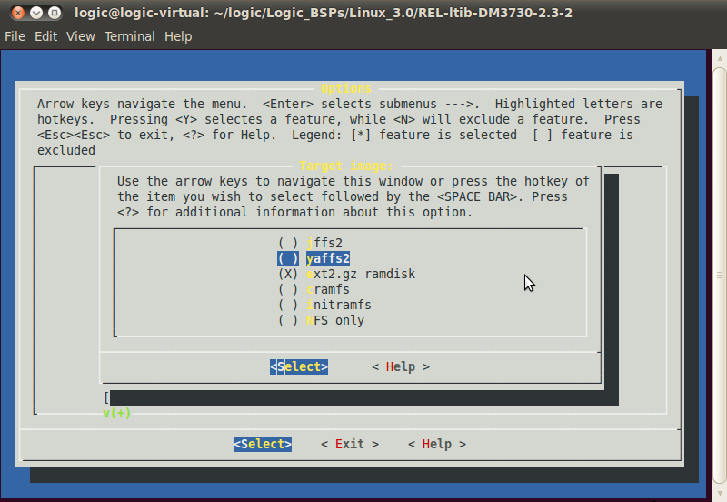
Example: Target Image Generation
Highlight YAFFS.
Exit and save configuration.

Slide 11
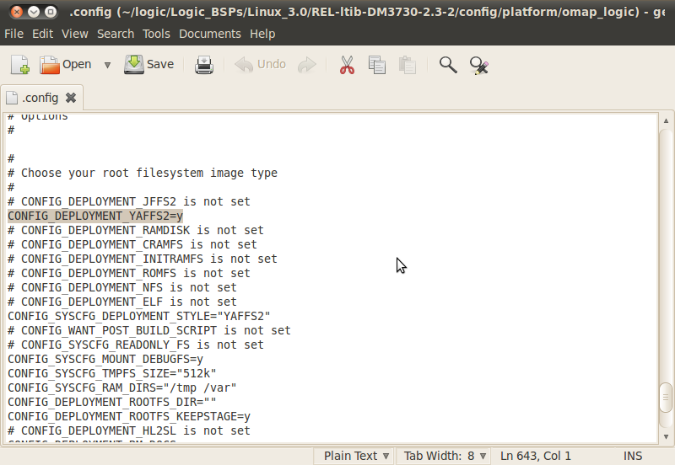
Example: Target Image Generation
Confirm the change in the .config file.

Slide 12
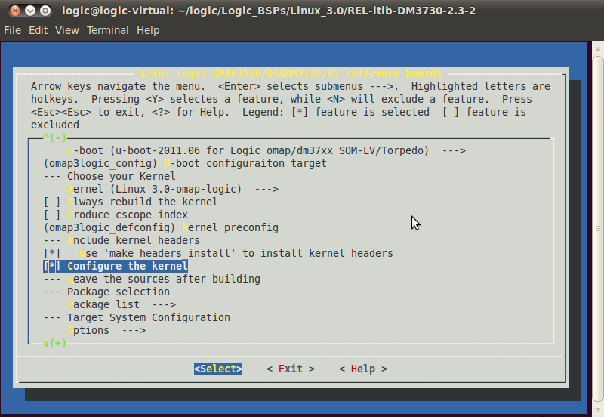
Kernel Configuration
Enter the LTIB configuration menu using the command below:
Select “Configure the kernel.”
$ ./ltib -c

Slide 13
Kernel Configuration
Commands to navigate the menu:
  Arrows: Navigate menu options
  Y: Select menu option
  N: Deselect menu option
  M: Select menu option as a kernel module
    Only applies to options marked with < >
  Enter: Select sub-menu

Slide 14
Example: Enable/Disable USB
Enter the LTIB configuration menu using the command below:
Select “Configure the kernel.”
$ ./ltib -c

Slide 15
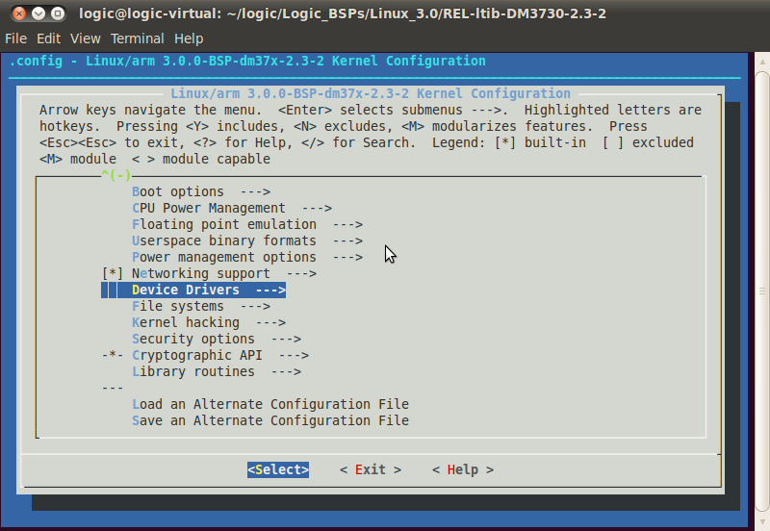
Example: Enable/Disable USB
Exit the LTIB configuration menu.
  The kernel configuration menu will appear after you exit the LTIB configuration menu.
Select “Device Drivers.”

Slide 16
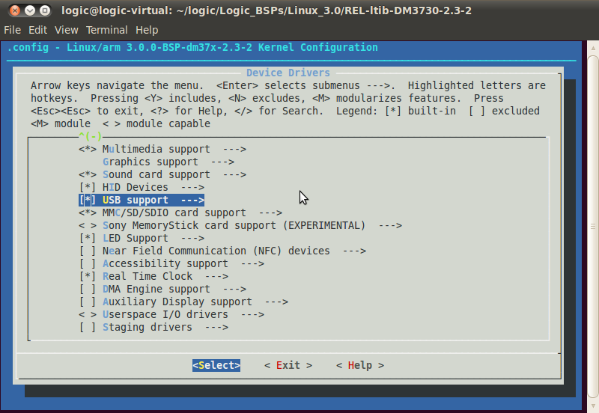
Example: Enable/Disable USB
Find “USB support.”

Slide 17
Example: Enable/Disable USB
Deselect “USB support” by pressing N.

Slide 18
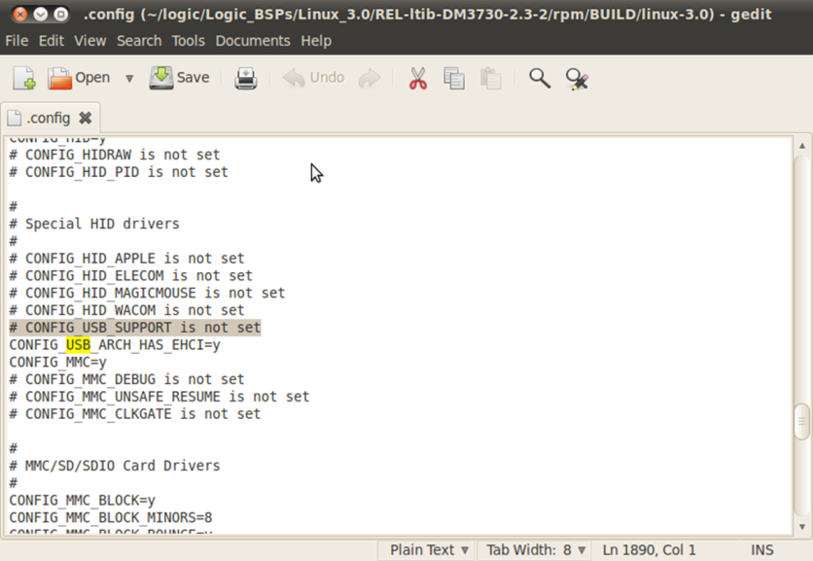
Example: Enable/Disable USB
Exit and save the configuration.
Confirm the change in the .config file.

Slide 19
File Systems
Logic PD officially supports three different filesystems:
  RAMdisk
    Resides in RAM, non-persistent filesystem
  YAFFS2
    Resides in NAND, persistent filesystem
  NFS
    Resides in host PC, persistent filesystem
    Setup for this file system is more involved
    Contact Logic PD support for more information

Slide 20
Boot Methods
Logic PD supports 3 methods for booting Linux:
  MMC
    Commonly used for quick prototyping and in-field updates
  NAND
    Commonly used for end-product manufacturing
  Network
    Commonly used for development
    Contact Logic PD support for more information

