Slide 1
DEMONSTRATION
OBJ Asset Pipeline
How It Works
A walkthrough of the management GUI and the Maya tools
Steve Mathew Varghese

Slide 2
SYSTEM OVERVIEW
One server, two ways to use it
Artists work in Maya; an administrator manages everything through a desktop GUI. Both talk to a central server, which stores the files on disk and the asset records in MongoDB Atlas.
Maya tools
artists upload & import .obj assets
FastAPI Server
MongoDB Atlas
handles uploads, logins, thumbnails
asset records (cloud database)
Management GUI
admin: server, users, asset browser
OBJ Asset Pipeline
2

Slide 3
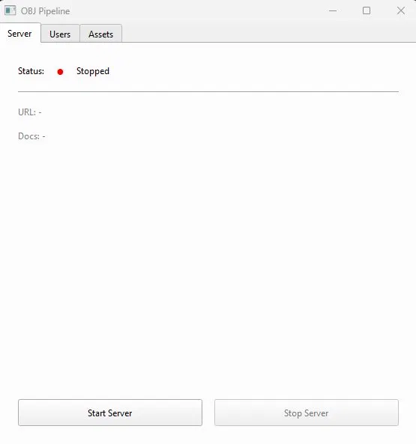
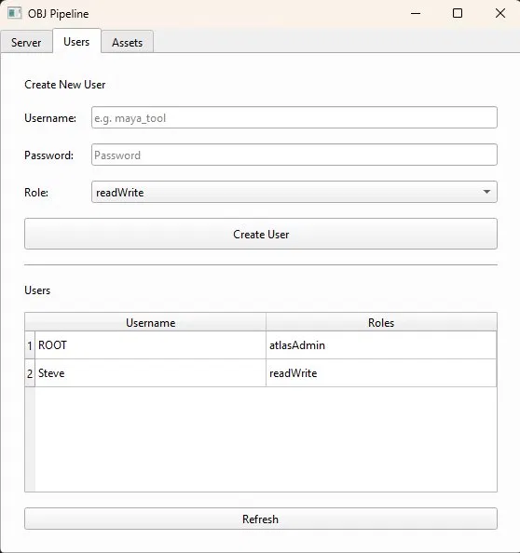
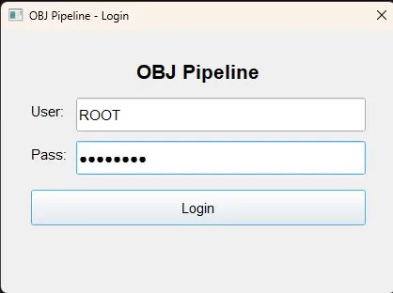
THE MANAGEMENT GUI
Login, server control and user accounts
1. Admin logs in
2. Start / stop the server
3. Create user accounts
The administrator logs in, starts the server with one click, and creates an account for each artist — so every upload is tied to a real user.
OBJ Asset Pipeline
3

Slide 4
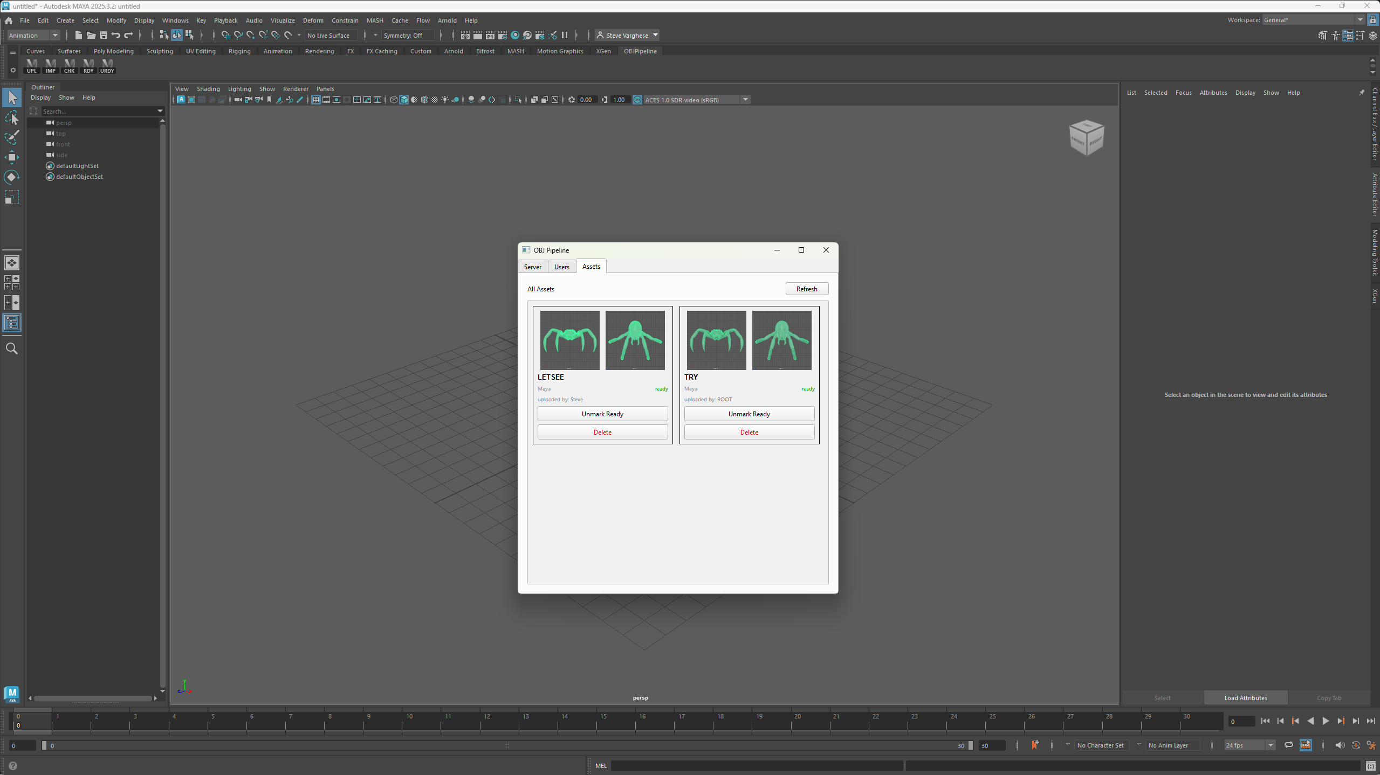
THE MANAGEMENT GUI
Browsing uploaded assets
• Thumbnails front & top views, captured automatically on upload
• Who & where each asset shows its uploader and source tool
• Ready state mark or unmark an asset as approved
• Delete remove an asset (admin only)
OBJ Asset Pipeline
4

Slide 5
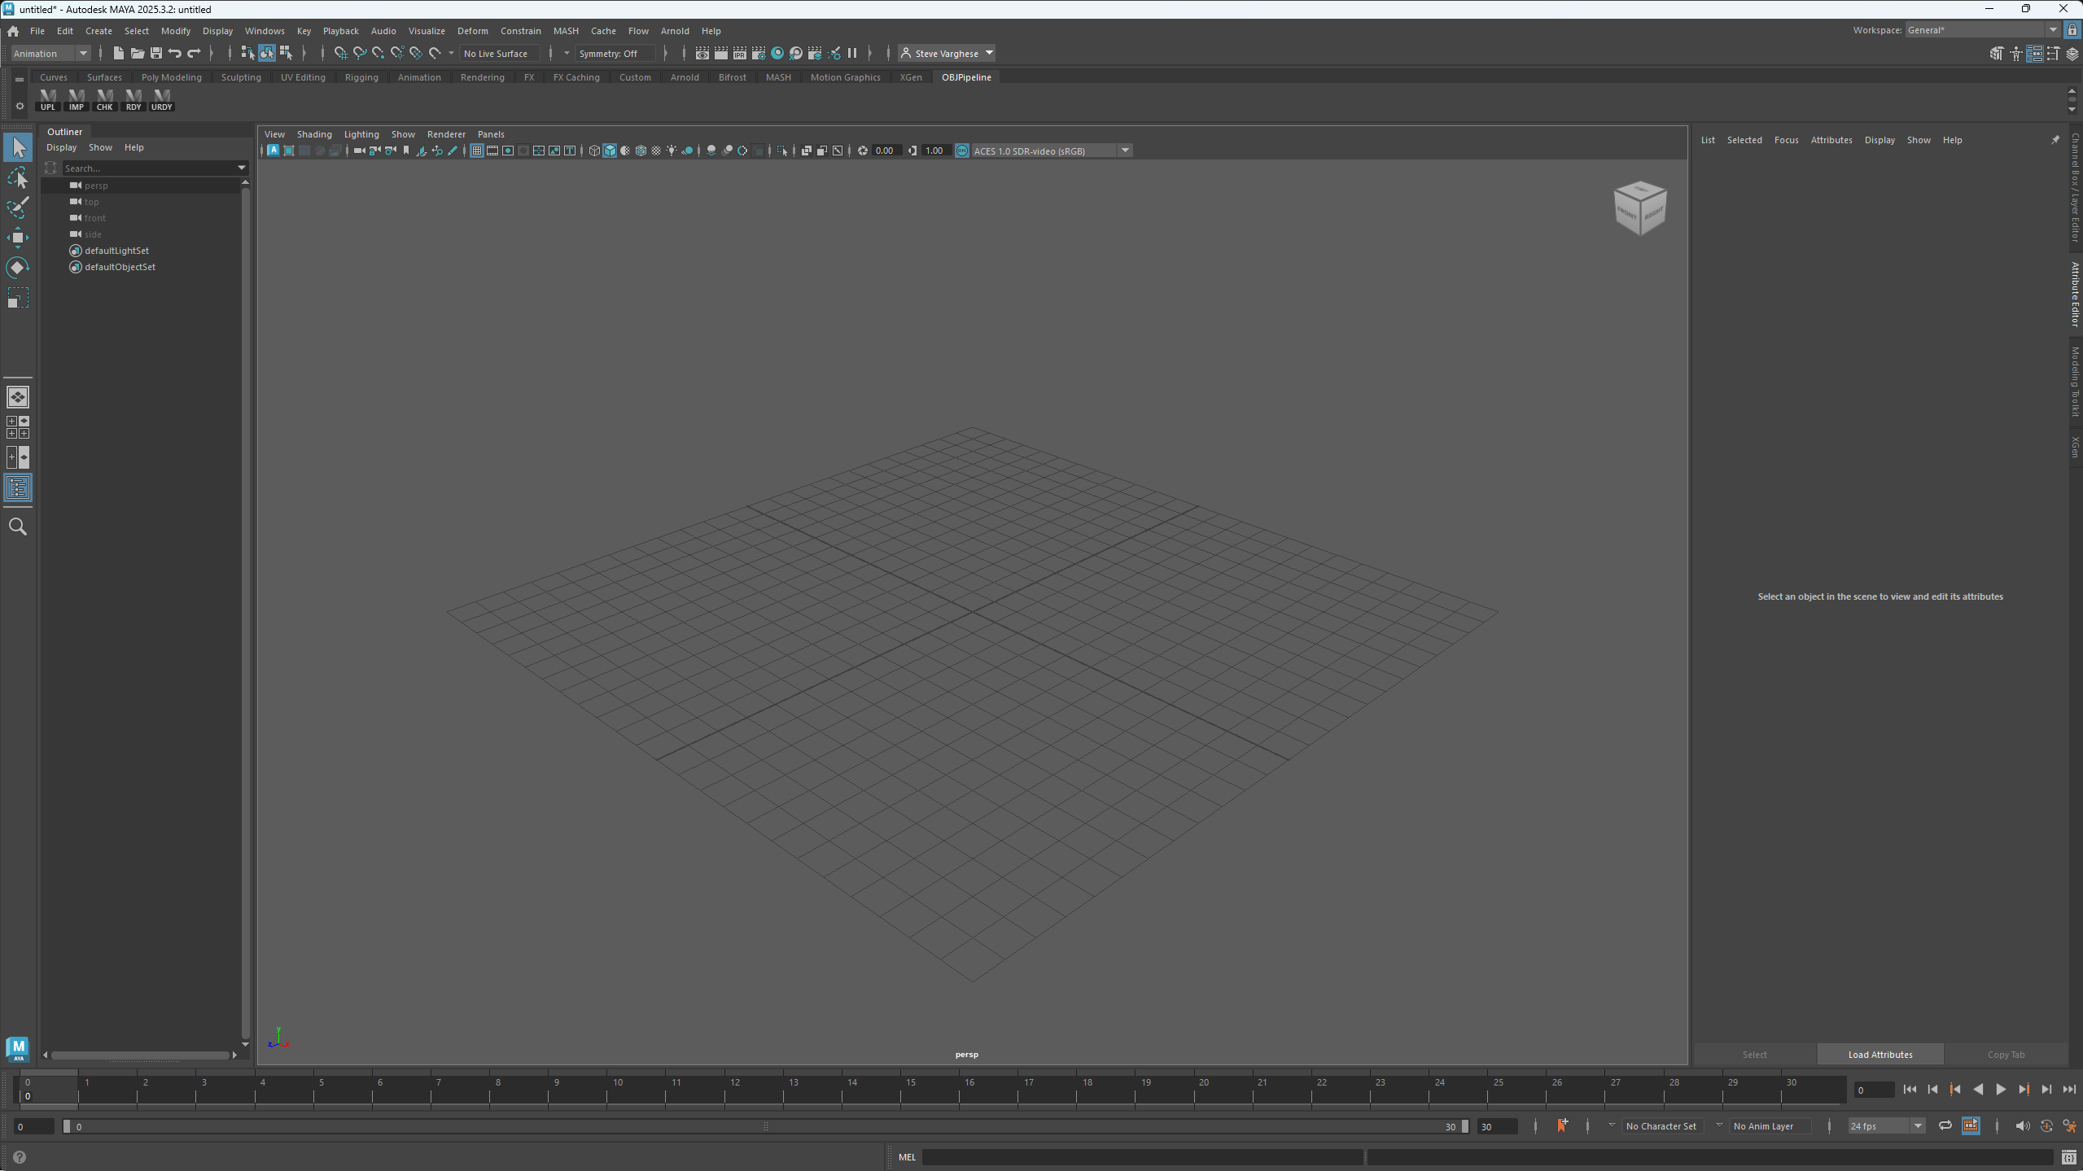
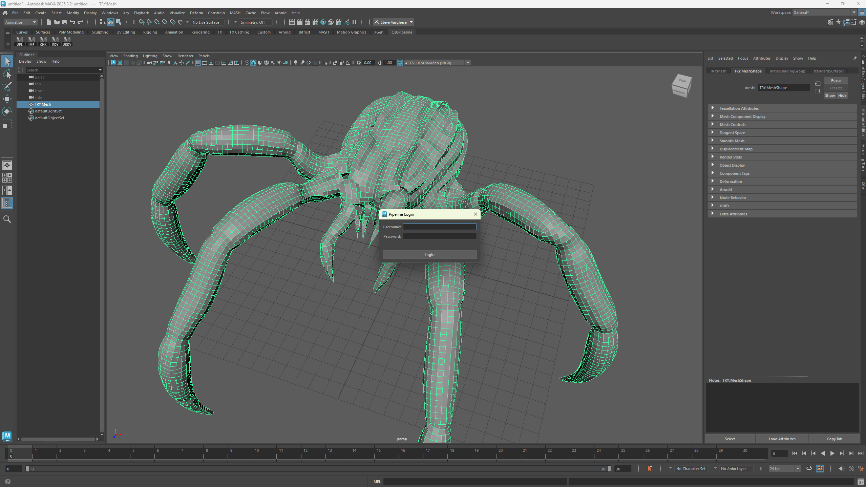
THE MAYA TOOLS
Setup: the OBJPipeline shelf
A custom shelf with one button per action
First click prompts a login
UPL upload IMP import ready CHK check ready RDY mark ready URDY unmark
OBJ Asset Pipeline
5

Slide 6
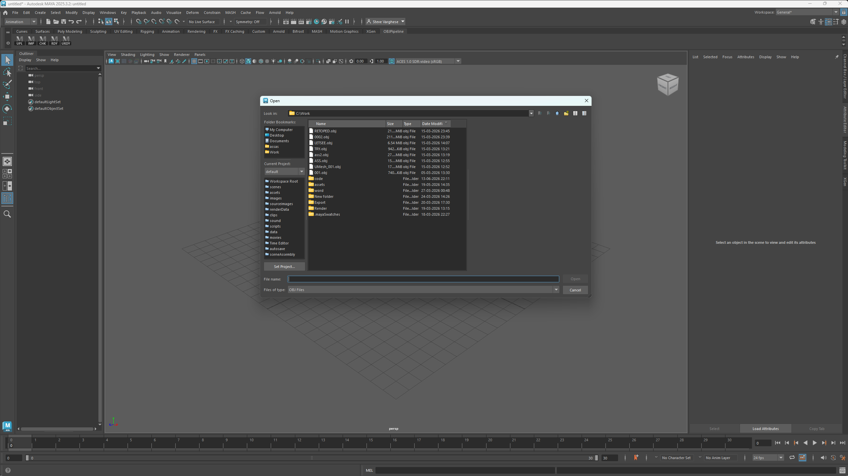
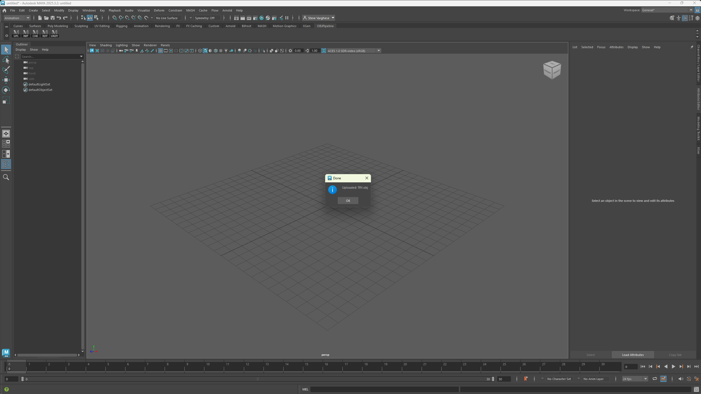
THE MAYA TOOLS
Uploading an asset (UPL)
1. Pick a .obj file
2. It uploads and confirms
The artist chooses a .obj file; the tool sends it to the server, records who uploaded it, and quietly captures front and top thumbnails behind the scenes.
OBJ Asset Pipeline
6

Slide 7
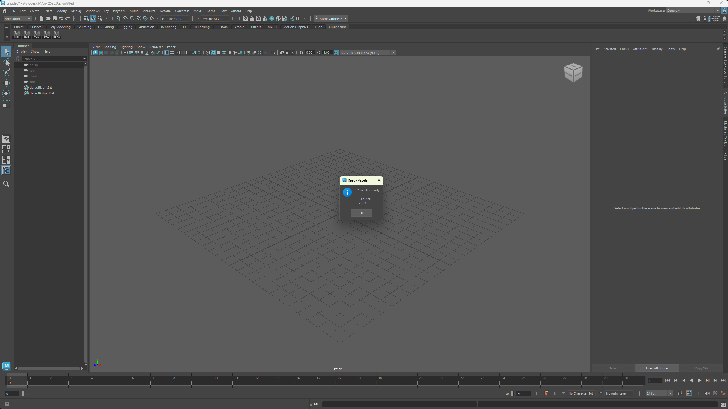
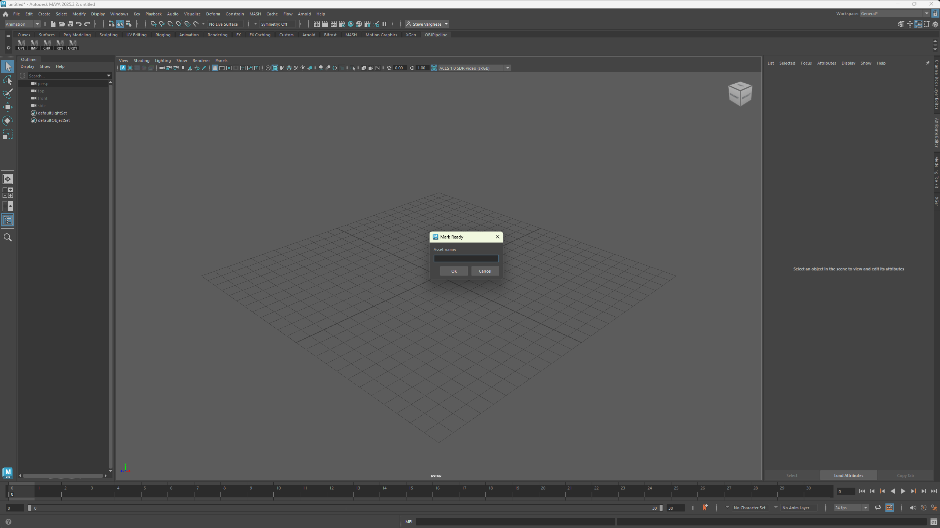
THE MAYA TOOLS
Sharing: check what's ready (CHK) and mark ready (RDY)
CHK — lists assets ready to import
RDY — marks an asset as approved
Once an asset is approved, any other artist can see it under CHK and pull it straight into their own scene with IMP.
OBJ Asset Pipeline
7

Slide 8
PUTTING IT TOGETHER
The end-to-end workflow
1
2
3
4
Upload
Approve
Discover
Import
Artist A sends a .obj from Maya (UPL)
Mark it ready when finished (RDY)
Artist B checks what's ready (CHK)
Pull it into their scene (IMP)
No manual file-sharing, no wrong versions — the server always hands over the latest approved asset.
OBJ Asset Pipeline
8

Slide 9
SUMMARY
What it does
• Artists upload .obj assets from Maya to a shared server
• Assets are approved, then imported by anyone — straight into Maya
• A desktop GUI manages the server, user accounts and the asset library
• Front & top thumbnails are captured automatically on upload
Built with Python · FastAPI · MongoDB Atlas · PySide6 · Maya Python API · Docker
Thank you

