Slide 1
MSc Computer Animation & Visual Effects · NCCA, Bournemouth
A Lightweight USD-Based Asset
Pipeline for Cross-DCC Collaboration
Reliable, versioned asset exchange for small studios and student teams
Project Proposal
Steve Mathew Varghese · Supervisor: [TBC] · [Date]

Slide 2
THE PROBLEM
Small teams have no real asset pipeline
Big studios
Small teams
The cost
Heavyweight systems (ShotGrid, Perforce, proprietary tools). Powerful, but costly and assume dedicated pipeline staff.
Fall back to manual file-sharing: cloud drives, naming conventions, messaging. No versioning, no “approved” state.
Wrong versions used, missing textures, overwritten work, time lost chasing the latest file — the errors a pipeline prevents.

Slide 3
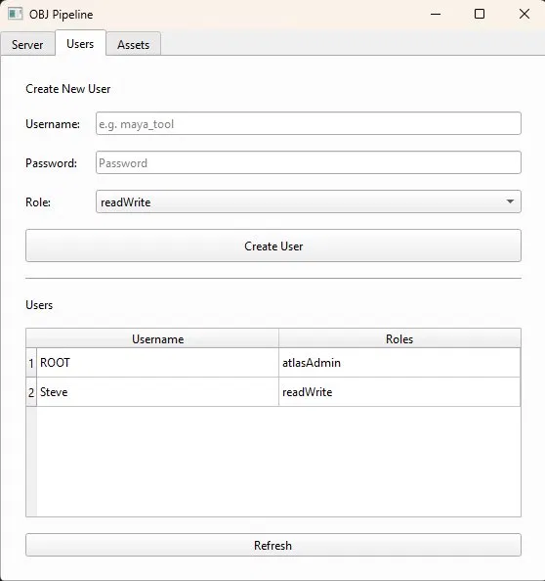
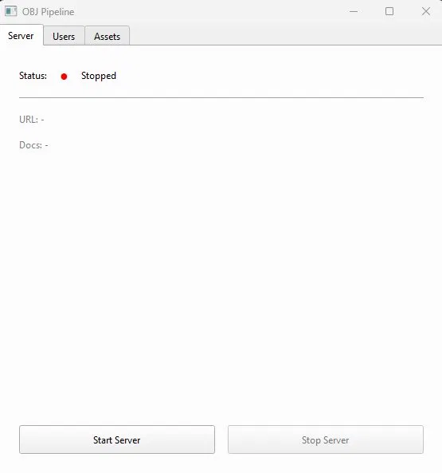
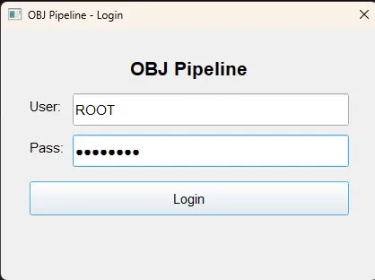
STARTING POINT
I built a working prototype
Login & accounts
Multi-user management
Server control
FastAPI + MongoDB server, PySide6 GUI, Maya shelf tools — it works, but .obj and the lack of versioning are exactly its limits.

Slide 4
THE IDEA
Can a USD-based system give small teams reliable,
versioned, cross-DCC asset exchange — and beat manual sharing?
.obj — the prototype
OpenUSD — the proposal
— Geometry only
— No materials or textures
— No hierarchy or variants
— Re-upload overwrites history
— Versioning via USD composition / layers
— Cross-DCC native in Maya, Houdini, Unreal
— Rich data hierarchy + materials travel along
— Industry standard (Pixar, NVIDIA Omniverse)

Slide 5
OBJECTIVES & IMPLEMENTATION METHODS
What I'll build, and how
OBJECTIVES
METHODS
— Review existing pipelines (Kitsu, Prism, USD)
— Versioned server with an “approved” state
— USD publish/consume in Maya + Houdini
— Consume “latest approved” or a pinned version
— Evaluate with artists (study + SUS survey)
— Python + FastAPI server, USD via pxr bindings
— PySide6 clients inside Maya & Houdini
— Docker + CI reproducible deploy & tests
— Design-and-build + empirical user evaluation
DCC clients → FastAPI server → versioned USD storage

Slide 6
KEY CHALLENGES
What could be hard — and the plan
USD learning curve
Version resolution
Powerful but complex. Mitigation: use prebuilt usd-core; a focused week-1 spike.
A full custom USD resolver is large. Fallback: resolve versions server-side.
Persistent file storage
Recruiting test artists
Cloud disks are ephemeral. Move assets to object storage (S3 / GridFS).
Studies need participants. Recruit from the NCCA cohort; keep tasks short.

Slide 7
REFERENCES & SUPPORTING MATERIAL
References
— OpenUSD — Pixar / Alliance for OpenUSD (AOUSD) documentation & specification
— NVIDIA Omniverse — OpenUSD pipeline resources and tooling
— Autodesk Maya USD / SideFX Houdini Solaris — native USD authoring docs
— Kitsu (CGWire) & Prism Pipeline — open-source asset/production tools (comparison)
— Brooke, J. (1996) — SUS: A 'quick and dirty' usability scale (evaluation method)
Thank you — questions welcome.

