Slide 1
Mini Project · AI for Cybersecurity
An Explainable and Robust
Cyber-Defence Model
Network intrusion detection on CIC-UNSW-NB15
Can we trust a detector that scores 0.97?
Group 6: Kirill Silchenko, Stefanos Ntentopoulos
AI for Cybersecurity (D7084E / D7041E) · 15 October 2026
1
Notes:
Target time: 35 seconds. Presenter: Kirill.
Slide 1: Title
Before we start, we press Run All in the notebook. It runs everything from the raw CSV files, from top to bottom, and takes about two minutes; we will look at it twice during the talk. The trained models load from a saved cache, because training them all from scratch takes about 25 minutes.
We are Kirill and Stefanos. Our project is a network intrusion detector on CIC-UNSW-NB15. It scores 0.97. The talk is about whether we should trust that number.

Slide 2
Problem, data and baseline
Who uses it
SOC analysts, who get an alert for every flow called an attack.
0.737
What errors cost
A false alarm costs analyst time and causes alert fatigue; a missed attack costs more, per case.
accuracy for "always benign", with recall 0.
The data
305,105 clean flows (141,742 duplicates removed), 26.3% attacks, nine attack types, split 60/20/20 stratified.
Accuracy is useless here; we report macro-F1, recall, PR-AUC and the false alarm rate (FAR).
Notebook Part A · results/tables/A2_class_balance.csv, A4_baseline.csv
2
Notes:
Target time: 70 seconds. Presenter: Kirill.
Slide 2: Problem, data and baseline
The problem: for every network flow, one conversation between two computers summarised as numbers about packets, sizes and timing, decide whether it is normal or part of an attack. The users are SOC analysts. A false alarm costs them time, and with millions of flows a day even 1% false alarms buries the real ones. A missed attack costs more per case, because the attacker goes unnoticed. So we want high recall at a low false alarm rate.
The data is CIC-UNSW-NB15, flows with 76 features. I removed 141,742 exact duplicates, because a copy in training and another in test makes the test too easy, and kept all 305,105 remaining flows; no subsample. 26.3% are attacks, of nine types. The split is 60/20/20, stratified on the attack type.
The trivial baseline calls everything benign. It gets 74% accuracy and catches nothing, which is why accuracy is not one of my scores.

Slide 3
Three models, one test
Test set (61,021 flows)
Macro-F1
Recall
FAR
+0.003
Always benign
0.424
0.000
0.000
Decision tree (depth 12)
0.969
0.985
0.028
what the black box buys over a readable tree.
Logistic regression
0.961
0.996
0.041
Gradient boosting
0.972
0.992
0.028
Settings chosen on validation; test used once, and it agrees within 0.003.
Notebook Part B · results/tables/B3_test_scores.csv
3
Notes:
Target time: 55 seconds. Presenter: Kirill.
Slide 3: Three models, one test
Two glass boxes, a decision tree and logistic regression, and one black box, gradient boosting. Every setting, the tree depth, the regularisation and the boosting grid, was chosen on the validation set, and the test set was used once at the end. Validation and test agree within 0.003 on every score.
All three are far above the baseline. Boosting is best, but only by 0.003 macro-F1 over a depth-12 tree. Logistic regression catches the most attacks but raises the most false alarms. I read that small gap as a warning, not a success: if a tree solves the problem this well, the model probably relies on a few strong signals. Parts D and E show which ones.

Slide 4
Live: the notebook
The test scores, computed now
Section "Part B: scores on the test set, next to the trivial baseline"
Computed from the raw CSV files during this talk; the trained models load from the saved cache.
mini_project_unsw_nb15.ipynb, running now (Restart Kernel and Run All on slide 1)
4
Notes:
Target time: 30 seconds. Presenter: Kirill.
Slide 4: Live: the test scores, computed now
This is the notebook we started almost three minutes ago. It is already past Part B: here is the test table, computed just now, with the same 0.972 as on the slide. It is now working through the explanation part. We come back at the end. Stefanos now takes Parts C, D and E.

Slide 5
10% of the labels
Pseudo-labelling
−0.003
The model labels the flows it is at least 95% sure of, two rounds (cutoff chosen on validation).
macro-F1, the cost of hiding 90% of the labels (lower line 0.969 against 0.972).
Result
Test macro-F1 0.9685 with pseudo-labels, against 0.9688 without: no gain.
Why
Round 1 added 143,824 guesses, 99.5% right, but all flows the model already got right.
The unlabelled data did not help: the confident guesses were right, but not new.
Notebook Part C · results/tables/C2_rounds.csv, C4_all_models_test.csv
5
Notes:
Target time: 60 seconds. Presenter: Stefanos.
Slide 5: 10% of the labels
Part C: what if only 10% of the training flows have labels? The lower line, boosting on those 18,306 flows, loses only 0.003 macro-F1. So there was very little to win back.
I tried pseudo-labelling: the model labels the unlabelled flows it is very sure about, they join the training data, and it retrains, for two rounds. The cutoff, 0.95, was chosen on validation. The answer is no: on test it is slightly below the lower line. The reason is in the guesses: the first round added 143,824 flows and 99.5% were right, but they were flows the model already classified correctly, so they taught it nothing. An extra check with only 1% of the labels did find a small real gain. Unlabelled data help only when labels are really scarce.

Slide 6
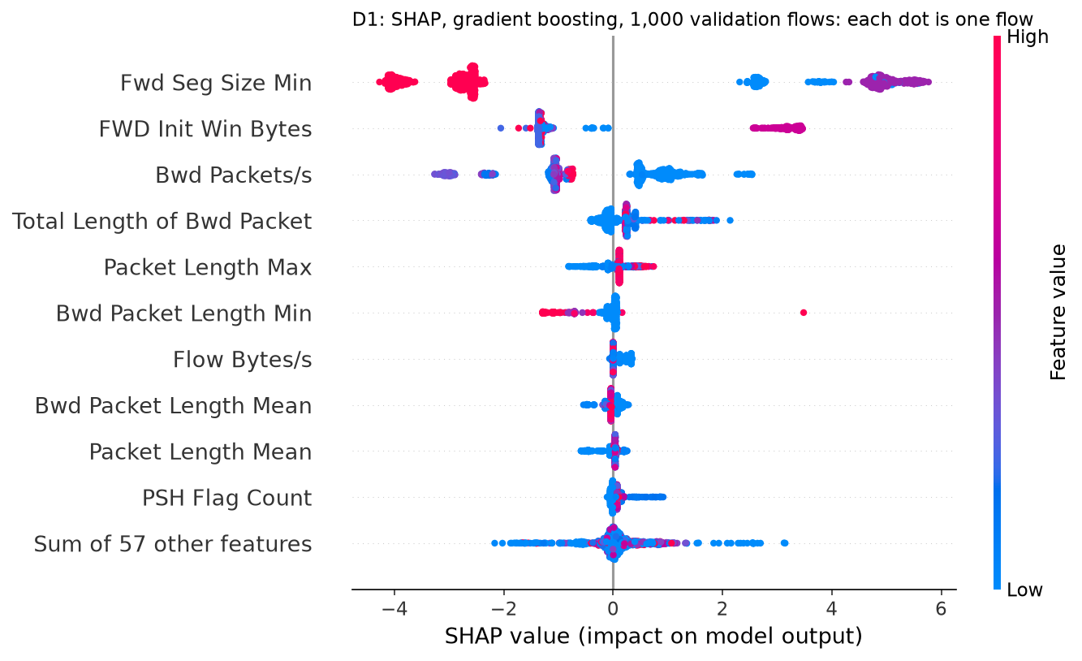
What the model looks at
76%
of the SHAP weight on three features.
Fwd Seg Size Min 42%, FWD Init Win Bytes 21%, Bwd Packets/s 13%.
The first two are TCP settings of the attacker's own machine: 95% of training attacks announce a window of exactly 16,383 bytes.
The model recognises the attacker machines' TCP fingerprint: a shortcut, not attack behaviour.
Notebook Part D · results/figures/D1_shap_beeswarm.png, results/tables/D1_shap_top.csv
6
Notes:
Target time: 55 seconds. Presenter: Stefanos.
Slide 6: What the model looks at
Part D. SHAP on 1,000 validation flows. Three features carry 76% of the weight. The top two are not properties of an attack. They are TCP settings of the machine that opens the connection: the segment size and the initial window. In training, 95% of all attacks announce a window of exactly 16,383 bytes, and 89% of flows with a segment size of 20 are attacks.
The UNSW-NB15 attacks were generated from a few attacker machines, so the model has learned to recognise those machines. That is a shortcut. You can see it in the plot: the top two features split into separate clouds, one value pushes hard to attack, the other to benign.

Slide 7
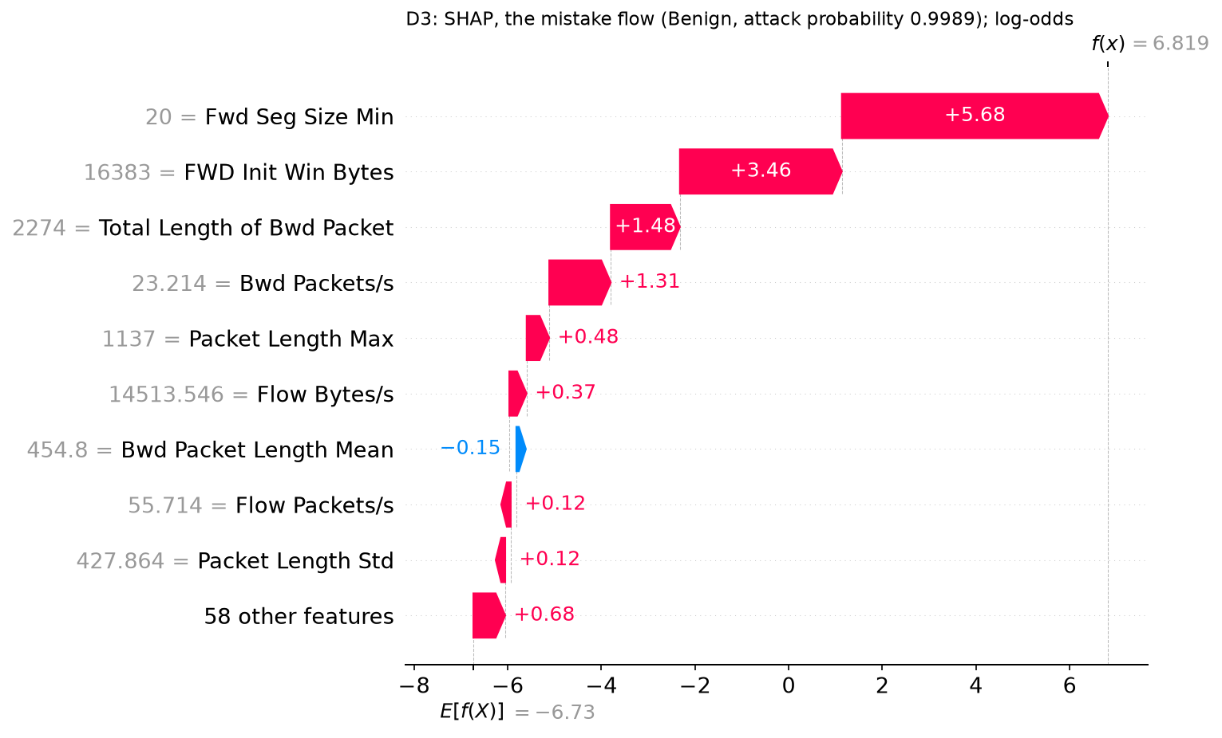
The most confident mistake
0.999
the attack probability of a benign flow.
The two TCP features alone add +5.7 and +3.5 log-odds.
1,197 of the 1,241 false alarms on the test set carry the same fingerprint.
The explanation found the weakness that the scores hid.
Notebook Part D · results/figures/D3_shap_mistake.png, results/tables/D3_shap_values.csv
7
Notes:
Target time: 40 seconds. Presenter: Stefanos.
Slide 7: The most confident mistake
I explained three test flows: the most confident detection, the most confident correct negative, and the most confident mistake. This is the mistake: a benign flow called an attack with probability 0.999. It happens to use the attacker's TCP settings, and SHAP shows those two values alone add 5.7 and 3.5 log-odds. It is not a one-off: 1,197 of the 1,241 false alarms on the test set are benign flows with that fingerprint.

Slide 8
Can we trust the explanation?
Faithful
Replacing each flow's top SHAP feature with its median flips 100% of 500 attack decisions; one random feature flips 2.8%.
Stable
TreeSHAP gives identical values on every rerun. LIME's top 3 changed between seeds, and was the same for all three flows.
Agreement
SHAP and LIME share 1 to 2 of 3 features. LIME's local fit R² is 0.06 to 0.29: a straight line cannot fit a switch.
We would show analysts SHAP: exact, stable and faithful here.
Notebook Part D · results/tables/D4_deletion.csv, D5_lime_stability.csv, D6_investigation.csv
8
Notes:
Target time: 50 seconds. Presenter: Stefanos.
Slide 8: Can we trust the explanation?
Is the explanation itself right? Fidelity: on 500 flows called attacks, replacing the top SHAP feature with its training median flipped every single decision to benign; a random feature, 2.8%. So SHAP is faithful, and the test confirms the shortcut as cause and effect. Stability: TreeSHAP is exact and gives the same values every time. LIME changed with the seed, and gave the same top three for all three flows, so it was describing the model in general, not the flow. They agree only partly, and of four reasons I tested the main one is fit: the model behaves like a switch, and LIME's straight line cannot describe it.

Slide 9
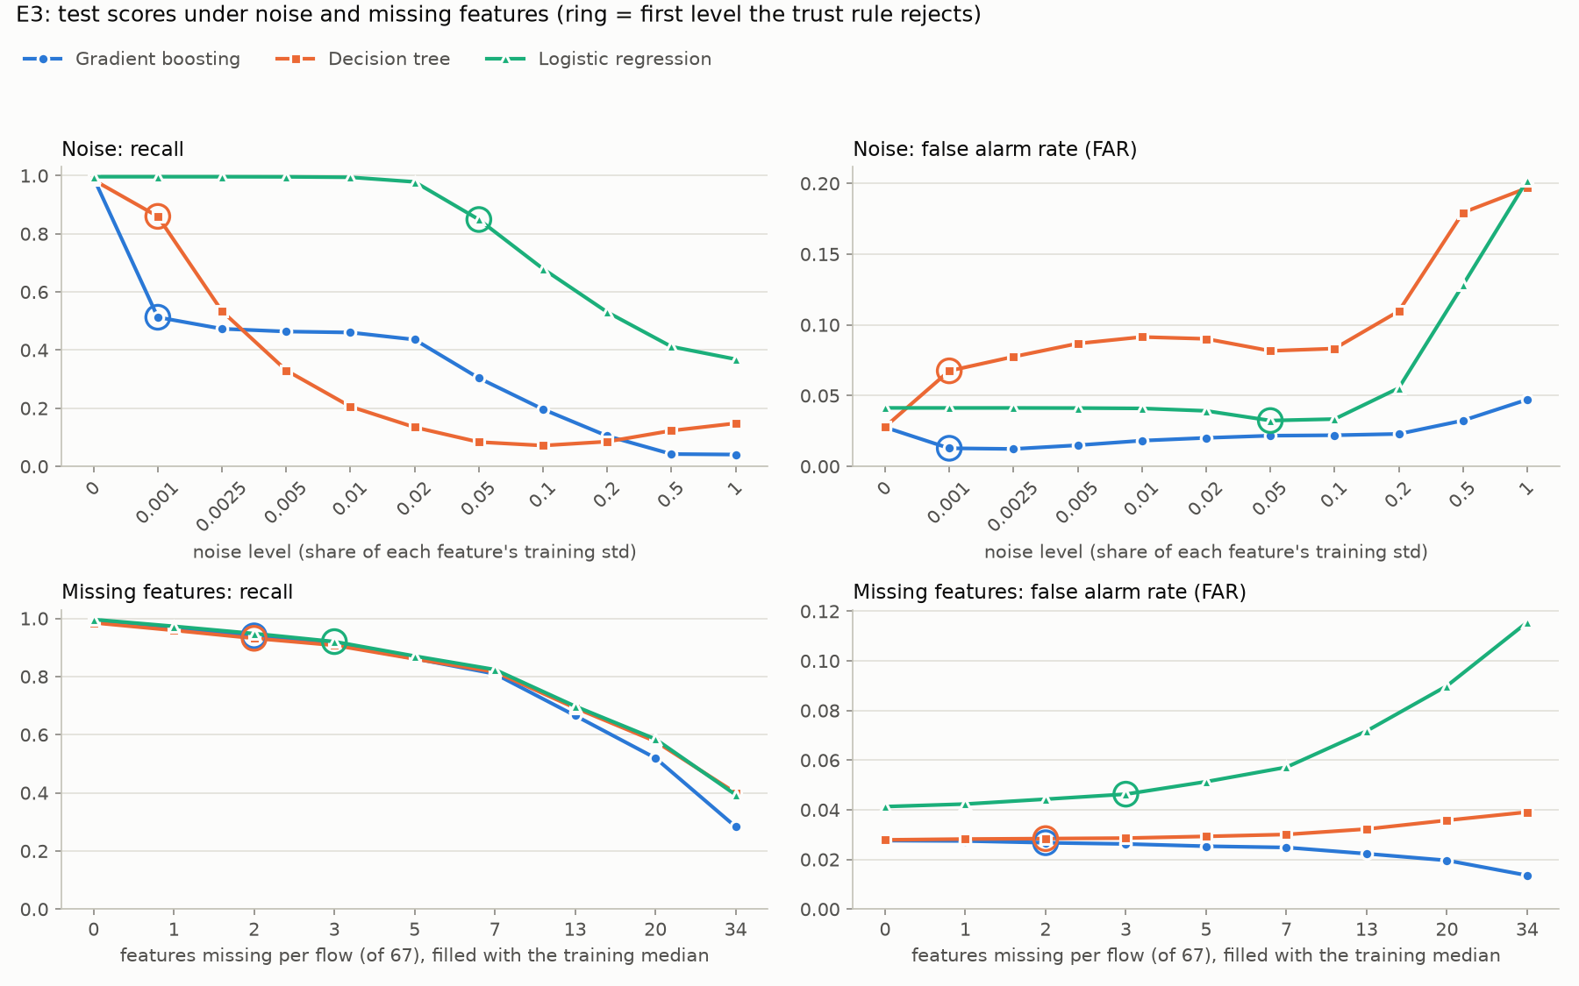
Noise and missing fields
0.992 to 0.513
boosting's recall at noise of one thousandth of a standard deviation.
Logistic regression stays at 0.98 up to noise 0.02, twenty times more.
Missing fields: one per flow is tolerated, two or three are not.
The models fail silently: recall falls, the FAR does not, and the dashboard looks calmer.
Notebook Part E · results/figures/E3_robustness.png, results/tables/E3_stop_trusting.csv
9
Notes:
Target time: 45 seconds. Presenter: Stefanos.
Slide 9: Noise and missing fields
Part E. I added measurement noise, scaled to each feature's spread, and replaced fields with the training median. The rule for when to stop trusting a model was fixed before the tests. What broke first: the two tree models under noise. A thousandth of a standard deviation already halves boosting's recall. The reason is the shortcut again: the trees test for a narrow interval around the exact fingerprint value, and tiny noise moves it out. Logistic regression survives twenty times more. And in every case it was recall that broke, not the false alarm rate: fewer alerts, which looks like good news.

Slide 10
What an attacker would fake
Cheap to fake
0.000
69% of the SHAP weight is on features the attacker controls, above all their own TCP settings.
boosting's recall when all 16,052 test attacks use a benign machine's TCP settings.
All three models fall
Tree 0.011, logistic regression 0.066.
One change is enough
A greedy search allowed only attacker-controlled changes evades boosting for all 50 attacks it tried, each with one change to Fwd Seg Size Min.
One or two system settings, at no cost to the attack, defeat all three models.
Notebook Part E · results/tables/E4_feature_groups.csv, E4_whatif_benign_tcp.csv; separate notebook of additional checks
10
Notes:
Target time: 45 seconds. Presenter: Stefanos.
Slide 10: What an attacker would fake
What would an attacker fake? I sorted the features by who controls them. 69% of the SHAP weight is on features the attacker can change cheaply, above all the TCP settings of their own machine. If every test attack simply copies the most common benign settings, and nothing else, boosting's recall drops to zero. A greedy attack search, in the separate notebook of extra checks, allowed only changes the attacker controls, needed a single change for all 50 attacks it tried. I will show that live after Part F, which Kirill presents now.

Slide 11
A belief rule base on two features
Bwd Packets/s
Test set, same 2 features
Macro-F1
Recall
FAR
Low
Medium
High
Low
Medium
Low
Low
BRB, 9 rules
0.953
0.982
0.044
Medium
Medium
Low
Low
Decision tree (depth 4)
0.962
0.996
0.040
Random forest (100 trees)
0.962
0.996
0.040
High
High
Medium
Low
Inputs: the top two SHAP features with three distinct levels (5th percentile, median, 95th percentile). Rule beliefs from the training data; threshold 48.5 chosen on validation.
Rows: FWD Init Win Bytes. Columns: Bwd Packets/s.
Each cell is one rule, showing the risk level it believes most.
0.009 behind a fair comparison, because three levels cannot isolate the exact window 16,383.
Notebook Part F · results/tables/F2_rules.csv, F3_brb_comparison.csv
11
Notes:
Target time: 55 seconds. Presenter: Kirill.
Slide 11: A belief rule base on two features
Part F, a knowledge-based layer: a belief rule base with evidential reasoning, the engine from our Lab 3. Its inputs are the two most important SHAP features that take three distinct levels; the top feature had to be skipped because two of its three levels coincide. Three levels each gives nine rules like "if the window is High and the reply rate is Low, then High risk". Each rule's belief comes from the attack share of the training flows it covers, and the threshold was chosen on validation.
The fair comparison is against a tree and a forest that see the same two features. The BRB is 0.009 macro-F1 behind, because three levels are too coarse to isolate the exact fingerprint value.

Slide 12
What Unknown buys
Less certain about the mistake
For the false alarm of slide 7: Low 0.09, Medium 0.54, High 0.37, utility 63.8; still wrong, but not 0.999 sure.
Says when it cannot decide
With Bwd Packets/s missing, Unknown rises to 0.43 and the risk becomes a range, 16.9 to 59.6, across the threshold.
Survives noise
At noise 0.05 its macro-F1 is 0.897, against 0.472 for the 2-feature tree and 0.536 for the forest.
The cost: lower accuracy, only two features (rules grow as 3 to the power of the number of features), and hand-made levels.
Notebook Part F · results/tables/F4_beliefs.csv, F5_brb_vs_forest_checks.csv
12
Notes:
Target time: 45 seconds. Presenter: Kirill.
Slide 12: What Unknown buys
What does the BRB give for that cost? A traceable reason for each decision, and an explicit Unknown. For the false alarm from Part D it still says attack, but with beliefs spread over Medium and High, not 0.999. With an input missing, Unknown rises and the risk becomes a range that spans the threshold: the honest answer "cannot decide", which should go to an analyst. And it survives noise far better than the tree and forest on the same features. The costs are on the slide. Back to Stefanos for Part G.

Slide 13
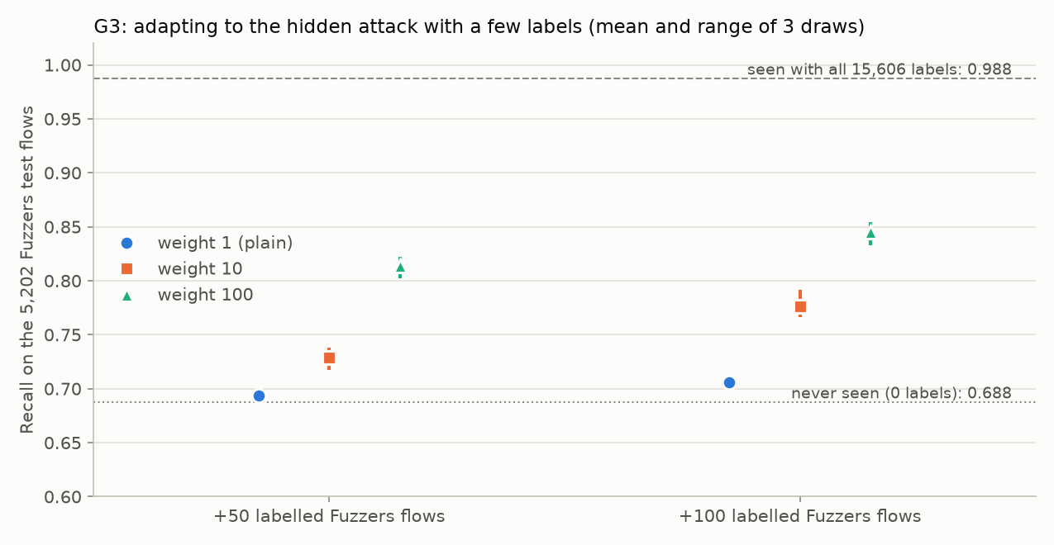
A new attack: Fuzzers
0.988 to 0.688
recall on the 5,202 Fuzzers test flows when Fuzzers is hidden from training.
The dashboard looked better
The FAR fell from 0.028 to 0.019; only the share of unsure predictions showed it (43% to 82%).
A few labels
100 Fuzzers flows labelled by an analyst: 0.706 as ordinary flows, 0.845 weighted 100 times.
Watch the share of unsure predictions: it needs no labels.
Notebook Part G · results/tables/G2_hidden.csv, G3_adapt_summary.csv, results/figures/G3_adapt.png
13
Notes:
Target time: 60 seconds. Presenter: Stefanos.
Slide 13: A new attack: Fuzzers
Part G. I hid one attack type, Fuzzers, a third of the training attacks, from training only, and retrained with the same settings. Recall on Fuzzers fell from 0.988 to 0.688, while the other types barely moved. And the false alarm rate went down, so the alert count would suggest things got better. The sign was elsewhere: 82% of Fuzzers flows got a probability between 0.1 and 0.9, against 43% before.
Then an analyst labels 100 Fuzzers flows, taken from the removed training flows, never from test. As ordinary flows they barely help. Weighted 100 times they bring recall to 0.845: more than half of the loss recovered. A learning curve in the extra notebook reaches 0.956 with 500 weighted labels.

Slide 14
Live: the notebook
One attack, two settings changed
The test attack the model is most sure about (an Exploits flow)
Then: Fwd Seg Size Min set to 32, and FWD Init Win Bytes to 5792, the benign machines' values
mini_project_unsw_nb15.ipynb, running now (Restart Kernel and Run All on slide 1)
14
Notes:
Target time: 40 seconds. Presenter: Stefanos.
Slide 14: Live: one attack, two settings changed
Back to the notebook: the run has finished, all the way to Part G. One more cell. This is the test attack the model is most sure about, an Exploits flow, 0.9996. I change one number, the segment size, to what normal machines use. Now it is 0.003: benign. That is one system setting on the attacker's side, and the attack itself is unchanged. Kirill closes.

Slide 15
Would we deploy this?
Not as it is.
The numbers we least trust
The 0.972 itself (it measures the UNSW-NB15 attacker machines), and the FAR: at a realistic 2.5% attacks only 48% of alerts would be real.
A better model
Without the three TCP features: macro-F1 0.971, recall under noise 0.831 instead of 0.513, but the attack search still evades it for 34 of 50 attacks.
How we would run it
The model without the fingerprint, the BRB as a readable second opinion that sends "cannot decide" to an analyst, monitoring of unsure predictions, and features over many flows.
Where it would fail: shared operating systems, NAT or proxies that rewrite TCP settings, other flow tools, new traffic.
Report Section 7 · results/tables/B4_alarms_per_day.csv, X6_clean.csv, X6_noise.csv, X3_attack_summary.csv
15
Notes:
Target time: 55 seconds. Presenter: Kirill.
Slide 15: Would we deploy this?
Would we deploy this? Not as it is. On this dataset it is excellent, but its accuracy rests on recognising a few attacker machines, and that says nothing about attackers elsewhere. Also, the test set has 26% attacks; real traffic has about 2.5%, and then fewer than half of the alerts would be real.
Without the three TCP features, the model loses almost nothing, 0.971, and is far more robust to noise. We would deploy that one, but not alone: timing and padding are still cheap to fake. So: that model, the BRB as a second opinion that sends undecided flows to an analyst, monitoring of the share of unsure predictions, and features computed over many flows. Thank you.

Slide 16
Questions
Thank you.
Kirill Silchenko (Parts A, B and F) · Stefanos Ntentopoulos (Parts C, D, E and G)
Notebook: mini_project_unsw_nb15.ipynb · Report and README on Canvas
16

Slide 17
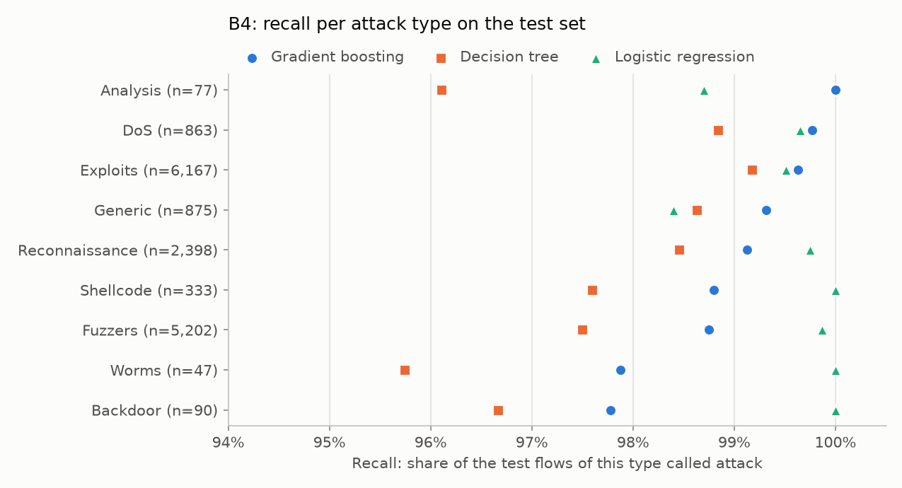
Backup: recall per attack type
Notebook Part B · results/figures/B4_recall_per_type.png
B1

Slide 18
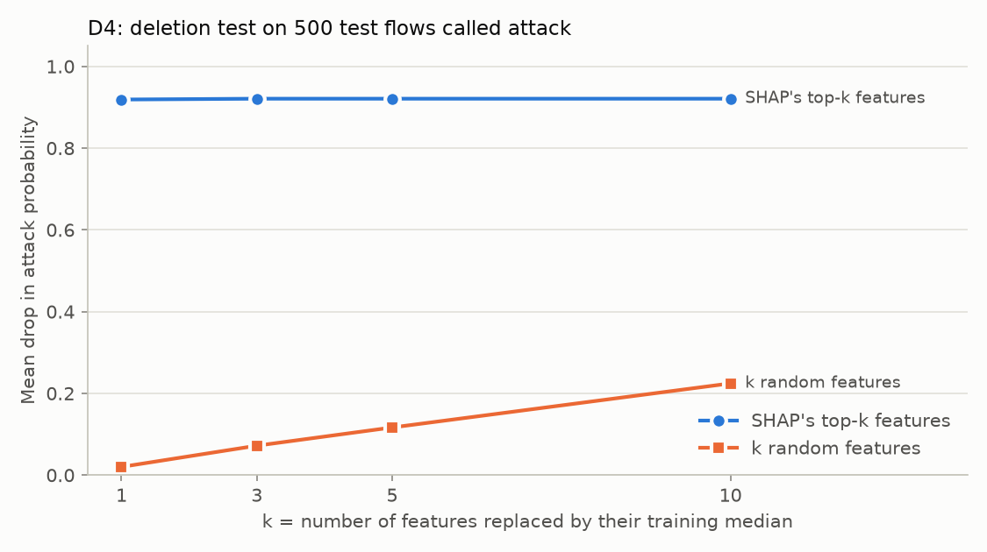
Backup: the deletion test
Notebook Part D · results/figures/D4_deletion.png
B2

Slide 19
Backup: the nine rules of the BRB
Rule (FWD Init Win Bytes, Bwd Packets/s)
Low risk
Medium risk
High risk
Attack share
1. Low, Low
0.03
0.97
0.00
0.49
2. Low, Medium
1.00
0.00
0.00
0.00
3. Low, High
1.00
0.00
0.00
0.00
4. Medium, Low
0.18
0.81
0.00
0.41
5. Medium, Medium
0.94
0.06
0.00
0.03
6. Medium, High
1.00
0.00
0.00
0.00
7. High, Low
0.00
0.23
0.77
0.89
8. High, Medium
0.05
0.94
0.00
0.47
9. High, High
1.00
0.00
0.00
0.00
Notebook Part F · results/tables/F2_rules.csv
B3

Slide 20
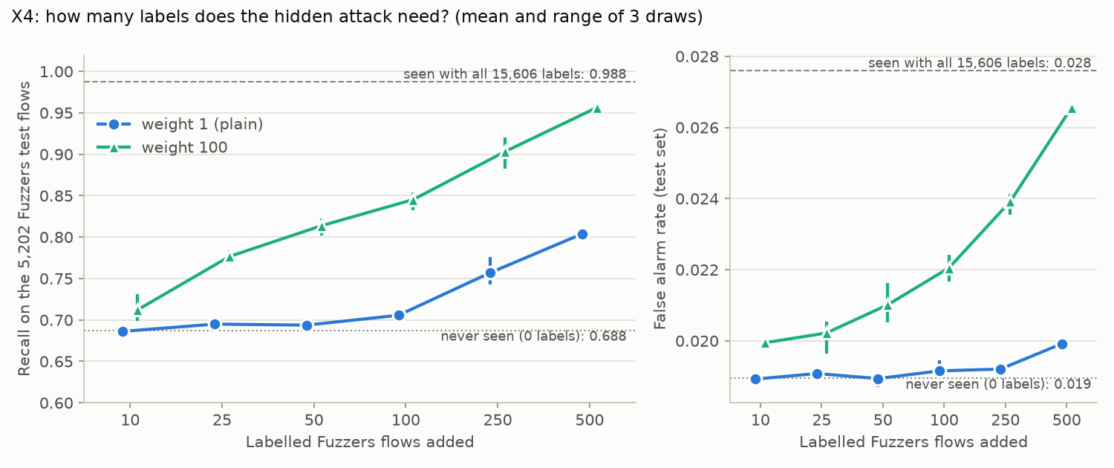
Backup: labels needed for the hidden attack
Separate notebook of additional checks · results/figures/X4_learning_curve.png
B4

