Slide 1

Smart IoT-based Fire Detection Application for Forest Areas
An open-source project from 2 PhD Candidates!
University of the Aegean - CCSL

Slide 2
Who we are ?
Stefanos Plastras (PhD Candidate) and Lefteris Tsipis (PhD Candidate) both alumni, and PhD candidates at the University of the Aegean, Computer and Communication Systems Laboratory (CCSL).
Mainly software developers with passion, time and motivation to design and implement this idea from a concept to a reality!
Lefteris mainly involved in the hardware designing, testing and implementation including the Libelium board, LoRa module, sensors, as well the Raspberry Pi Gateway and the Things Network platform configuration, while Stefanos in the software development of the back/front-end software needed to run the application in the database installation and in the overall software services.

Slide 3
When it all started ?
Back to December of 2023 in Neo Karlovasi, Samos. Came from on-site contact and discussion regarding the live monitoring of forest areas in Samos island. Project design and implementation started on February of 2024 and completed in June 2024. On 16th July, the first public release (v1.0.0) was ready (GitHub repo)!

Slide 4

Main Idea
We want to:
View in Web, metric plots (Sensor O2, CO2, NO2, Humidity), and real-time plots with thresholds
Our goal:
Develop entire data pipeline system
Create Web service offering this functionality
Making it extensible through IoT data distribution platform
Promoting open-source project
Project place
GitHub Repo: https://github.com/steve-pla/Smart-IoT-based-Fire-Detection-Application

Slide 5

All-in-One
Our concept utilizes eco-friendly approach due to Libelium Waspmote low-power IoT device
Low-cost solution
Scalable (More sensors)
Upgradable (Any hardware part)
Open-source

Slide 6
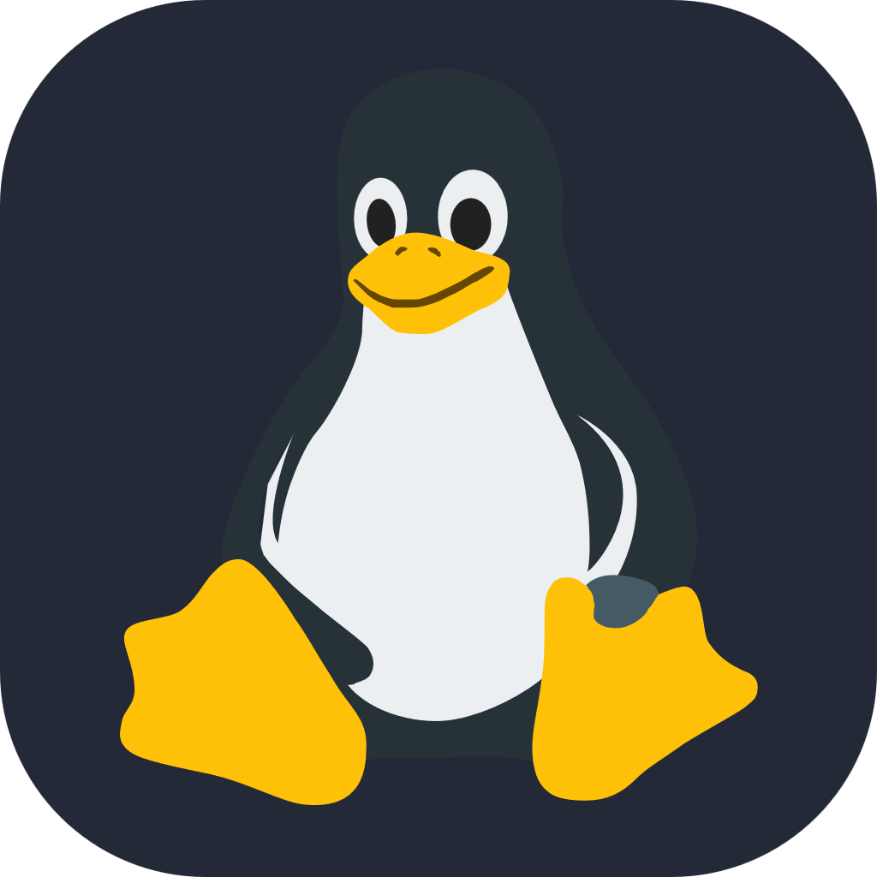
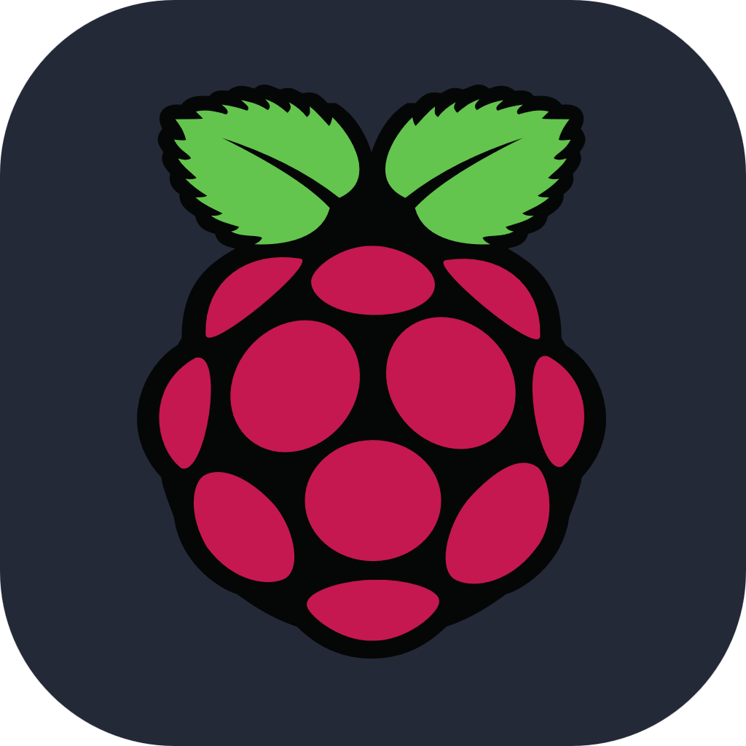


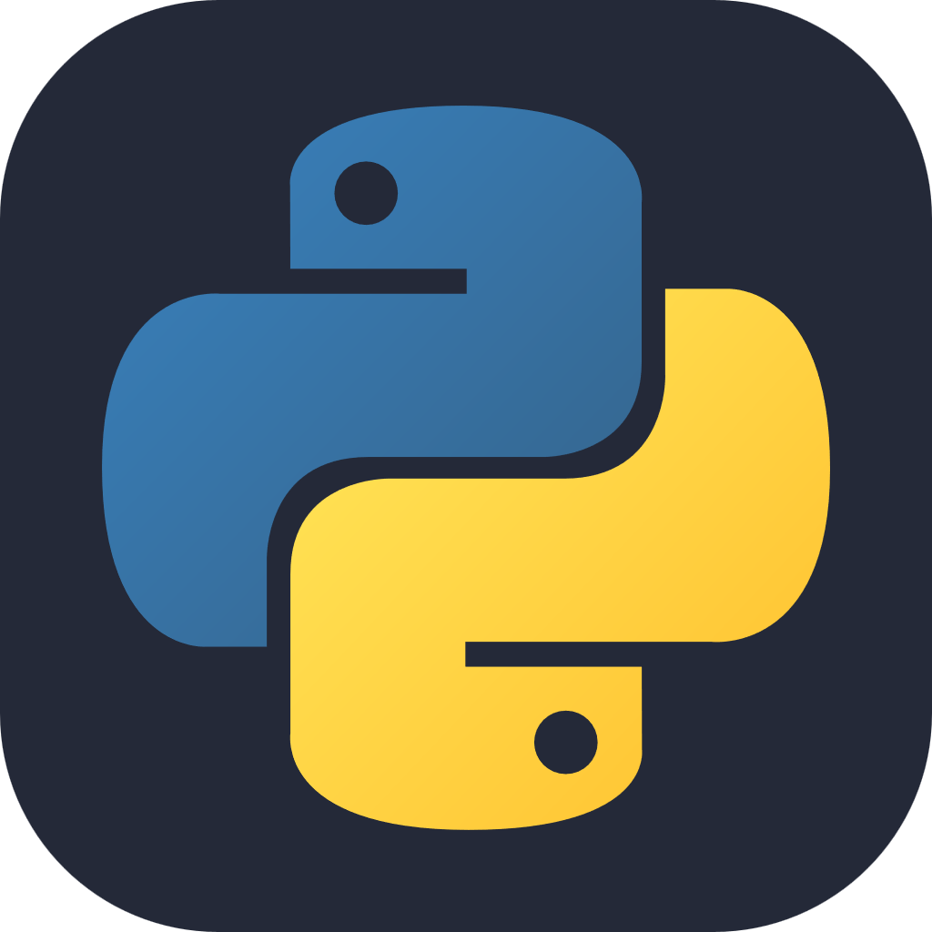



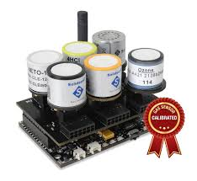
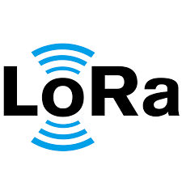

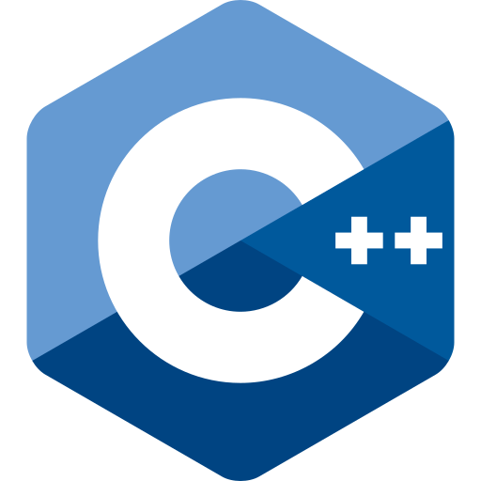
Application
The app combines technologies such as Libelium, Raspberry Pi 3 Model b+, Python 3.10, MQTT, JavaScript, HTML, CSS, CPP, LoRa, The Things Network, PostgreSQL
In general, there are 4 layers
Data Sensing (Libelium + sensors)
Data Forwarding (Raspberry Pi LoRa GW)
Data Distribution (The Things Network)
Data Retrieval - Web Service (Python Services)

Slide 7
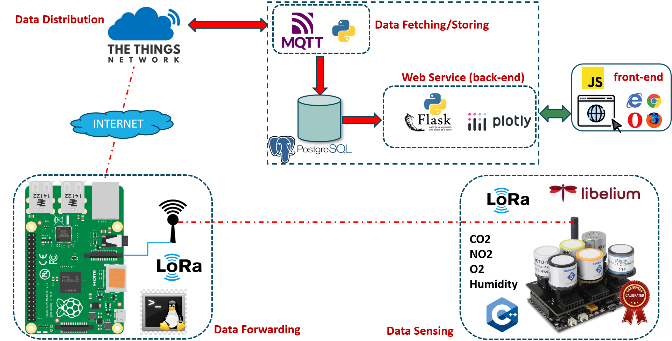
Architectural View

Slide 8
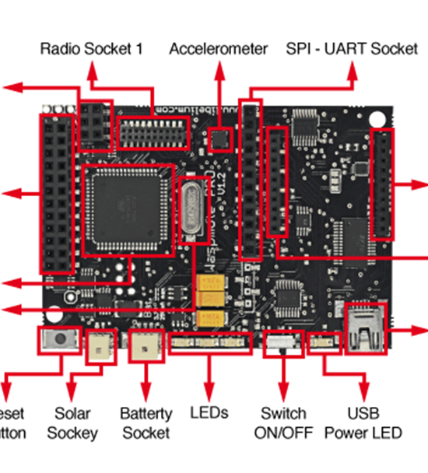
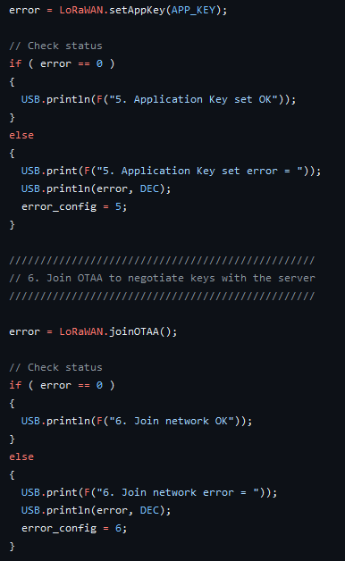
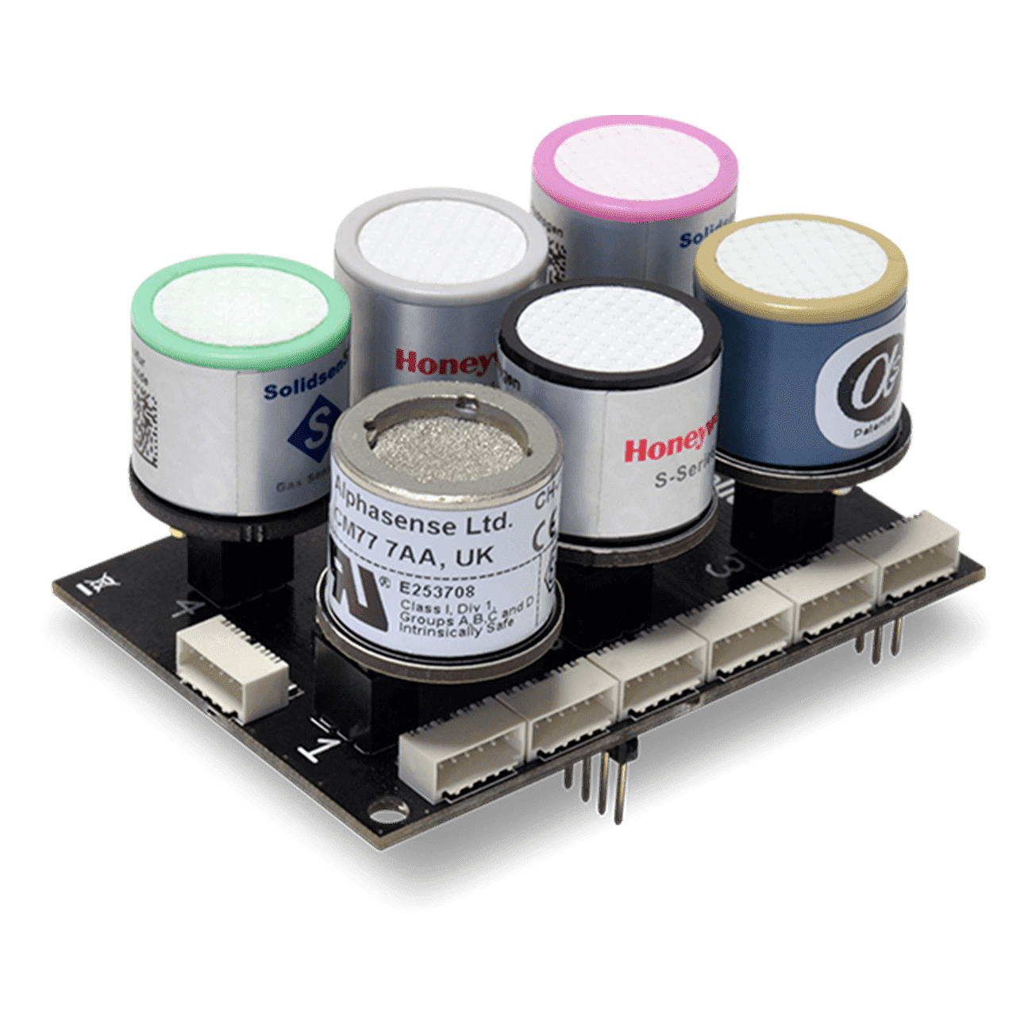
Data Sensing
Libelium Wasp mote act as Data Producer
Wasp mote senses the environmental metrics
Transmits data through LoRa
Collects data through Sensirion (CO2, O2, NO2, Temperature) sensors
Firmware based on custom CPP

Slide 9
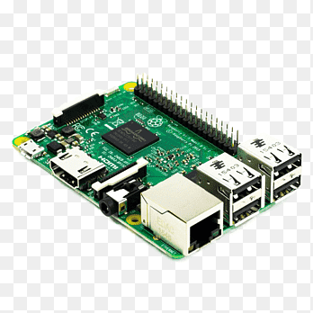
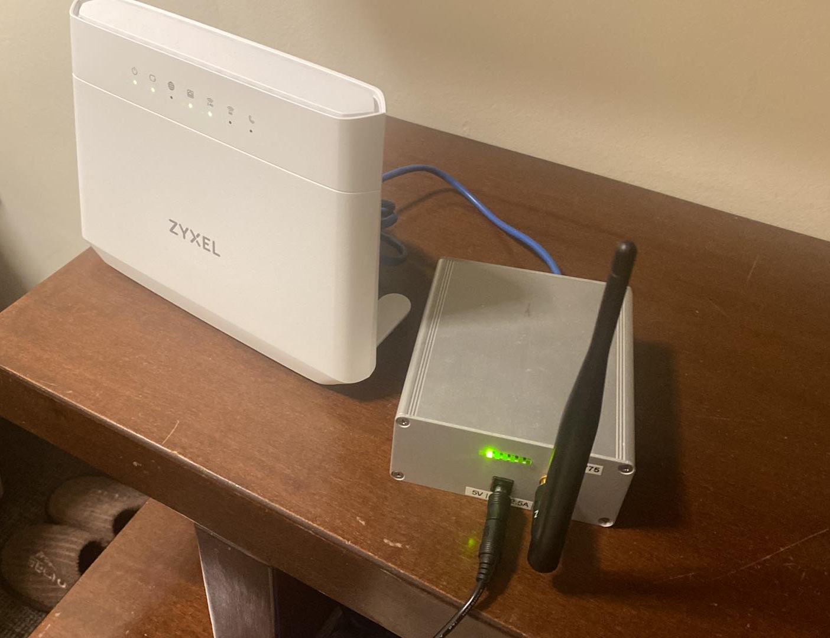
Data Forwarding
Raspberry Pi 3 act as Data Forwarder
Raspbian OS
Linux Shell CMDs
Connects to the Things Networks (TNN)
Receives metrics via LoRa
Forwards them to the TNN through Internet connection

Slide 10
Data Distribution
The Things Network
Account → Gateway → Applications
Data Storage service
Data Fetching service via MQTT protocol
Generic View

Slide 11
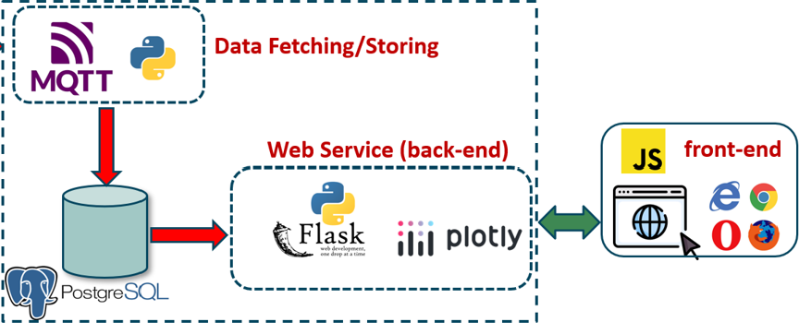
Data Retrieval
2 Python Services
1st MQTT App: Fetch Data from TNN service and stores them into a PostgreSQL DB
2nd Environmental Monitoring: Runs Web Service serving web pages, live plots reading from PostgreSQL DB

Slide 12

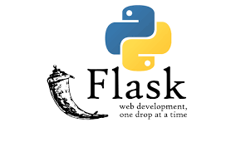




Front-End Concept
Back-End
Front-End
HTTP GET API
FETCH GET
Register, Authenticate User
View Dashboard
View Live-Plot GET

Slide 13
Contact
Stefanos Plastras
s.plastras@gmail.com
GitHub: https://github.com/steve-pla
Lefteris Tsipis
ltsipis@aegean.gr
GitHub: https://github.com/LefterisTsipis

