Slide 1

Smart & Sustainable Wash Machines Live Monitoring App
Project from the Students of University of the Aegean to the students!
University of the Aegean
Dept. of ICSD, Mathematics and Statistics – Samos University Region

Slide 2
Who we are ?
Nikos Rekkas (alumni), Vasilis Katirtzoglou (undergraduate) and Stefanos Plastras (alumni), members of the University of the Aegean, Information & Communication System Engineering (ICSE) Dept.
Mainly software developers with passion, time and motivation to design and implement this idea from a concept to a reality!
Nikos mainly involved in the hardware designing and implementation, Vasilis in the hardware installation in the field of wash machines and in testing the application while Stefanos in the development of the back/front-end software needed to run the application.

Slide 3
When it all started ?
Back to February of 2023 in Neo Karlovasi, Samos. Came from on-site contact and discussion regarding the live monitoring of wash machines for the local students rooms.
Project design and implementation started on March of 2023 and completed on June 2023. On 28th June, the first public release (v1.0.0) was ready (GitHub repo)!

Slide 4

Main Idea
We want to:
View in Web, the wash machines states every time
Our goal:
Develop entire data pipeline system
Create Web service offering this functionality
Making it public through local network
Promoting open-source project
Project place
GitHub Repo: https://github.com/stevpla/wash_machines_monitoring_project

Slide 5


All-in-One
Our concept utilizes eco-friendly approach due to ESP32-MCU low-power IoT device
Sustainability in wash machines longer lifecycle (Predictive maintenance)
Low-cost solution
Scalable (More AC sensors)
Upgradable (Any hardware part)
Agnostic-vendor (Plug-n-Play)
Open-source

Slide 6
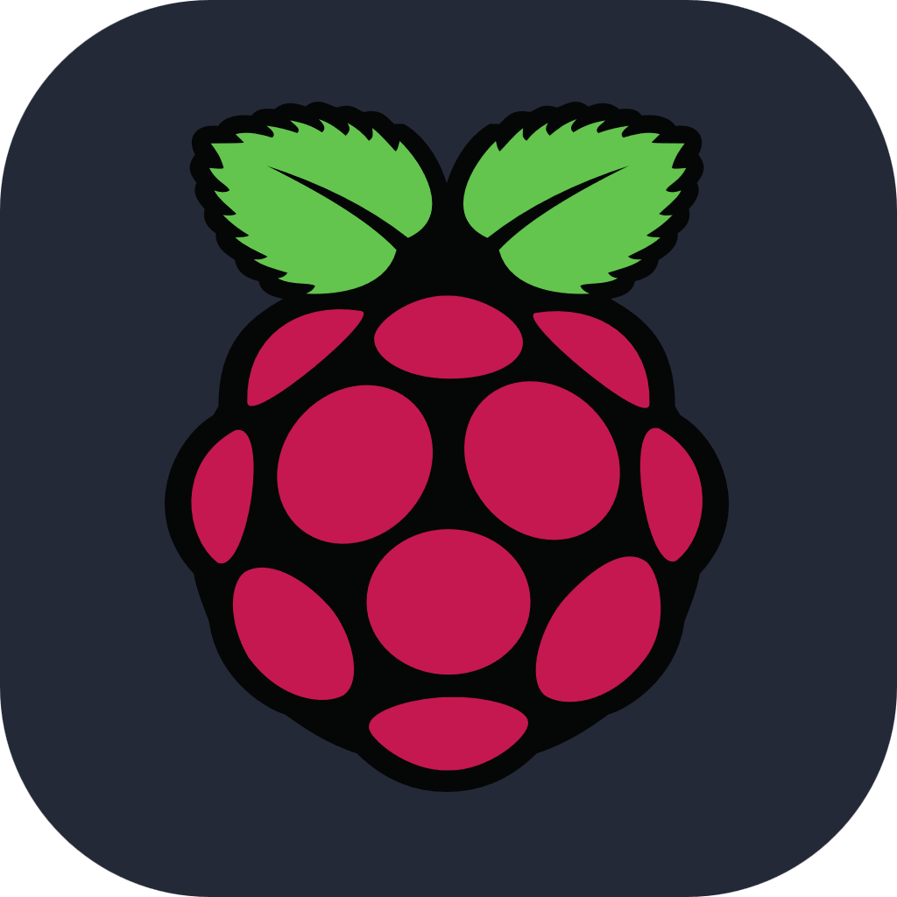


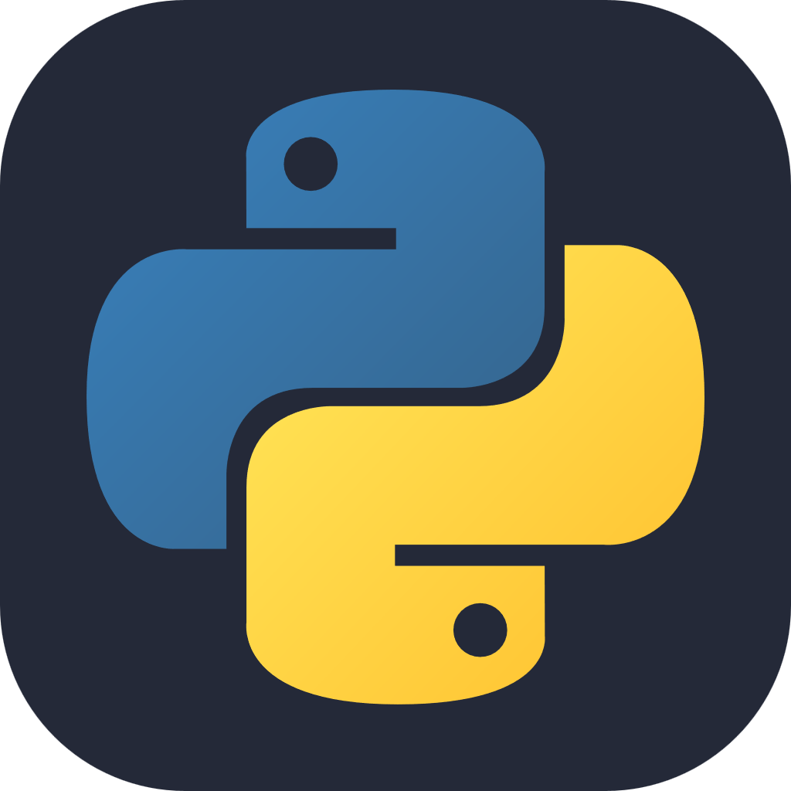






Application
The app combines technologies such as ESP32, Raspberry Pi 3 Model b+, Python 3.10, MQTT, JavaScript, HTML, CSS, CPP
In general, there are 4 layers
Data Producer (ESP32)
Data Broker (Raspberry Pi )
Data Consumer (Raspberry Pi )
Web Service (Raspberry Pi )

Slide 7
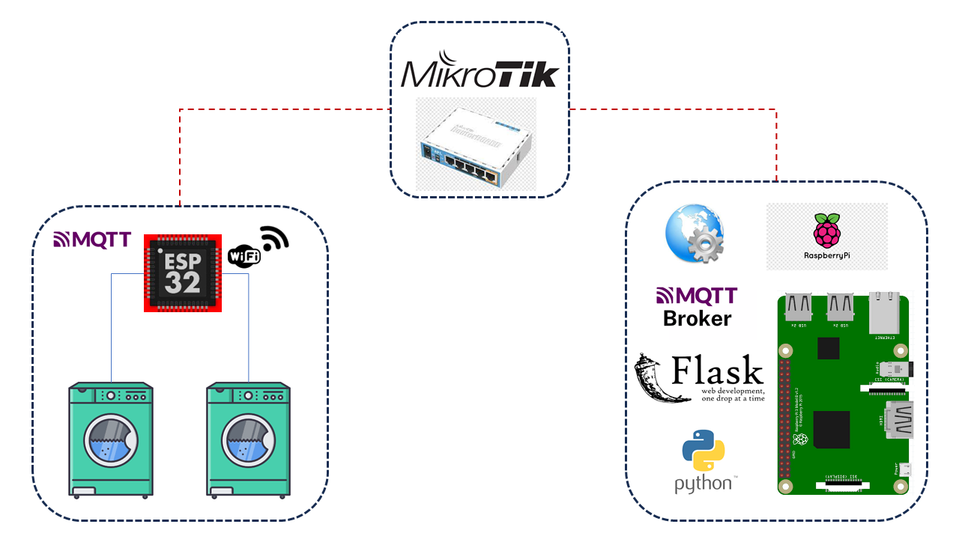
Architectural View
Data Consumption
Web Interface
Data Production
Data Transmission

Slide 8
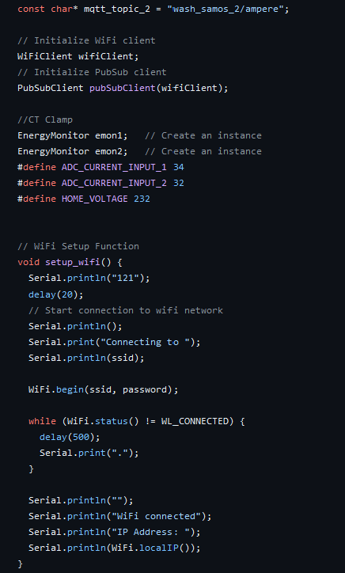
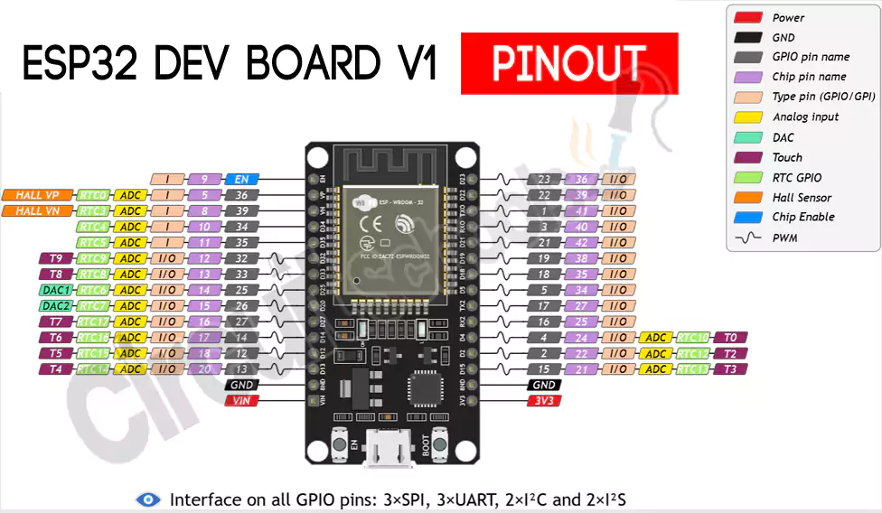
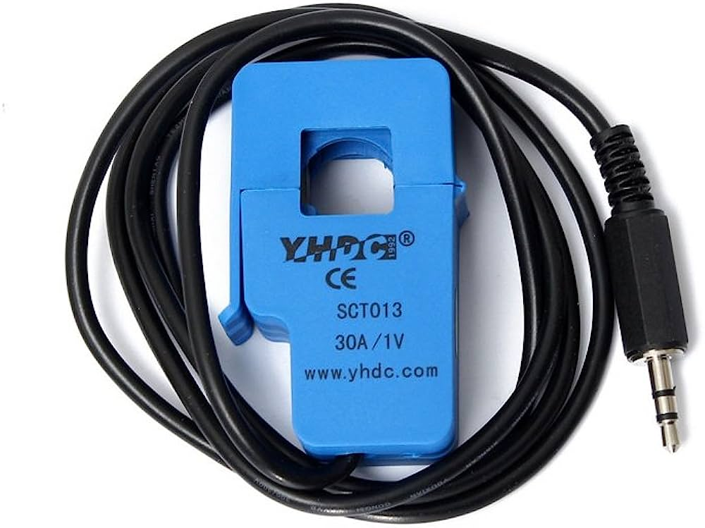
Data Producer
ESP32-MCU act as Data Producer
MQTT Data Producer
Transmits data through Wi-Fi
Collects data through 030 AC Sensors (x2)
Firmware based on custom CPP

Slide 9
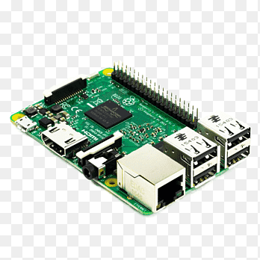
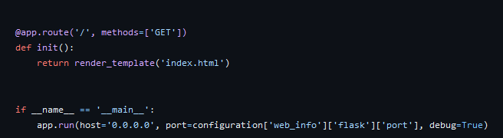
Data Broker-Consumer
Raspberry Pi 3 act as Data Broker-Consumer
Raspbian OS
MQTT Broker
MQTT Consumer (Subscribes to the topics)
Python Service for data consuming, providing web interface (flask_mqtt)

Slide 10
Raspberry Pi 3 Model B+ Service View
LAN
IF
Flask – 8000 port
Broker
mqtt client– 1883 port
Mosquito Service
Python Service

Slide 11
Raspberry Pi 3 Model B+ Service View Plus Statistical Information
LAN
IF
Flask – 8000 port
Broker
mqtt client– 1883 port
DB Handler
Mosquito Service
Python Service
MongoDB
04-Jul-23

Slide 12





Front-End Concept
Back-End
Front-End
HTTP GET API
FETCH GET
Retrieve wash machines states and timestamp
mqtt_subscribe
Implement control logic as back-end GET

Slide 13
Contact
Nikos Rekkas
nrekkas@gmail.com
GitHub: https://github.com/nikosrk
Vasilis Katirtzoglou
Stefanos Plastras
s.plastras@gmail.com
GitHub: https://github.com/stevpla

