Slide 1
Static Type Analysis of Dynamically Typed Programming Language
Author: Štěpán Šindelář (43600220)
Supervisor: Matthew Roberts

Slide 2
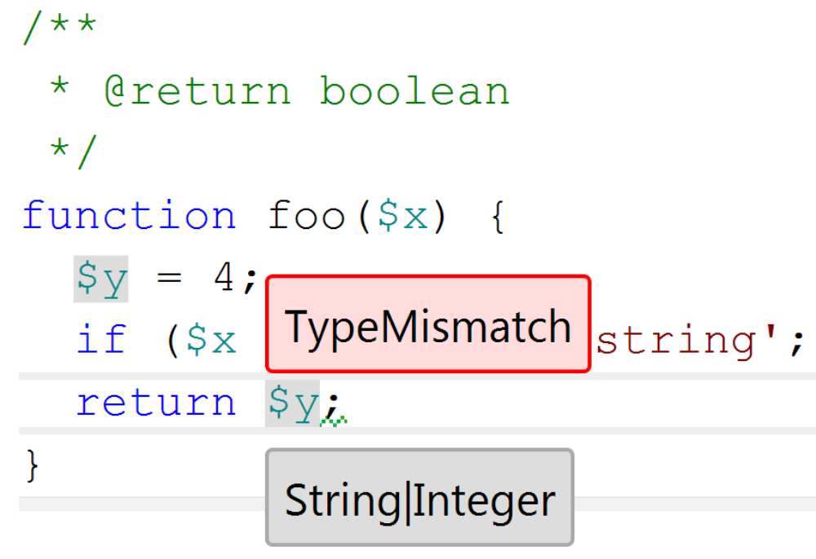
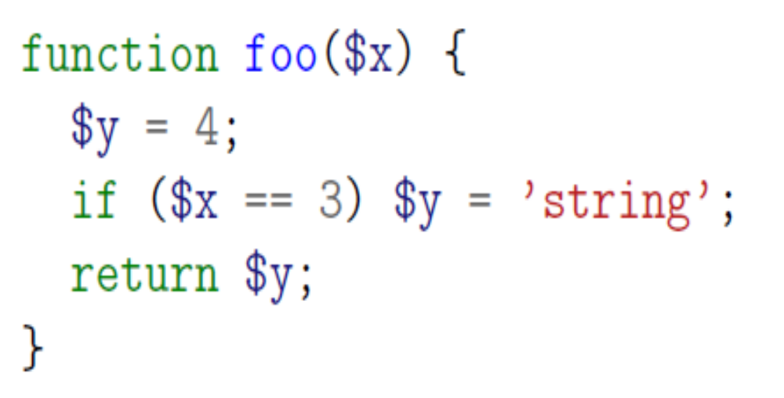
The Aim: Static Type Analysis of PHP Code
PHP is a dynamic language → no type information, one variable: multiple types.
Static Analysis: analyse the code without executing it.
  can guarantee termination and bounds on complexity
Aim: use static analysis to infer type information
  useful for integrated development environments
  useful for compiler back-ends
In the context of Phalanger project
  The PHP compiler for .NET written in C#

Slide 3
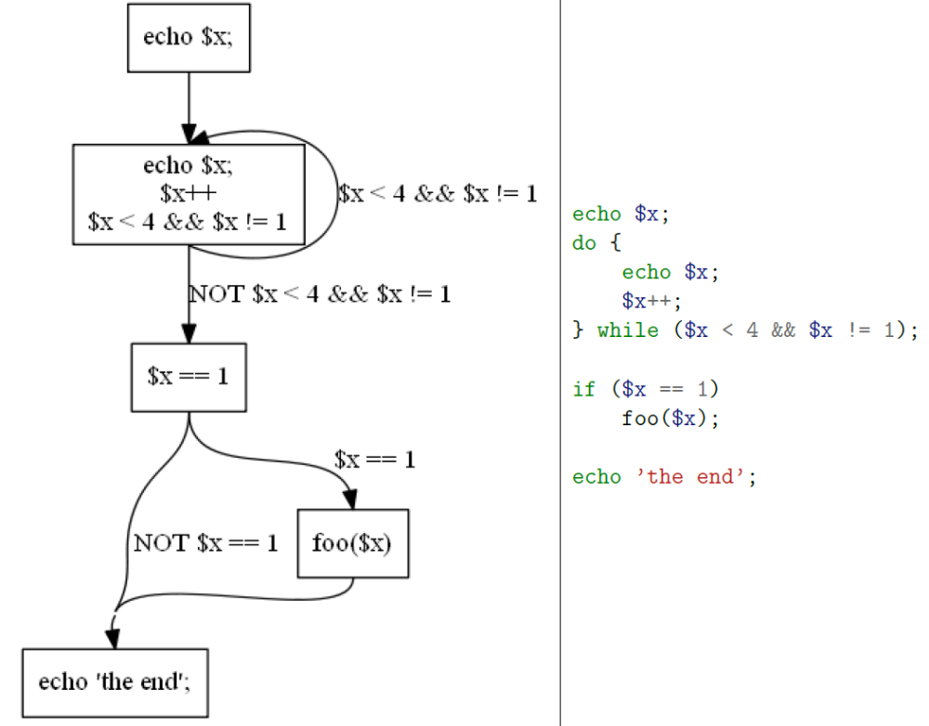

Work to be done
Research into various methods for static analysis
Implementation
  Control Flow Graph construction
  Generic framework for Data Flow Analysis
  Type Analysis based on the generic framework
Evaluation
Final Report & Presentation

Slide 4
Work to be done
Research into various methods for static analysis
Implementation
  Control Flow Graph construction
  Generic framework for Data Flow Analysis
  Type Analysis based on the generic framework
Evaluation
Final Report & Presentation

Slide 5
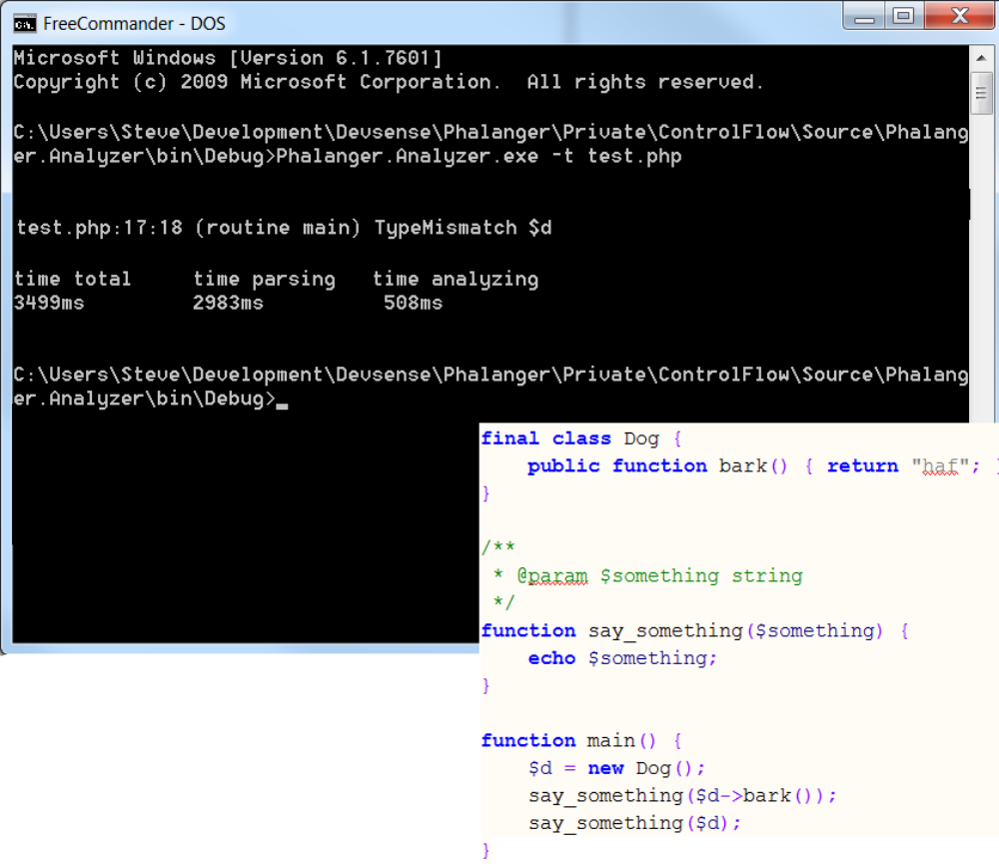
Type Analysis Based on the Generic Framework
Finish the implementation
Provide a Command Line Interface
  for testing & evaluation purposes
Due today :-)

Slide 6



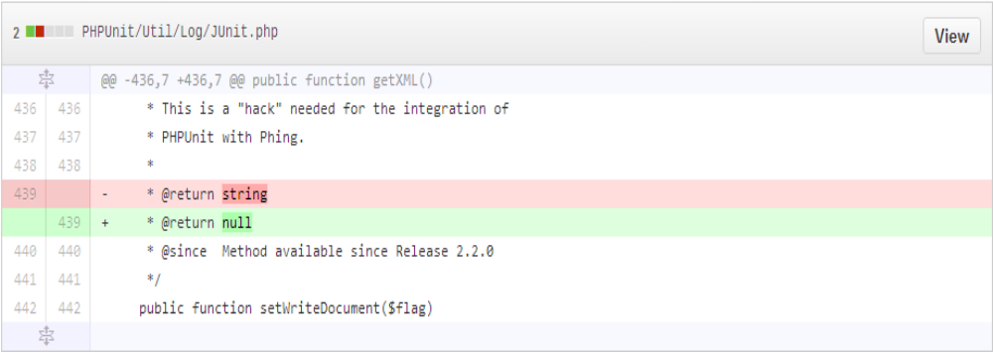
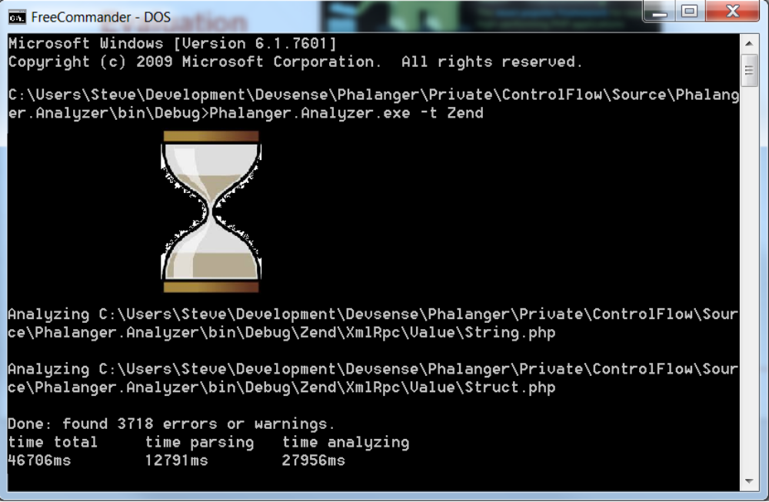
Evaluation
Several PHP open source projects
  Zend Framework, WordPress, PhpUnit ...
Run the analysis on their source code
  fix bugs where possible
  record actual errors discovered by the tool
  possibly: performance benchmarking
  possibly: compare to other tools' results

Slide 7
Final Report & Presentation

Slide 8
Thank you for you attention
QA

