Slide 1
Static Type Analysis of Dynamically Typed Programming Language
Author: Štěpán Šindelář (43600220)
Supervisor: Matthew Roberts

Slide 2
Outline
The aim of the project
Related work
  Static analysis theory
  Existing tools
Design and Implementation
Demo
Evaluation
Conclusion

Slide 3
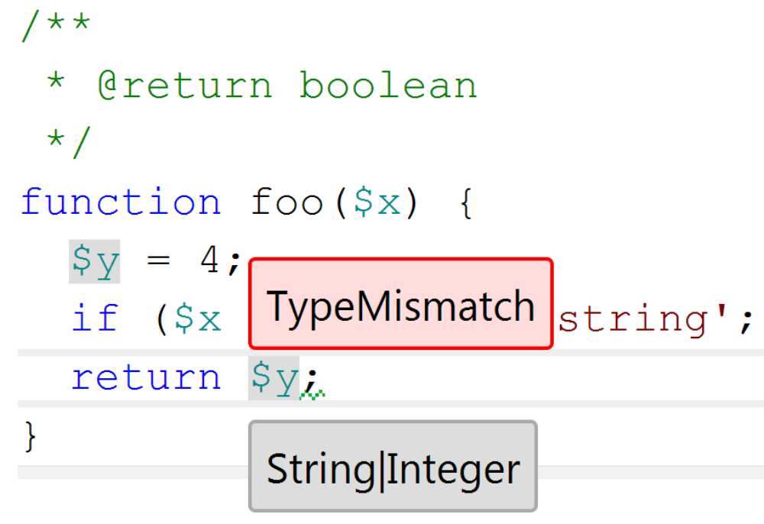
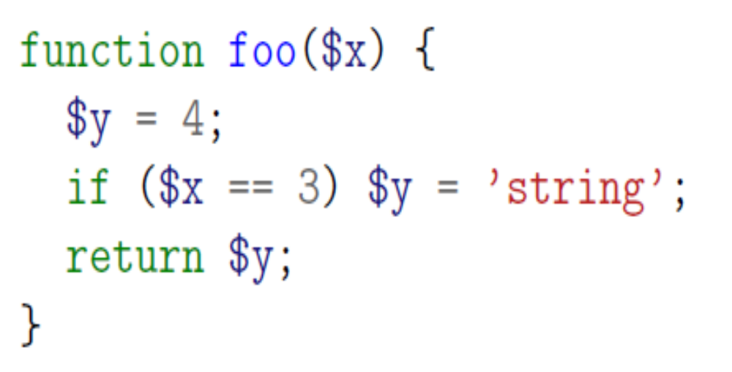
The Aim: Static Type Analysis of PHP Code
PHP is a dynamic language → no type information, one variable: multiple types.
Static Analysis: analyse the code without executing it.
  can guarantee termination and bounds on complexity
Aim: use static analysis to infer type information
  useful for integrated development environments
  useful for compiler back-ends
In the context of Phalanger project
  The PHP compiler for .NET written in C#

Slide 4
Outline
The aim of the project
Related work
  Static analysis theory
  Existing tools
Design and Implementation
Demo
Evaluation
Conclusion

Slide 5

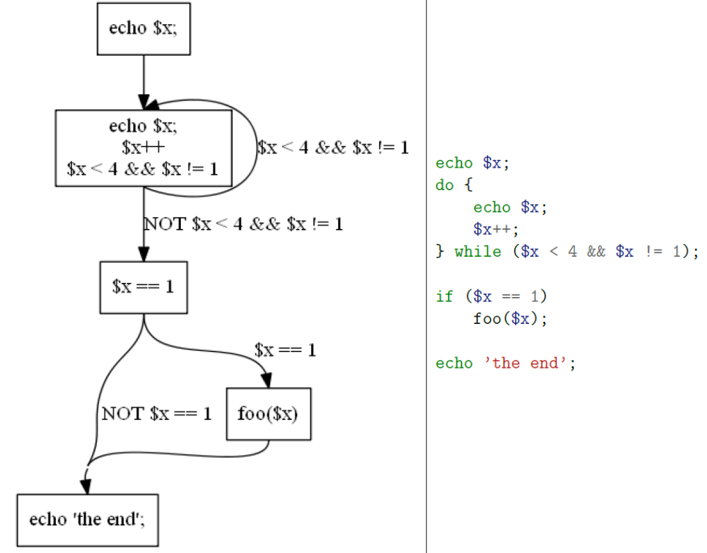
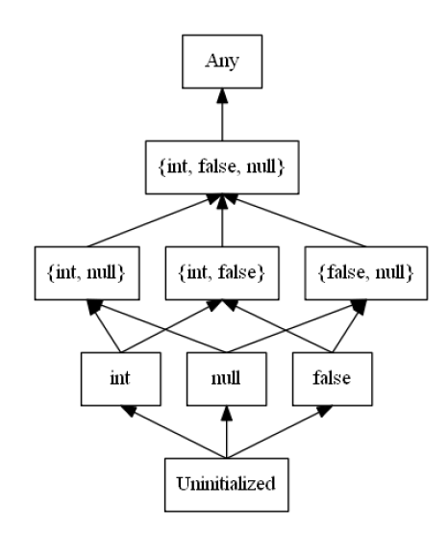
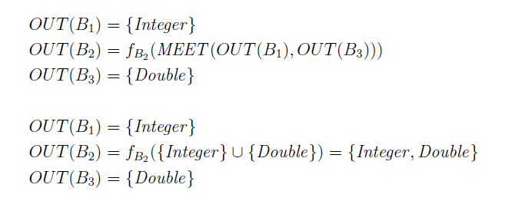
Related Work: Static Analysis
Data-flow Analysis (DFA) - the de-facto standard for optimizing compilers and basis for other approaches
  control flow graph
  data-flow equations
  iterative algorithm to solve the equations
Our task
  choose the data flow values (domain)
  deal with intraprocedural analysis
  deal with real world programming language - PHP...
    inheritance, polymorphism, type conversions, ...
  ... and its caevats
    aliasing (pointers), incomplete code, ...,

Slide 6
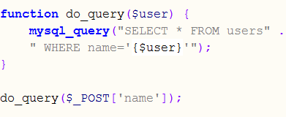
Related Work: Existing Tools
Focused on security analysis of Web applications
  Weverca, Pixy
  Have to follow where the
  data values go, not only types.
  Precise memory model
Type inference for PHP
  Phantm
  although only type inference,
  similarly powerful memory model

Slide 7
Related Work: Existing Tools
Precise memory model
  Have to follow where the data values go, not only types.
  Precise memory model
Our approach: modularity
  summarize the expectations and
  (side) effects of all functions in generic setting
  compose everything together
  Not as precise, but simpler and
  allows more efficient implementation

Slide 8
Outline
The aim of the project
Related work
  Static analysis theory
  Existing tools
Design and Implementation
Demo
Evaluation
Conclusion

Slide 9
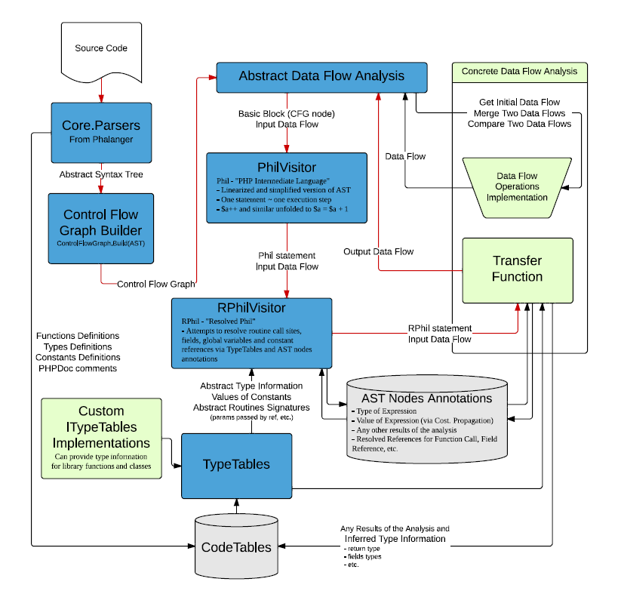
Design and Implementation
Focus on modularity and reusability
Integration with the rest of Phalanger project
Extensive test suite
  ~2K lines of PHP code for testing

Slide 10
Outline
The aim of the project
Related work
  Static analysis theory
  Existing tools
Design and Implementation
Demo
Evaluation
Conclusion

Slide 11
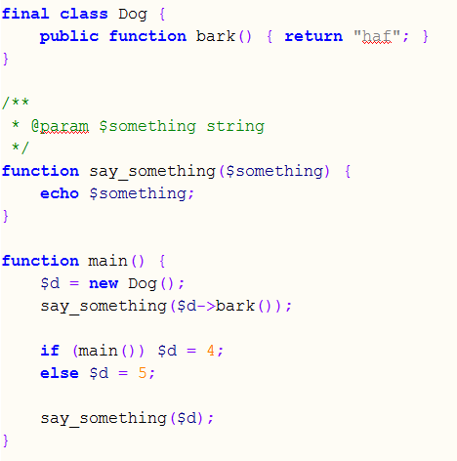
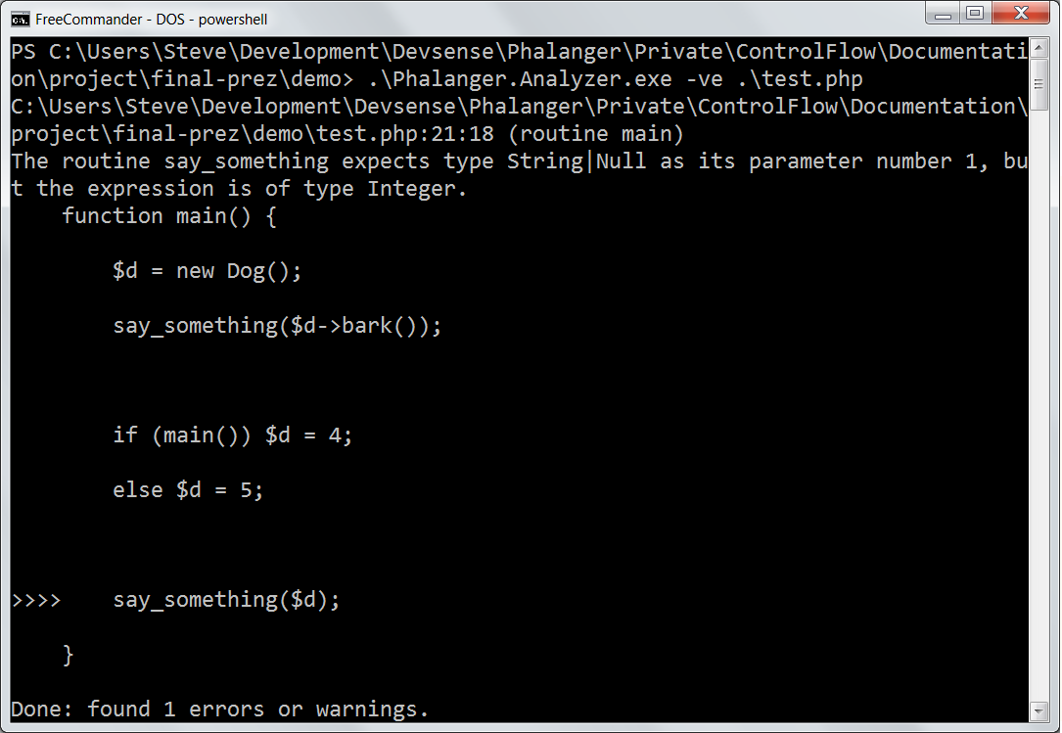
Demo

Slide 12
Outline
The aim of the project
Related work
  Static analysis theory
  Existing tools
Design and Implementation
Demo
Evaluation
Conclusion

Slide 13


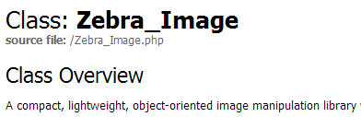
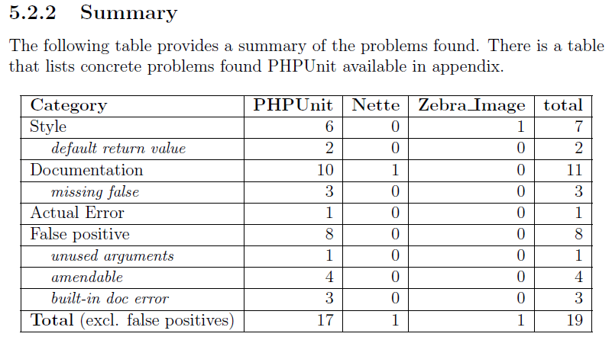
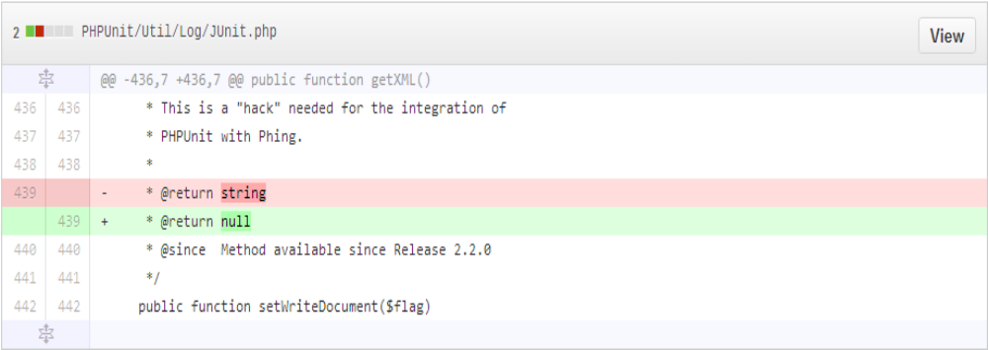
Evaluation
PHP open source projects
  Zebra_Image, PHPUnit, Nette
Run the analysis on their source code
  fix bugs where possible
  record actual errors discovered by the tool
  possibly: performance benchmarking
  possibly: compare to other tools' results

Slide 14
Outline
The aim of the project
Related work
  Static analysis theory
  Existing tools
Design and Implementation
Demo
Evaluation
Conclusion

Slide 15
Conclusion
Even without complex memory abstraction, the tool is capable of discovering real issues in the source code with good ratio of false positives
Were some imprecision in the analysis results can be tolerated, the modular approach we used can give results comparable to those of tools that use more complex methods.
Future Work:
  more evaluation
  intergration with the compiler, performance evaluation of the emitted code
  arrays support
  performance tuning and performance evaluation

Slide 16
Thank you for you attention
QA

Slide 17
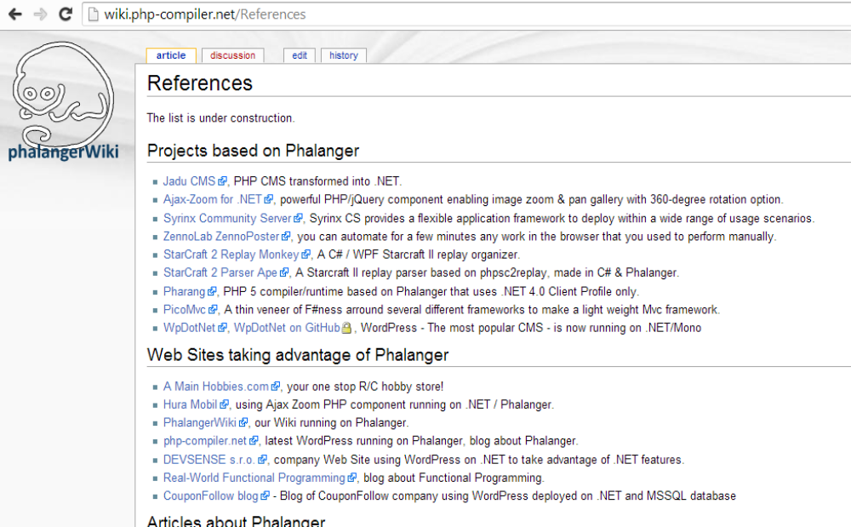
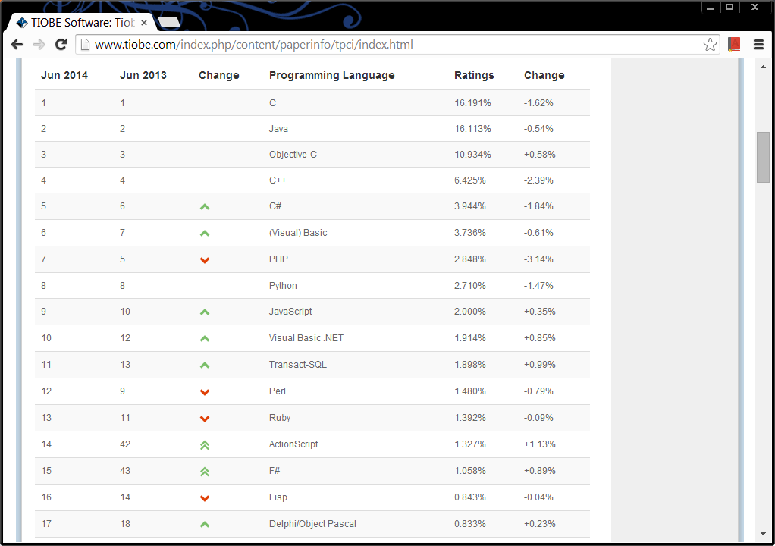

Slide 18
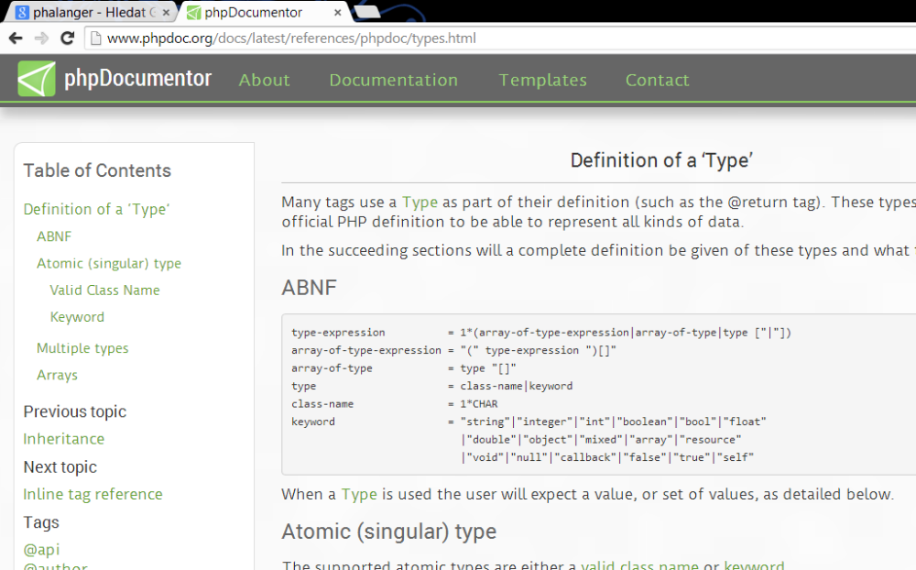
PHPDoc

