Slide 1
FDI and Uncertainty
2024/8/14

Slide 2
Compare the first 2 and last 3 characters
Compare the first two characters and the last three characters of the industry name.
If the industry in “twindustry_to_isic” satisfying this condition is singleton, we get the match.
The industry in “上市公司對外投資事業名錄” is left unidentified if there is no industry satisfying the condition or there is multiple industry satisfying it.

Slide 3
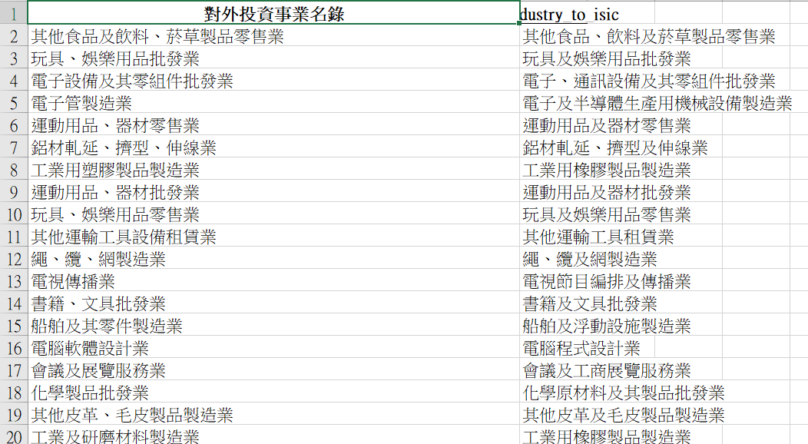
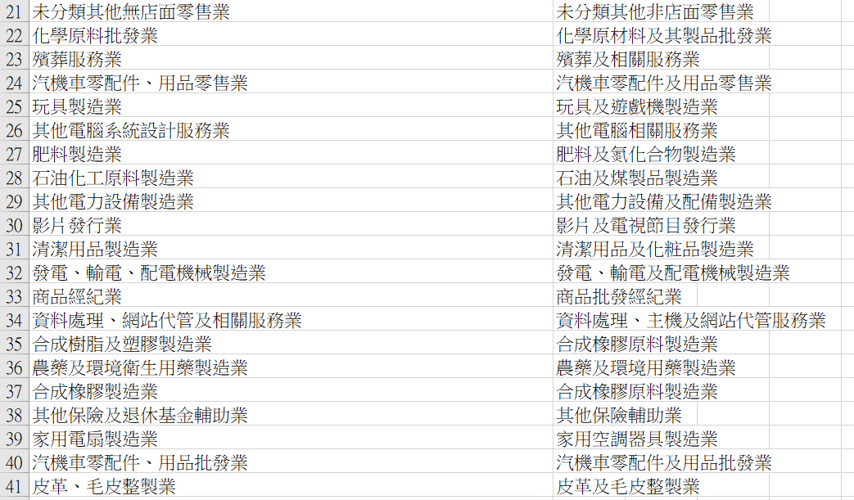
Correspondence using F2L3

Slide 4
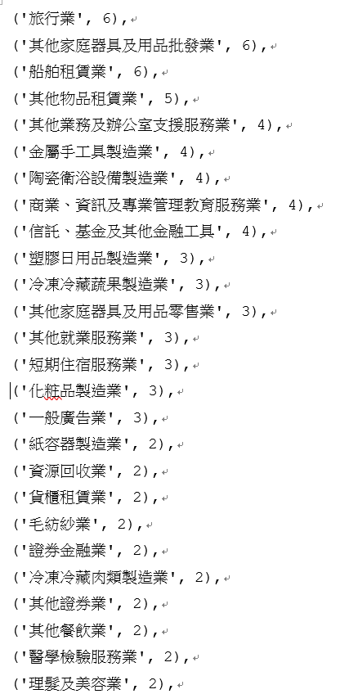
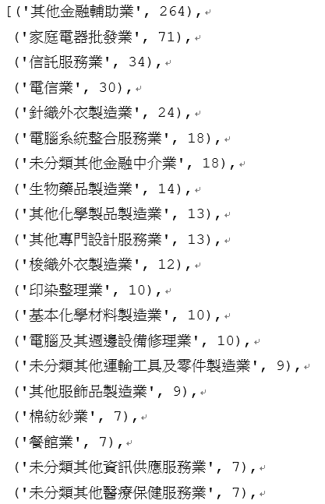
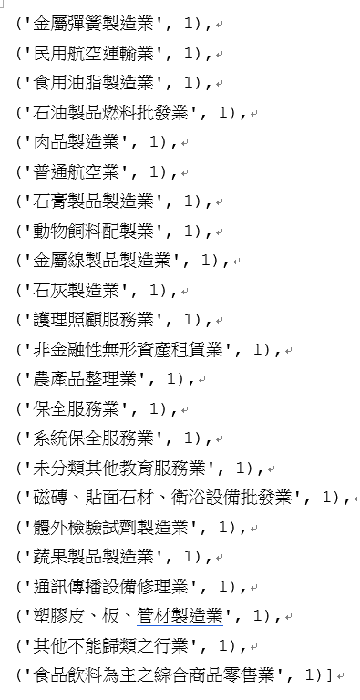
Still unidentified after F2L3

Slide 5
Use the text similarity technique to match
Levenshtein distance (character-based method)
Jaccard similarity (token-based method)

Slide 6
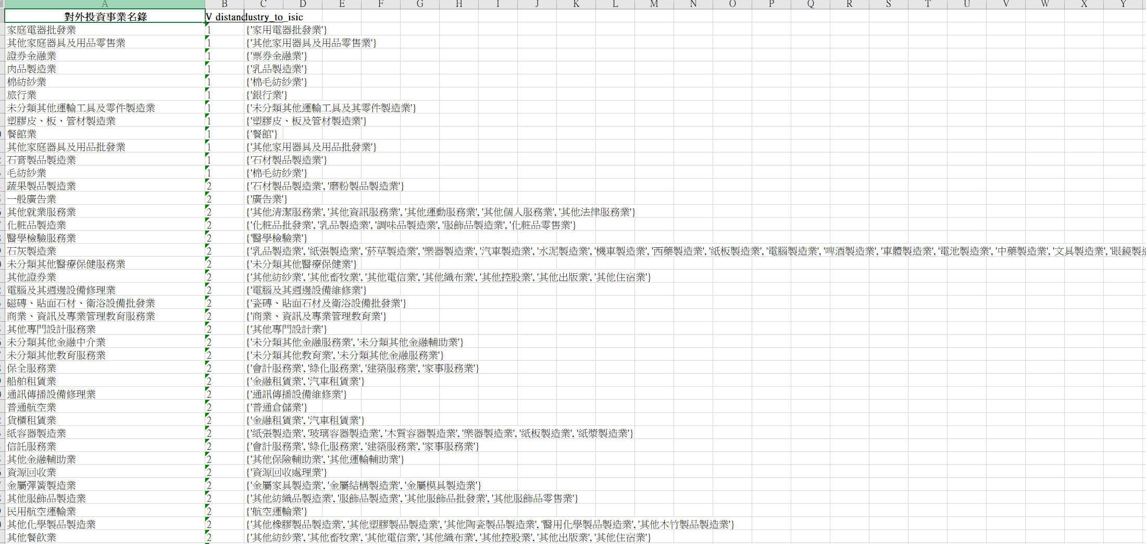
Correspondence using Levenshtein Distance

Slide 7
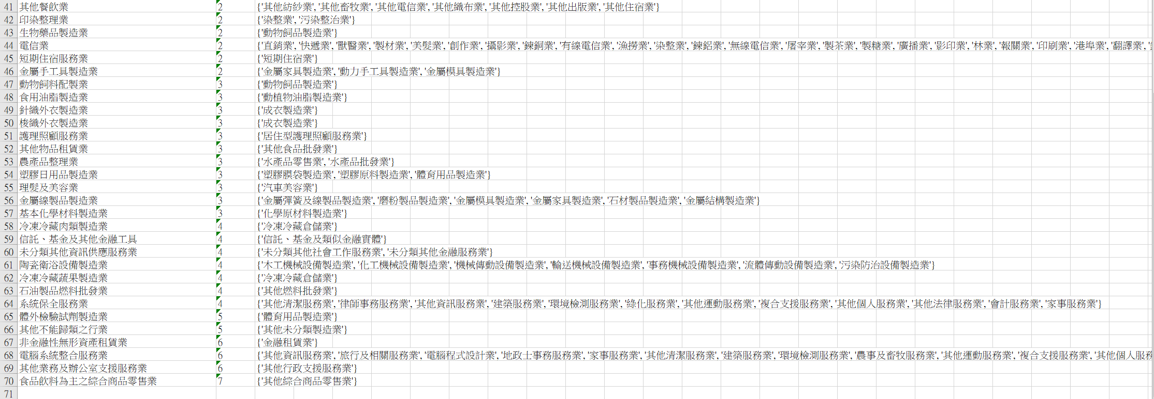
Correspondence using Levenshtein Distance (continued)

Slide 8
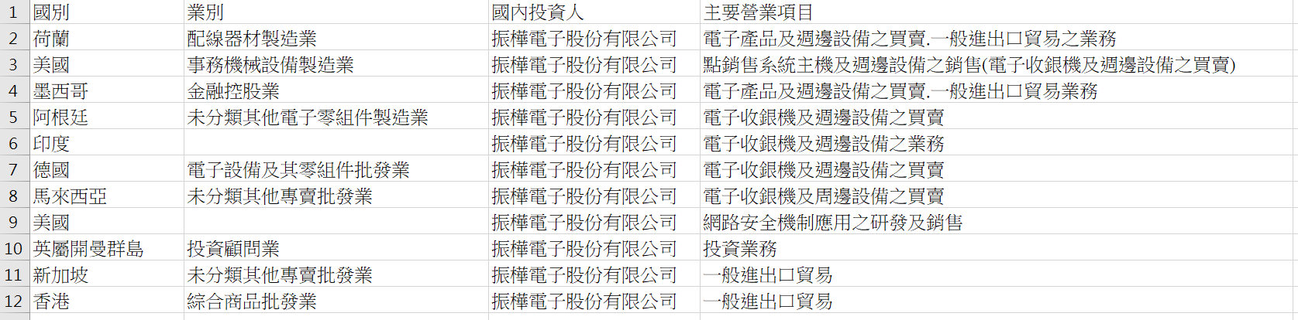
Identify using information of 主要營業項目 (for the observations without industry name entry)

Slide 9
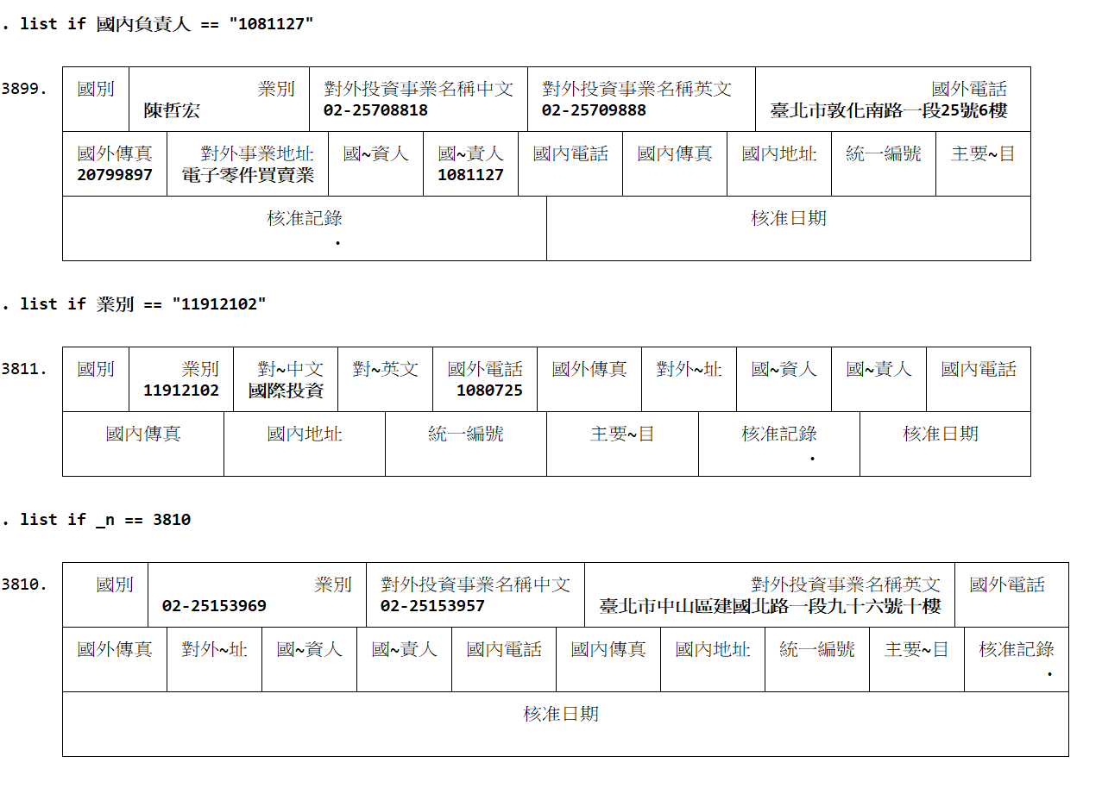
Some observations deleted

