Slide 1
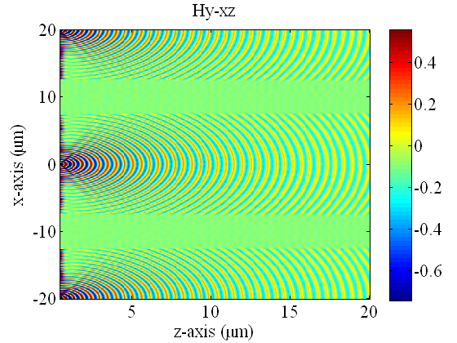
PML_width : 5 lambda

Slide 2

PML_width : 4 lambda

Slide 3
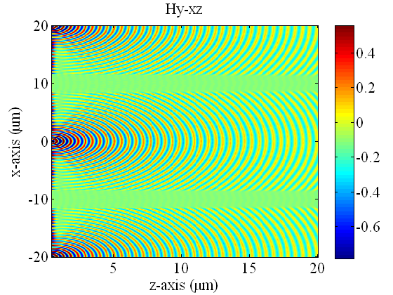
PML_width : 3 lambda

Slide 4

PML_width : 2 lambda

Slide 5

PML_width : 1 lambda

