Slide 1
右倾 -> 左旋
1
5
5
5
1
7
3
7
3
7
3
1
好像好一些
好像不如前一个

Slide 2
右倾 -> 左旋
1
5
2
5
1
7
3
7
2
3
这个例子更能体现优势

Slide 3
左倾 -> 右旋
9
5
5
11
3
9
3
7
1
7
11
1

Slide 4
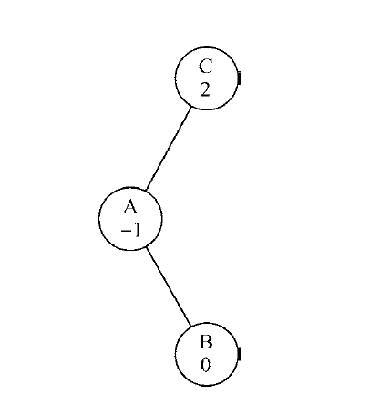
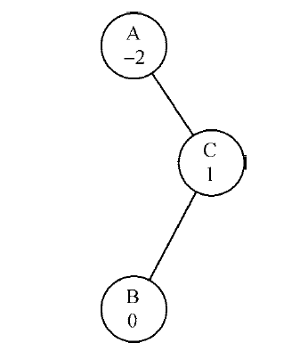

Slide 5
(Step 1)
(dfn, low)
(1, 1)
(, )
B
C
D
(, )
假设A先走了B
(3, 31)
A
F
(, )
E
(, )
H
G
(2, 2)
(, )

Slide 6
(Step 2)
(dfn, low)
(1, 1)
(, )
B
C
D
(, )
(3, 31)
A
F
(5, 5)
E
(, )
H
G
(2, 2)
(4, 4)

Slide 7
(Step 3)
(dfn, low)
(1, 1)
(, )
B
C
D
(, )
(3, 31)
A
F
(5, 51)
E
(, )
H
G
(2, 2)
(4, 41)

Slide 8
(Step 4)
(dfn, low)
假设6先探索了DE这条支路
(1, 1)
(6, 6)
B
C
D
(7, 7)
(3, 31)
A
F
(5, 51)
E
(8, 8)
H
G
(2, 2)
(4, 41)

Slide 9
(Step 5)
(dfn, low)
假设6先探索了DE这条支路
(1, 1)
(6, 61)
B
C
D
(7, 7)
(3, 31)
A
F
(5, 51)
E
(8, 8)
H
G
(2, 2)
(4, 41)

Slide 10
(Step 6)
(dfn, low)
假设6先探索了DE这条支路
(1, 1)
(6, 61)
B
C
D
(7, 7)
(3, 31)
A
F
到现在A才遍历完所有下家，
才能确定H和B的low值
(5, 51)
E
(8, 8)
H
G
(2, 21)
(4, 41)

Slide 11
A
D
E
F
H
B
G
C

Slide 12
(dfn, low)
A
(1, 1)
A
B
C
(2, 1)
B
D
E
(3, 1)
(4, 2)
D
C
(5, 2)
E
A
B

