Slide 1

We are INSUREU
Laxman Singh(A0178223E) <e0267534@u.nus.edu>
Ramasamy Muthuraman(A0179756H) <e0269775@u.nus.edu>
Tan Chee Wei(A0179723U) <cw.tan@u.nus.edu>

Slide 2
Agenda
Business Problem Statement
Architecture
Design - Logical Data Model
Design - Physical Data Model
Dashboard (4 slides)
Conclusion
Action items

Slide 3
Business Problem Statement
Identify financial protection gap for Singapore residents and How to address the Gap
Query
Are you underinsured?
What’s your insurance need?
Can your insurance coverage keep up with the rising cost?
Are you properly covered pre and post retirement?
Focus
Critical Illness protection gap, Family Expense and life expectancy
Five Most important Insurance types:
Health
Term Life
Whole life
Critical Illness (CI)
Personal Accident

Slide 4




Architecture
Excel
ETL
SQL Server
(DWH)
PDF
L
T
E
JSON
CSV
Desktop

Slide 5
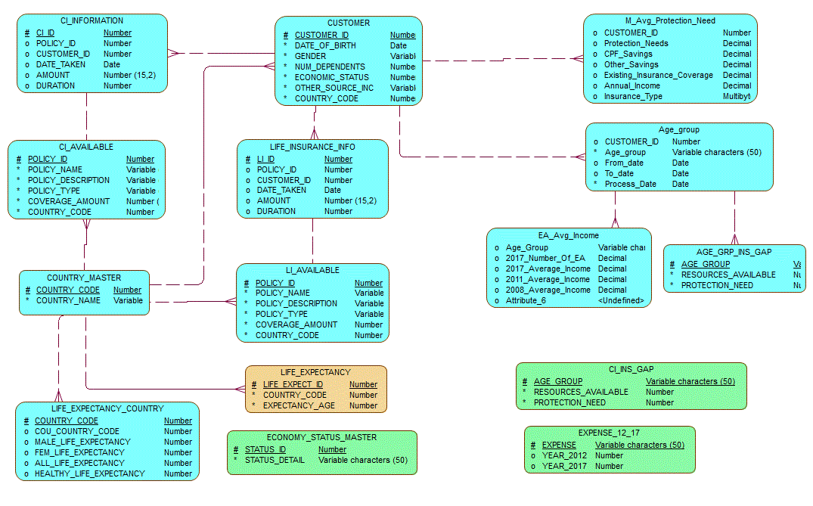
Design – Logical Data Model

Slide 6
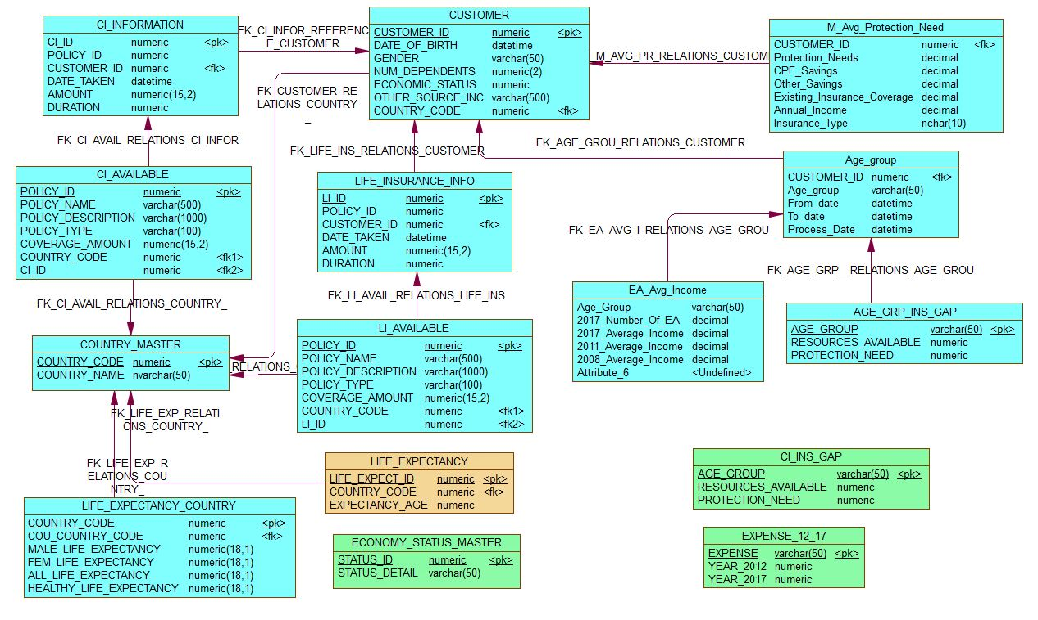
Design – Physical Data model

Slide 7
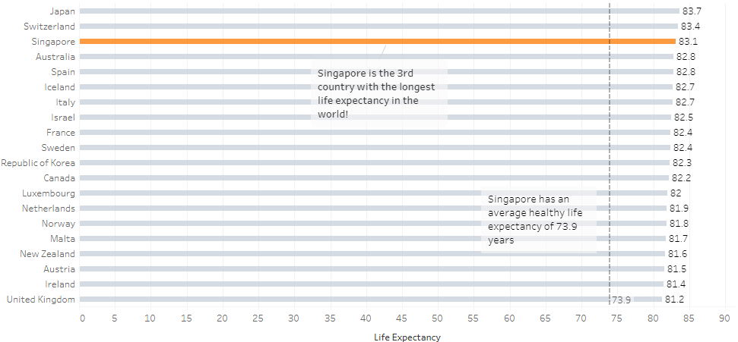
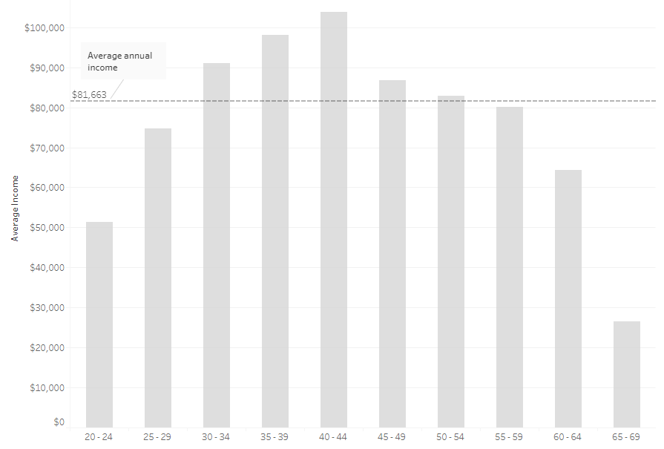
Visualization (Dashboard 1 of 4)
Average Life Expectancy
Average Annual Income

Slide 8
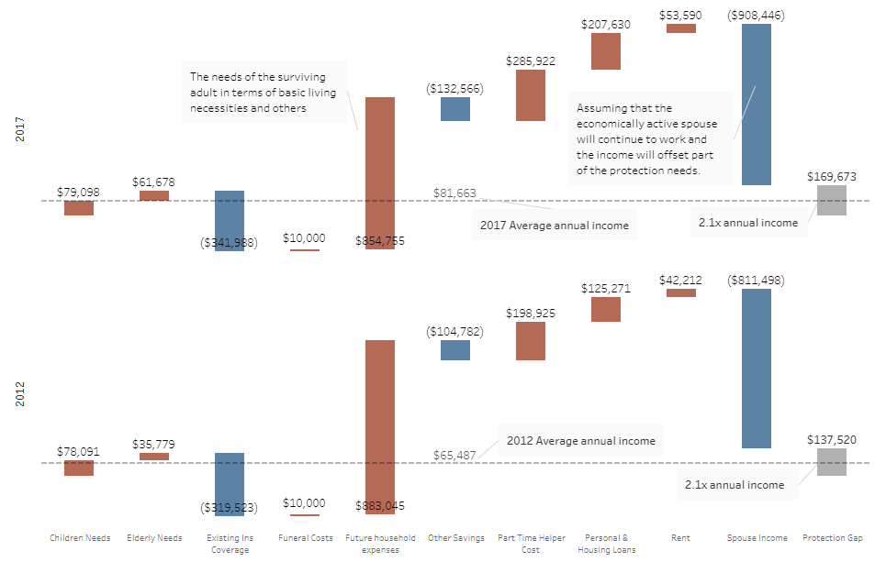
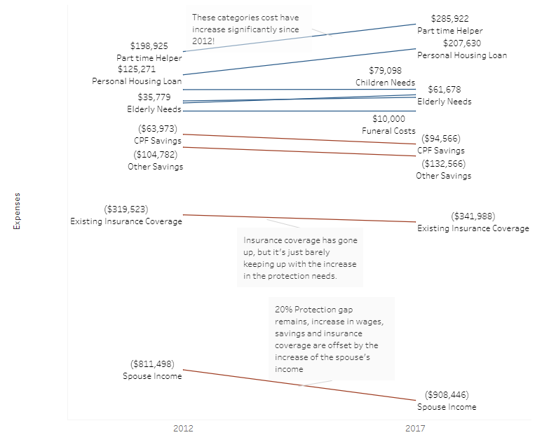
Visualization (Dashboard 2 of 4)
Mortality Protection Gap Breakdown
Mortality Protection Gap Changes Between 2012 vs 2017

Slide 9
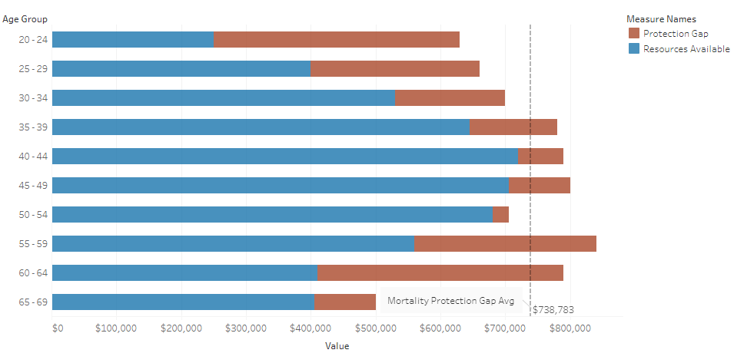
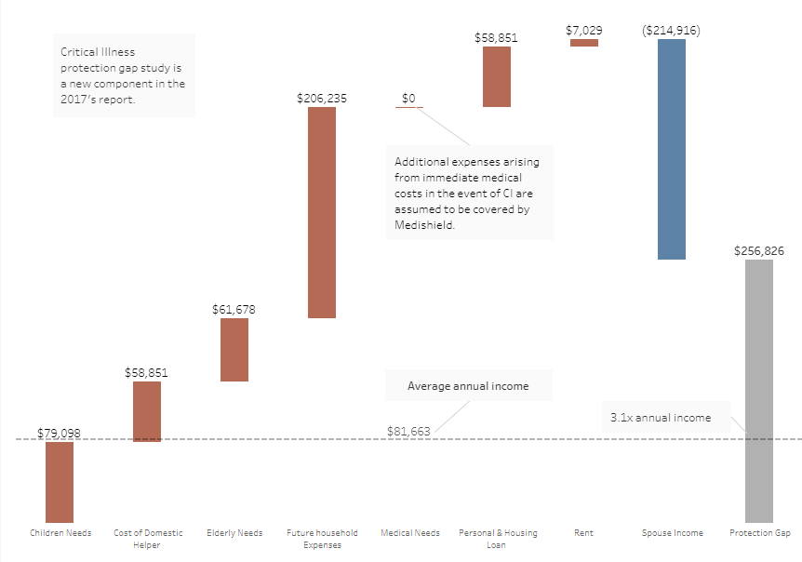
Visualization (Dashboard 3 of 4)
Mortality Protection Gap Breakdown by Age Group
Critical Illness Protection Gap Breakdown

Slide 10
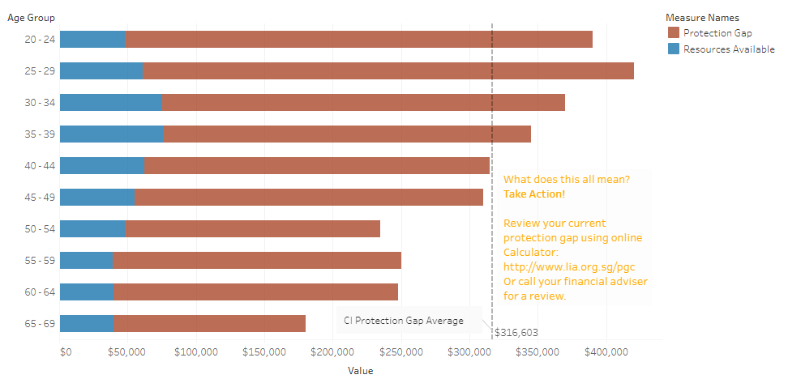
Visualization (Dashboard 4 of 4)
Critical Illness Protection Gap Breakdown by Age Group
Access the public hosted dashboard click here

Slide 11
Conclusion
Determine and plan coverage based on CI and Term/whole life needs
Use online calculator to determine your protection gap.
Follow “Action items” mentioned in next slide
Select right Insurance type based on purpose will reduce or fulfill individual protection gap
Top 5 insurance types with reasons to take and recommended coverage are as follows,
Rank | Type | Reasons | Recommendation | Analysis
1 | Health (H&S) | High cost of Hospital and Surgical bills & outpatient care | Private hospital and Public A | Singaporeans / PRs are covered for this. No study is done on this further.
2 | Term/Whole life | Death of an individual assure amount to the family members or dependent | Five times of your yearly income or based on your liabilities | Dashboard covers representation for this.
3 | Critical illness (CI) | Sum assured to meet huge cost of medical expenses with the discovery of CI. | Payout tied to life insurance | Dashboard covers representation for this.
4 | Disability | Monthly sum payout to meet your minimum expenses in case of loss of pay | It should be greater than 3000 SGD or depends upon your current income and minimum monthly expenses | This is not in scope of the report
5 | Personal Accident | Huge cost of outpatient medical expenses | Totally payout linked to insurance and paid by them based on expenses incurred | This is not in scope of the report.

Slide 12
Action items
Assessment and review is an iterative process.
Call Agent and review insurance policies.
Online calculator is available to calculate protection gap.
Review Insurance policies and determine protection gap. At least the following policies,
CI / Health policy (hospitalization & surgical, private hospital coverage)
Life policy (term or life)
Review Gaps
Discuss your policies with others, insurance agents and go for the best which suites your needs.
Find Insurance Gap
Call Agent
Review Life policy
Review CI Policy
Discuss with others

