Slide 1
V HireU
Frank Tran (A0178233A)
Laxman Singh(A0178223E
Ramasamy Muthuraman(A0179756H)
Tan Chee Wei(A0179723U)

Slide 2
Agenda
Business Problem Statement
Architecture
Design - Data Model
Visualization Dashboard (4 slides)
Conclusion
Next Steps
Q&A
Demo

Slide 3
Business Problem Statement
To analyze ISS M.Tech student Career Progression benefits
Stepping stone to next level/position after course
Career change and benefits
Change career path to data science domain
Evaluate value of ROI

Slide 4










Architecture
Tableau public cloud
PDF
Data Integration
Data Lake
(Mongo DB)
DWH (Data Ware house)
Data Scraping
Internet
Users
JSON
Desktop
Desktop
Users
CSV

Slide 5
Design Data Model
Data Lake
(Mongo DB)
Data Warehouse (SQL Server)

Slide 6
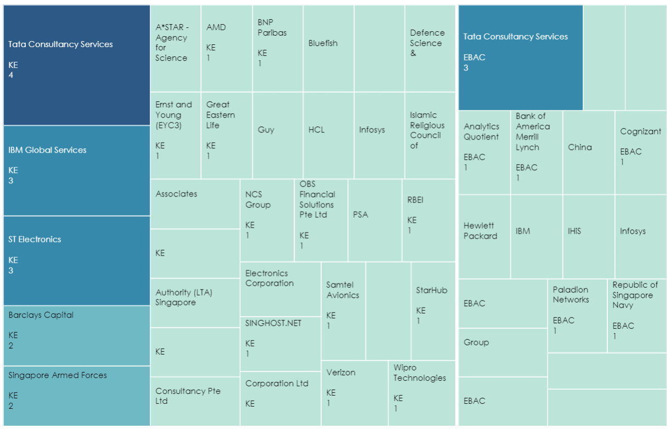
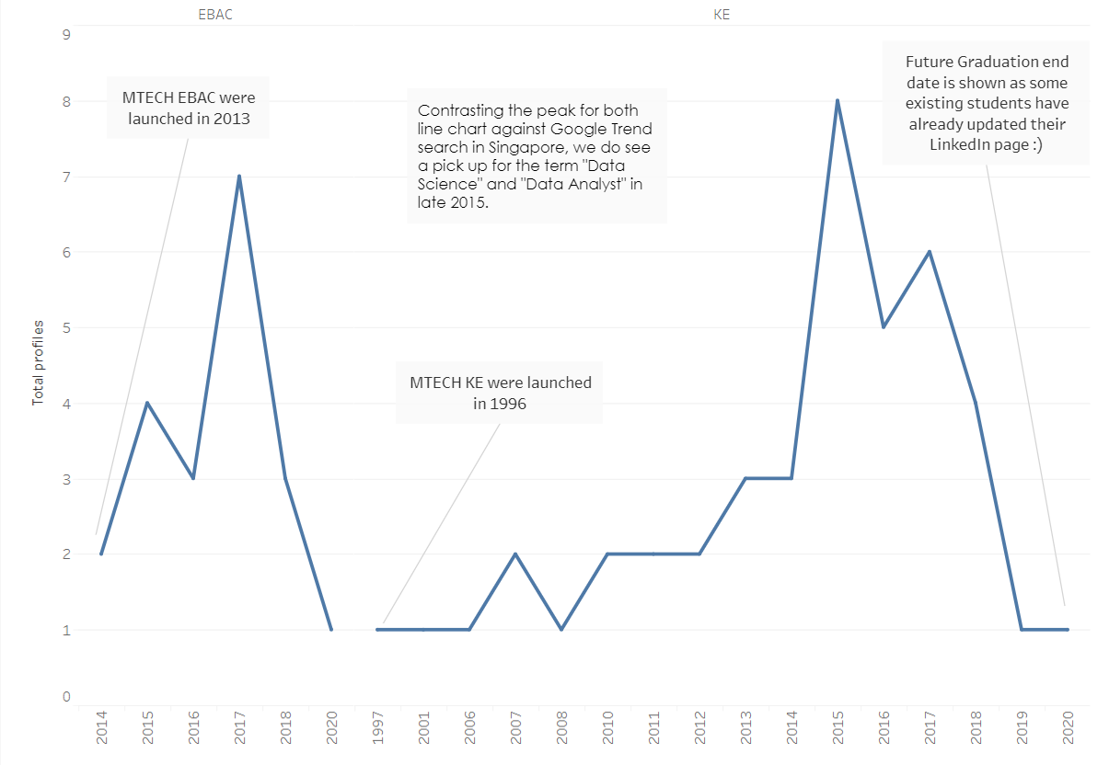
Visualization Dash board 1 of 5
The candidates profiles for the analysis
Graduation year of the candidates

Slide 7
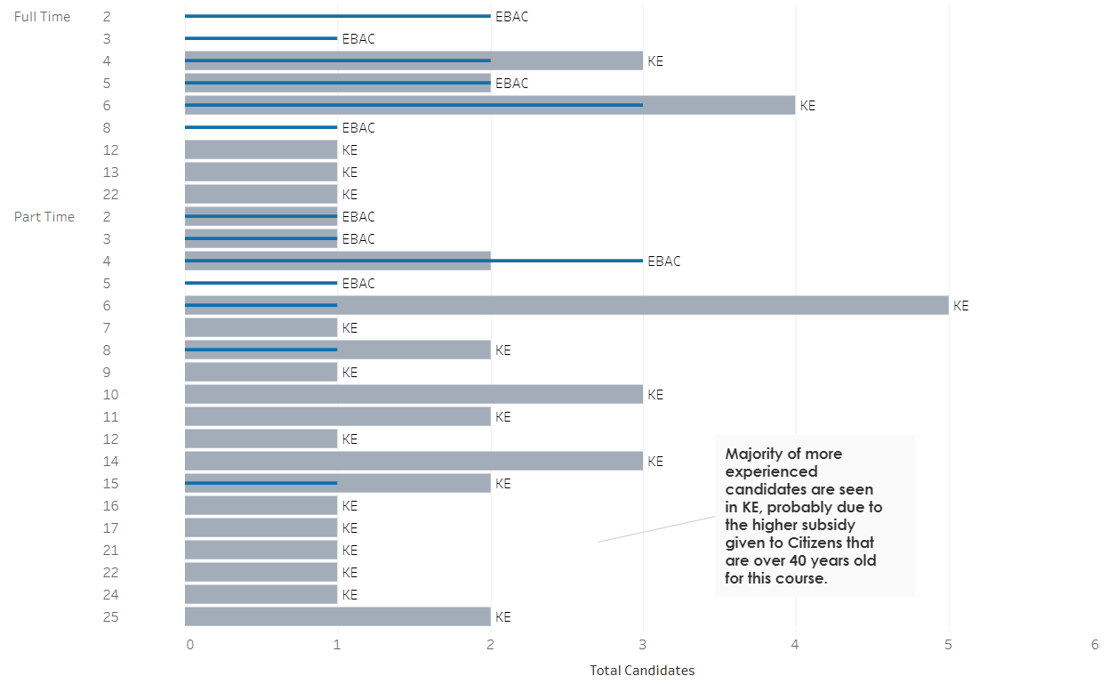
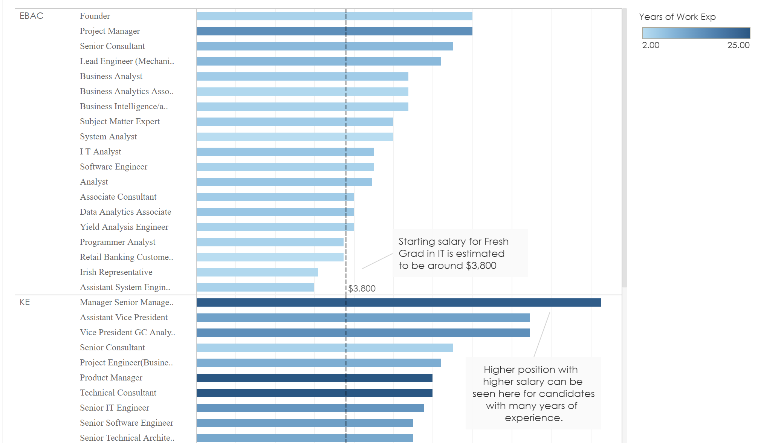
Visualization Dash board 2 of 5
Show candidate’s work experience
Previous salary range of the candidates

Slide 8
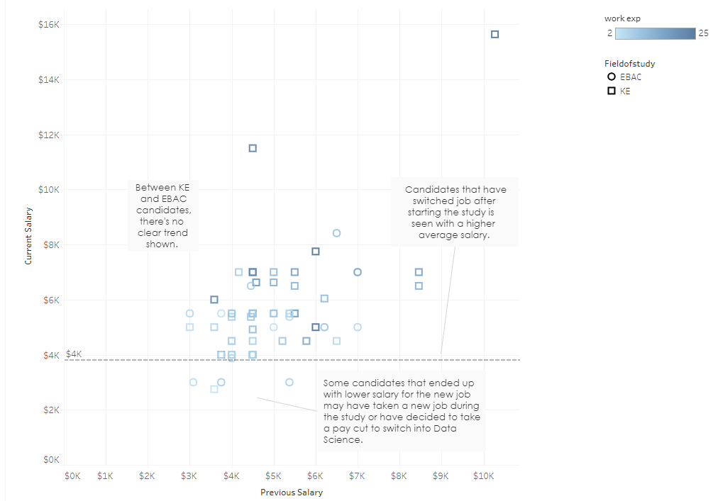
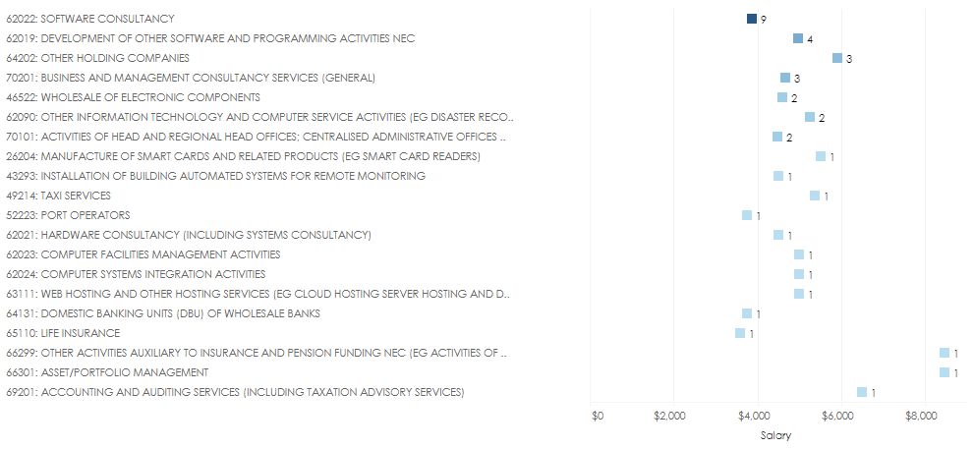
Visualization Dash board 3 of 5
Industry breakdown by salary (Previous)
Previous vs Current Salary of Candidates

Slide 9
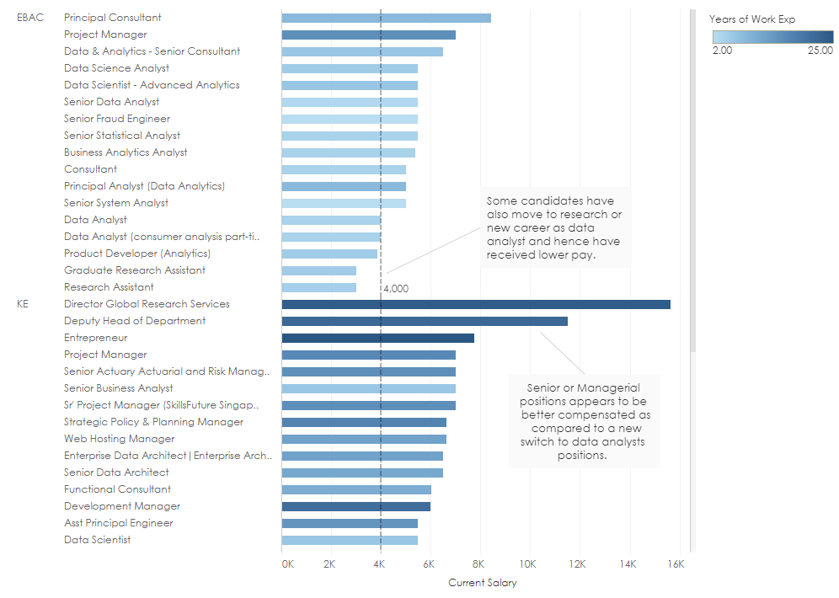
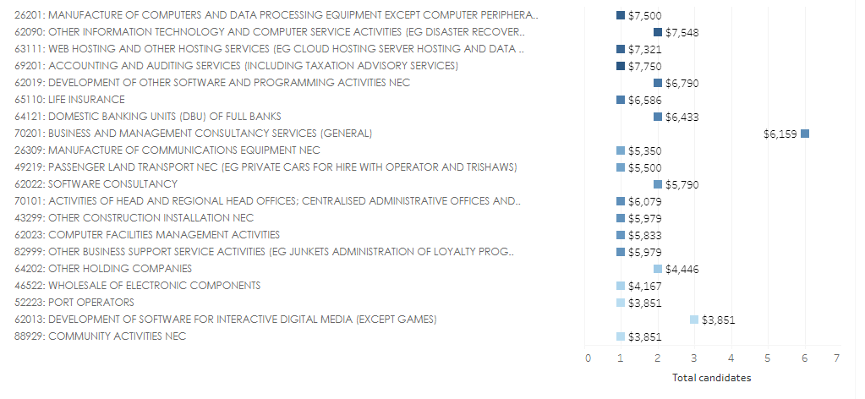
Visualization Dash board 4 of 5
Industry breakdown by salary (Current)
Salary range (Post study)

Slide 10
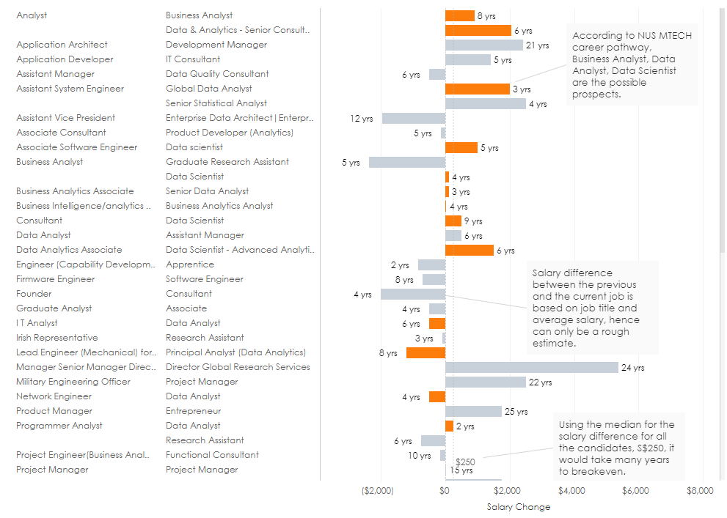
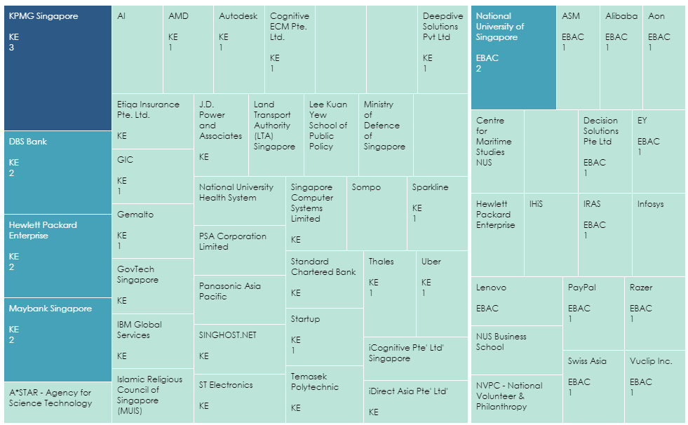
Visualization Dash board 5 of 5
Career Switch
Candidates current company

Slide 11
Conclusion
To analyze ISS M.Tech student Career Progression and benefits
Higher probability to move to data science
Overview of real trends
ROI
Stepping stone to next level
Salary and Job band change
Value addition to student to move to new career

Slide 12
Next Steps
Illustrate benefits to professionals to scale up their capabilities.
Career progression to new roles

Slide 13

Q & A

Slide 14



Demo

