Slide 1

HW 5 RISC
My Tears
RISC CPU
Steve Gillet

Slide 2
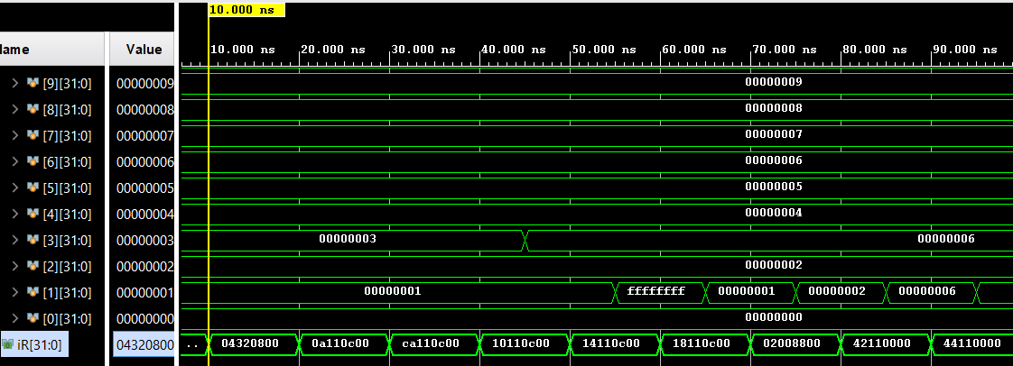
ADD
{ADD,R3,R4,R2,zFill3reg}

Slide 3
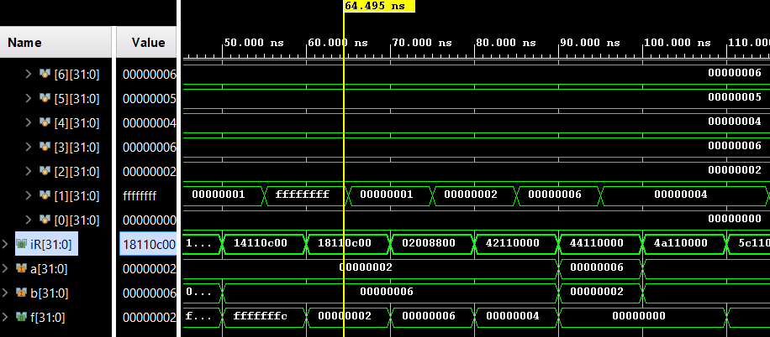
XOR
{XOR,R1,R2,R3,zFill3reg}

Slide 4
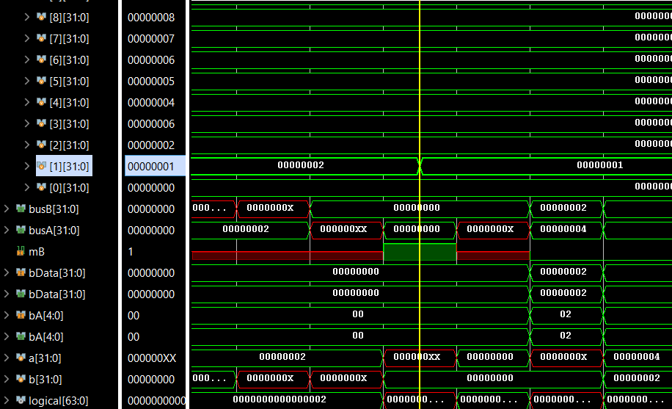
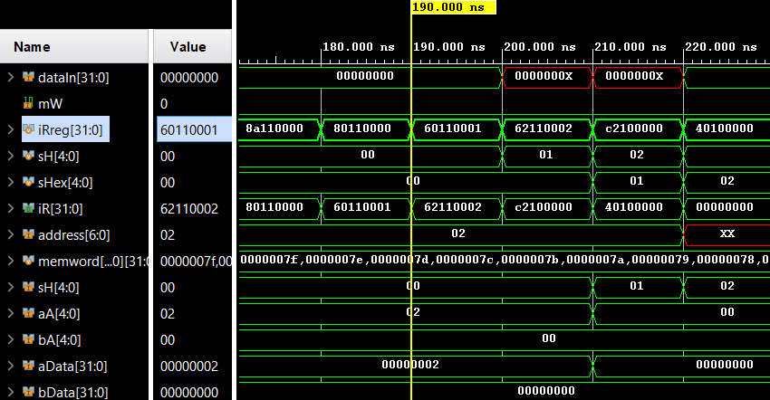
LSL
LSL, R1, R2

Slide 5
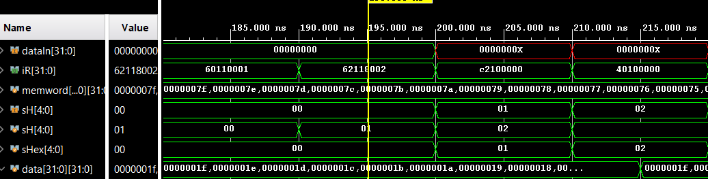
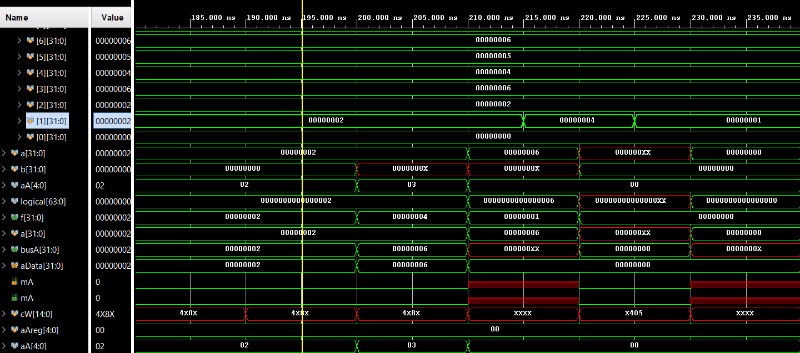
LSR
memword[19] = {LSR,R1,R3,zFill3reg,5'b00010};

Slide 6
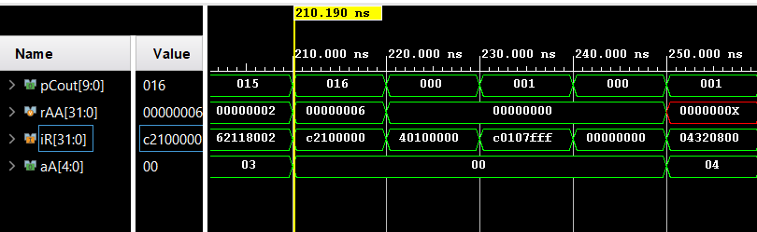
JMR
{JMR,R1,R0, zFill2reg}

