Slide 1

RISC-y Multiplication HW 6
Steve Gillet

Slide 2

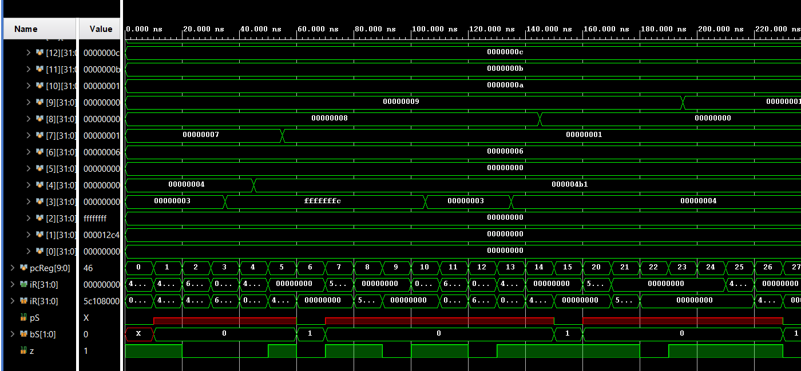


Loading Values
Loading values to multiply in R4 & R3
Check if negative and 2’s complement if so, store whether R3 negative in R7 and R4 in R8

Slide 3




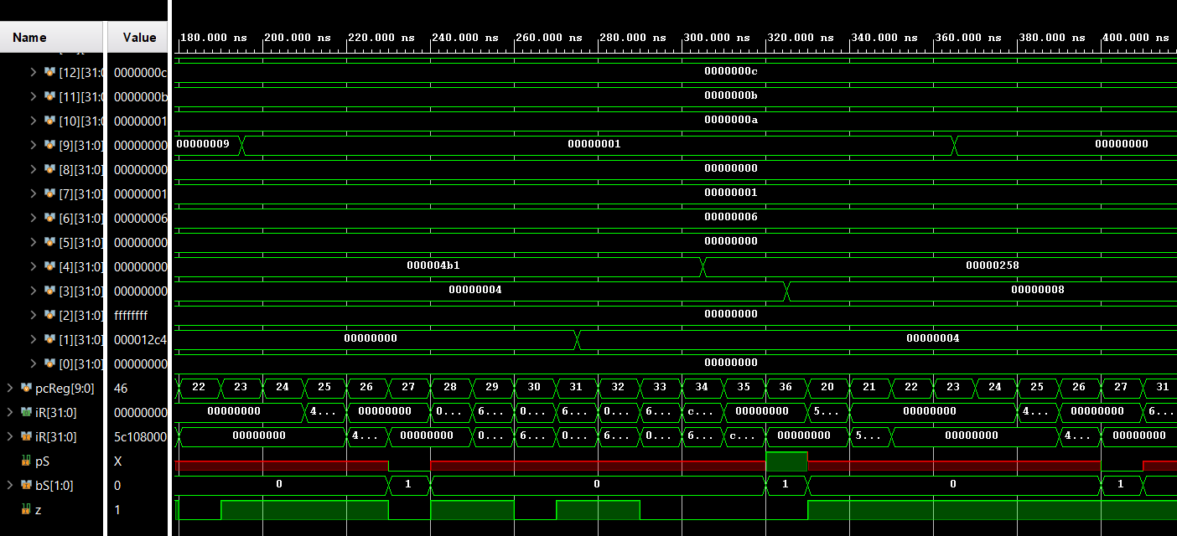
Adding
R9 keeps track of whether to add R3 or not based on low bit of R4
R4 gets shifted down
R1 holds result

Slide 4

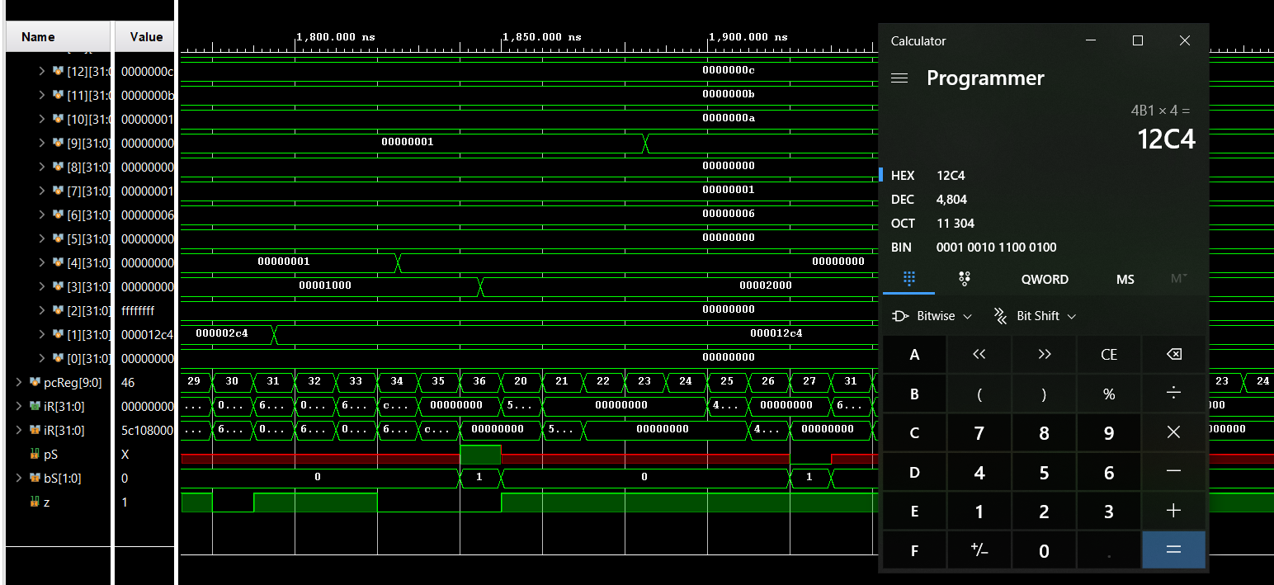
Results
4B1x4 = 12C4

Slide 5
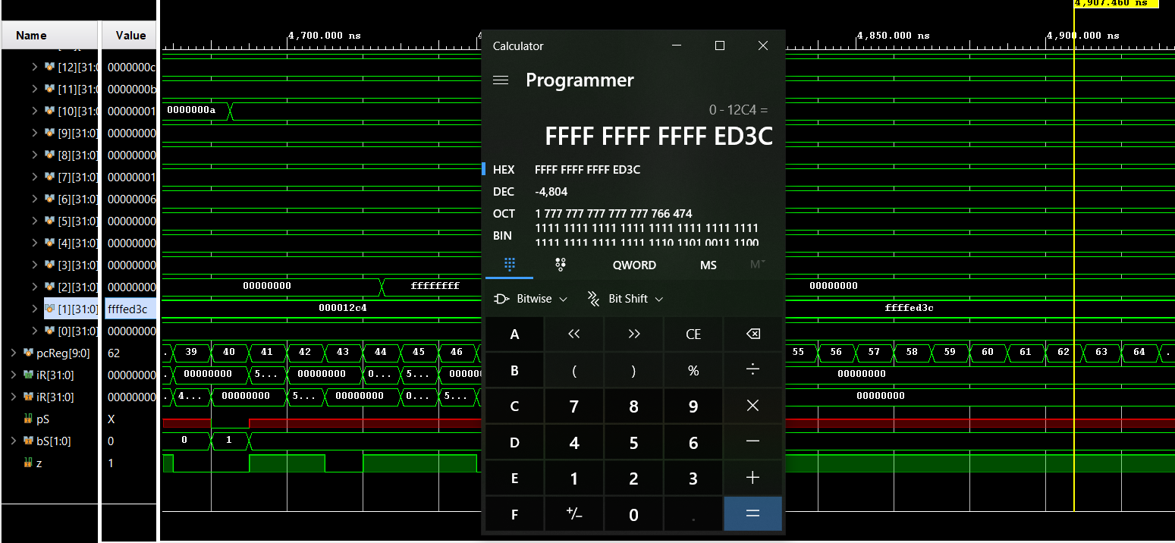
Fixing Signs

