Slide 1
Artemis Training
Overview and Prework

Slide 2
What is Artemis?
Article Routing Tracking Exchange and Management Integration System replaces FMP, eTP, Dickens (files kept in Amazon Cloud) and uses TAC
Who is going to use Artemis?
All DJS
In future, customers and vendors
Artemis Components
AD, FB, AR, IS
Get Chrome
What are your credentials?
Click here to log in to Artemis
Brief tour of interface
If you are successful, send email to your GL.
How to Log Out
What's Next
Quiz/Evaluation
Workflow
S3 Amazon tasks components assets issues articles ads front matter back matter TNQ copy edit issue-sequencing browser username password training trainer technical HELP DJS Sheridan Winning easy

Slide 4
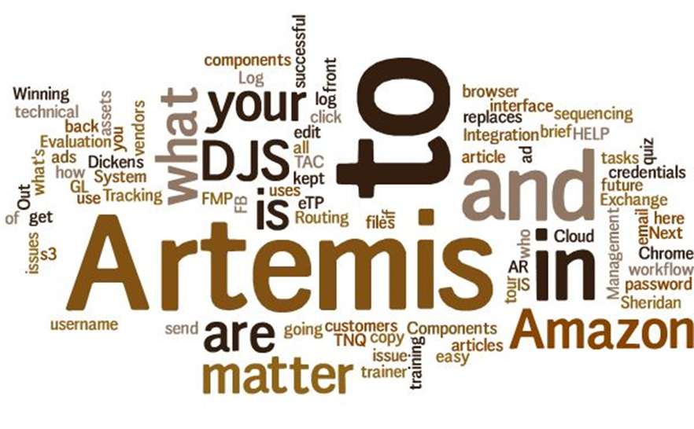
etete

Slide 5
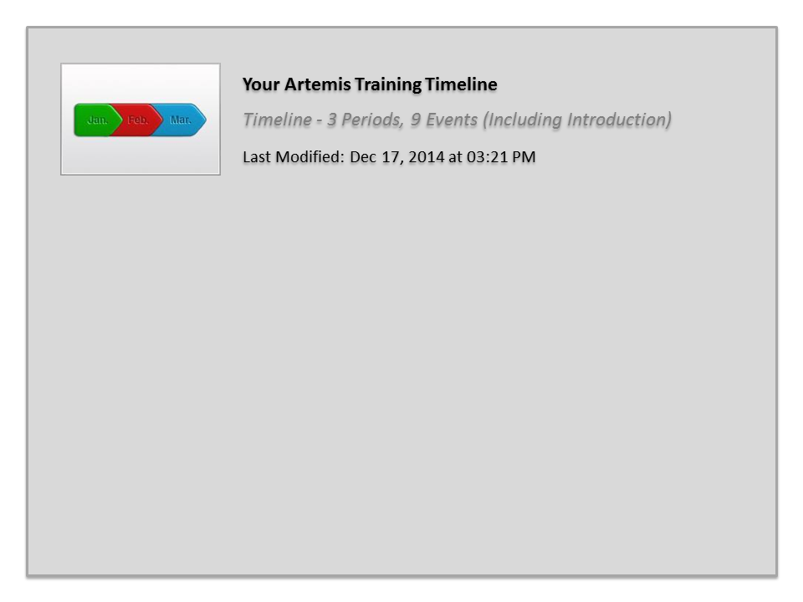
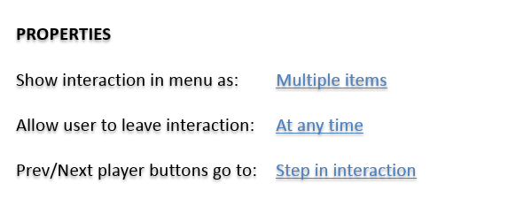

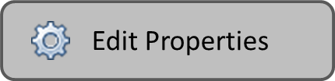
Your Artemis Training Timeline

Slide 6
What is Artemis?
Artemis is the Article Routing, Tracking, Exchange, and Management Integration System.

Slide 7
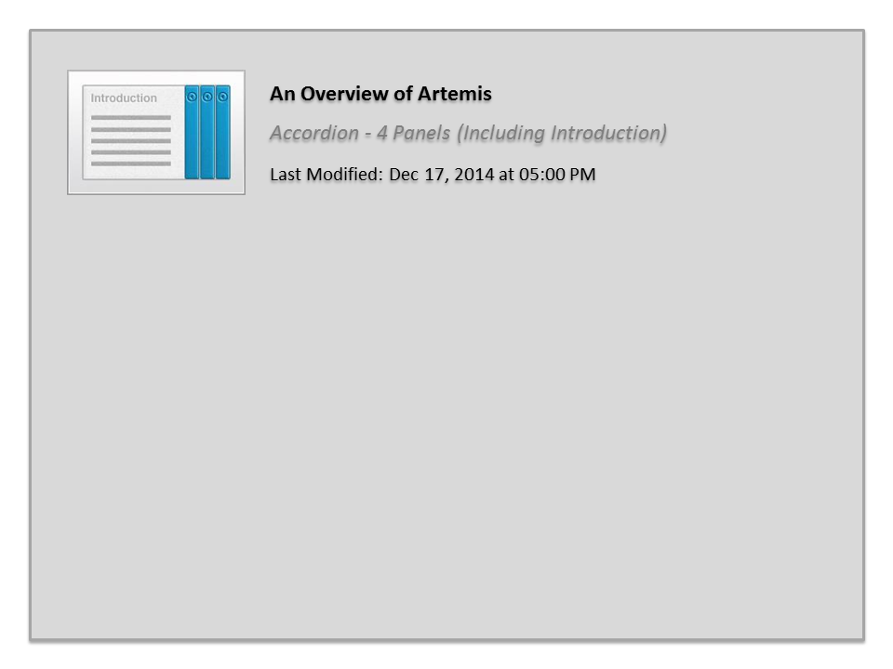
An Overview of Artemis

Slide 8
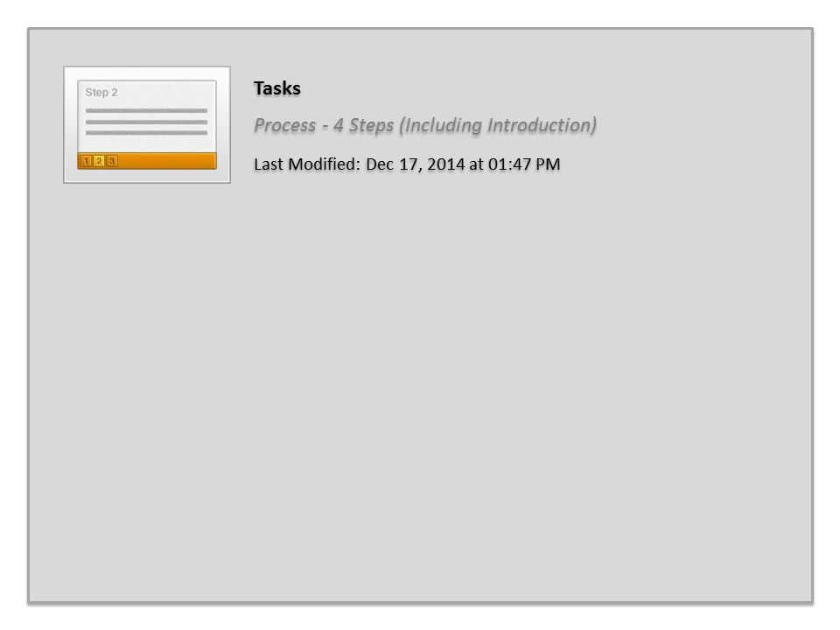
Tasks

