Slide 1
Artemis Productivity
Learning Artemis Tasks and Procedures

Slide 2
Course Introduction
Before you begin…

Slide 3
Introduction
What is this course about?
Methods we’ll use.
Housekeeping – Breaks, questions, et ceteras.
Notes:
This course introduces you to Artemis.
We’re going to use a lecture format, but most of the work will be a demonstration and then you’ll follow along. At the end of the course you will be able to use Artemis in your daily work. You all should have received a link to the assets we’ll use in today’s training, along with the login information.
Now, we’ll move through at our own pace. There will be a formal break to use the restroom, check messages, etc.
And one more thing….(MOVE TO NEXT SLIDE)

Slide 4
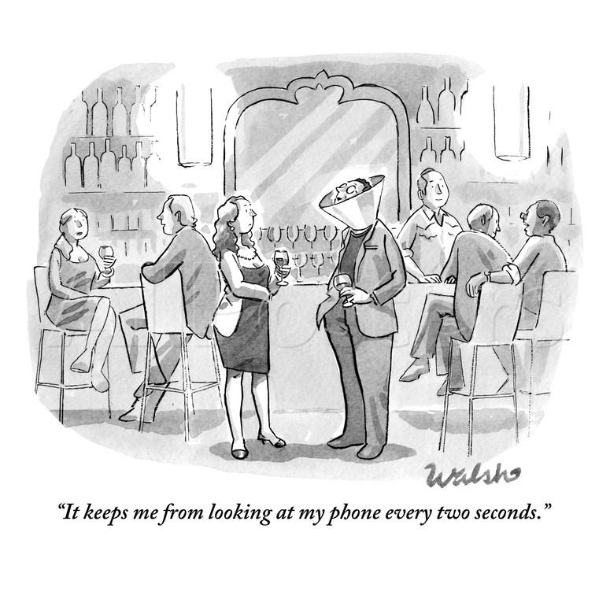
Turn it off, please.

Slide 5
Introducing Artemis
What is Artemis?
How does Artemis fit in with our strategy?
How is Artemis different from our FileMaker system?
Notes:
Artemis is our new, web-based software – also known as SaaS, or Software as a Service – that we transitioning to from FileMaker. The interface is cleaner, more intuitive, and was built with each task in mind.
Artemis is easier to learn, easier to use, and will help with the goal of reducing costs and time to delivery.
Artemis is web-based. That means you can use it from anywhere. You can use it here at work, at home, while waiting for a plane – anywhere you have a net connection. You’ll use the internet and not a connection to “The Farm.”

Slide 6
Artemis Overview
A walk through
Notes:
Switch to browser, log in, and walk through Artemis.
TASKS Tab and screen. This is where they’ll land when logging in. Explain that there may be more tabs or fewer tabs available depending on their role. The PE roles has three—Administer, Production, Tasks. Let’s go through each.
ADMINISTER – used to view / add / edit organizations (customers), titles, roles, groups, and perform Setup. As a rule, PEs won’t be using this tab.
PRODUCTION – access the individual components – Ads, FMBM, Articles, and Issues. You can use this to find and work with specific components.
TASKS – Use to search and find components at specific tasks. For example, find an article in (AR) MS Prep. Incidentally, you’ll see that each task name has two letter in parenthesis as a prefix. This indicates the type of component: AD --Ad
AR -- Article FM – Front matter/back matter IS – Issue

Slide 7
Wrapping it up

Slide 8
Wrap Up
What you learned and what you can do.
Where to get more assistance.
Other training available.
Feedback!

