Slide 1
CSC 520: Devils Grip
By: Steven Moody
Advisor: Dr. Bo Hatfield

Slide 2
Overview
Objectives
Problem Specifications
Solution Design
Tools List
Time Schedule
Grading Scheme
Questions
Notes:
Aria: During this presentation we’ll be going over ^

Slide 3
Objectives
Learn how to develop a mobile iOS game
Learn how to use The Unity Game Engine
Learn more about the C# language
Further knowledge in Development Lifecycle
Implement a database within an IOS Application
Satisfying a client need for an applicaiton
Notes:
Aria

Slide 4
Problem Specifications
During COVID, Card games became a nightly routine for my girlfriend and I
Lost track of cards quickly
Pet kept making a mess of the piles
Reshuffling and replaying games became annoying
Downloading this specific game is not possible…No app exists
Notes:
deciding what to cook every night is a challenge
Food waste in the residence home

Slide 5
Problem Specifications cont...
In Devils Grip, the user will be able to:
Play the game itself
Choose various backgrounds for cards/background in game
Change the difficulty
Track their performance via a Highscore
Notes:
We wanted the user to be able to look through the ingredients they have available to them, and these are to be sorted based off of when they expire.
Originally we wanted the user to be able to find recipes based on what ingredients they have available, however we ran into issue with that that we will talk about later.
Keeping track of when things expire, these items will be at the top of your list so you will see them first. Cutting down on the time needed to plan a meal, as I know from my own experience I never know what I want to make for dinner, and i can take an hour to decide, where as I could have already had something made by then.
And we have added finding new recipes to try, as the app will show you new recipes you might want to give a try, and if you like them you can favorite them to always have to go back to.

Slide 6
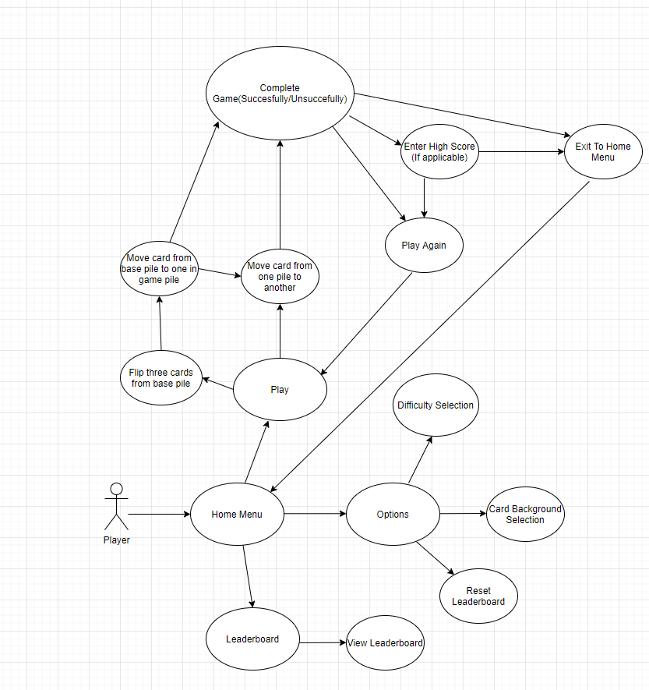
Solution Design:Sequence Diagram
Notes:
Zach: We switched to a declarativeUI architecture by using swiftUI. At first, we were using a MVC architecture, but it began to fight us more than we were able to make progress, so we decided to switch to a different architecture and we were able to make more progress with that in less time than with the MVC. We used Firebase authentication for the login system

Slide 7
Database Design
Notes:
Zach: We then switched to a noSQL database. Our reasoning for doing so is that our data model was changing throughout development and changing a data model in SQL. noSQL also made the login system easier to implement. Using noSQL also gives us the ability to add new features without having to change pre existing data. Another reason is that noSQL databases are very flexible, the data doesn't have to be structured and this was important as some of the recipes can have different formats.

Slide 8
Tools List
Github
Unity
Visual Studio
Xcode
Swift UI
Firebase Firestore - noSQL
Xcode’s Emulator
iOS device
Photoshop/Illustrator
Notes:
Zach: We have basically the same tools list as proposed, with the addition of firebase firestore as our database to use, as well as the use of an API

Slide 9
Time Schedule: Proposed
Weeks 1-2
Weeks 3-7
Weeks 8-10
Weeks 10-12
Weeks 12-13
Weeks 13-14
Bug fixes & Export to IOS
Beta Testing and final fixes
Report and Presentation
Unity Scripting/Object integration
Design and Implement Tests
Backend Implementation/ integration with Unity
Notes:
Aria: This is our proposed time schedule

Slide 10
Deliverables

Slide 11
Questions?

