Slide 1
CSC 520: Devils Grip
By: Steven Moody
CSC 521 Project Supervisor: Dr. Thomas Schmidt

Slide 2
Overview
Objectives
Problem Specifications
Solution Process/Design
Sequence Digram
UML/UI/DB Framework Design
Prototypes
Benchmark Specification
Tools List
Time Schedule
Grading Scheme
Deliverables
Questions

Slide 3
Objectives
Learn how to develop a mobile iOS game
Learn how to use The Unity Game Engine
Learn more about the C# language
Further knowledge in Development Lifecycle
Communicate with a real-world client

Slide 4
Problem Specifications
Motivation
During COVID, Card games became a nightly routine for my girlfriend and I
Board Games created clutter (small living space)
Lost track of cards quickly
Pet kept making a mess of the piles
Reshuffling and replaying games became annoying
Downloading various games became a potential solution
Downloading this specific game is (presumably) not possible…No app was found
In Devils Grip, the user will be able to:
Play the game itself
Change the difficulty
Track their performance via a Highscore
Use Anywhere at anytime through IOS device
Problem Specification

Slide 5
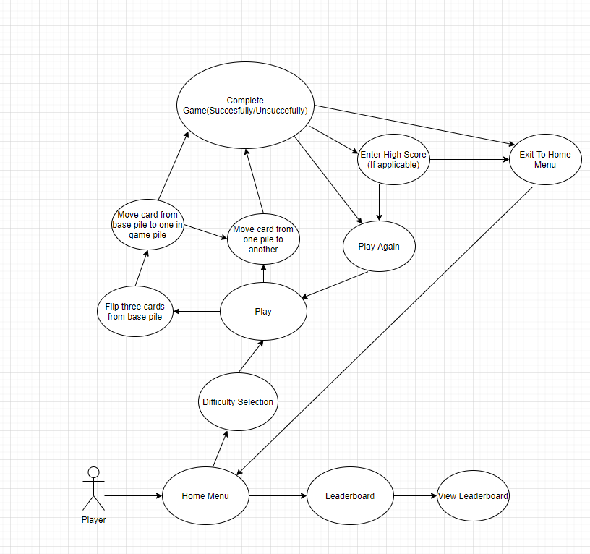
Solution Design:Sequence Diagram

Slide 6
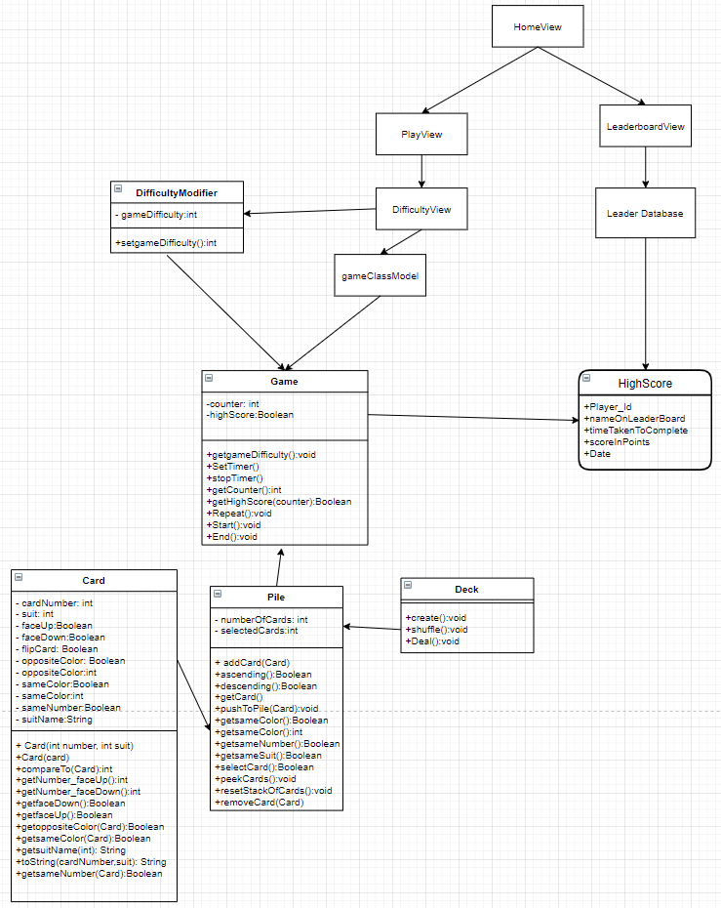
Solution Design:UML/UI/ Database Design (Preliminary and subject to change upon implementation)

Slide 7
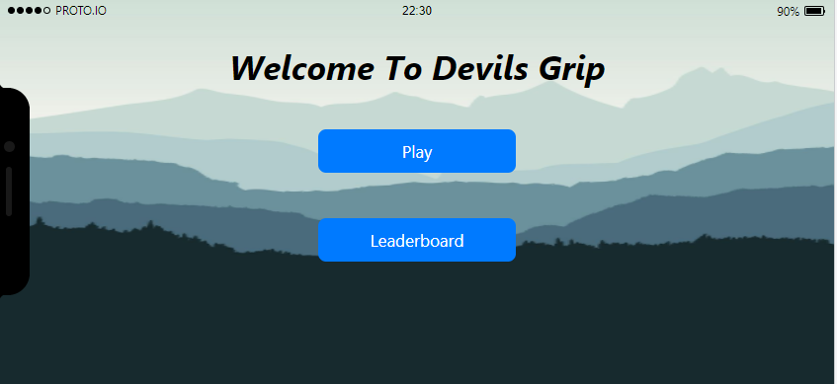
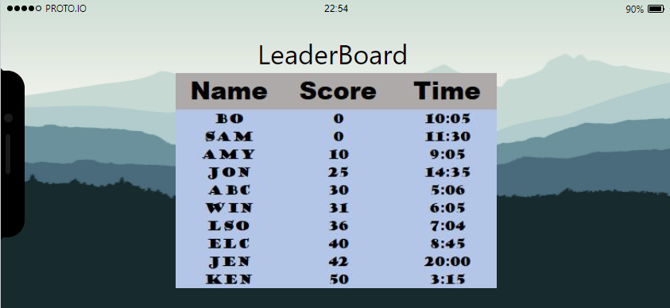
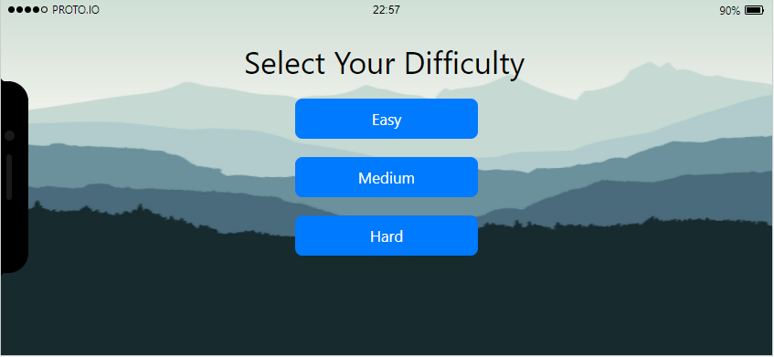
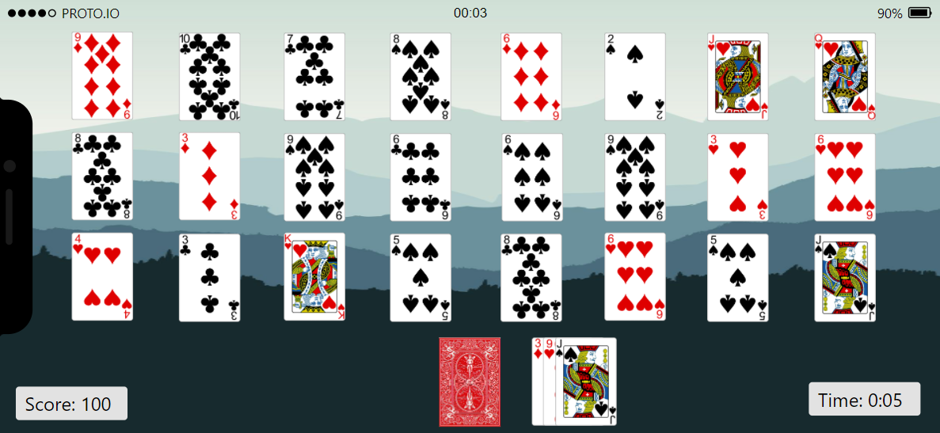
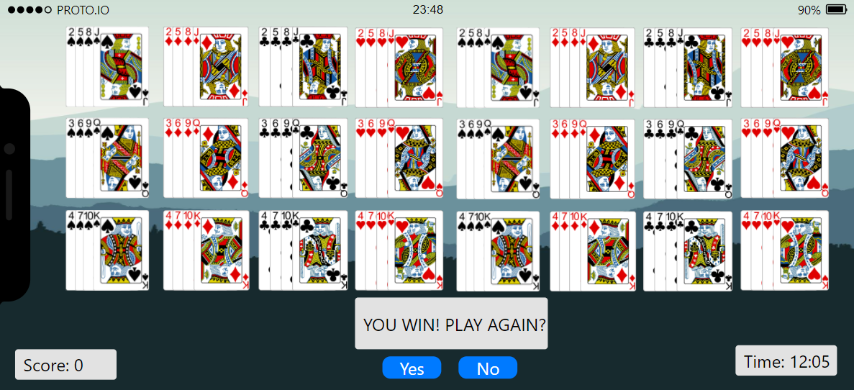
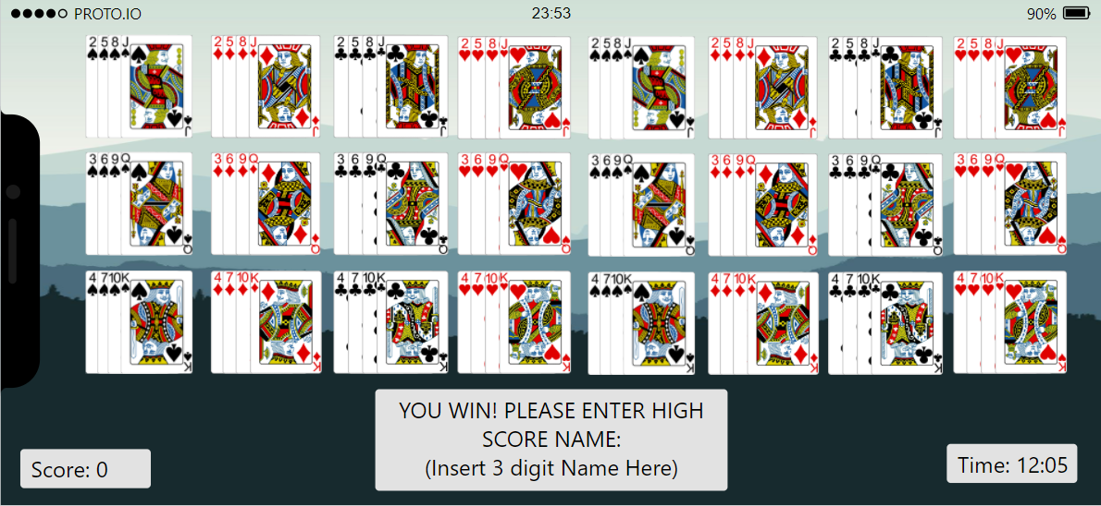
Solution Design:Prototypes

Slide 8
Benchmark Specification
Benchmark One
Playable on Windows PC through Unity Development and Implementation/playable on computer
Benchmark Two
Exportation to XCode for IOS development
Benchmark Three
IOS completion/debugging begins
Benchmark Four
Playable on IOS Device

Slide 9
Tools List
IDE/Editors:
Visual Studio
Xcode
Game Engine:
Unity
Version Control:
Git/Github
Language:
Swift/Unity UI
C#
Swift
Framework:
Rocket Data
Core Data
Hardware:
Windows PC
Mac
iOS Device
Other Tools:
Proto.io
Xcode’s Emulator
Swift

Slide 10
Time Schedule: Proposed
Weeks 1-4
Weeks 4-8
Weeks 8-11
Weeks 11-13
Weeks 13-14
Report and Presentation
Unity Scripting/ integration/PC playable
Integration with XCode/UI Development
Design and Implement Tests
Bug fixes/Beta Testing and export to IOS

Slide 11
Grading Scheme
Final Presentation: 10%
Report: 10%
Test cases: 10%
Playable Game on PC (Benchmark 1): 25%
Mac integration/ Mobile Game UI(Benchmarks 2/3): 25%
IOS App/emulated (Benchmark 4): 20%

Slide 12
Deliverables
original proposal and presentation file(s) (from CSC 520)
amendments to the proposal (approved by the project supervisor)
system architecture diagram(s) (UML, DFD context, etc.), enhanced with details determined during implementation
appropriately commented source code
documentation of project functionality (test results, screenshots, video capture of project execution, etc.)
sample output (screen shots and/or reports)
executables and/or projects
presentation documents (used to support the presentation of the completed CSC 521 project), including any presentation file(s)
project journal: a narrative of the progress of the project, in clear, concise English, including any problems encountered and how said problems were addressed
project postmortem: a summary of what was learned from the project and (based on that experience) discussion of how various aspects of the project might have been approached differently
a list of what areas of the proposal (if any) were not completed, including reasons why
presentation of the completed project (PowerPoint format), including screenshots of the functioning project

Slide 13
Questions?

