Slide 1
CSC 520: Devils Grip
By: Steven Moody
Advisor: Dr. Bo Hatfield

Slide 2
Overview
Objectives
Problem Specifications
Solution Design
Tools List
Time Schedule
Grading Scheme
Questions
Notes:
Aria: During this presentation we’ll be going over ^

Slide 3
Objectives
Learn how to develop a mobile iOS game
Learn how to use The Unity Game Engine
Learn more about the C# language
Further knowledge in Development Lifecycle
Implement a database within an IOS Application
Satisfying a client need for an applicaiton
Notes:
Aria

Slide 4
Problem Specifications
During COVID, Card games became a nightly routine for my girlfriend and I
Board Games created clutter (small living space)
Lost track of cards quickly
Pet kept making a mess of the piles
Reshuffling and replaying games became annoying
Downloading various games became a potential solution
Downloading this specific game is not possible…No app exists
Notes:
deciding what to cook every night is a challenge
Food waste in the residence home

Slide 5
Problem Specifications cont...
In Devils Grip, the user will be able to:
Play the game itself
Choose various backgrounds for cards/background in game
Change the difficulty
Track their performance via a Highscore
Use Anywhere at anytime through IOS device
Notes:
We wanted the user to be able to look through the ingredients they have available to them, and these are to be sorted based off of when they expire.
Originally we wanted the user to be able to find recipes based on what ingredients they have available, however we ran into issue with that that we will talk about later.
Keeping track of when things expire, these items will be at the top of your list so you will see them first. Cutting down on the time needed to plan a meal, as I know from my own experience I never know what I want to make for dinner, and i can take an hour to decide, where as I could have already had something made by then.
And we have added finding new recipes to try, as the app will show you new recipes you might want to give a try, and if you like them you can favorite them to always have to go back to.

Slide 6
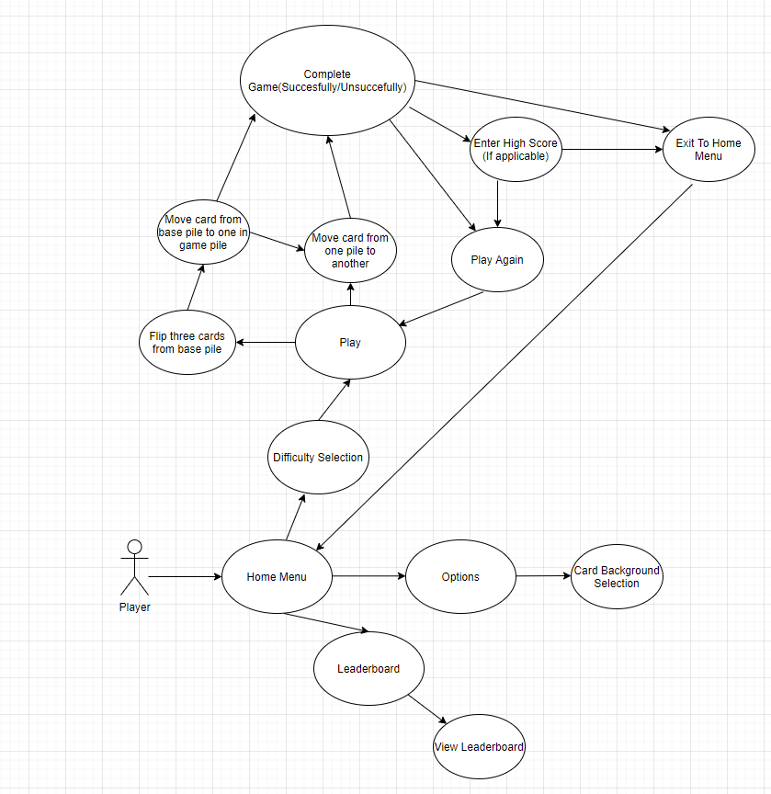
Solution Design:Sequence Diagram
Notes:
Zach: We switched to a declarativeUI architecture by using swiftUI. At first, we were using a MVC architecture, but it began to fight us more than we were able to make progress, so we decided to switch to a different architecture and we were able to make more progress with that in less time than with the MVC. We used Firebase authentication for the login system

Slide 7
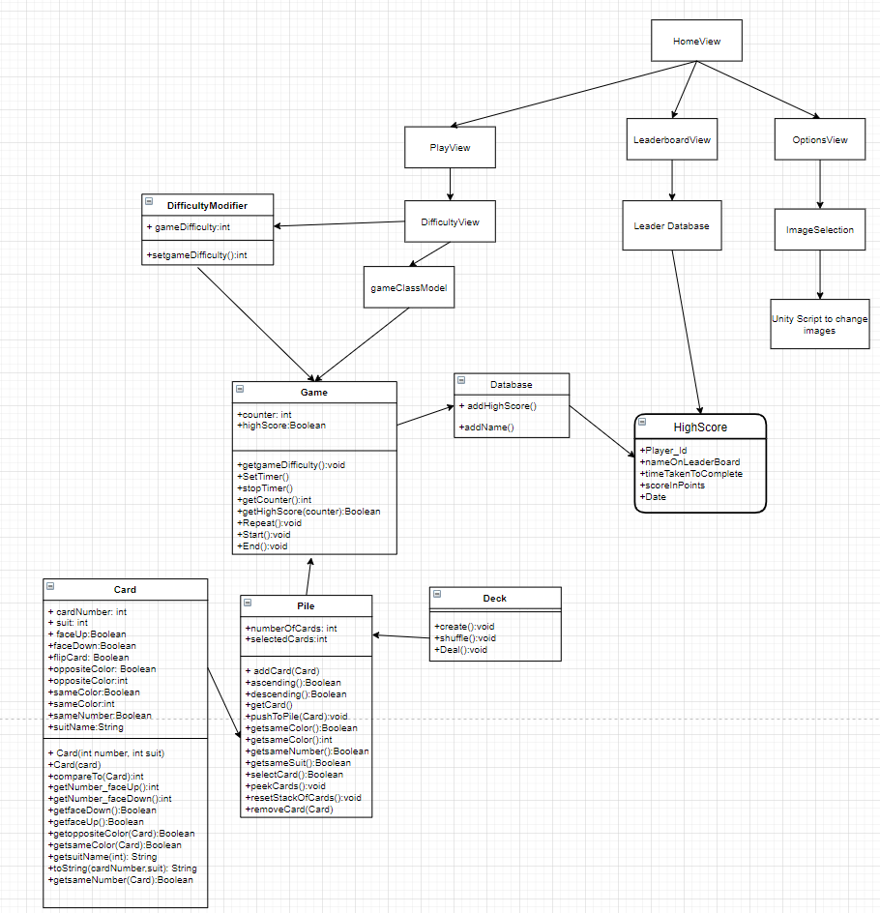
Solution Design:UML/UI/ SQL Database Design (Preliminary and subject to change upon implementation)
Notes:
Zach: We switched to a declarativeUI architecture by using swiftUI. At first, we were using a MVC architecture, but it began to fight us more than we were able to make progress, so we decided to switch to a different architecture and we were able to make more progress with that in less time than with the MVC. We used Firebase authentication for the login system

Slide 8
Tools List
Github
Unity
Visual Studio
Xcode
Swift UI
Rocket Data
Core Data (Apple local iOS storage framework)
Xcode’s Emulator
iOS device
Windows PC
Mac
Notes:
Zach: We have basically the same tools list as proposed, with the addition of firebase firestore as our database to use, as well as the use of an API

Slide 9
Time Schedule: Proposed
Weeks 1-4
Weeks 4-8
Weeks 8-11
Weeks 11-13
Weeks 13-14
Report and Presentation
Unity Scripting/Object integration
Integration with XCode/UI Development
Design and Implement Tests
Bug fixes/Beta Testing and export to IOS
Notes:
Aria: This is our proposed time schedule

Slide 10
Grading Scheme
Final Presentation: 10%
Report: 10%
Test cases: 10%
PC Executable: 20%
Mac integration/IOS App: 20%
Database Implementation: 10%
UI for IOS: 20%

Slide 11
Deliverables
original proposal and presentation file(s) (from CSC 520)
amendments to the proposal (approved by the project supervisor)
system architecture diagram(s) (UML, DFD context, etc.), enhanced with details determined during implementation
appropriately commented source code
documentation of project functionality (test results, screenshots, video capture of project execution, etc.)
sample output (screen shots and/or reports)
executables and/or projects
presentation documents (used to support the presentation of the completed CSC 521 project), including any presentation file(s)
project journal: a narrative of the progress of the project, in clear, concise English, including any problems encountered and how said problems were addressed
project post mortem: a summary of what was learned from the project and (based on that experience) discussion of how various aspects of the project might have been approached differently
a list of what areas of the proposal (if any) were not completed, including reasons why
presentation of the completed project (PowerPoint format), including screenshots of the functioning project
user's manual

Slide 12
Questions?

