Slide 1
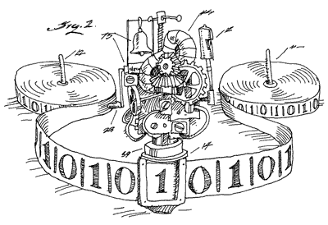
Theoretical Computation
Image: http://jonfwilkins.blogspot.com.au

Slide 2
Motivation: Why do we study theoretical computation?
Compilers
Language Theory
Hilbert Problems
  Problem 10: Find an algorithm to determine if a polynomial with integer coefficients has an integer solution

Slide 3
Turing Machine
Set of States
Input Alphabet
Output Alphabet
Transition Function
Infinite Tape with Read/Write Head

Slide 4
Turing Machine Example
Symmetrical string of 1's and 0's
See whiteboard

Slide 5
Church Turing Thesis
Any algorithm can be represented as a turing machine!

Slide 6
Terminology
Decision problem = Language
Accept / Reject
Halt / Loop
Decide
Recognize
Corecognize

Slide 7
Problem Syntax
PROBLEM-NAME = {input | accept condition}
SYM =
{str | str is a symmetrical string of 1s and 0s}
The problem (or language) “SYM” takes strings as input and accepts exactly when the input string is a symmetrical string of 0s and 1s

Slide 8
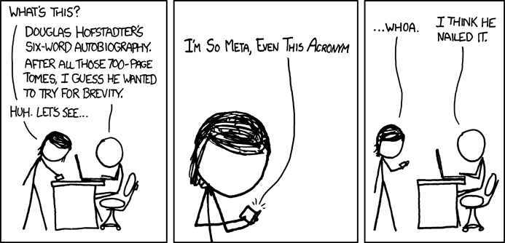
Self Referentiality need not be feared
Image: xkcd.com

Slide 9
Self Referentiality in real life
count-lines
Compilers

Slide 10
Proof by contradiction
To prove some statement
Assume it's false
Show that this results in a contradiction
The initial assumption must be wrong
Therefore the statement is true

Slide 11
The Halting Problem
HALT = {<P>, x | P(x) halts}
Given some program description and some input for that program, does the program ever terminate on the input?
How can you write a program to decide HALT?

Slide 12
You can't!
Proof: see whiteboard

Slide 13
More HALT
It is recognizable
It is NOT co-recognizable
To make it easy to prove this, establish that a problem is decidable if and only if it is both recognizable and co-recognizable
Proof on whiteboard

Slide 14
Two important results
HALT is not decidable
HALT is not co-recognizable
That is, (NOT-HALT) is not recognizable.
NOT-HALT = {<P>, x | P(x) loops forever}

Slide 15
Reductions
Proof technique for proving non-decidability or non-recognizability
Form of proof by contradiction
Assume the problem is decidable (recognizable), then construct a turing machine that decides (recognizes) HALT (NOT-HALT), creating a contradiction.

Slide 16
Reduction Example
A = {<P>, <Q>, x | P(x) runs for at least as many steps as Q(x)}
If a program doesn't halt, it is said to run for infininty steps, so if both P(x) and Q(x) loop forever, (<P>, <Q>, x) is accepted.
Is this decidable/recognizable?

Slide 17
Not Recognizable
Proof: see whiteboard

Slide 18
Dove-Tailing
Technique for traversing multiple (potentially) infinite lists
We can't just traverse one after the other
Simple example: write a program that will eventually print out any given fraction with integer numerator and denominator

Slide 19
Printing Fractions
 | 1 | 2 | 3 | 4
1 | 1/1 | 1/2 | 1/3 | 1/4
2 | 2/1 | 2/2 | 2/3 | 2/4
3 | 3/1 | 3/2 | 3/3 | 3/4
4 | 4/1 | 4/2 | 4/3 | 4/4
“Print one row, then the next row, etc” isn't going to work
Better approach:
1/1, 2/1, 1/2, 3/1, 2/2, 1/3, 4/1, ...

Slide 20
Why is this relevant?
We can execute multiple programs inside other programs without fear that one of them doesn't halt.
For example:
A = {<P> | P(i) halts for at least one 0 <= i <= 10}
Is this problem recognizable/decidable?

Slide 21
Recognizable
Recognizer uses dovetailing: see whiteboard
Not decidable – if it was decidable we could use it to decide HALT

