Slide 1
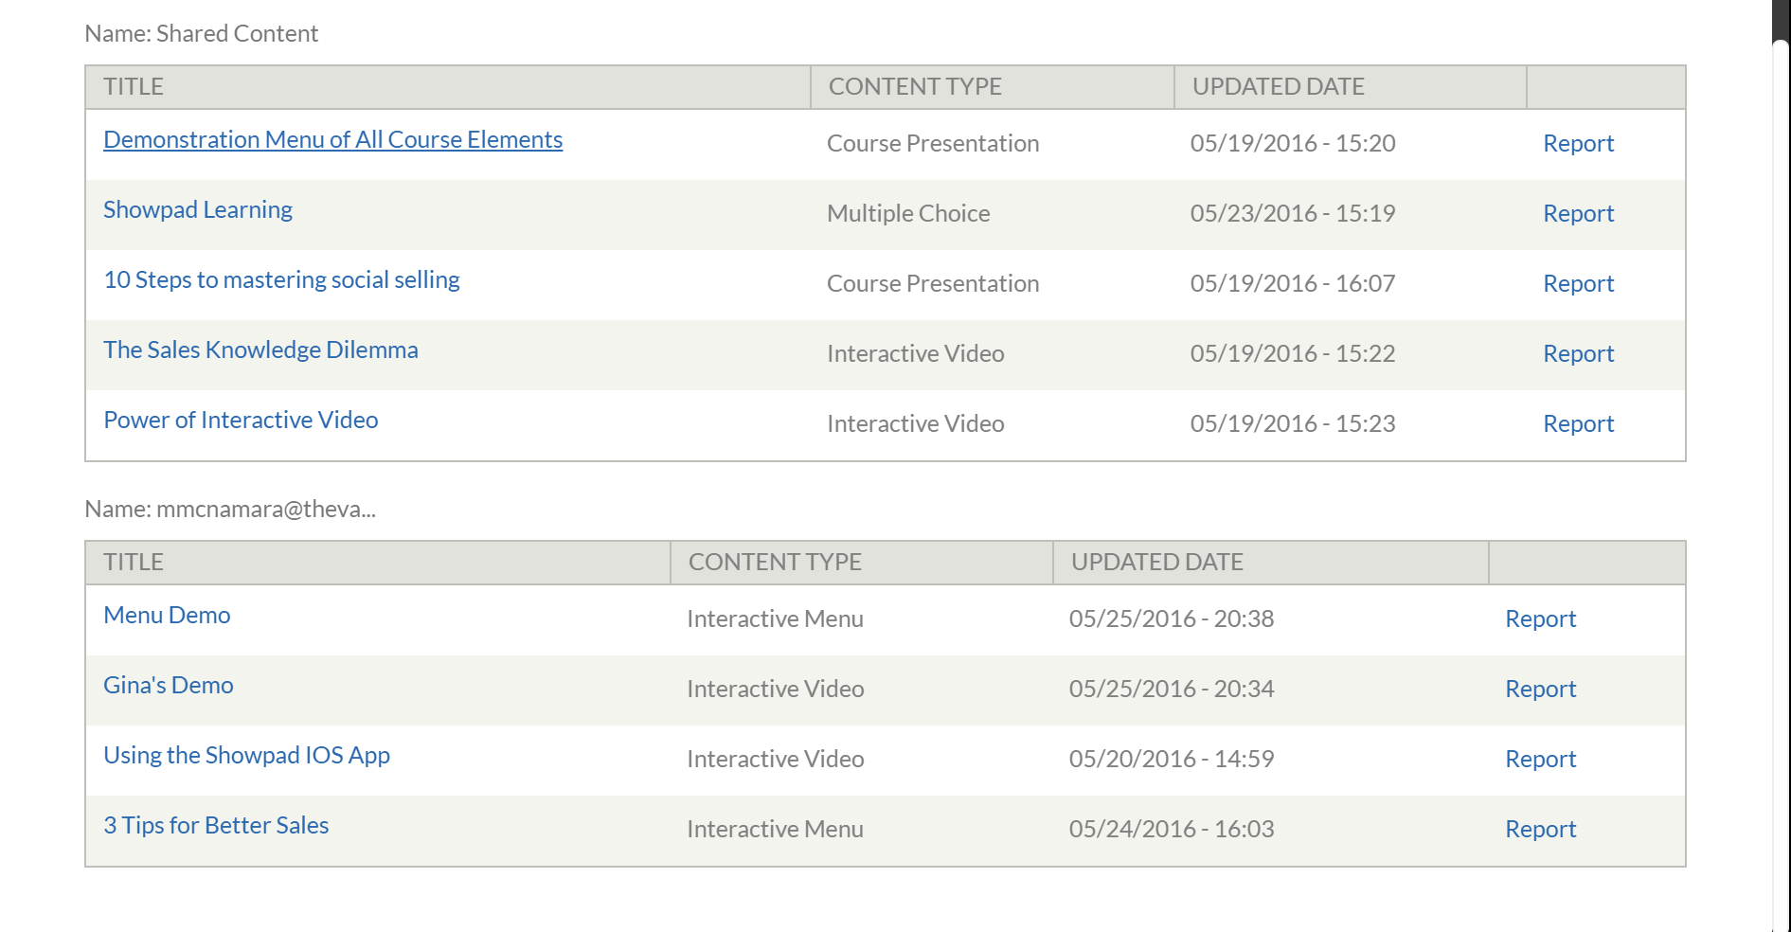
My Content
Create Content

Slide 2
My Content
Create Content
Interactive Menu
Micro Learning
Interactive Video
Interactive Course

Slide 3

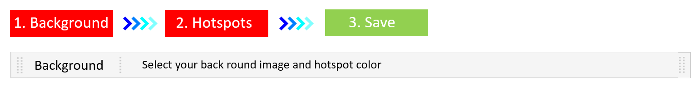

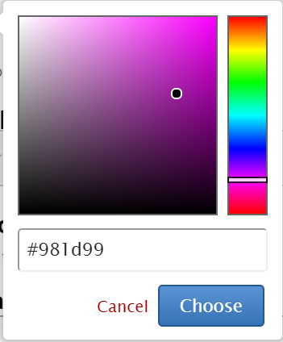
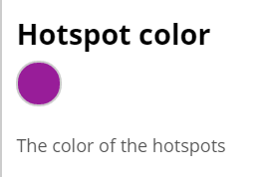

My Content
Create Content
Interactive Menu
Select your background image and hotspot color
Background

Slide 4





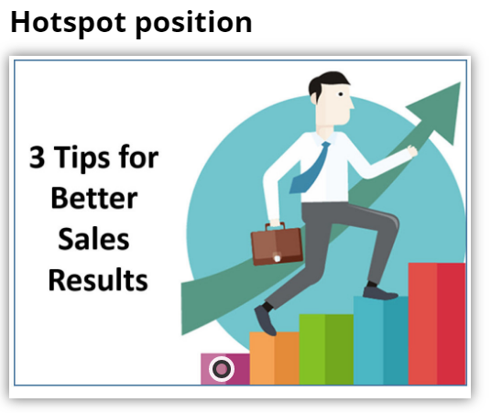
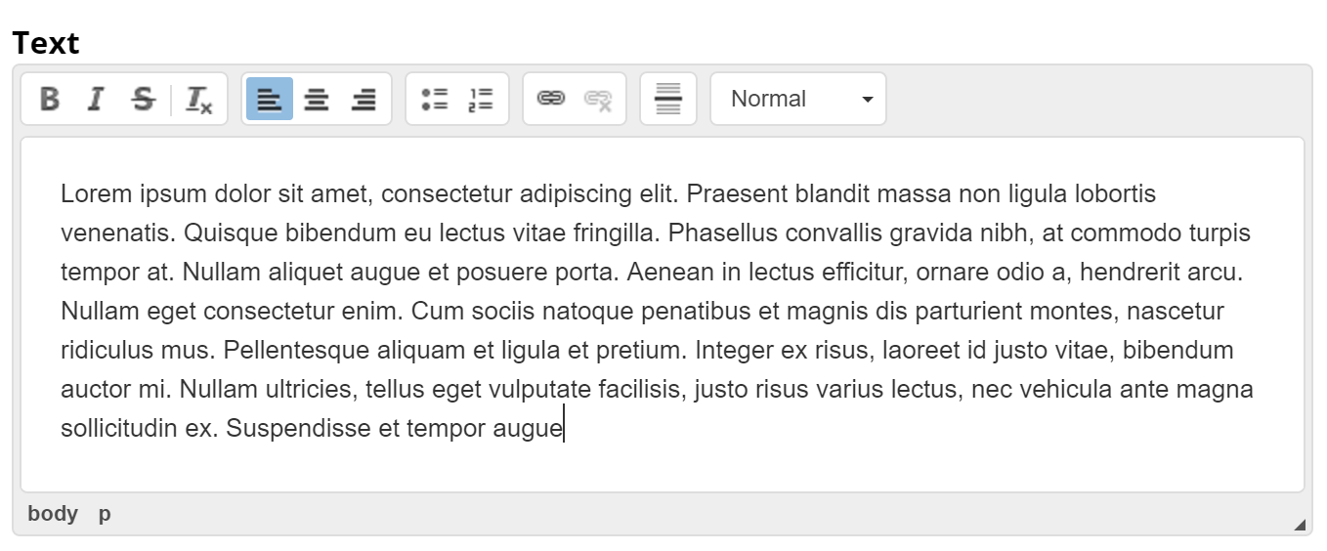
My Content
Create Content
Interactive Menu
Select a hotspot type to be displayed
Hotspots

Slide 5


My Content
Create Content
Interactive Menu
Select a hotspot type to be displayed
Hotspots

Slide 6


My Content
Create Content
Interactive Menu
Select a hotspot type to be displayed
Hotspots

Slide 7

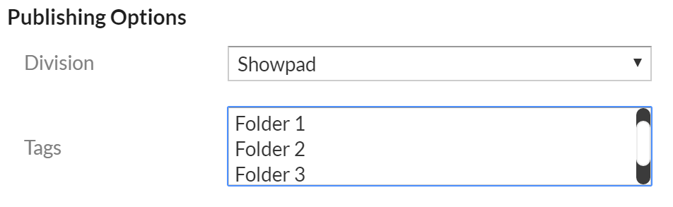
My Content
Create Content
3 Tips for Better Selling
Publish
Edit

Slide 8
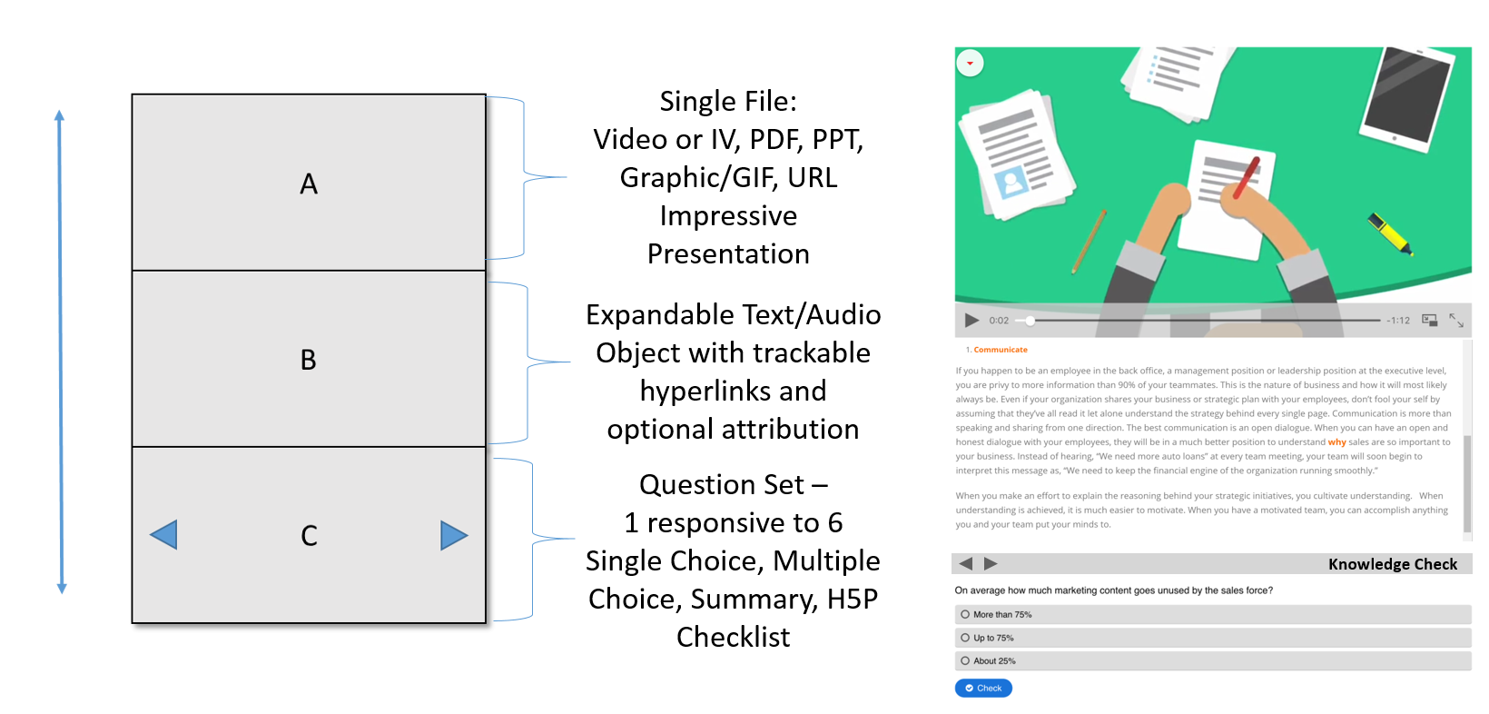

Slide 9

My Content
Create Content
Interactive Menu
1. Background
2. Hotspots
3. Save
Background
Select your background image and hotspot color

Slide 10

My Content
Create Content
Interactive Menu
Background

Slide 11
My Content
Create Content
Interactive Menu
Background

Slide 12
My Content
Create Content
Interactive Menu
Background

Slide 13
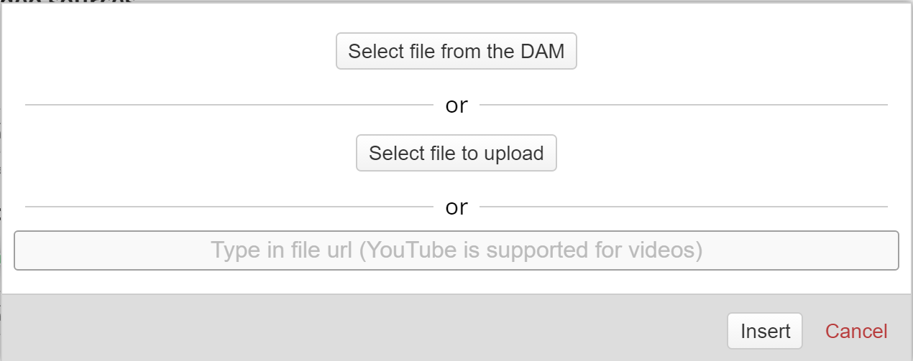
My Content
Create Content
Interactive Menu
Background

Slide 14
My Content
Create Content
Interactive Menu
Background

Slide 15
My Content
Create Content
Interactive Menu
Background

