Slide 1
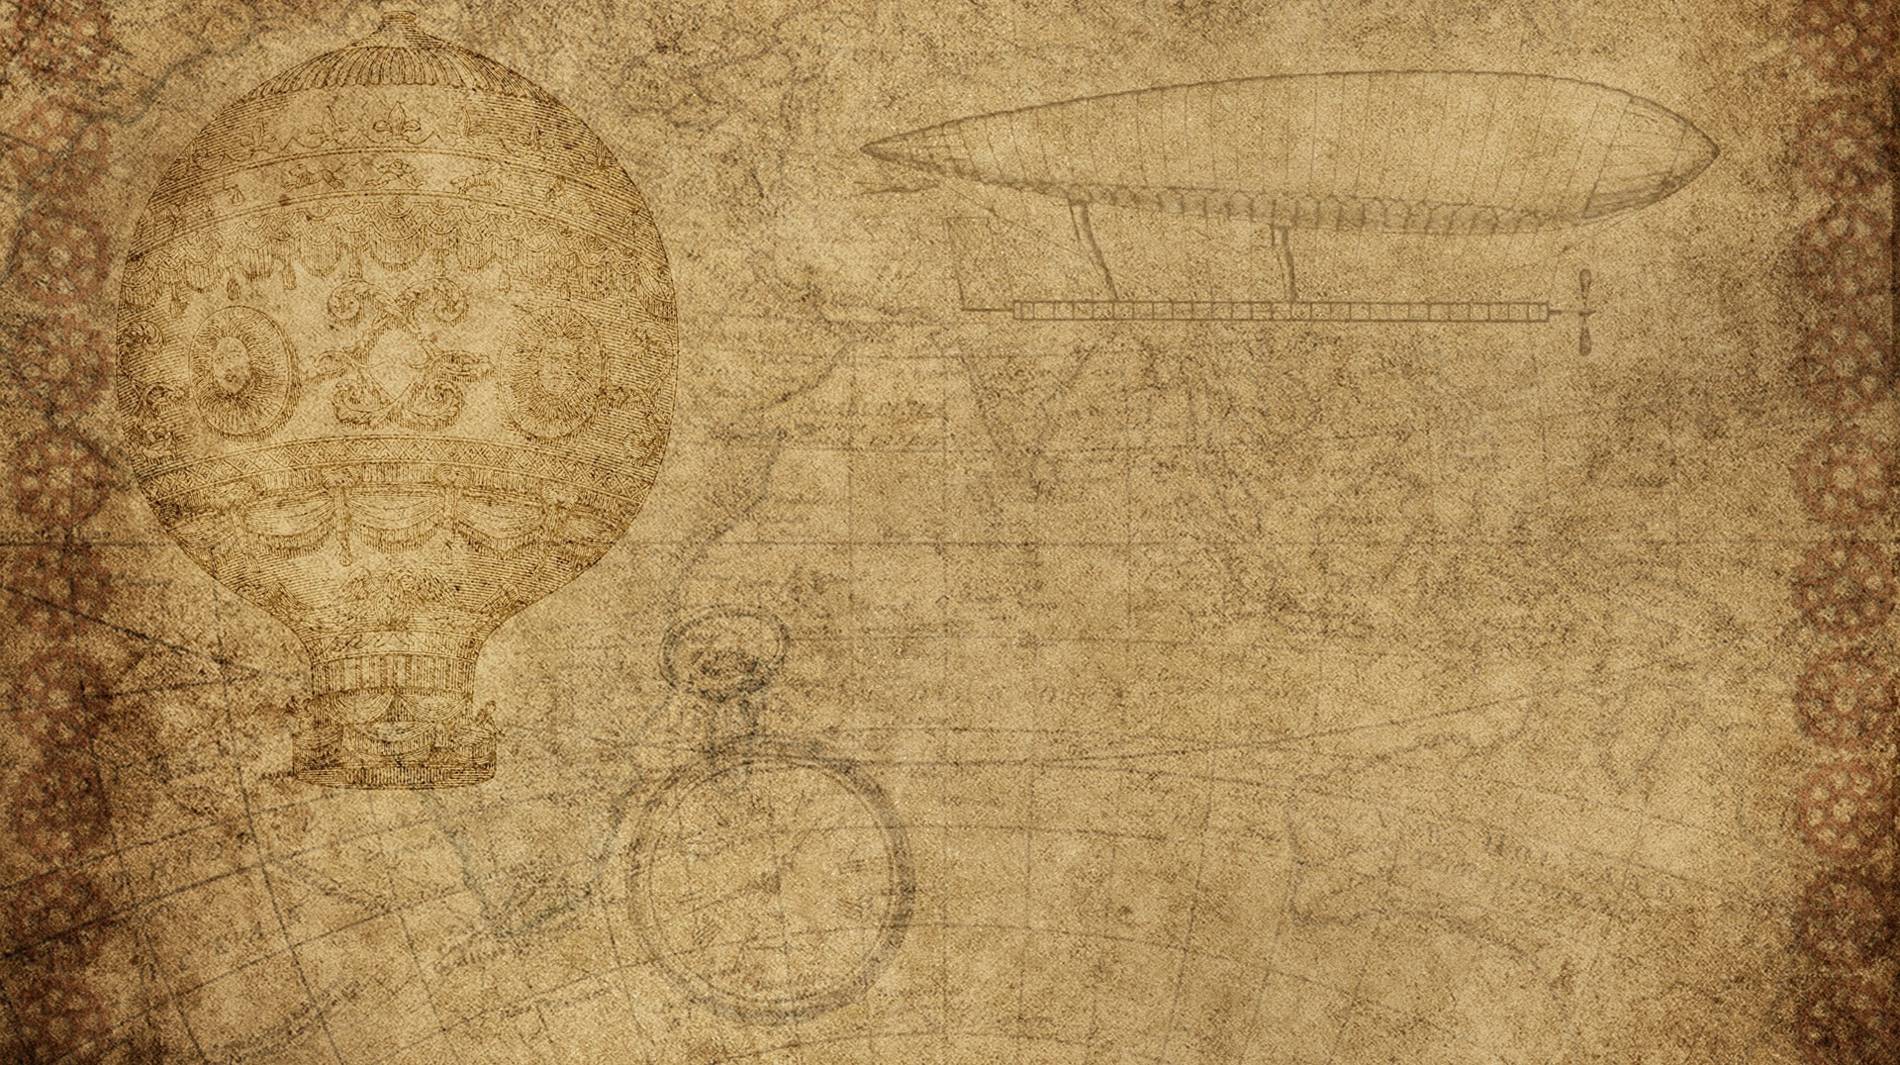

Physics Destroyer
Matthew Peace
Dustin Bramos
Steve Catherman
Steven Jazrawi
Chris Wiegand

Slide 2

Application Goal
Our goal is to create a physics calculator that will allow users to enter known variables and automatically solve all equations possible with those known variables.

Slide 3
Changes in Sprint 2
Created methods for each of the equations used.
Implemented the equations into another method that solves them
We now have the equations integrated into the GUI
All functions have now been centralized into a single button
Help menu includes credits and about sections

Slide 4
ideas FOR Sprint 3
Extensive testing / bug fixes
Streamlining / polishing
Adding more variables and equations
Adding unit conversion

Slide 5
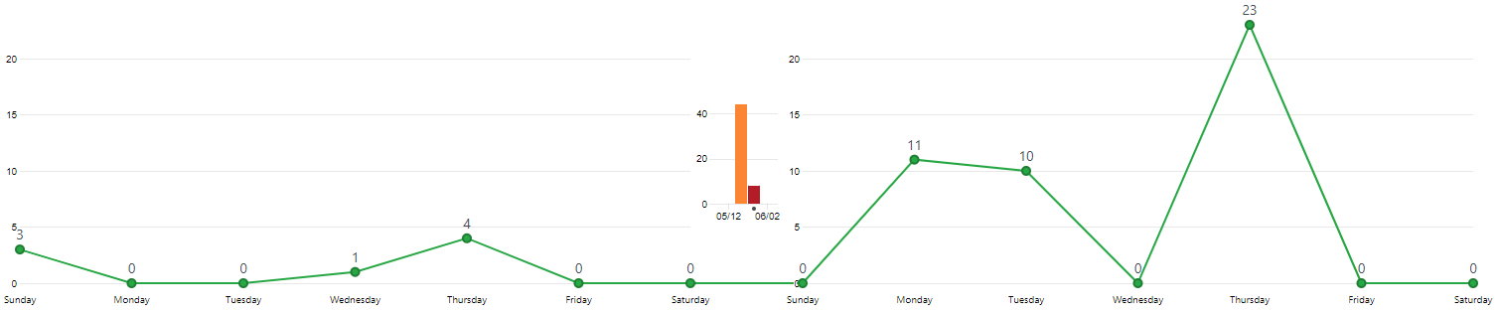
GitHub Commits

Slide 6

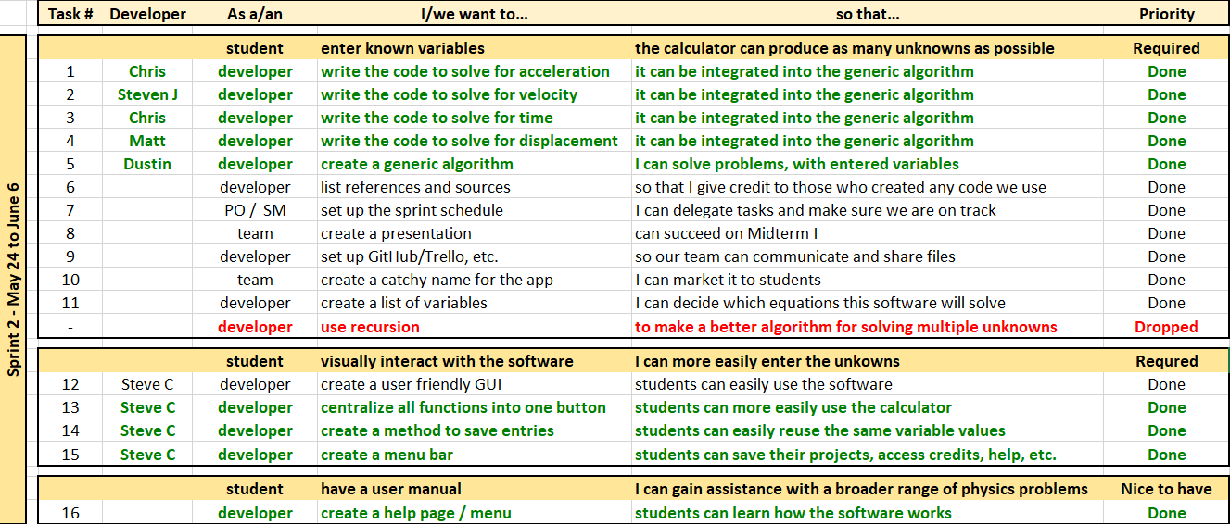
Product Backlog

Slide 7
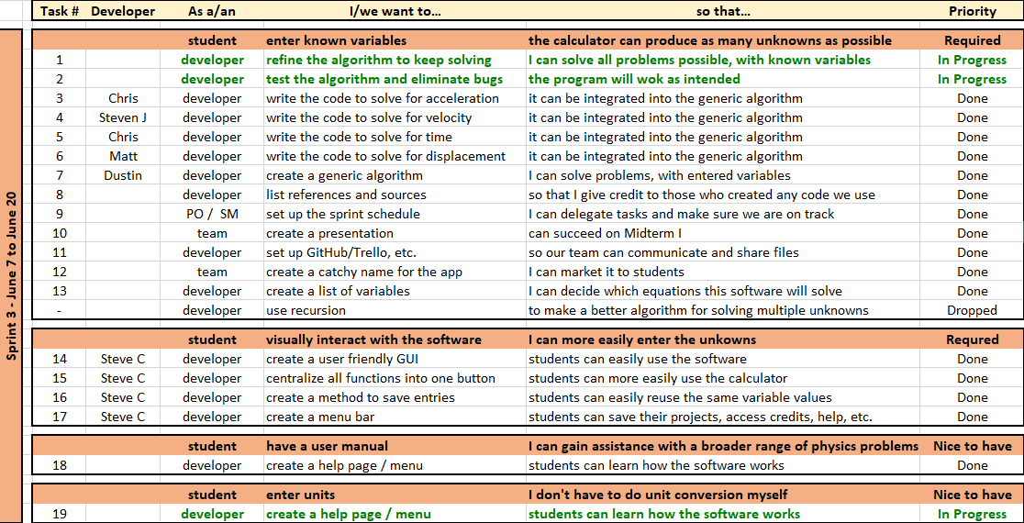
Product Backlog

Slide 8
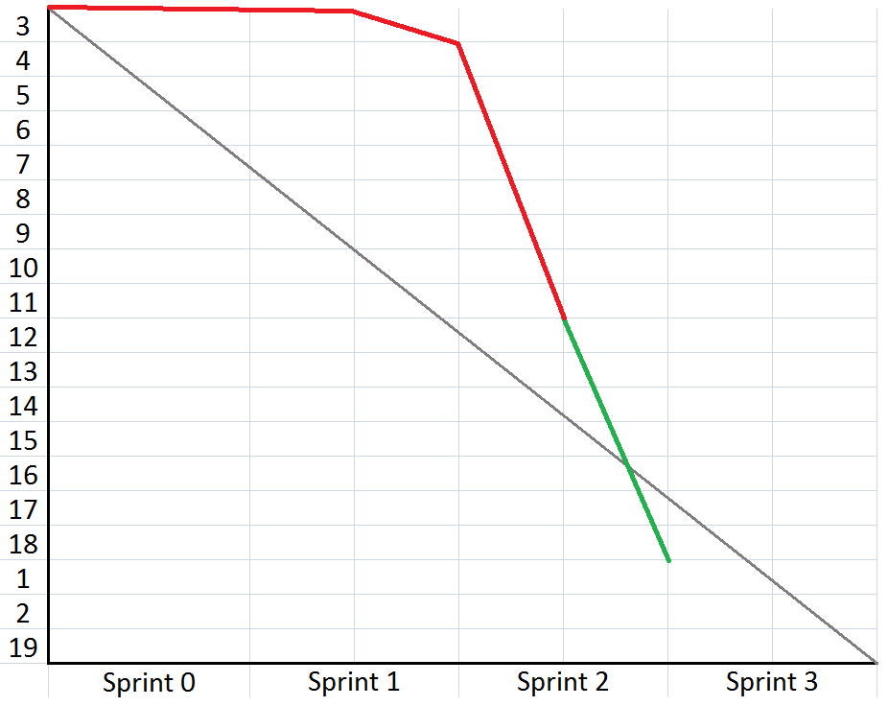

Burn Down

