Slide 1

WPS Office®
Welcome to WPS Office - Presentation
WPS Office is a lightweight, feature-rich comprehensive office suite with high compatibility. As a handy and professional office software, WPS Office allows you to edit files in Writer, Presentation, Spreadsheet, and PDF to improve your work efficiency.

Slide 2
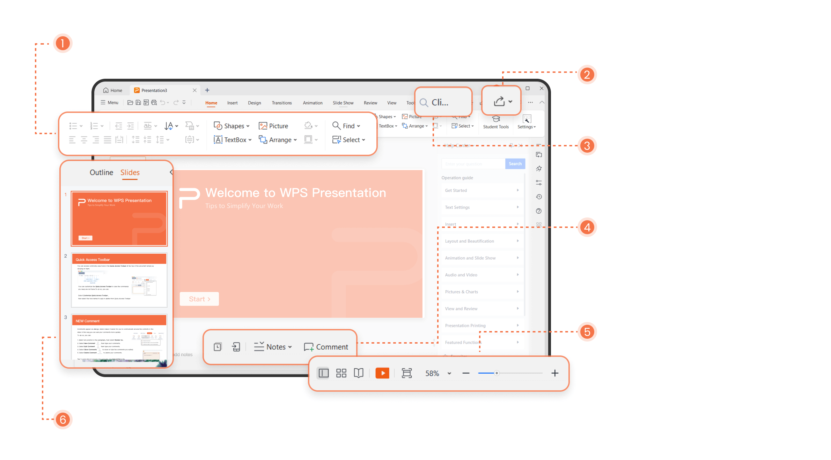
Switch tabs to find different commands for processing your presentation.
Share your slides with others.
Find all of presentation's commands.
Quickly add comments or speaker notes.
Quickly switch views, adjust the page display scale, and show slides.
Switch between slides and the outline view at will.

Slide 3
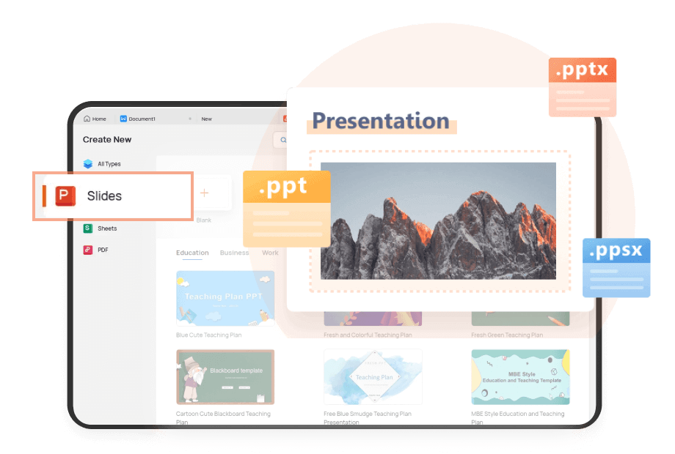
Create new slides
Usually, we are required to use slides to present or summarize projects. How can we make our slides more compelling than others? Try our templates! Our extensive collection of eye-catching templates provides you with more opportunities to stand out in the competitive job market!
To do so, you can:
Click【New】>【slides】, and select or search for the desired template.
We provide templates for education, business summaries, work plans, albums, fresh styles...
Subscribe to WPSPro and enjoy unlimited template downloads.

Slide 4

Master Slide
To have all slides contain the same font and image, such as a logo, you can make these changes, the slide master, in one place, and those changes will apply to all slides.
To do so, you can:
Click on 【Design】>【Edit Slide Master】. The first slide is called the master. Now, try adding a random image to the master.
Note: It's a good idea to edit the slide master and layouts before you start creating individual slides.

Slide 5
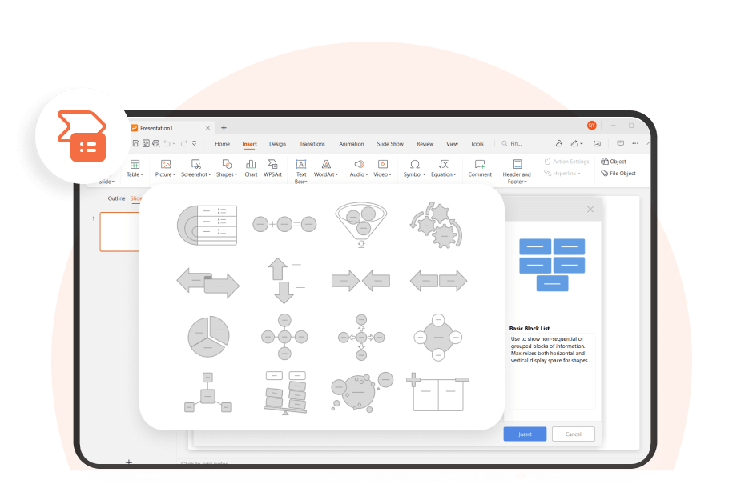
WPS Art
A picture speaks more than a thousand words. WPSArt provides a wide range of chart options, including flowcharts, organizational charts, cycle charts, hierarchical charts, and more, to meet various data visualization needs. You can quickly create professional graphics without using other specialized software.
To do so, you can:
Click【Insert】>【WPSArt】, Select your preferred
shape template, then click OK.

Slide 6
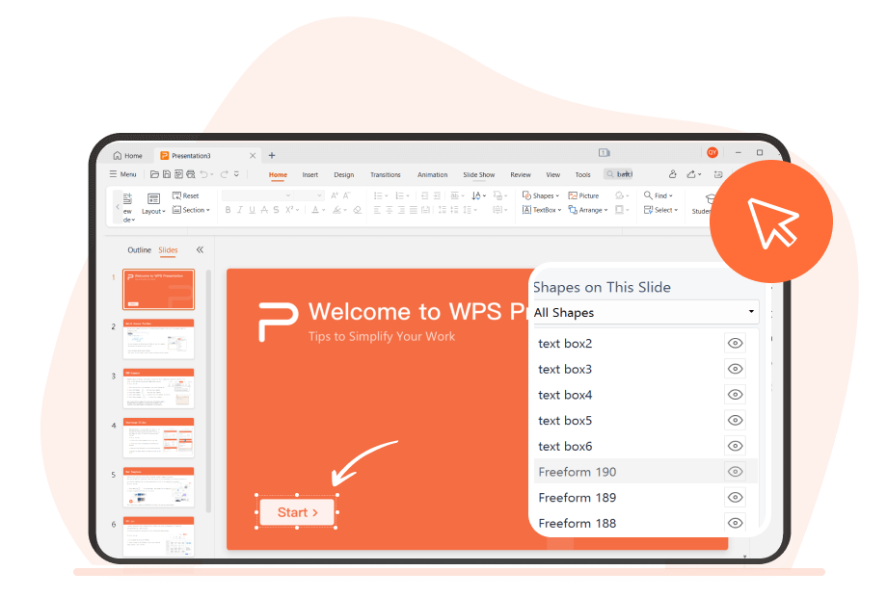
Selection Pane
The Selection Pane is a great tool for organizing and managing objects like pictures, shapes, text boxes, and more on the slides.
To do so, you can:
Click on 【Home】 > 【Select】. From there, you can select all, select audio, or go to the Selection Pane.
First, you can filter the type of objects on the slide, such as pictures, text, or shapes.
You can select specific objects from the list, hide or show them, delete them, or change their order.

Slide 7
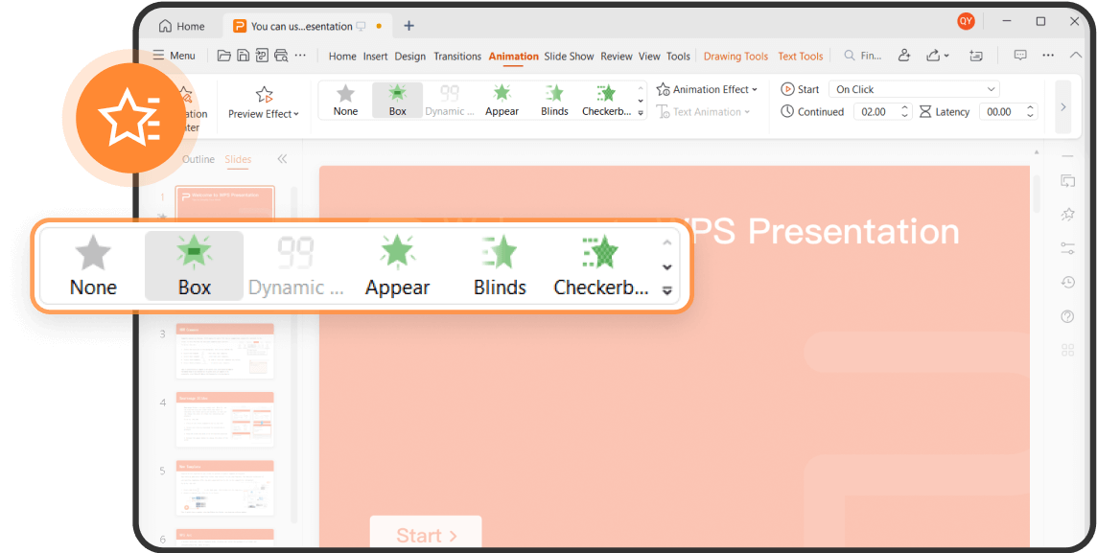
Animate text and objects
You can animate text, pictures, shapes, tables, and other objects in your WPS Presentation. Animation effects can make objects appear, disappear, or move. You can also change the size or color of an object.
To do so, you can:
Select the object you want to animate, click on the 【Animation】 tab, where you can find all the commands for animation settings. Choose your preferred animation effect and set how the animation starts and its duration.
If necessary, you can use the animation painter to copy the same animation to other objects.

Slide 8
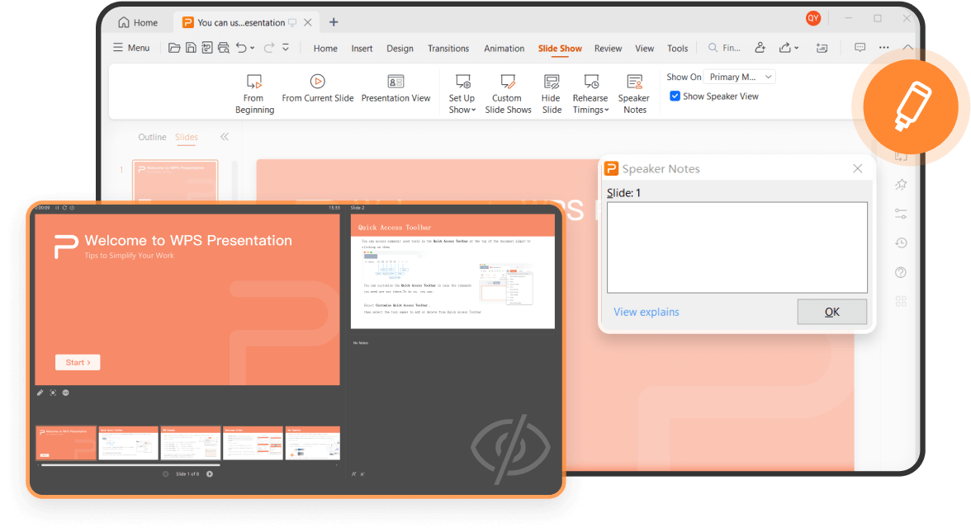
Set up speaker notes
The presenter view is convenient. You can view the presentation with speaker notes on your computer while only the slides themselves appear on the screen that the audience sees.
To do so, you can:
Click on 【Slide Show】>【Speaker Notes】, or at the bottom of the slide, you can also add notes directly.
Click on 【Set Up Show】 and make sure to check the box for 【Show Presenter View】.

Slide 9
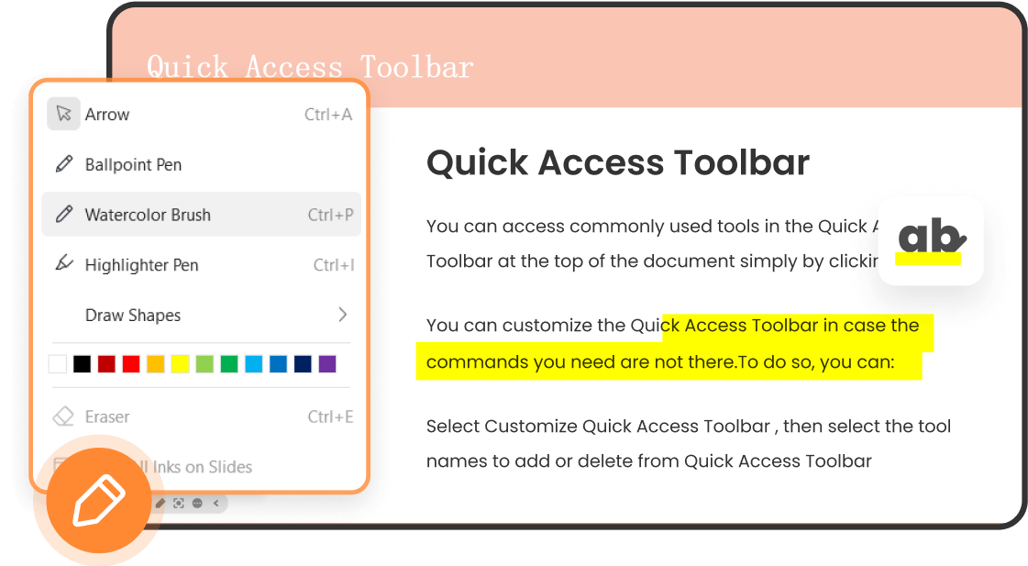
Marking the Presentation projection
By sharing the screen with the audience, the speaker can annotate and explain directly on the slides. They can use features like highlighting, zooming, or spotlight effects on text content, which helps the audience to better focus on the main points of the presentation.
To do so, you can:
When the slideshow is in progress, click on the floating toolbar that appears below.
You can try using the ballpoint pen, watercolor brush, highlighter pen, draw shapes, spotlight, and more.

Slide 10
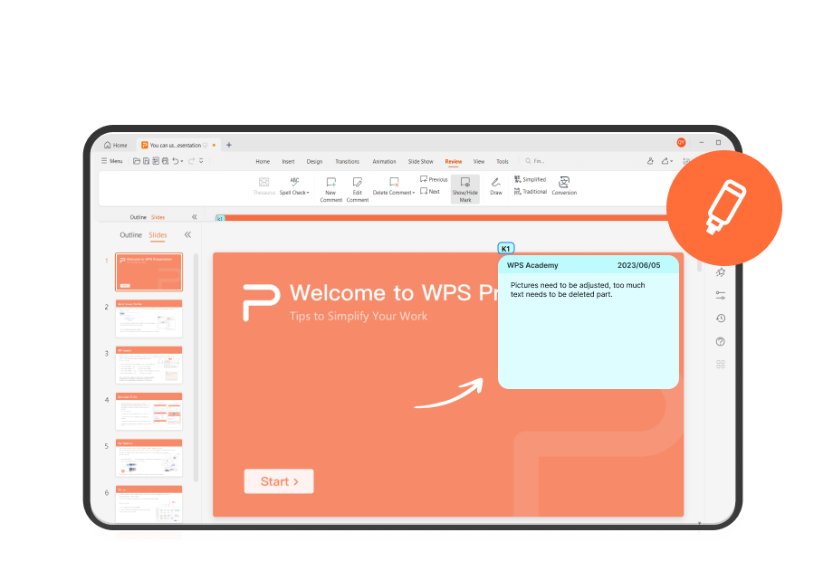
Review your slides
WPS Presentation can help you check for spelling errors in the text of your slides and provide correct suggestions. If you want others to review and provide feedback on a presentation you've created, you can use comments.
To do so, you can:
When you're done with the slide, click on 【Review】 > 【Spell Check】 to correct any misspelled text.
If you need to add comments, click on 【New Comment】. Your comment will be marked in the slide. You can delete, show, or hide the mark.

Slide 11





More Popular features
Convert to Image like ppt
Format Convert
You can convert PPT to a non-editable image format while preserving the original format of the presentation. This allows it to be displayed normally in PPT without any changes.
Easily Convert PPT to PDF, Word, PNG, JPG, video and more. Batch convert multiple files smoothly.
Screen Recorder
Merge and split
Print slides
Capture screen on computer and generate video, audio files. Support turn on timer recording and editing, add watermark
Easily split or merge files without the need for specialized software. You can conveniently organize and manage your files with this feature.
Print Presentation slides, handouts, or notes.

Slide 12
Shortcut keys in WPS Presentation
Ctrl+A: to select all the elements in the slide
Ctrl+M: to insert a new slide
Ctrl+B: to make the selected text bold
Ctrl+I: to italicize the selected text
Ctrl+U: to underline the selected text
Ctrl+C: to copy the selected objects
Ctrl+V: to paste the copied objects
Ctrl+X: to cut the selected objects
Ctrl+E: to center text
Ctrl+L: to align text to the left
Ctrl+F: to find text in the docment
Ctrl+H: to replace text in the document
Ctrl+G: to group objects
Ctrl+K: to insert hyperlink
Ctrl+N: to create a new PowerPoint document
Ctrl+W: to close the current document
Ctrl+P: to print out the document
Ctrl+S: to save the document
Ctrl+Z: to undo
F5: to start the slide show from the first slide
Shift+F: to start the slide show from the current slide

Slide 13
