Slide 1

HOMEWORK 5
Introduction to Computer Science Section 2
Spring 2021
hgl235@nyu.edu
File IO
Problem solving

Slide 2
Homework Requirements
This homework is designed to reinforce your understanding of File IO operations.
This homework involves:
Reading and Writing Files
Use of the String class
Converting Between Data Types
Problem Solving Techniques.
Use of Static Methods
Create a single Java Program (consisting of a single class) that accomplishes the specified tasks.
Pay careful attention to the restrictions…follow them exactly.
Organize the code in your solution program as shown on slide 5.
This assignment will be graded not only on correct execution but also on simplicity and readability…ensure you avoid the use of overly complex and hard to read/follow code/logic.

Slide 3
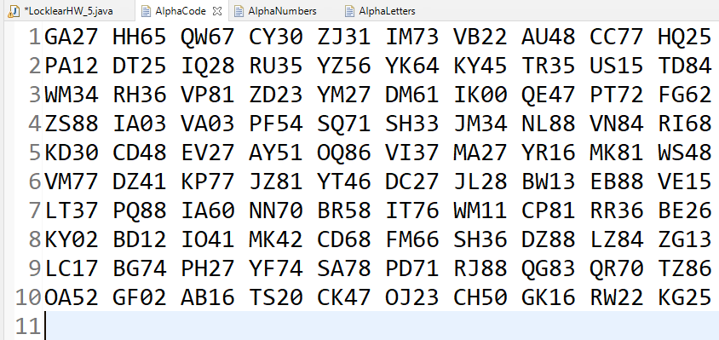
Task
Create the static method generateAlphaNumericCode that accepts three parameters
Number of lines in the file.
Number of four digit alphanumeric codes on each line.
Name of the file to write the codes to.
The method randomly generates a file of alphanumeric code as shown in the example below.

Slide 4
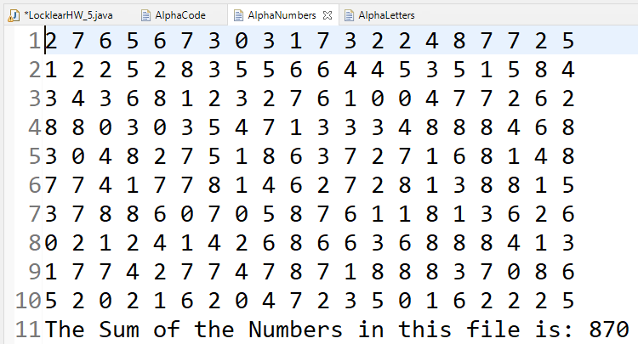
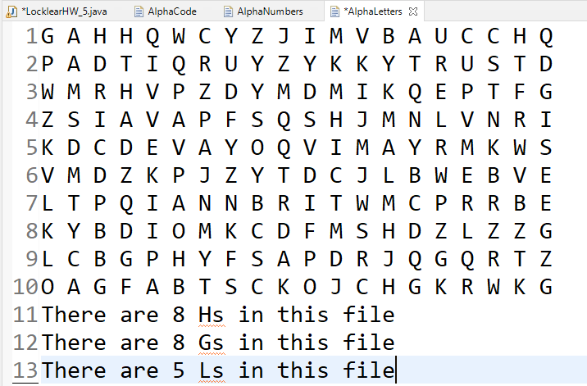
Task
Create the static method extractNumbersLettersToFile that accepts three parameters
Name of the code file.
Name of the file that will contains only the numbers.
Name of the file that will contains only the letters.
The method reads the code file and produces two additional files as shown in the example below.
\\AlphaNumbers
\\AlphaLetters
\\AlphaCode
Count only H, G, and Ls

Slide 5
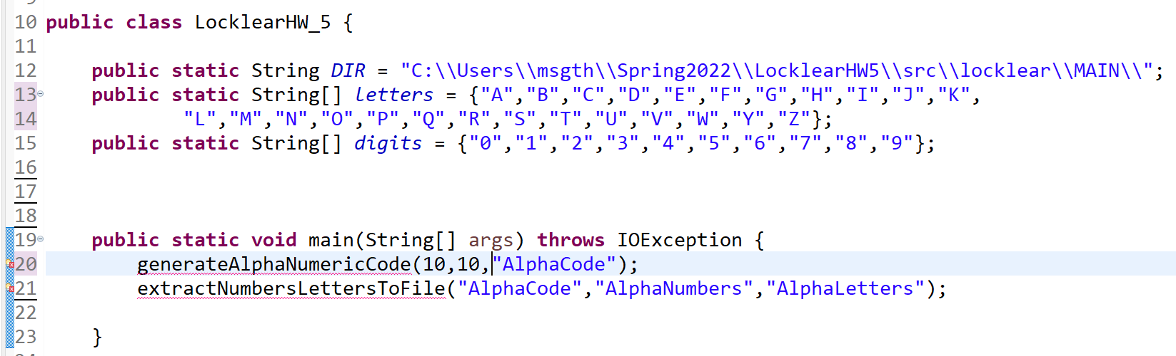
Class Structure
Your Eclipse Project filepath goes here
All your code goes here
All methods that you create must only use 1D arrays of type int, String or char…you may not use multidimensional arrays or any other data structure (ArrayList, List, Maps, etc.)
All calculated values and reading and writing of files must be done inside a loop.
You must make use of the letters and digits arrays in one or more of your methods.
The main method of your class must look exactly as shown above.

