Slide 1
Predicting the Stock Market
Professor Chen
Data Mining Project
Brian Ethier
Sayali Thorat
Steven Cifarelli

Slide 2
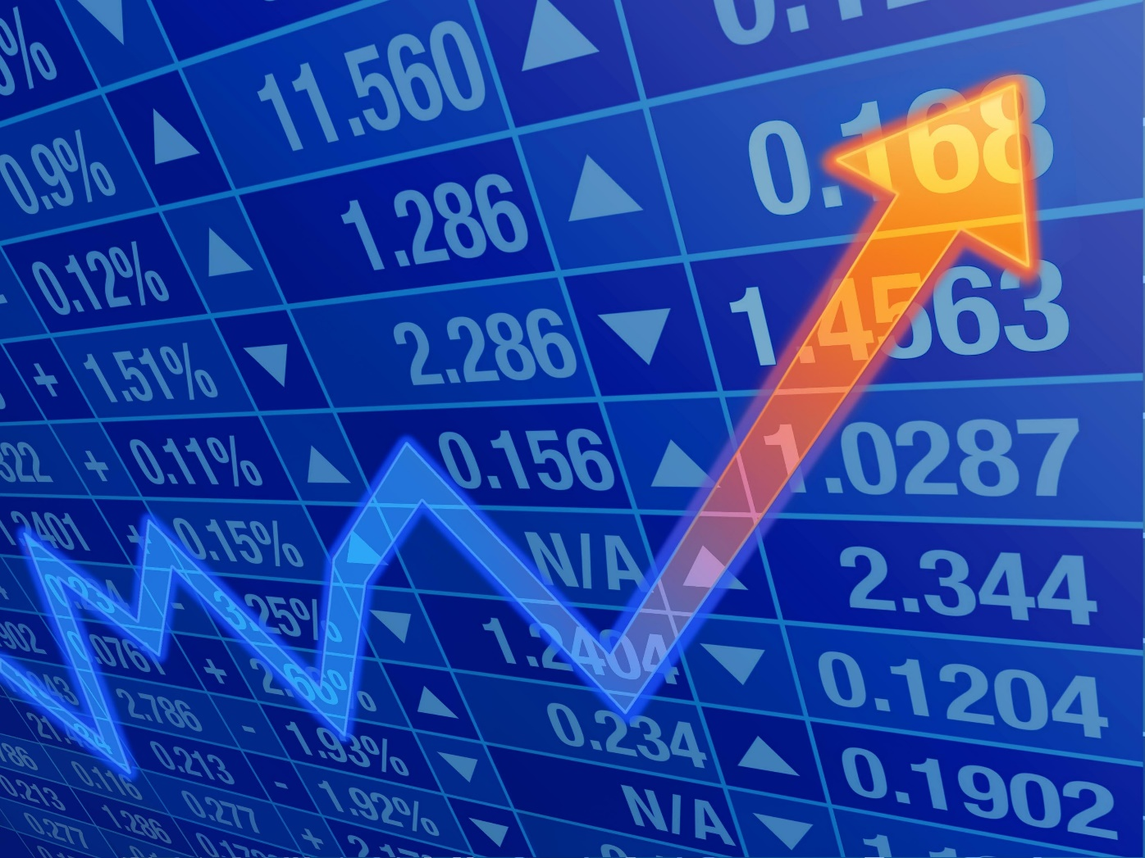

Can we relate tweets to the stock market?
Using tweets off twitter from the past can we determine a pattern
Can we then use that pattern to predict future stock changes?
Is there a correlation?

Slide 3

How do we prove the correlation?
First we chose to test with a single company, Exxonmobil for simplicities sake

Slide 4

How could stock prices be influenced by tweets?
Tweets show public opinion
What if public opinion influenced stock prices?

Slide 5
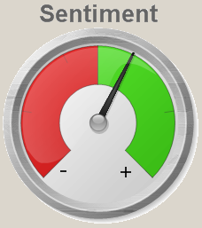
Premise: people’s opinion influences stock
Gather tweets based on companies
Compare sentiments to stock prices

Slide 6

How do you determine public opinion?
Python can help!
Pattern.en can already determine sentiment

Slide 7
The Algorithm
Using this algorithm we were able to test the correlation between the two data points

Slide 8

Data Collection-Training Data
For testing data, we chose to use tweets and (closing) stock prices from 2013
Reasoning: ‘easily’ accessible data that’s still relatively recent

Slide 9
Was there a correlation?
Using the training data, there was ………
Then we proceeded to test on our data from 2014

Slide 10

Data Collection-Testing Data
To test our theory, we needed to apply our trained program to a set of equally relevant data
For this, we chose to use the tweets and (closing) stock prices of 2014

Slide 11

Results
Success! We were able to determine the stock changes within …..

